Slide 1
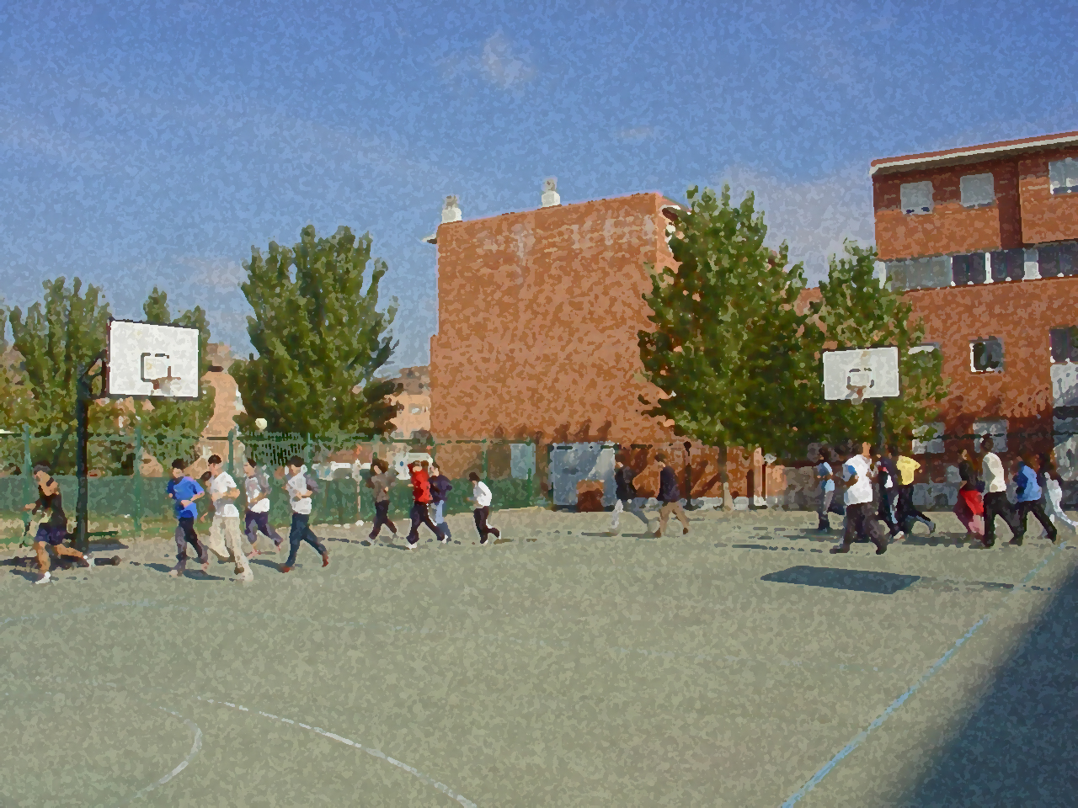
Fundamentals for Secondary School and Baccalaureate. Comprehensive and experiential learning
WARM-UP

Slide 2
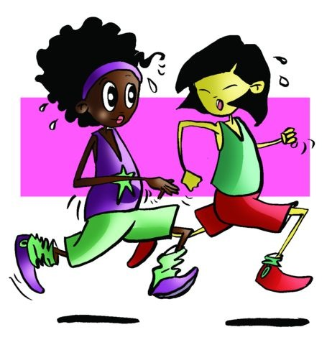
WARM-UP
1. Objectives
2. Concept of Warming Up
3. Objectives of Warming Up
4. Factors to Be Taken Into Account in Warming Up
5. Warm-Up Activities: Phases/Stages of Implementation
6. Types of Warm-Ups: General and Specific
7. Cool Down

Slide 3
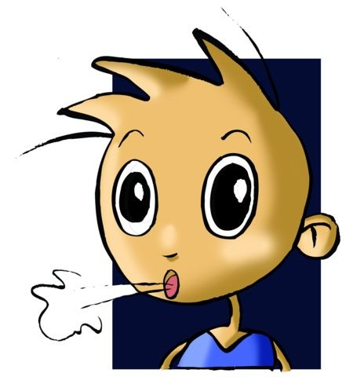
OBJECTIVES
To learn why you should warm up properly, as well as the factors involved in its different types.
To develop and put into practice—in accordance with the school year—general and specific warm-ups.

Slide 4
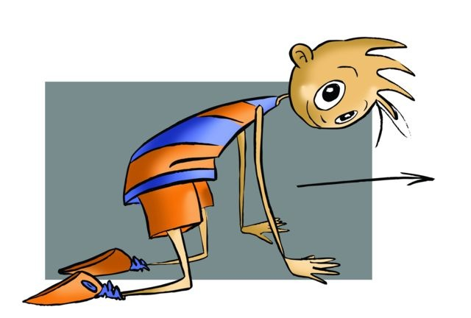
DEFINITION OF WARMING UP
By warming up, we mean all those activities and exercises prior to the main physical activity that we perform in a general or specific way, albeit gently, to prepare our body and our mind for the subsequent effort.

Slide 5
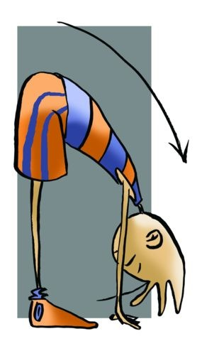
FACTORS TO BE TAKEN INTO ACCOUNT IN WARMING UP
Duration | Considering that our lessons are 50/55 minutes, we will dedicate 10 minutes for the warm-up, enough time to start up all systems. In the case of a training session, it is going to be longer and more intense. We must adapt the warm-up to these aspects, taking up to 15 or even 30 minutes.
Intensity | Intensity must be low since we are starting an activity and our organism has not “woken up” yet, we have to get it ready little by little. This level of intensity will be increased gradually during warm-up.
Repetitions | The exercises cannot be repeated too many times as this may lead to an increase in intensity. This way we get to do a more varied and entertaining activity. The exercises may be repeated between 8-10 times.
Order | It is convenient, especially at the beginning, to perform warm-up exercises following an order, that is, from top to bottom or from bottom to top. This way, no parts will be forgotten. Later we can vary the exercises so that we do not fall into a routine although some authors consider discipline essential and a guarantee of a good warm-up.
Breaks | When doing low intensity exercises, we must avoid them as much as possible, or take active breaks (e.g. walking). If we take too many breaks, we will not be able to gradually increase the heart rate so we would lose part of what we had achieved up to that point. Some authors uphold that the nearer the end of the warm-up to the beginning of the event, the greater the effect; others, however, advocate for a rest of about 5’-10’ while trying not to lower body temperature.

Slide 6
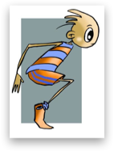
WARM-UP ACTIVITIES
We have to avoid all those exercises that require great strength, endurance or speed since the organism is not ready for it yet. We will do exercises that involve a general activity, i.e., exercises with a global approach using and moving the largest number of segments and muscles and/or specific exercises depending on the parts of the body that are going to be involved in the exercise, to activate first the circulatory and respiratory systems and then activate the muscular system.

Slide 7
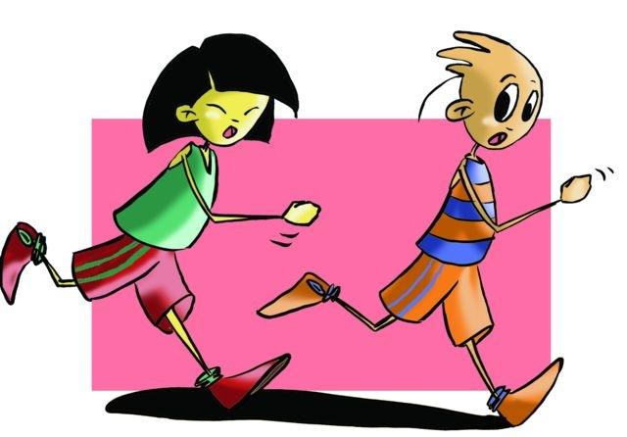
Locomotion phase
PHASES/STAGES OF IMPLEMENTATION
In which we will do easy jogging or games in which running plays the lead role.

Slide 8
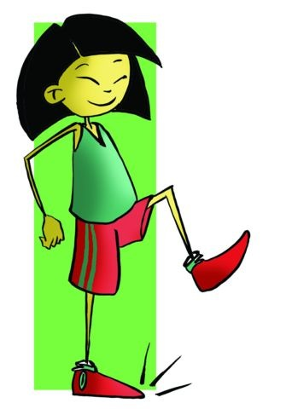
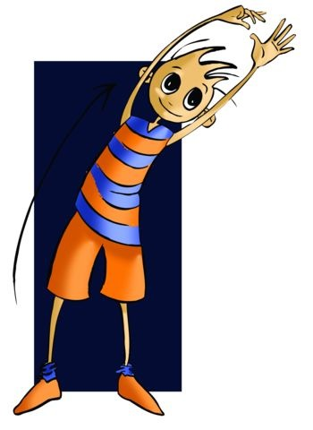
Joint mobility phase
In which we must get the different joints moving, either in place or running, e.g., forward flexing of the torso, moving the arms forwards and backwards, etc.

Slide 9
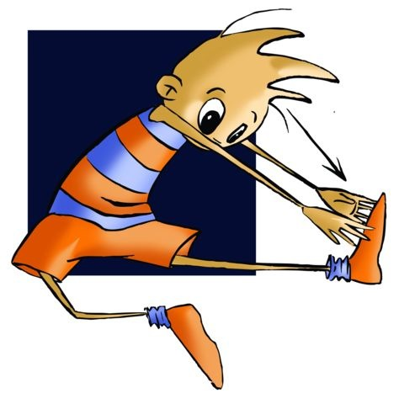
Stretching phase
In which the aim is to stretch the muscles by bringing about or “forcing” certain positions, for example, from sitting in hurdle position, try to touch one or the other leg with the hands.

Slide 10
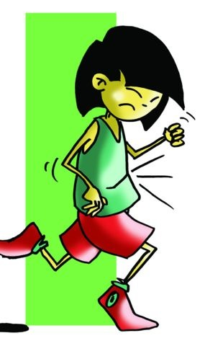
“Speed” exercises phase
In which we must always be the last and during which we can incorporate exercises that require some more intensity, like sprint simulations, changes of direction, skipping, etc.

Slide 11
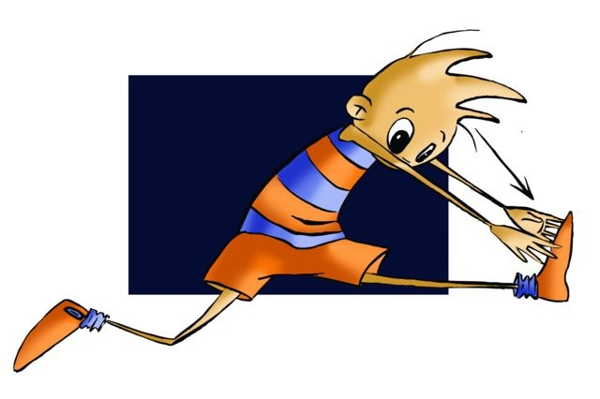
TYPES OF WARM-UP
General Warm-Up
In this type, we have to gradually start up all our body parts. All our body segments must move in order since after this warm-up, the activities will not involve a specific part of the body. Examples of such activities are team sports like basketball, handball, volleyball, etc.
Specific Warm-Up
This type of warm-up is aimed at the body parts that will be involved mainly or even exclusively in the activity. We must not forget, however, to warm up all segments, albeit moderately, since it is difficult to do a sporting activity moving only one part of the body.

Slide 12
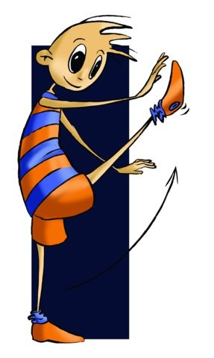
These warm-ups, four of which we consider you ought to know.
Static Warm-Up
This warm-up is constituted almost entirely of stretching and joint mobility exercises performed in place.
Dynamic Warm-Up
All these exercises are performed while moving around an area.
General Warm-Up
It is a combination of static and dynamic warm-up.
Sports-Specific Warm-Up
It is the one that uses games to start us all systems.

Slide 13
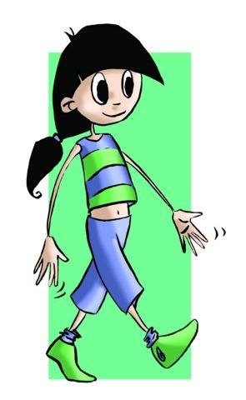
COOL DOWN
We need our organism to return to normality gradually, not abruptly. Therefore, we understand that cool-down exercises help us catch our breath and gradually lower heart rate until we feel relaxed.

Slide 14
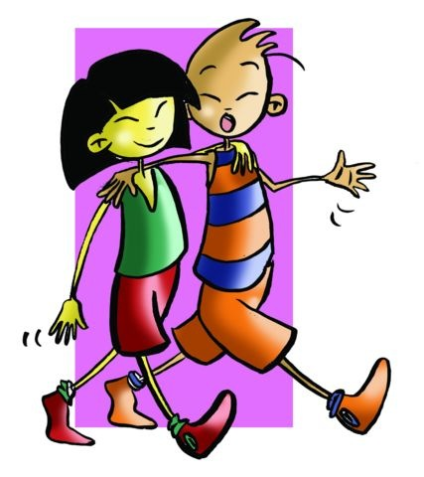
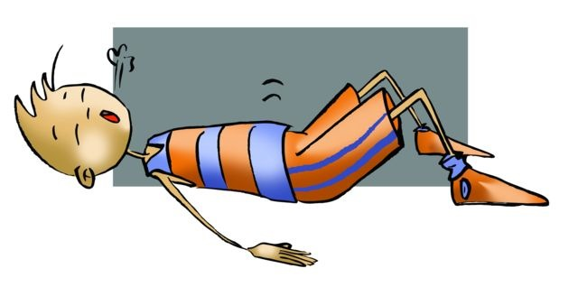
To achieve this goal we will use light and easy exercises, so as to gradually decrease the intensity of the workout.
As examples of exercises for this part of the session we find the following:
- Easy jogging, walking, and breathing exercises, gentle stretches or specific exercises in relaxation techniques, among others.

Slide 15
QUESTIONNAIRE AND ACTIVITIES
Why must we start a physical activity with a warm-up routine?
Make a global comment about the factors to be taken into account in warming-up.
Think of some examples of exercises that you would do in a warm-up.
Observe how a team from a superior/senior category warm up.
Analyse and identify which exercises are static, dynamic, etc.
Write down in your notebook unknown vocabulary from this unit.

