Slide 1
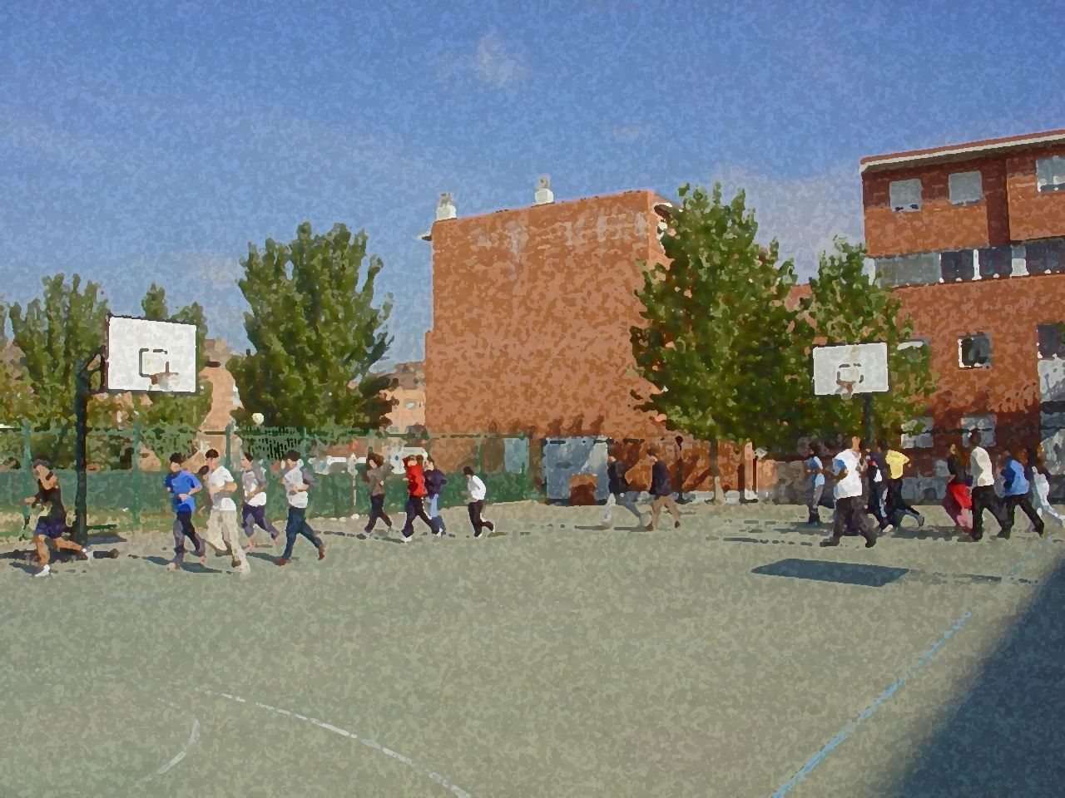
Fundamentals for Secondary School and Baccalaureate. Comprehensive and experiential learning
Volleyball

Slide 2
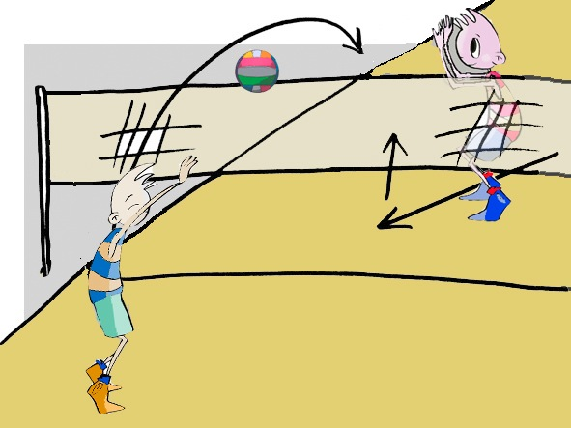
VOLLEYBALL
Objectives
Regulations, Facilities and Equipment
Basic Technical-Tactical Resources
Basic Exercises
Questionnaire and Activities

Slide 3
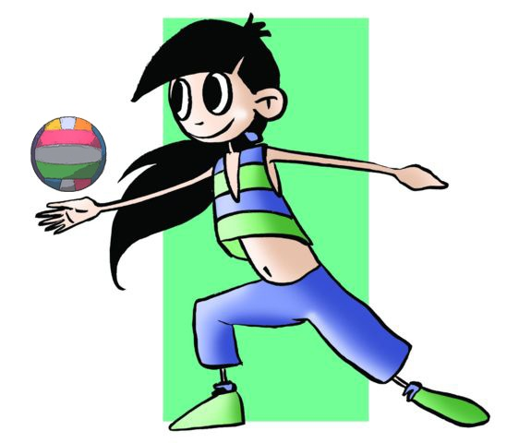
OBJECTIVES
To learn the technical-tactical elements and basic regulations concerning volleyball.
To understand their application in real game situations and to collaborate with teammates in the development and implementation of these elements and regulations in these activities.

Slide 4
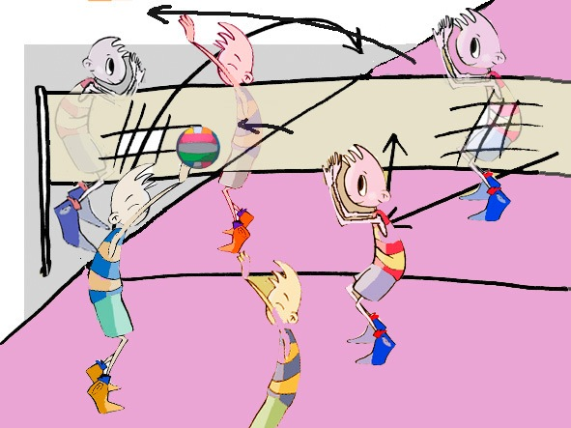
History
Volleyball arose in the United States towards the end of nineteenth century as an alternative to basketball. William Morgan, a teacher, discovered the way to play without there being physical contact and reducing the risks of injury. It quickly spread throughout all of United States and Canada as well as Japan. By 1960, the Spanish Volleyball Federation had started operating in Spain. The first men’s world championships were held in 1949 and the women’s in 1952. Countries such as the former USSR, Japan and China have been strong contenders in both categories. It finally was finally declared an Olympic sport in Tokyo in 1964. Today, it is the Italians, Cubans, Canadians, Russians, Japanese and Brazilians the ones who dominate the world panorama in both male and female categories.
Spain is considered to be in the top ten in the world. In 2007 it won the European championship and a silver medal in 2004 Olympics in men’s beach volleyball.

Slide 5
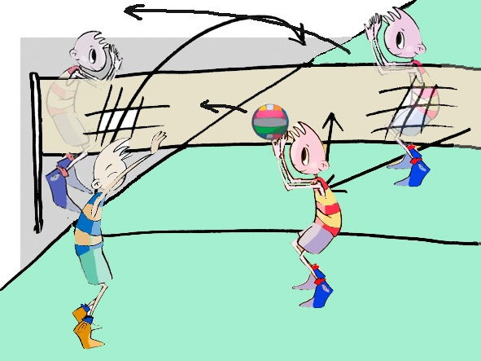
Basic Regulations
The game of volleyball, where two teams of 6 players respectively face each other, consists of a player hitting a ball with his/her hands and sending it to over the net to the opposing team’s side of the court with the intention of it landing on the floor or returning a ball with a maximum of three players touching the ball.

Slide 6
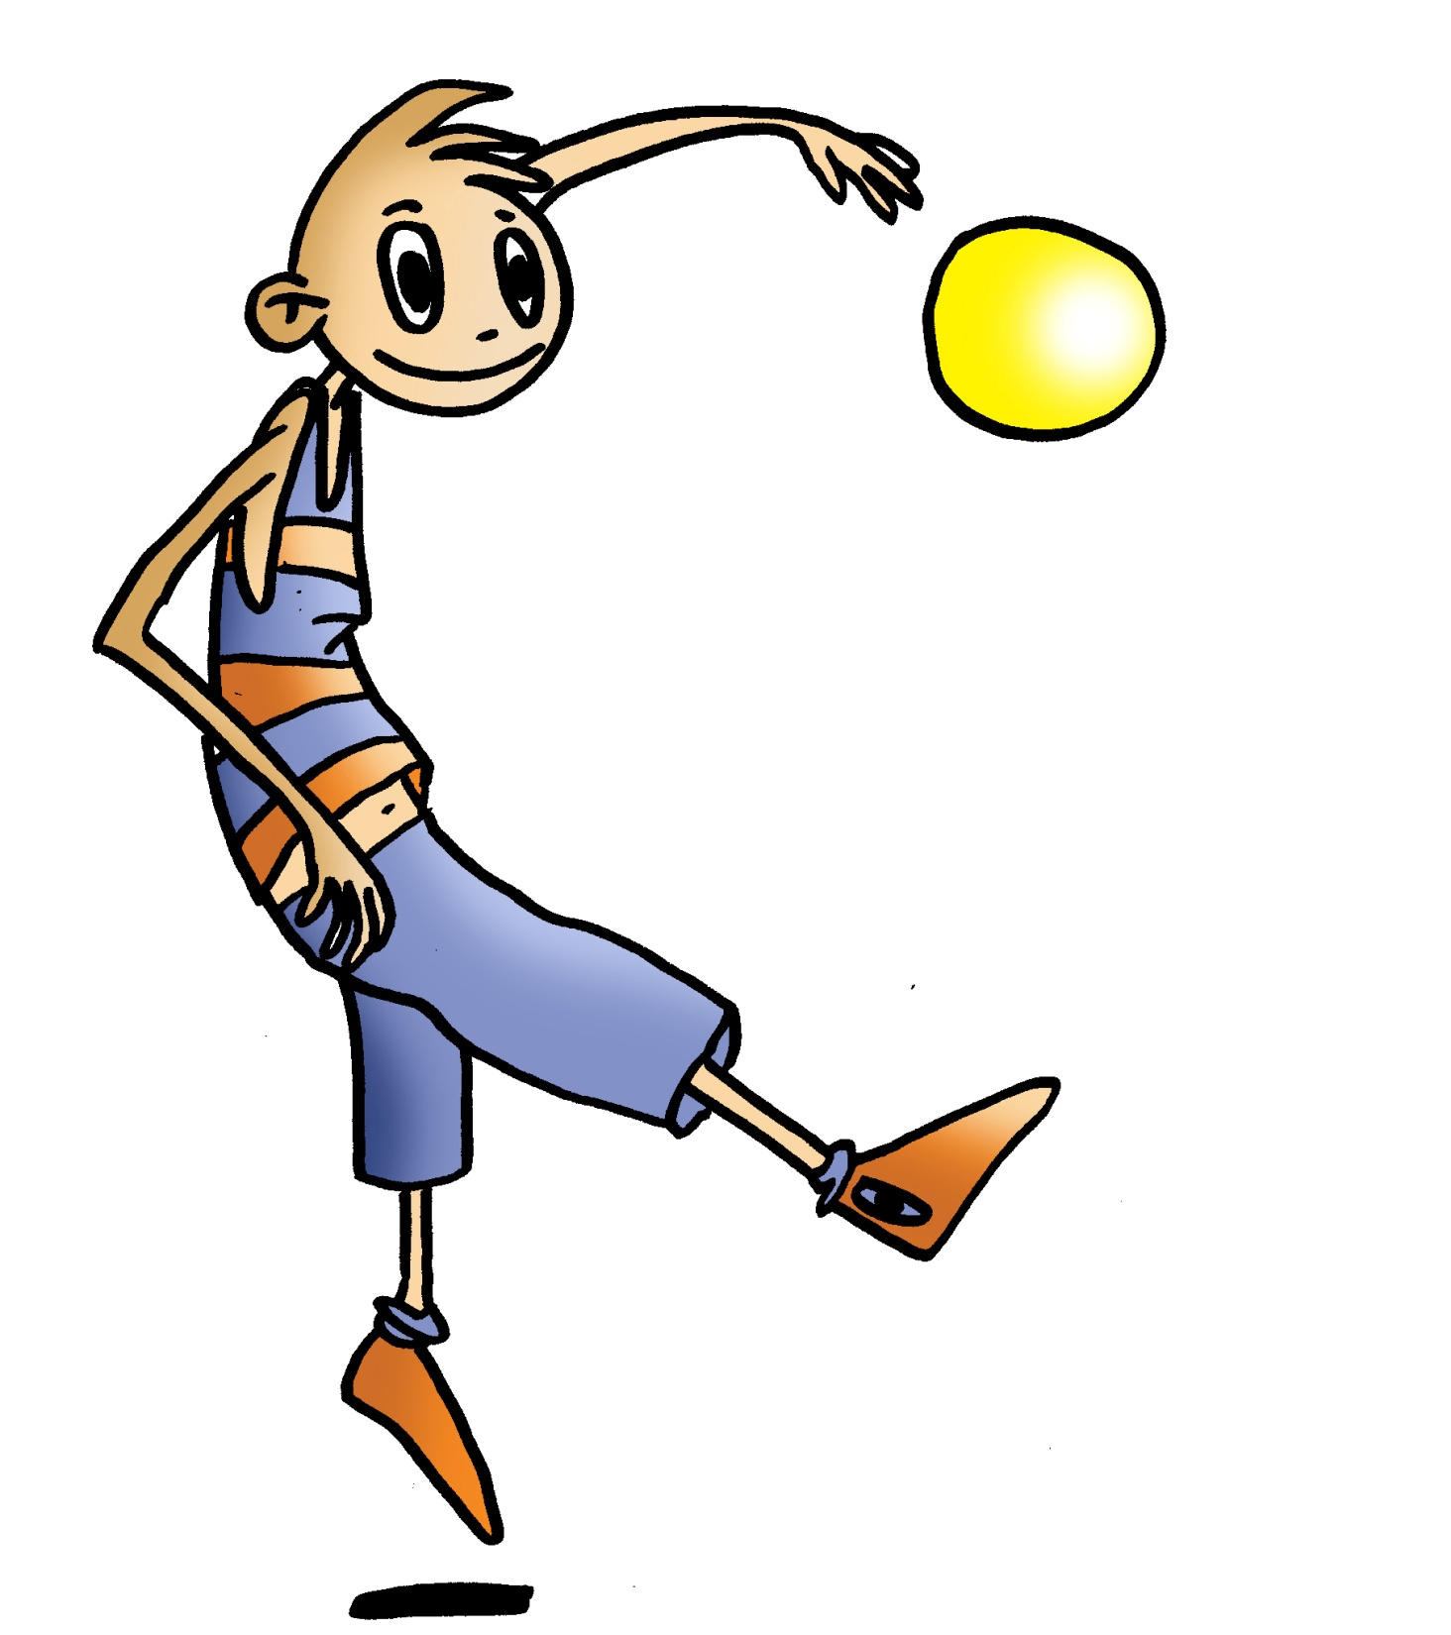
Basic Regulations
Scoring
A point is won when the ball goes over the net and lands on the floor. Another way to score a point is when the opposing team does not manage to pass the ball over to the other side of the net.
In order to win a set, it is necessary to obtain 25 points, with a minimum advantage of 2 points over the other team’s total score. In the case of a tie, i.e., 24–24 the match will continue until one of the teams has an advantage of 2 points.
To win a match, it is necessary to win three sets. In the case of a tie (2–2) a 5th set of 15 points will be played with a minimum advantage of 2 points.

Slide 7
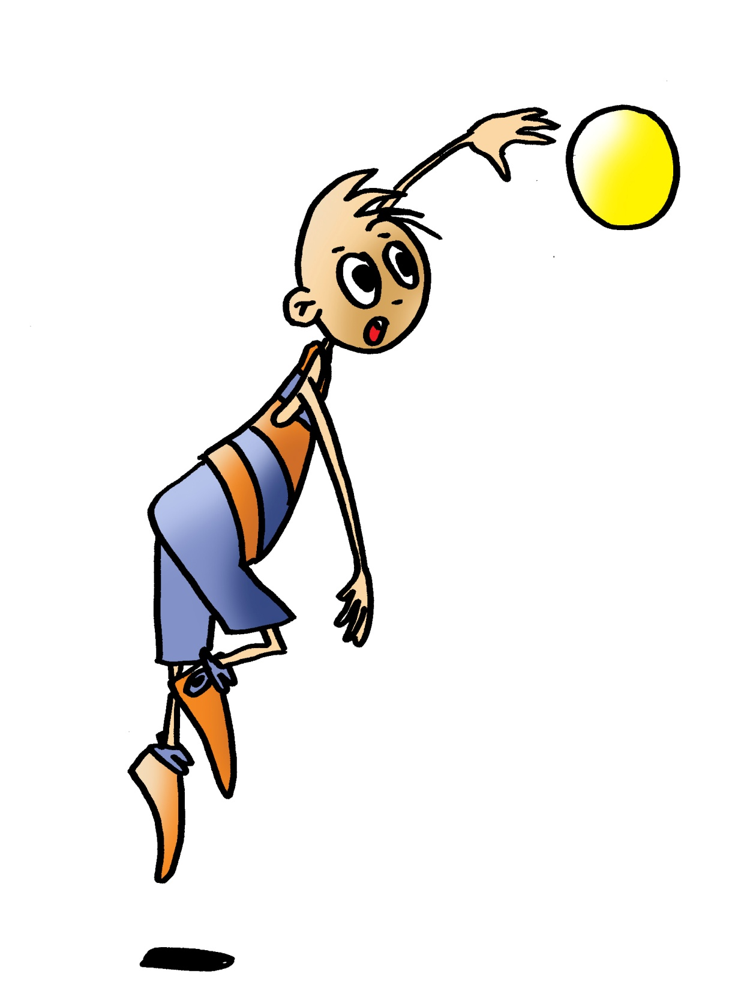
Basic Regulations
Match
Three is the maximum number of contacts a team may have with the volleyball before it is returned to the opponent’s side of the court. The classic play of the ball when it is on one side of the court is the receiver player who bumps or passes the volleyball to the setter who then sends the ball to where the attacker may hit it over the net. However, blocking or preventing the ball from going over the net is not counted as a hit.
A player may not touch the ball two times successively.
Each time a point is awarded to a team, they secure the right to serve. The players of the team which have to perform the serve have to rotate one position clockwise.
There may only be a maximum of six players on each side of the court. One of them will have been assigned to play defence exclusively, that player will wear a jersey of a different colour and is called libero. This player’s hands may not pass over the net. Furthermore, a libero may not block or serve.
Those players located in defensive zone 1-6-5 may not return the ball to the other side of the court if they are behind the attack line, separating the front row players from the back row players.
There can only be a maximum of six substitutions in each set. The ball may be hit by any part of the body. Players may not touch the net, and a serve is executed in the service area which is behind the end line.

Slide 8
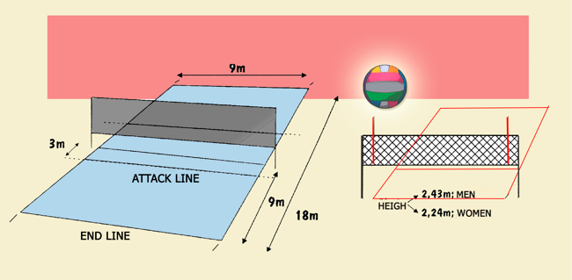
Basic Regulations
Equipment and Facilities:

Slide 9
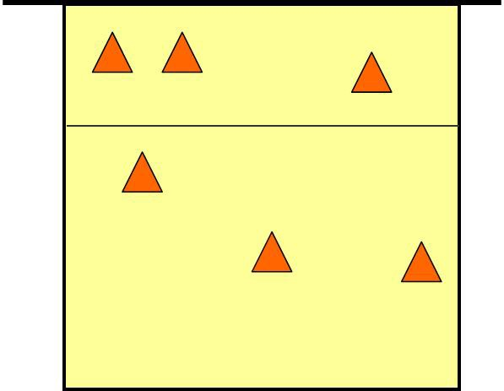
BASIC TECHNICAL-TACTICAL RESOURCES
Volleyball is a fun and exciting game since the speed of its actions and spectacular movements so permit it. Like all other team sports, there are some technical-tactical resources in volleyball which require making decisions about what responses should be given to participate in the game (how to hit the ball, what game to play, what action or moves a player may take which will help the team, etc.), and what co-ordinated responses the team should make. What should be stressed here is that when you are on the court, it is important to be alert to how you could help your team, and what actions you and your team members may call for also taking into account the different play areas and the characteristics of the other team with regards to areas they leave free, weaknesses of a particular player, etc.

Slide 10
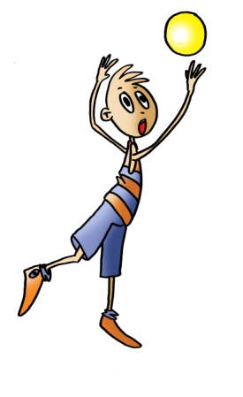
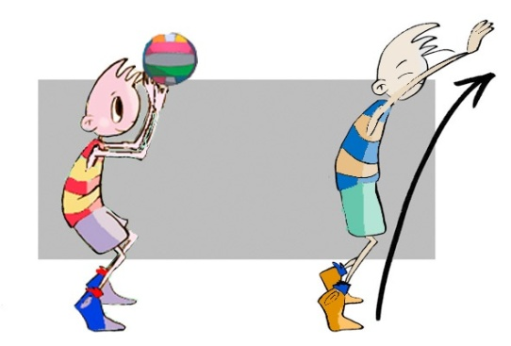
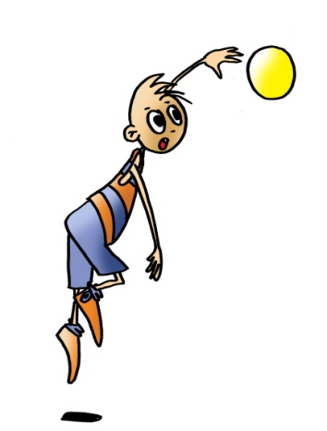
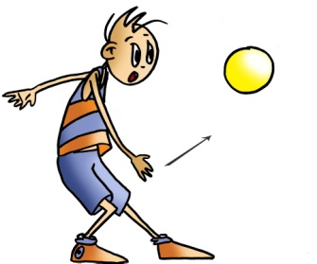
BASIC TECHNICAL-TACTICAL RESOURCES
Attack
Serve
Set
Underhand
Overhand
Spike or Attack

Slide 11
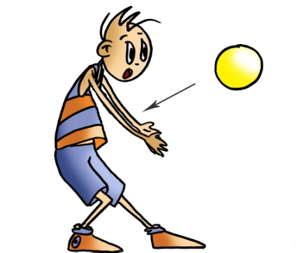
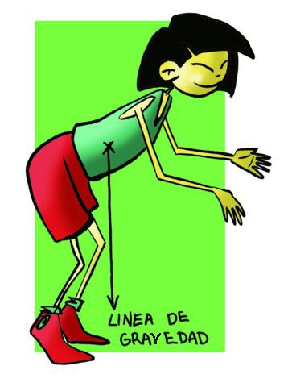
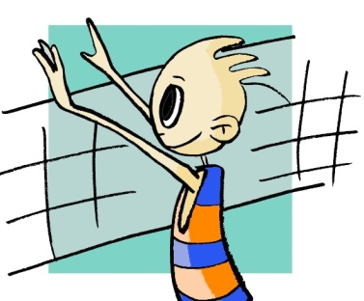
BASIC TECHNICAL-TACTICAL RESOURCES
Defence
Forearm Pass or Bump
Over-the-Shoulder Roll and Dive
Basic defensive stance
Block
Dive

Slide 12
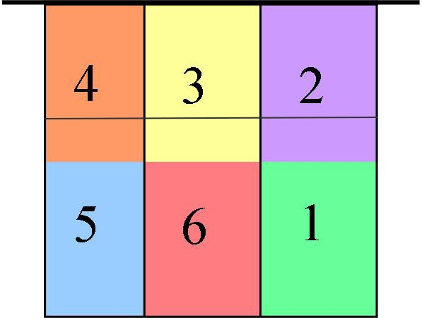
Joint Tactical Organisation
The first thing to do is distribute ourselves onto the court in areas of personal responsibility, each player taking charge of a portion of the court and all the balls that fall in it, as well as any individual action or ball contact to keep the match going.
Court formation by area is as follows:

Slide 13
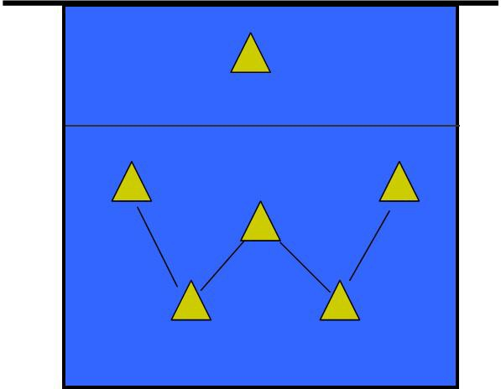
Joint Tactical Organisation
Defence
W formation
Players stand trying to occupy the greatest possible space to receive the ball sent by the opposing team. Its position on the court is in the shape of a W.

Slide 14
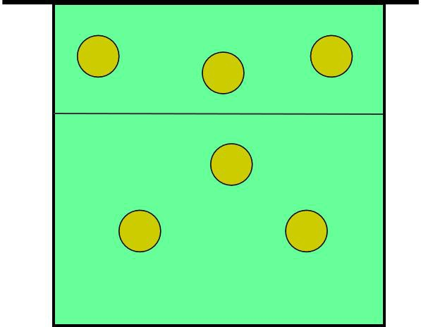
Joint Tactical Organisation
In offence
3-1-2
One way to jointly organise an attack is to use the 3-1-2 formation. The defensive W formation is held. The players shift forward a little, except the playset hitter.

Slide 15
Volleyball and Decision-Making
OPPONENT IS IN POSSESSION OF THE BALL
Option 1: Serve reception, so our actions will aim to do the following: | Occupy the spaces on the court.
 | Communicate with our teammates and take advantage of opportunities to co-ordinated our response.
 | Move, if needed and fast.
 | Be well placed to receive by placing ourselves in basic volleyball stance.
Option 2: Defence in an attack. When the ball is being played by the opposing team. | Occupy as much space as possible and help to block.
 | Block.
 | Respond defensively to an oncoming ball (possibly a spike) from the opposing team and place ourselves in zones where the ball can fall with the intention of blocking it.

Slide 16
Volleyball and Decision-Making
B) WE ARE IN POSSESSION OF THE BALL
Option 1: Serve, but which the player serving should do the following: | Locate the gaps that exist in the opponent’s court.
 | Decide which serve to use.
 | Execute the serve accurately.
 | Return to the game as quickly as possible.
Option 2: Construct an attack, where all players must do the following: | Locate the spaces in the opponent’s side of the court.
 | Communicate with teammates.
 | Execute a formation of attack using different ball hits (games).
 | Assist with a spike or hit.

Slide 17
¿Podrías identificar y describir qué recurso-táctico que está realizando cada jugador?

Slide 18
QUESTIONNAIRE AND ACTIVITIES
Write a short summary on how to play volleyball.
Do you know how to play Newcomb ball (cachibol)?
Discuss what decisions can be taken when a partner has handled the serve of the opposing team and you are situated in zone 3.
Discuss the 3-2-1 strategy, and what we mean by rotation.
Have you ever watched a volleyball match? Discuss it with a partner.
Write down in your notebook unknown vocabulary from this unit.
Check the Federation website or any sports association in your region and checks for changes or modifications, if any, in its regulations.

