Slide 1
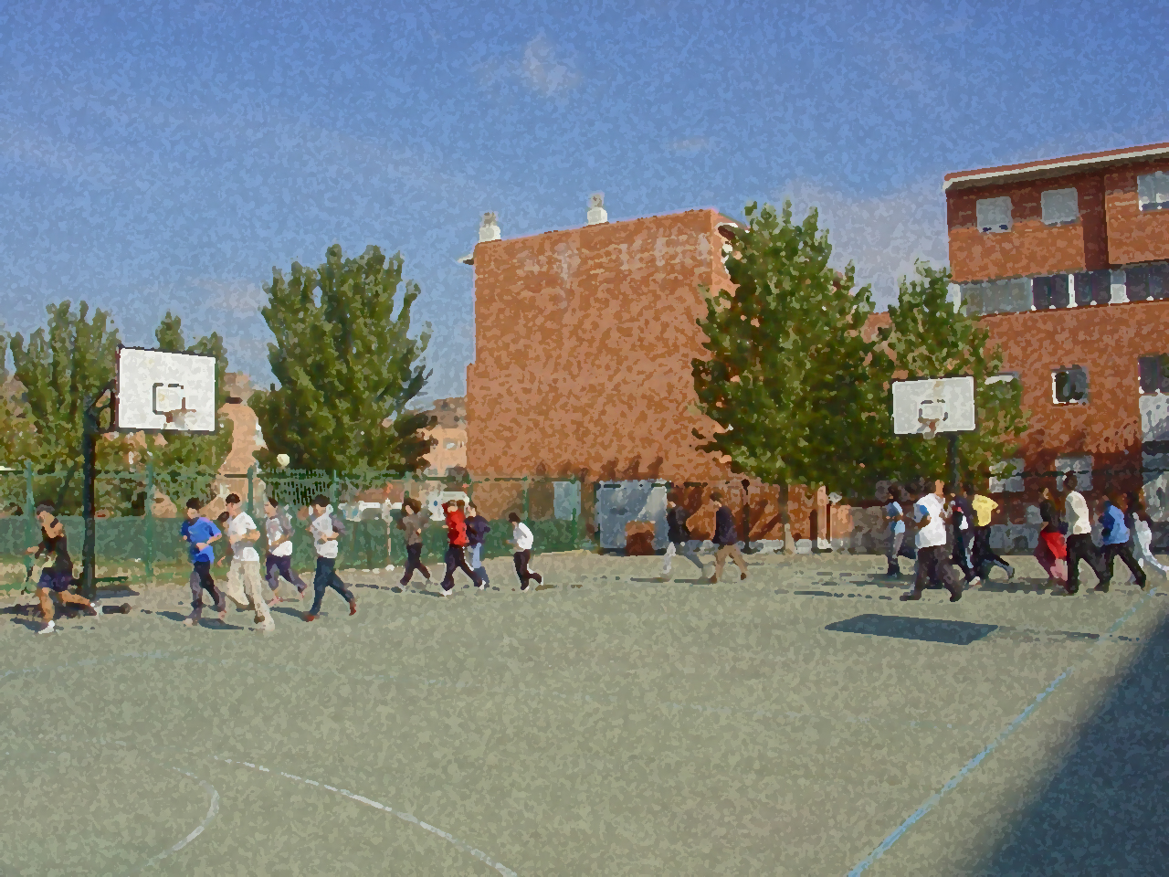
Fundamentals for Secondary School and Baccalaureate. Comprehensive and experiential learning
Corporal Expression: your body as a communication medium

Slide 2
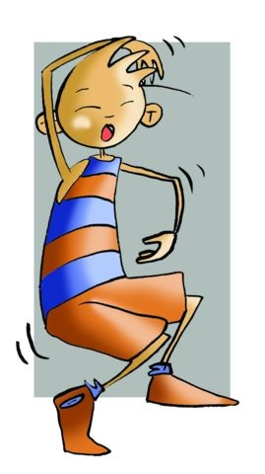
Corporal expression, in PE, has the clear goal of teaching you that your body is an amazing vehicle for communication, first to yourself and then to others. This wonderful ability to communicate is improved through greater knowledge of your body as well as the possibilities of movement.
The most important thing in corporal expression is the body itself. You need to become aware of it, through it, signals are transmitted of what we want to communicate and come up with the answers that we want it to deliver. Corporal expression is, without a doubt, a surprise package; it is an explosion of creativity whose full scope is not known.

Slide 3
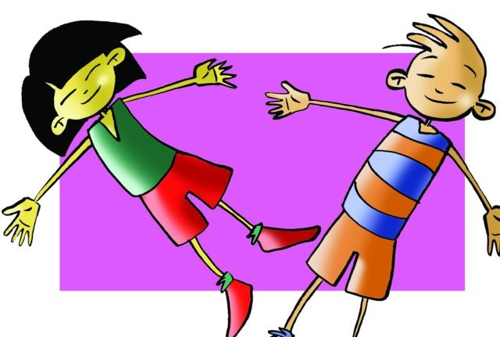
Objectives
Corporal Expression
Basic Notions
Relaxation in Expression
Basic Exercises
Questionnaire and Activities
Contents

Slide 4
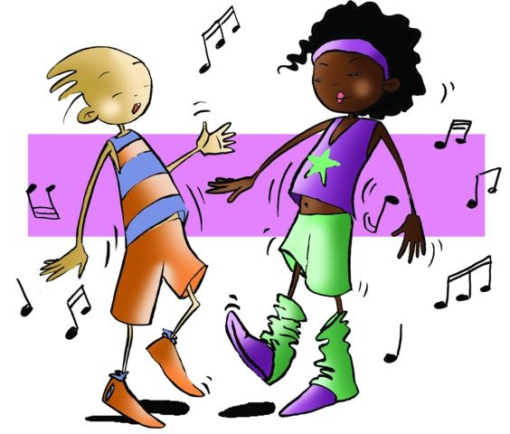
OBJECTIVES
To take part in corporal expression in order to eliminate those tensions that always appear when your body wants to express itself in a natural way.
To foster your development as a person, and that will help you improve your confidence and eliminate your inhibitions.

Slide 5
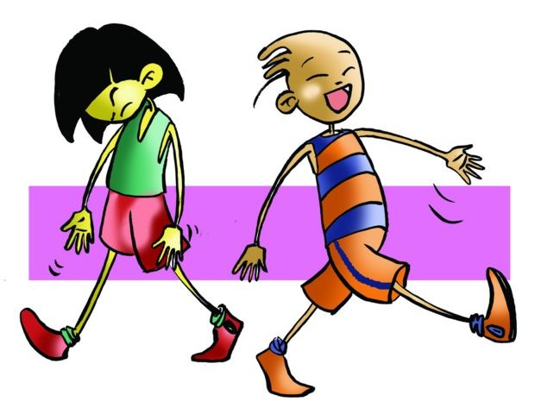
CORPORAL EXPRESSION
In your school, corporal expression can be developed through a variety of activities that will require great effort on your part. Sometimes you will practise techniques and very simple methods like dance moves or drama, and others you will delve into free expression where your movements will respond to an intrinsic drive to express yourself.
As you have learned to exercise your body taking into account physical abilities or learning sport movements, so you will not find it difficult or believe you may show up your body in the movement of "throwing a ball to a teammate" for example. You can and must learn to, at least, show yourself without impediments, all your movements need to express feelings or personal situations outside of any technique.

Slide 6
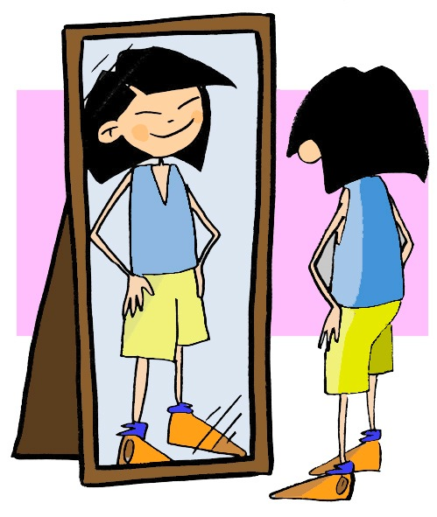
BASIC NOTIONS
Knowledge of our bodies | refers to the comprehensive control of body shapes and the mastery of the segments of the body, either alone or as a whole, facilitating our body language. This language uses gestures, posture or movements; imagine a sad face expressing joy, strange right?
Mastery of space | is essential to highlight how corporal adaption in a given space, the path, direction and perceptions, together with continued body control, the posture adopted.
Study and rhythm control | mean that our movements must conform to a certain rhythm, instant or tempo; they can be both external and internal. That which is external, such as music, induces the body to try to follow it. Those which are internal are what naturally accompany us in a debate, an exhibition or just in conversation, settling into an appropriate rhythm, interspersing pauses or raising pitch for example, in an orderly manner.
Muscle control | needs, from this point of view, a basic awareness of muscle contraction and relaxation, and correlate them directly to stressful situations or situations that are obviously relaxed.

Slide 7
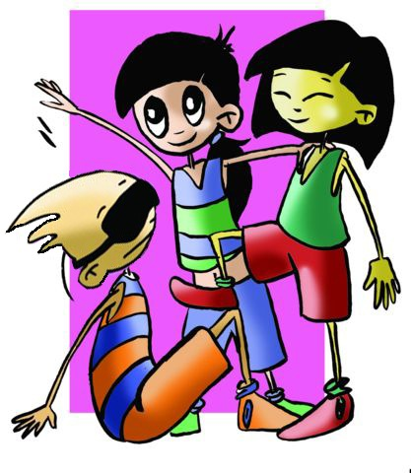
BASIC NOTIONS
Unintended movements | are flowing movements in all their expressive forces and in which each person shows what they feel deep down, getting rid of those constraints to which they have been subjected is the triumph of the instinctive.
Creative Movement | is a fundamental aspect of corporal expression that constantly arises in gestures and exercises that produce the sensation of easy and free movement, which is creativity.
Social Value | means, without a doubt, that corporal expression has an impact on the human aspects concerning social relations as in group work. Do not forget that corporal expression is a means of communication and relationship.
Sensory development | is the ability we have to receive information from the outside through the senses. We can know how things are like through sight, hearing, taste, smell and touch.

Slide 8
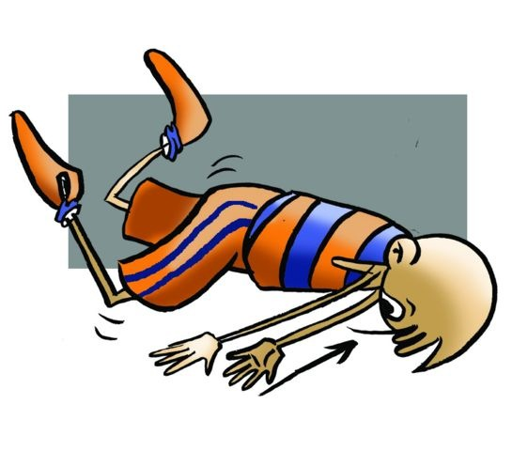
RELAXATION IN EXPRESSION
- In corporal expression, relaxation is essential because it facilitates awareness and favours body control to directly influence the states of muscle contraction and relaxation.
- Breathing must also be taken into account in relaxation activities, which we control both in situations of rest and full effort. Achieving slow and regular breathing gives us very important physical wellbeing, and it is indispensable as a conduit and facilitator of sensations.
- The accumulated tensions of students at the start of the session, caused by the apparent lack of attention and excessive distraction, disappear more quickly with initial practice of relaxation exercises.

Slide 9
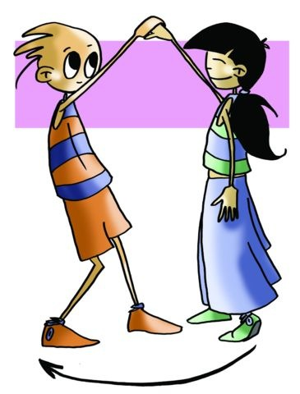
QUESTIONNAIRE AND ACTIVITIES
1. What is corporal expression?
2. Have your skills of expression improved with practice? What have you learned?
3. What difficulties have you encountered in the practice of this unit?
4. Have you improved your relationships with classmates after these exercises?

