Slide 1
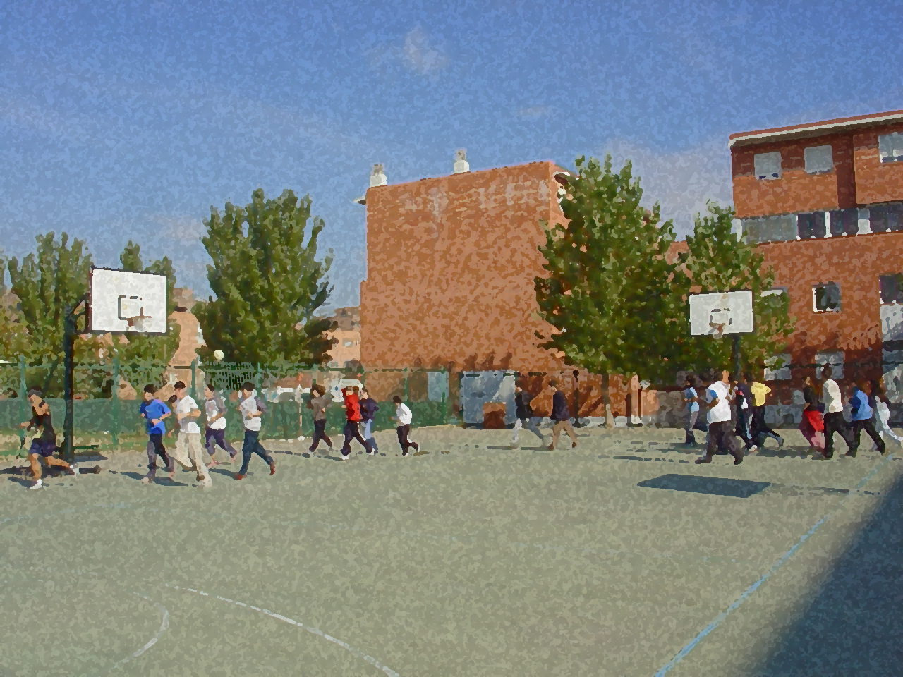

Fundamentals for Secondary School and Baccalaureate. Comprehensive and experiential learning
HANDBALL

Slide 2
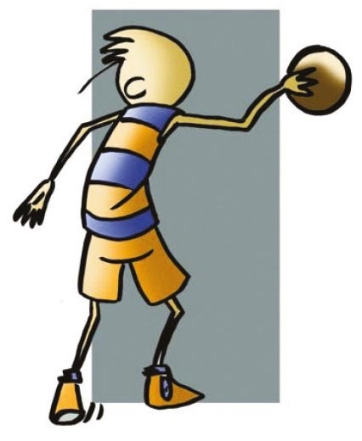
HANDBALL
Objectives
Regulations, Facilities and Equipment
Basic Technical-Tactical Resources
Basic Exercises
Questionnaire and Activities

Slide 3
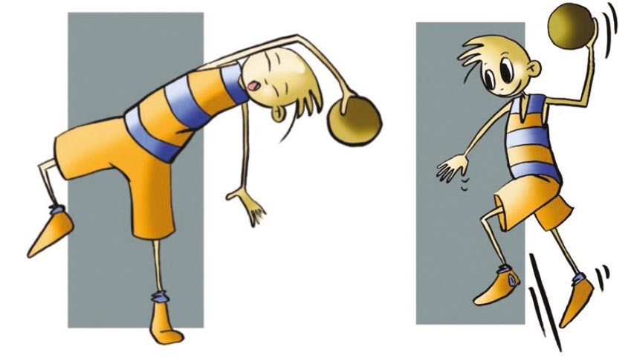
Objectives
– To learn the basic technical and tactical and regulatory resources.
– To understand their application in real game situations.
– To collaborate with teammates in the development and implementation of activities.

Slide 4
History
Handball came into existence in Germany as a result of a search to find an alternative to foot- ball. Initially handball was played eleven against eleven on an outside field with the same dimensions as a football pitch.
Northern European countries were the ones who had the highest level in the sport, especially Austria, Germany and Denmark.
In the 1936 Berlin Olympics, it was still played with 11 players and was an important moment in its development. From the 50s, handball, as we know it now played by seven, saw its popularity expand throughout Europe.
At the Munich Olympics in 1972, it established itself as an international sport with specific rules of handball seven. However, in Spain its development, perhaps motivated by the lack of indoor facilities, was slow. From the sixties it became one of the most popular sports and provided international triumphs, both in terms of sports clubs and national teams. Currently Spain is considered a world power in this sport, two examples are that it managed to become the world champion in 2005 and 2013, and European champion in 2018. The women's team was runner-up in Europe in the Macedonia games in 2008 and Croatia in 2014. They came third in the 2011 Brazil World Championship, and went on to win a bronze medal in the 2012 London Olympics.

Slide 5
Basic regulations
The basic regulations that will allow you to meet the regulatory aspects of the sport as well as the material used and its facilities are as follows:
– ￼The total number of players on the court will be seven, of which 6 will field players and goalkeeper who wear a different jersey to their teammates. There are no limits to the changes that can be made.
– The goalkeeper is the only player who can touch the ball with any part of his/her body. If the goalkeeper comes out of the goal area they have to keep to the same rules as their teammates.
– For players between 12 — 16 years old, two periods of 25 minutes with a half-time break of 10 minutes are played. For players older than 16, a match has two halves of 30 minutes with a 10-minute half-time break.
– The game begins with a throw-off from the centre line by one of the two teams. All players have to be in their respective sides of the field. Each team will have three time-outs to organise their game.
– Only the goalkeeper may remain in the area. If an attacking player touches the ball with any part of his body in the goal area, including the goal line they will be penalized with free throw against them. If a defending player enters the goal area to gain advantage over the opponent he will be penalised with a 7-metre throw.

Slide 6
Basic regulations
– The ball can be thrown, hit, pushed, caught and stopped with the hands, arms, head, torso, thighs and knees.
– It may take three steps at most with the ball in our hands. If we want to move more space in posses- sion, we have to throw it.
– You are considered to have scored a goal when the ball completely passes the goal line.
– The goal is executed by the goalkeeper provided the ball passes the goal line, i.e. a goalkeeper- throw. There is no need to wait for the referee’s signal.
– Violations of “fair play” against the opposing team will be punished with a yellow card. A player who continues to violate this rule will be suspended from the game for a time of 2’, the third suspension will entail disqualification, which is being shown the red card.
Aggression during play will result in expulsion, and the player may not be substituted

Slide 7
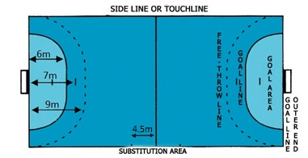
FACILITIES AND EQUIPMENT

Slide 8
BASIC TECHNICAL-TACTICAL RESOURCES
In handball, as well as other sports of invasion, there are some resources that allow you to implement the strategic principles, and that must be used depending on the decisions that are taken as the match progresses. These resources, which we call technical and tactical, will enable you to pass and receive, take shots on goal, mark or provide cover to a teammate, block, feint, etc. As we have seen in collective invasion sports, we believe that the best thing is that, based on the skills you already have, e.g., throwing the ball, moving, jumping ... you pay more attention on which resource to use, instead of how to do it.

Slide 9
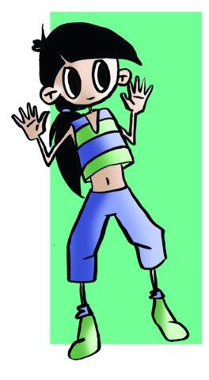
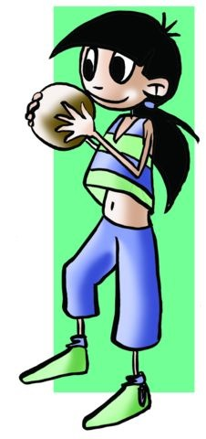
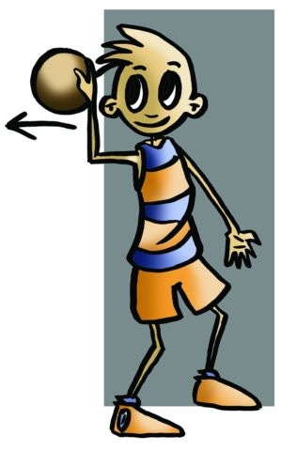
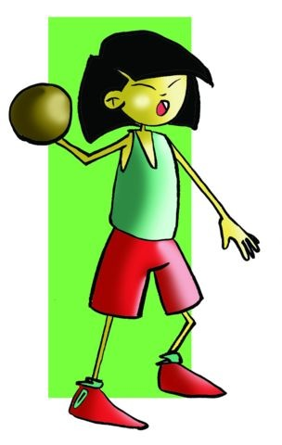
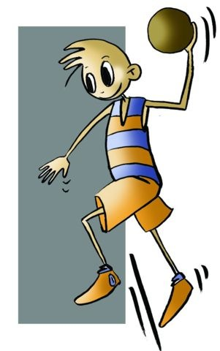
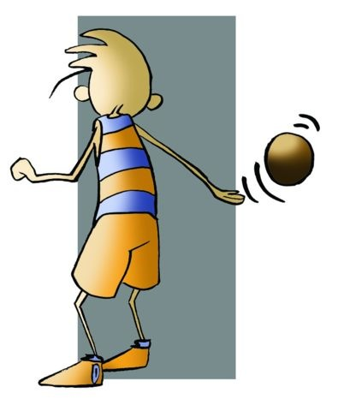
BASIC TECHNICAL-TACTICAL RESOURCES
Basic Stance and Passing
Recepción
PASSING
Side Pass
One-Hand Pass
Jump Pass
Back Pass

Slide 10
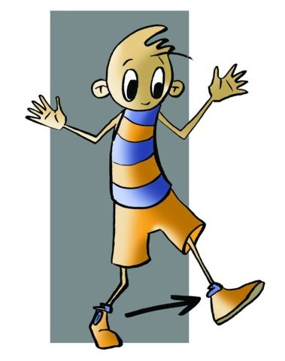
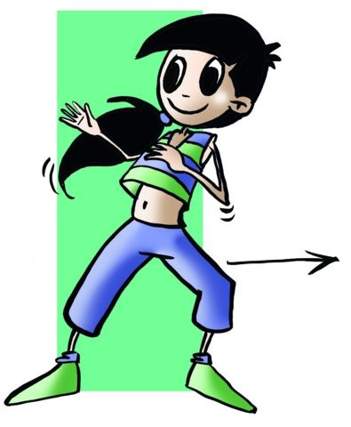
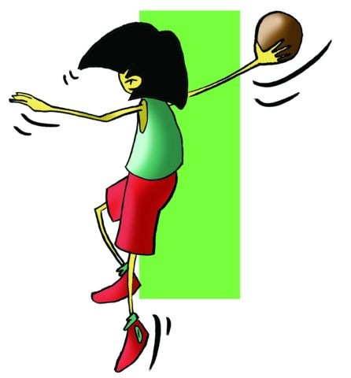
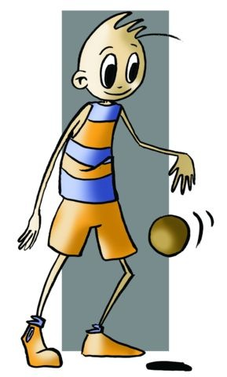
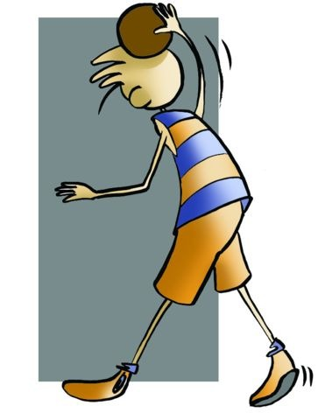
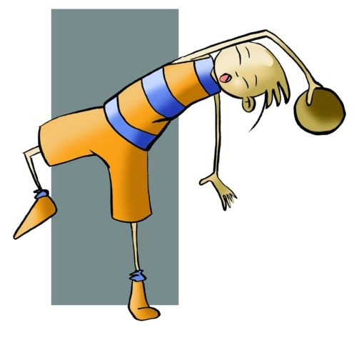
BASIC TECHNICAL-TACTICAL RESOURCES
Moving
Shots on Goal
without the Ball
Straight
Lateral or slide step
Jump Shot
Standing Shot
Dribbling
Overarm Shot

Slide 11
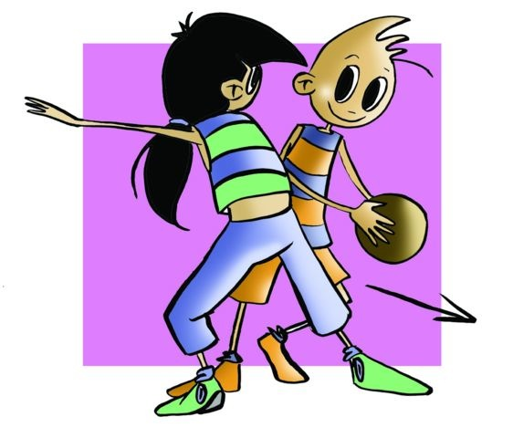
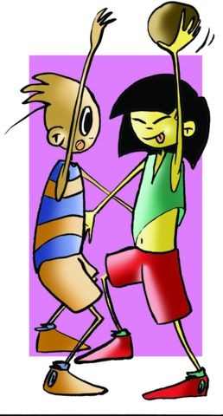
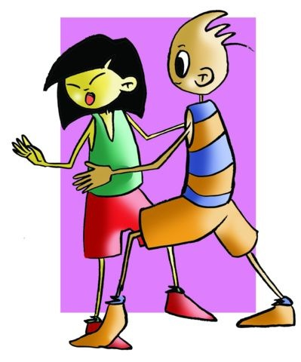
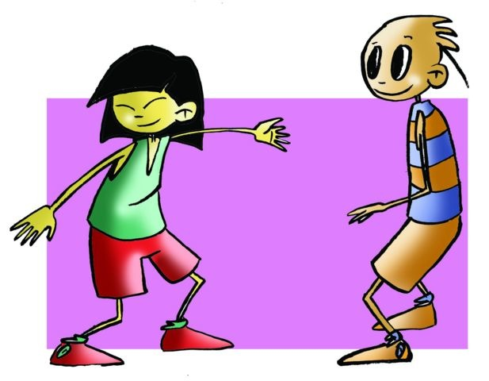
BASIC TECHNICAL-TACTICAL RESOURCES
Feinting
Getting Away
Marking
Opponent without the ball
Opponent with the ball
You can get away from the opponent (defender) who is marking you in order to intervene in the game more easily.
Man-to-man marking
Zonal marking

Slide 12
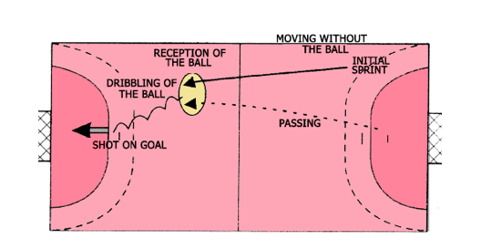
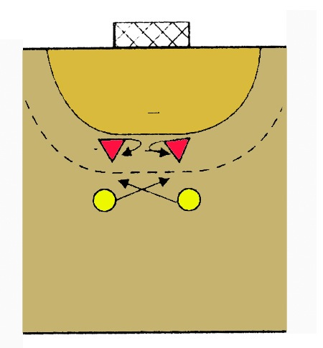
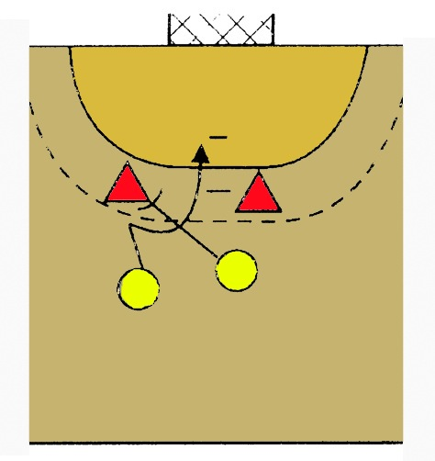
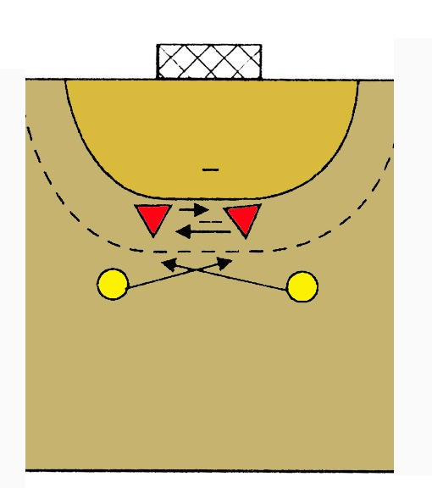
BASIC TECHNICAL-TACTICAL RESOURCES
Counter-attack
Change of Opponent
Blocking
Cross Play

Slide 13
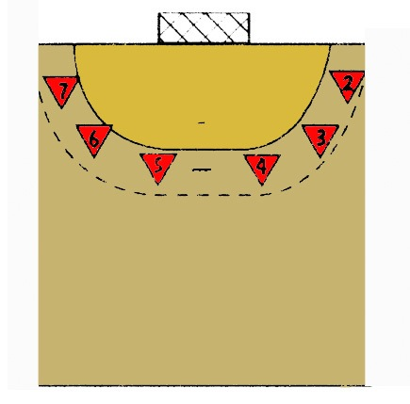
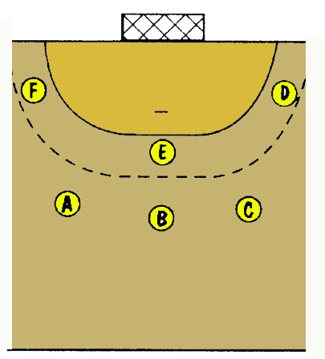
Joint Tactical Organisation
Joint tactical organisation as it is understood is the different possibilities that players have to act collectively and in a rational and organised fashion.
How can players distribute themselves in the court taking into account the characteristics of the sport and different positions co-ordinate their moves?
The first thing that has to be done is for the players to distribute themselves on the court by zones of personal responsibility, each player taking charge of a portion of the court and all the balls that enter the area, as well as individual moves or tactical resources to continue a gameplay.
IN DEFENCE IN ATTACK

Slide 14
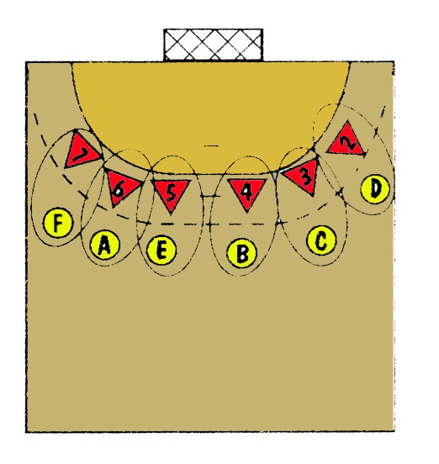
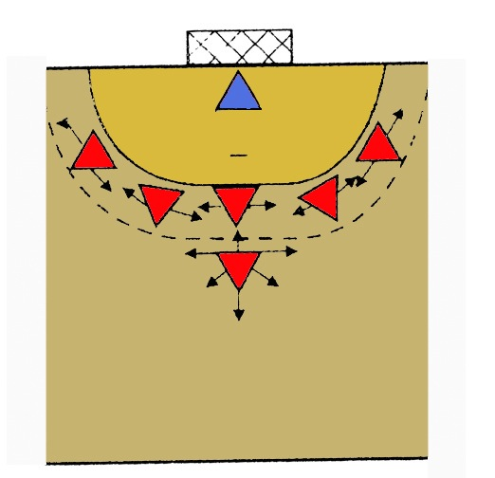
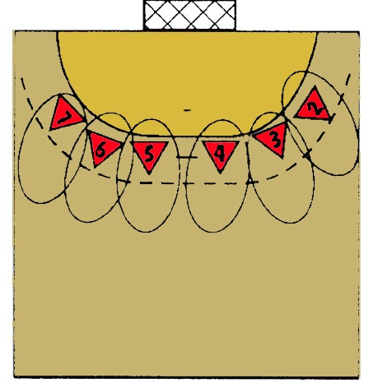
Joint Tactical Requirements
seek numerical superiority,
reciprocal assistance among teammates,
initiate and perform moves in a timely manner, and
vary the moves.
In Defence
Individual Zone 6:0 5:1

Slide 15
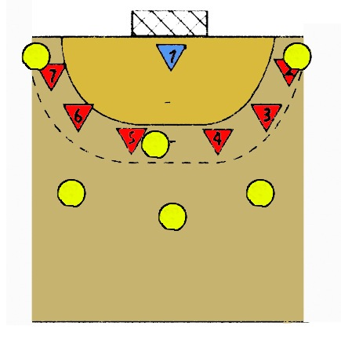
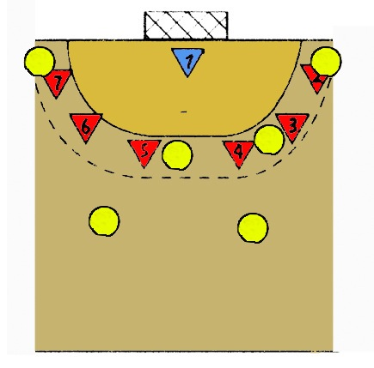
Joint Tactical Requirements
- seek numerical superiority,
- reciprocal assistance among teammates,
- initiate and perform moves in a timely manner, and
- vary the moves
In Attack
3 -3 2 -4

Slide 16
QUESTIONNAIRE AND ACTIVITIES
1. Write a short summary on how to play handball. Do research.
2. Do you know what a datchball is? Look it up on the internet and play it.
3. Describe the positions of the first and second-line players in 3-3 attack.
4. Discuss the differences between the joint organisations: individual and 4-2.
5. Have you seen a handball match? Discuss it with a partner.
6. Write down in your notebook unknown vocabulary from this unit.

