Slide 1
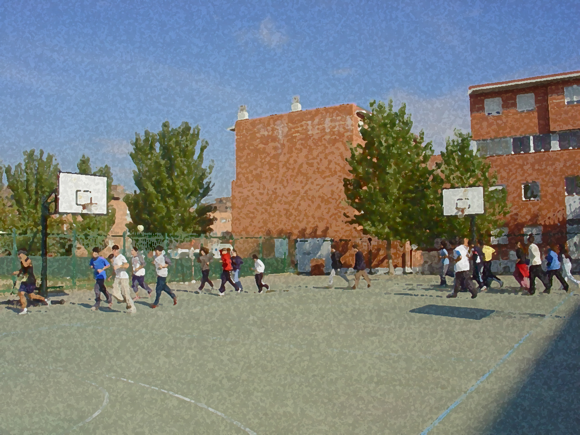
Fundamentals for Secondary School and Baccalaureate. Comprehensive and experiential learning
Co-ordination

Slide 2
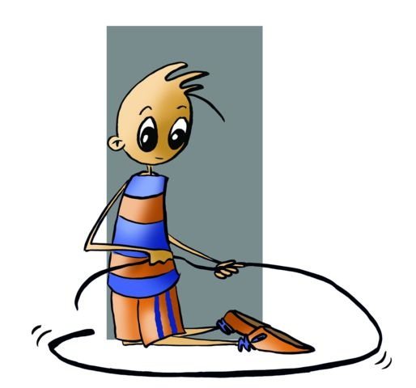
Co-ordination
Objectives
Concept and Types of Co-ordination
General Dynamic
Specific or Segmented Dynamic
Eye-Hand Co-ordination
Foot-Eye Co-ordination.
Dynamic-Manual Co-ordination.
Questionnaire and Activities

Slide 3
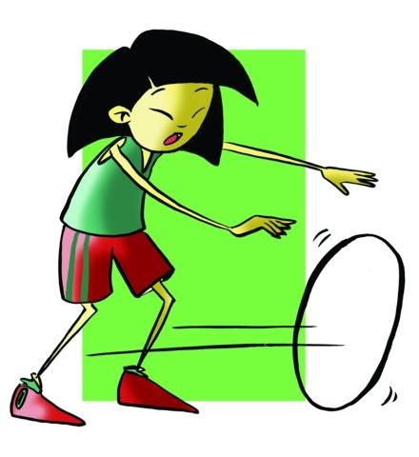
OBJECTIVES
˗ To understand the link between the nervous system and the muscular system, and its unquestionable complexity.
˗ To draw up and perform various exercises that involve not only isolated parts of the body but exercises that involve all the parts of the body like jumping or running.

Slide 4
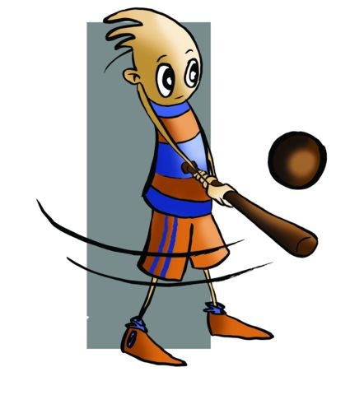
La coordinación
The student that has fluid movements to provide an adequate motor response, pure gestural speed to anticipate opponents’ actions, reaction speed to be able change positions or rectify actions in the final moments, precision to carry out the action in a throw or a pass and equilibrium to remain stable throughout the movement can consider himself/herself co-ordinated.

Slide 5
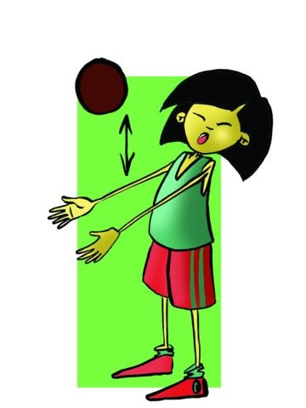
The ideal age to develop co-ordination is thought to be between seven and thirteen or fourteen years old. During this period you can attained a solid starting point so that in later life you can assimilate more complex movements.

Slide 6
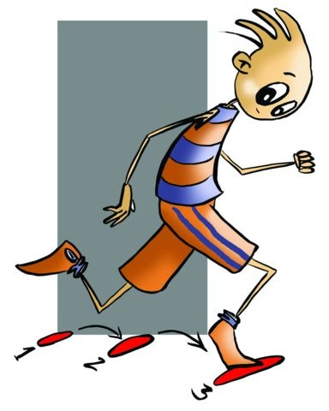
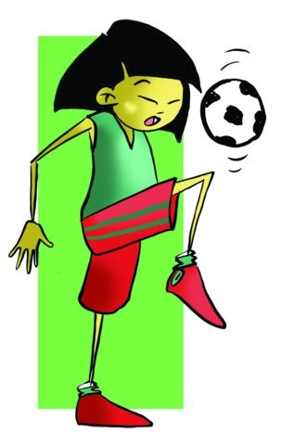
Morehouse (“Physiology of Exercise”) defines co-ordination as:
“the neural control of muscle contractions in the performance of motor actions.”
Types of Co-ordination:
General Dynamic Co-ordination
2. Specific or Segmented Dynamic Co-ordination (Visual-motor co-ordination)

Slide 7
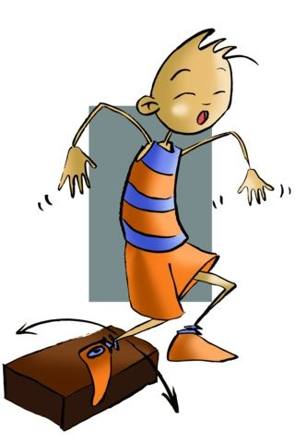
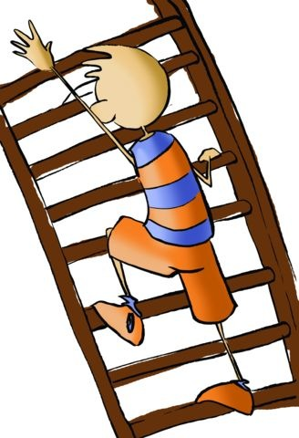
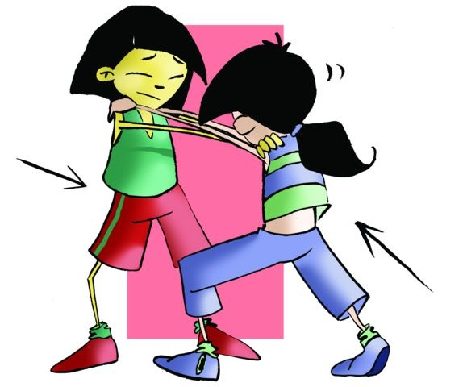
General Dynamic Co-ordination
It is defined as one that groups movements that require joint action by all the parts of the body, movements in which many parts of the body and their muscles are involved. These activities can be:
- moving on different limbs, running and jumping, etc.

Slide 8
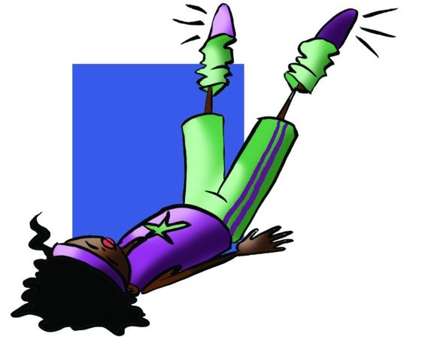
Specific or Segmented Dynamic Co-ordination (Visual-Motor Co-ordination)
This type of co-ordination is directed towards the existing relationship between one component and one part of our body and where sight is essential in its execution. The function of the segments includes movements such as:
Eye-Hand Co-ordination
Foot-Eye Co-ordination.
Dynamic-Manual Co-ordination.

Slide 9
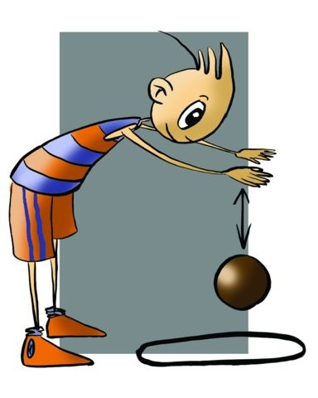
Eye-Hand Co-ordination.
Specific skill movements in the upper limbs (i.e. arms and hands) trying to achieve maximum precision. We can group this type of co-ordination in movements that centre in: manual skills, making lines, passing and receiving, and throwing in general.

Slide 10
Foot-Eye Co-ordination
Specific skilled movements in the lower limbs (i.e. legs and feet) trying to achieve maximum pre- cision, such as the launching of a ball towards the goal in football or receiving the ball on the inside foot. We can group this type of co-ordination in movements that centre in: controlling airborne items with the feet, making lines, passing and receiving and throwing in general.

Slide 11
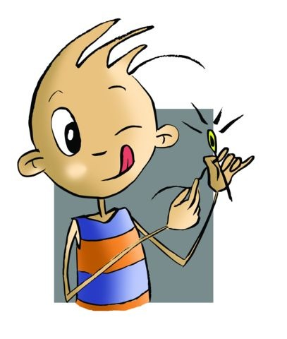
Dynamic-Manual Co-ordination.
Corresponds one-handed or two-handed movements, completed with precision and harmony. Distinguished by two types of co-ordination:
a) By how it is executed
b) By the kind of dynamism which is brought into play

Slide 12
QUESTIONNAIRE AND ACTIVITIES
1.Try to bounce two balls at the same time
2.Count, with a classmate, to see who can hit a post the most by throwing a ball ten times with your hand.
3.What do you understand by co-ordination?
4.When an athlete takes a long jump, what type of co-ordination does he/she require?
5.When a handball player completes a shot on goal, what type of co-ordination does he/she employ?
6.Write down in your notebook unknown vocabulary from this unit.

