Slide 1
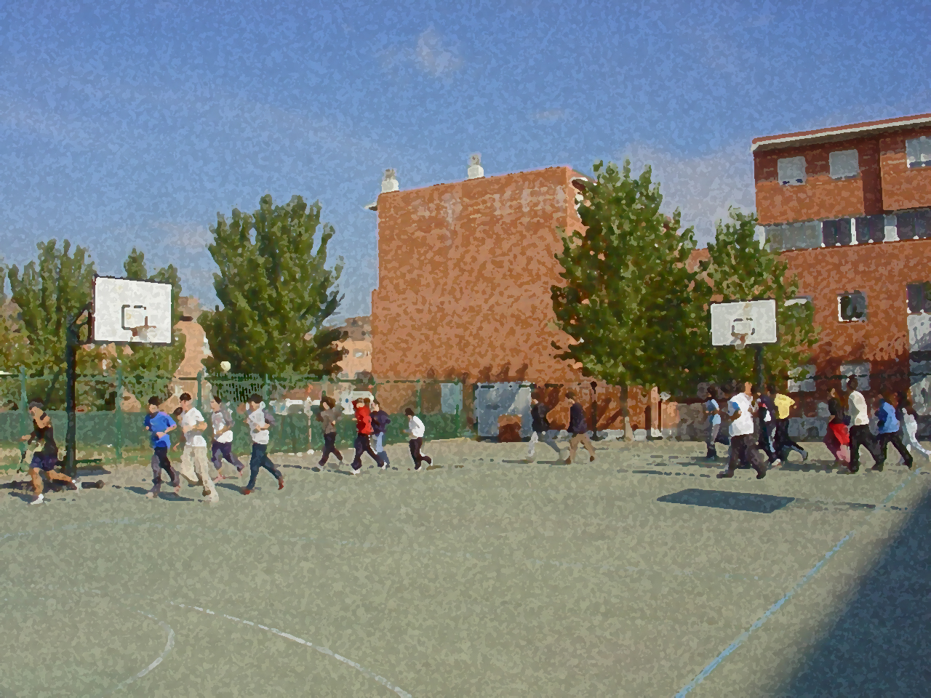
Fundamentals for Secondary School and Baccalaureate. Comprehensive and experiential learning
RUGBY

Slide 2
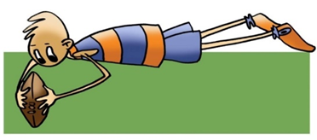
RUGBY
Objectives
Regulations, Facilities and Equipment
Basic Technical-Tactical Resources
Basic Exercises
Questionnaire and Activities

Slide 3
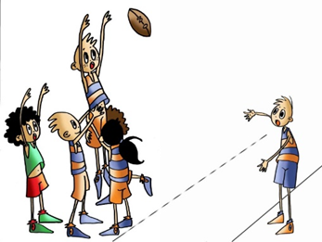
Objectives
To know the basic technical-tactical and regulatory elements concerning rugby.
To understand their application in real game situations, and to collaborate with your teammates in the development and implementation of these activities.

Slide 4
History
Around 1820 in a town in England, called Rugby, there was a famous school where the pupils amused themselves with a game of carnival football. The essential rule of the game was that you could catch it with your hands, but players had to kick the ball in order to move it. W. Ellis, playing one day, ran out with the ball in his hands and crossed the whole field, from this moment onwards small changes in regulations began to be made to the game.
In 1842 some basic rules were already admitted, such as players running with the ball in their hands and being able to stop it by grabbing it or blocking.
As the students moved to the university, so did the game, and in 1843 the GUYS HOSPITAL was formed, which was a team made up of medical students.
In 1871 rugby was officially recognized as a sport, with the creation of the Rugby Football Union.
In Spain, rugby was introduced in the early years of the 20th century. It was first established in Barcelona, and in 1923 the Federación Española de Rugby (FER) was created. The men's national team is in the 2nd division and participates in the "Six Nations B", has participated in the 1999 World Cup in Wales and the Six Nations B in which it has finished third on three occasions.
The women's national team took longer to establish itself as in its early days it was played in secret as it was not well seen, hence its late start. However, in these short years it has participated in European and world tournaments and is currently considered among the top 10 in the world. They have won in many Europeans and has achieved a sixth place in the World Championships. They have beaten world champions New Zealand and are slowly but surely growing on the world stage.

Slide 5
Basic regulations
- The aim is to get the ball into the opposing team's marking area.
- The field is rectangular, 100 x 70m plus a 22m zone behind each goal line (in-goal).
- Each side of the field consists of a goal or try line, a 22m line, a 10m line, a half-way line and the dead-ball line and the touch (or side) touchlines, 15m and 5m lines.
- The duration of the match is two 40-minute halves with a 15-minute break.
- The match starts with a kick-off, in the same way as the second half starts or the match restarts after a try (“grounding the ball”), or conversion kick (kick at the goalposts).
- The kick-off is taken by a kick from the centre (on the half-way line). The ball must be kicked over the opponents' 10m line. The teams are positioned behind the last foot of the person who is going to kick, the kicker on the centre -point of the half-way line, and the other from the 10m line occupying positions.

Slide 6
Basic regulations
- The fundamental laws, as rugby does not have rules, in this sport is offside, which varies according to the different situations in the game:
a) When a player is in front of the teammate who is carrying the ball.
b) If during an orderly maul, a player crosses the offside line from behind the foot of the last player forming the maul.
- The pass is not allowed to be made forward, nor is the ball allowed to escape in the same direction as a player attempting to take the ball.
- Kicking the ball forward, tackling the player carrying the ball.
- You may catch or pick up the ball and run with it and pass the ball to another teammate as long as it is done backwards or sideways.
- Foul play is any action against the letter and spirit of the Laws by a person within the playing enclosure. It includes obstruction, unfair play, repeated infringements, dangerous play.
- What is prohibited:
Hitting an opponent, tripping, wilful Injury, holding, pushing, pushing, obstructing an opponent who is not carrying the ball, and when any team commits a violation of the laws (rules) of the game, the referee may punish them with a penalty stroke or an ordered scrum.

Slide 7
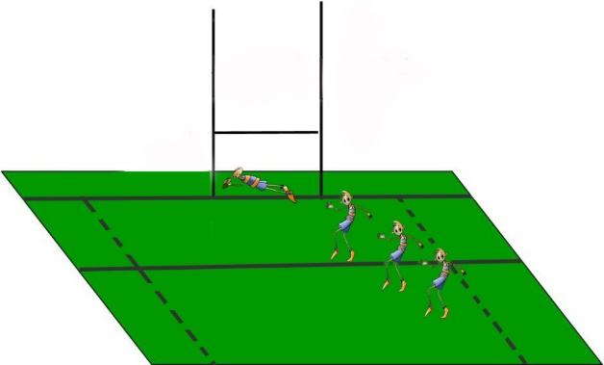
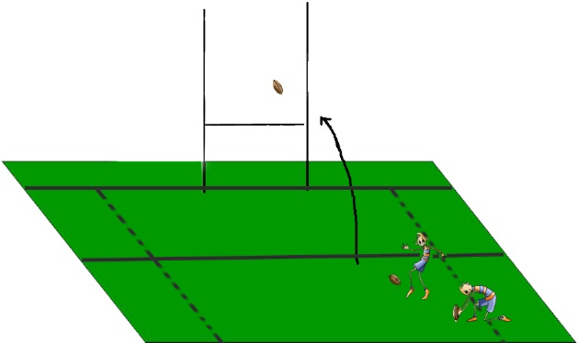
Scoring and Description:
Conversion: After scoring a try (5 points). Kicking the ball from anywhere in line with where the ball was grounded for the try, parallel to the touchlines and passing it between the posts over the crossbar (2 points).
Try: It is the placement of the ball on the ground in the opponent's goal line (try line) or in-goal area (between goal line and dead-ball line). (5 points)
Penalty try. It is awarded between the posts when foul play is used in a clear try-scoring position to prevent points being scored. (5 points)
Drop goal. A player, from any position, drops the ball, and once it is on the ground, he/she kicks it through the goalposts, over the crossbar. (3 points)
Penalty kick. Kicking the ball at the goalposts with the ball in place or kicking the ball when the foul was committed. (3 points)

Slide 8
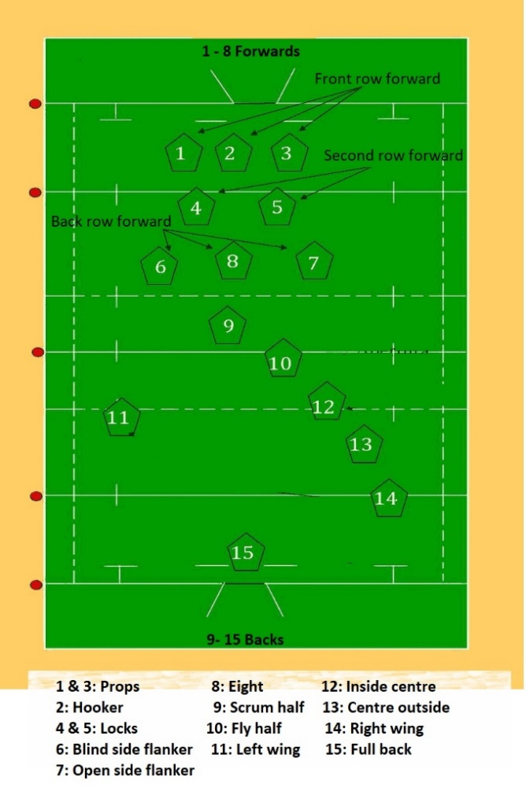
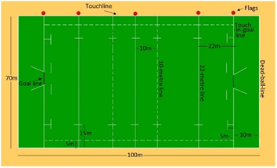
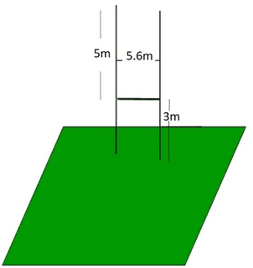
FACILITIES AND EQUIPMENT
Rugby ball. - It is oval and has a perimeter is between 76 and 79cm and a circumference between 60 and 65cm. The length measures between 28 and 29cm.

Slide 9
BASIC TECHNICAL-TACTICAL RESOURCES
As it has been said before, rugby consists of moving forward to get tries and conversions. The way to move forward is by running with the ball in the carrier’s hands, passing to teammates situated behind the ball carrier, and kicking the ball forward. Therefore, the technique will be based on kicking the ball, passing, and receiving with the hands, running with the ball in the player’s hands, and some very characteristic actions of this sport such as tackles and hand-offs.

Slide 10
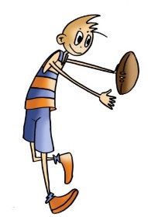
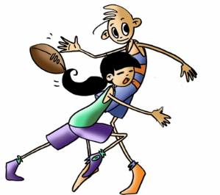
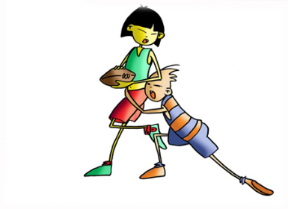
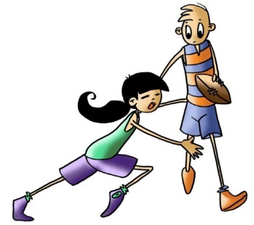
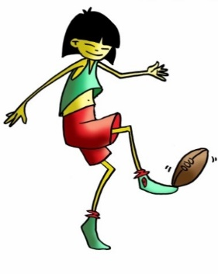
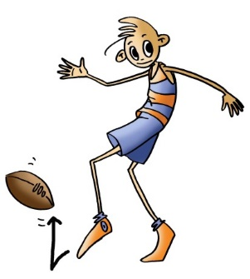
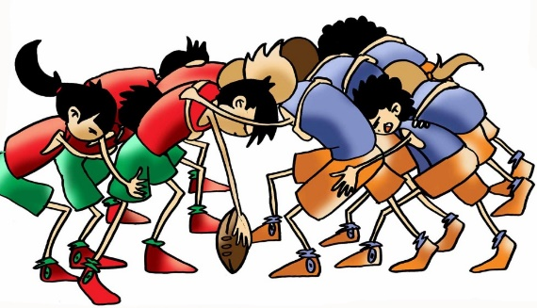
BASIC TECHNICAL-TACTICAL RESOURCES
Passing and Picking Up the Ball
Hand-off
Tackling
Ways to restart the game:
- Scrum
Kicking

Slide 11
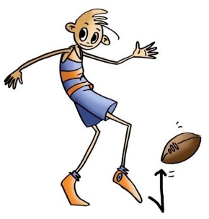
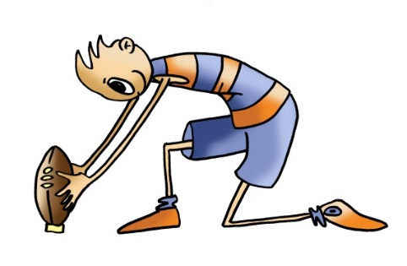
BASIC TECHNICAL-TACTICAL RESOURCES
22-Metre Drop-Out and Kick-Off from Midfield:
22-metre drop-out
Kick-Off from Midfield
The Lineout
Penalty kick

Slide 12
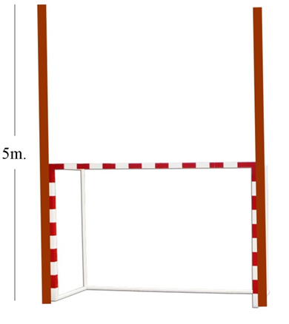
BASIC TECHNICAL-TACTICAL RESOURCES
ADAPTATIONS TO BE ABLE TO PLAY IN SCHOOL PLAYGROUNDS

Slide 13
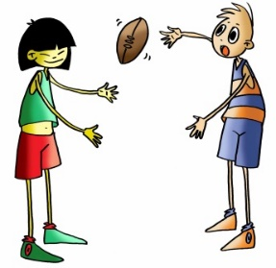
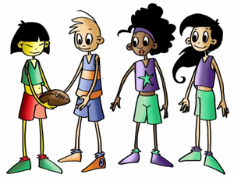
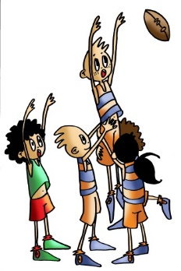
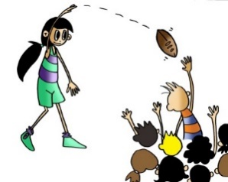
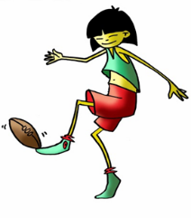
BASIC EXERCISES

Slide 14
QUESTIONNAIRE AND ACTIVITIES
1. Explain when offside occurs.
2. Name the lines on the rugby field.
3. What are the names of the three players who form the first row of a scrum?
4. How many points is a try worth in rugby and how many points is a conversion worth in rugby?
5. When can an opposition player be tackled?
6. When may the referee signal a penalty kick?
7. Can you place eight teammates in a scrum?
8. Do you know three ways to kick the ball?
9. What is "hand off"?
10. How would you organise a lineout?
11. Write down in your notebook unknown vocabulary from this unit.
12. Check the Federation website or any sports association in your region, and check for changes or modifications, if any, in its regulations.

