Slide 1
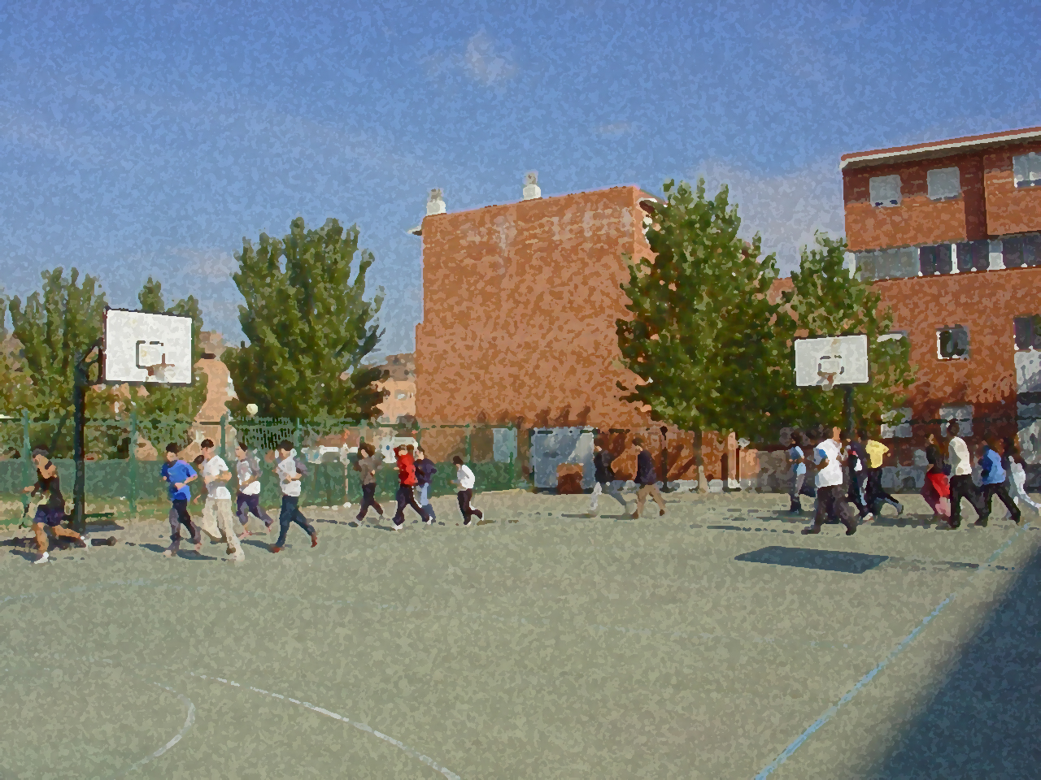
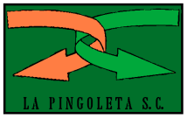
Fundamentals for Secondary School and Baccalaureate. Comprehensive and experiential learning
Traditional Sports

Slide 2
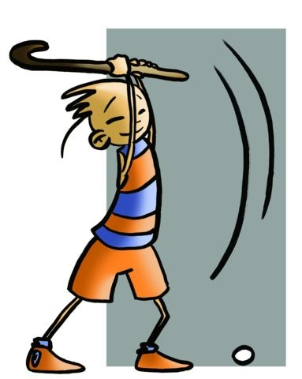
Contents
Objectives
General Classification
Throwing Games and Sports
Games and Sports of Strength
Combat Games and Sports
Questionnaire and Activities
Traditional sports, also known as regional or rural sports, arise as a result of popular customs, such as adapting certain type of field work. Some have evolved from games that eventually reached the rank of sport as the playing field became defined, equipment, participants and their specific techniques and regulations were endorsed by an entity at a national or community (i.e. federation) level that promoted, subsidised and endorsed them. Furthermore, these sports are noted for such characteristics as strength, stamina, skill or ability.

Slide 3
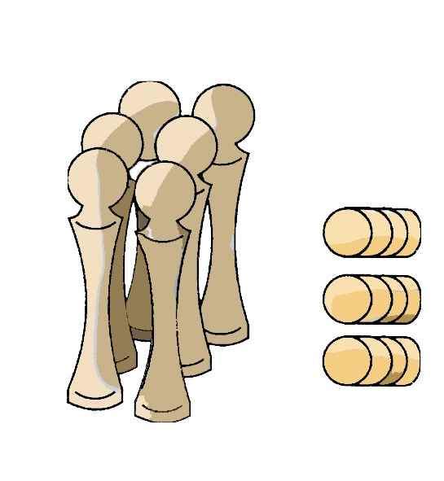
Objectives
To return to activities practised by our forefathers, restoring age-old customs and diving into cultural traditions.
To practise and value the traditional activities pertaining to your locality.

Slide 4
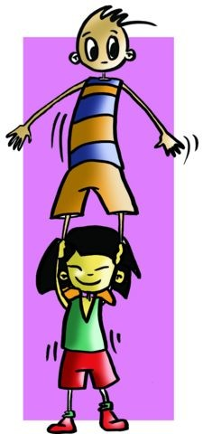
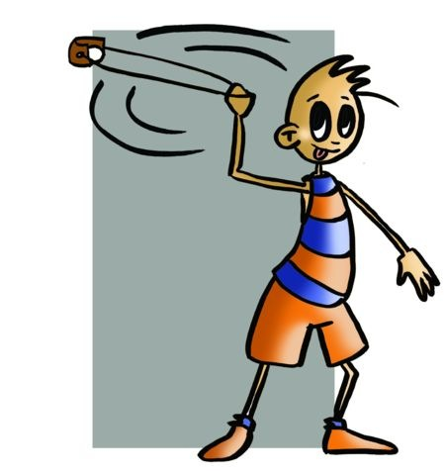
GENERAL CLASSIFICATION. (Professor García Serrano’s)
Games and Sports of Jumping and Acrobalance | Racing: andarines, korricolaris, etc.
 | Jumping: pasiegan jump, a Basque ritual dance involving jumping, etc.
 | Acrobalance: Castell, etc.
Throwing Games and Sports | Distance: tiro de reja (ploughshare throwing), sling throwing, lanzamiento de barra (metal bar throwing), etc.
 | Precision (bowling): caliche (hitting a wooden cylinder with a metal counter or moneo), herradura or herrones (horseshoes), etc.

Slide 5
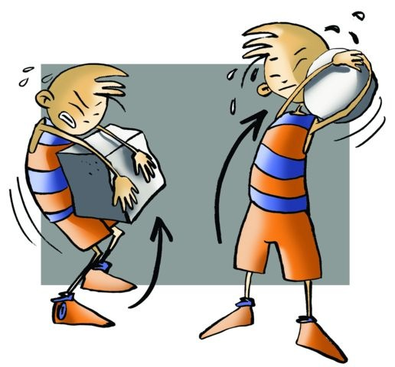
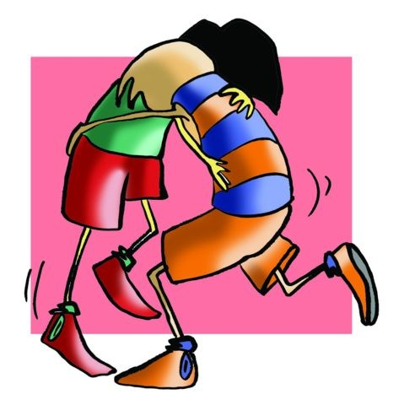
GENERAL CLASSIFICATION. (Professor García Serrano’s)
Games and Strength Sports | Lifting: stones, cántaros (ceramic pitchers), etc.
 | Dragging: sogatira (tug of war), tiro del palo (stick pulling), etc.
Combat Games and Sports | Lucha leonesa (Leonese wrestling), lucha canaria (Canary wrestling), loita (Galician fight), palo canario (a martial arts using stick).
Mallet and Ball Games | Types of hockey: chueca, brilla, lichona, perch, mallo, etc.
Ball Games and Sports | Basque pelota: played with a ball and hand, racket, or basket.
 | Valencian pilota: played in a trinquete (an indoor court), etc.

Slide 6
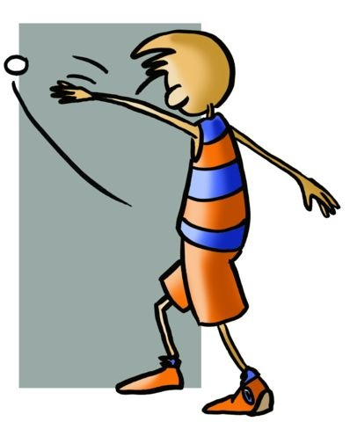
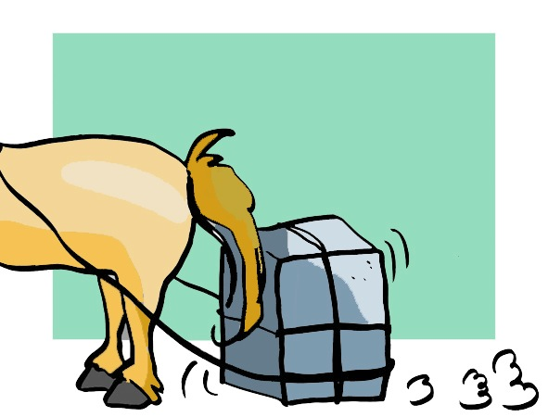
GENERAL CLASSIFICATION. (Professor García Serrano’s)
Popular Games of Skill at Work | Dragging: man, donkey dragging stone, etc.
 | Rural Work: aizcolari (wood chopping), segalari (scything), layador (laia competition), etc.
Games and Popular Sports with Animals and Vehicles | Equestrian: horse, donkey racing etc.
 | Cycling Games and Sports: bike, belt race, etc.

Slide 7
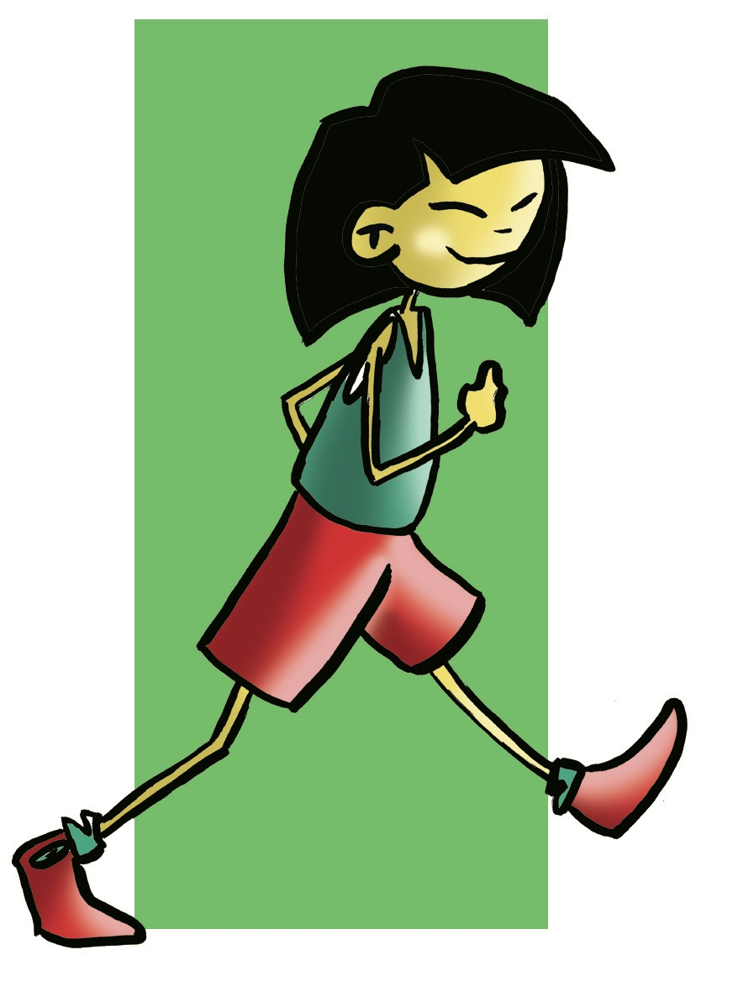
1. Games and Sports of Jumping and Acrobalance
Racing:
Andarines.
Korricolaris

Slide 8
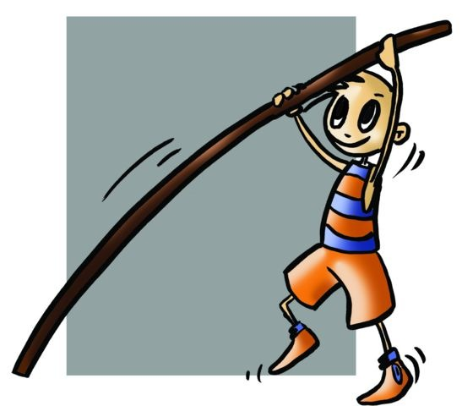
1. Jumping:
Pasiegan jump
a Basque ritual dance involving jumping, etc
Acrobalance:
Castells.

Slide 9
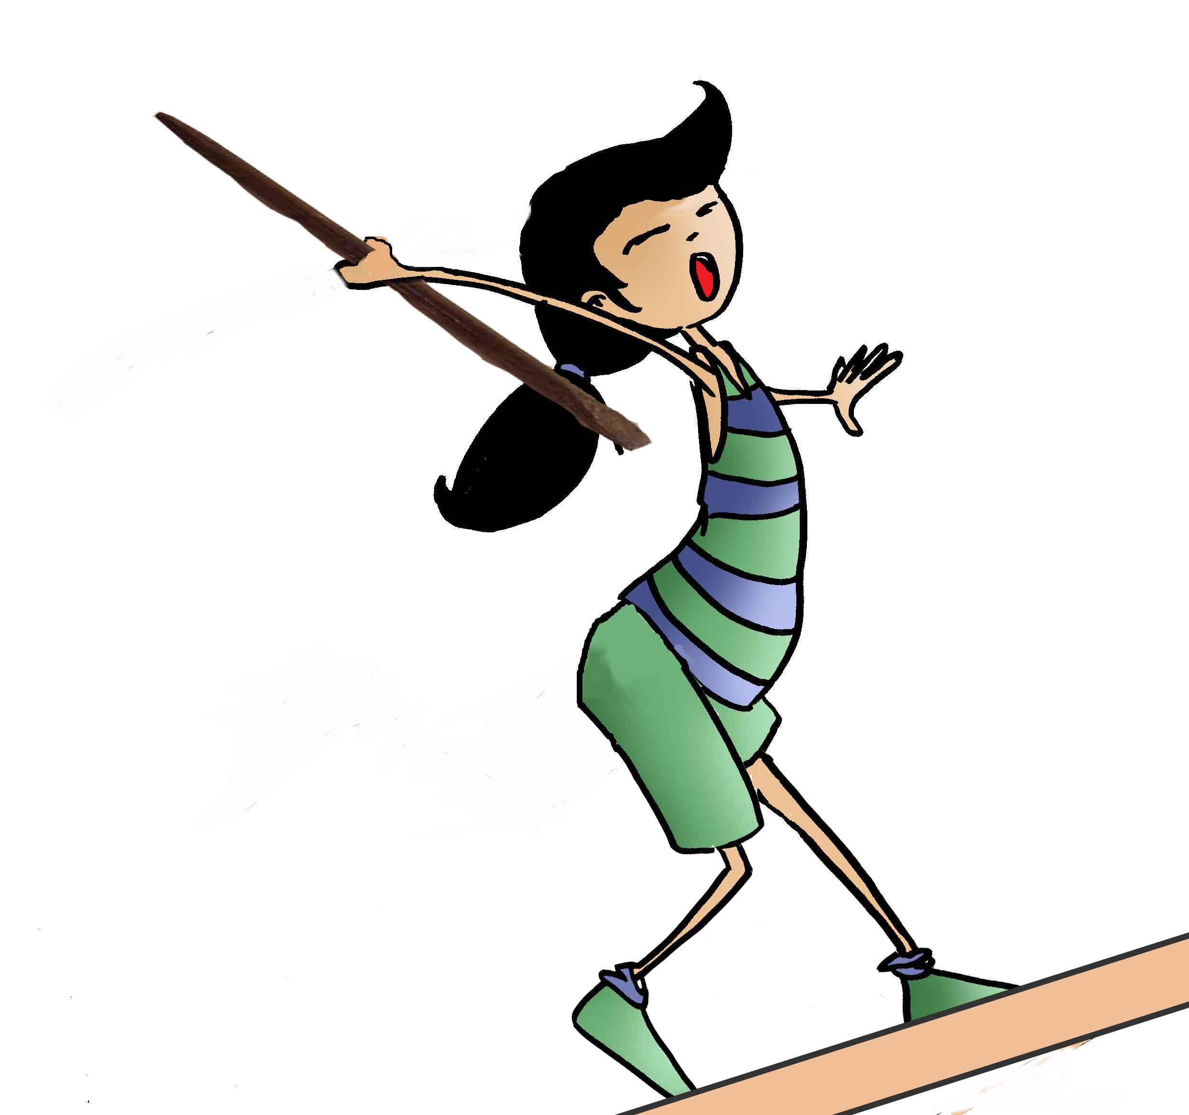
2. THROWING GAMES AND SPORTS
Tiro de reja involves throwing a piece from a ploughshare from a standing position and with one hand. It is widely practised in the Autonomous Community of Castilla-La Mancha.
Tir fona is practised mainly in the Balearic Islands. The shot is taken by throwing a stone with a sling. There are two marksmanship categories: accuracy involving shooting at a target, and the other is long range shooting.
Metal bar throwing is very popular in the Basque Country and Aragon. This sport involves throwing an iron bar that weighs between 3 and 7 kilos with one hand while the feet are placed on the take-off board.

Slide 10
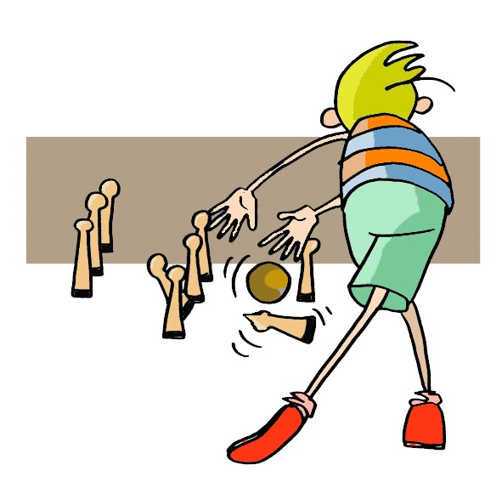
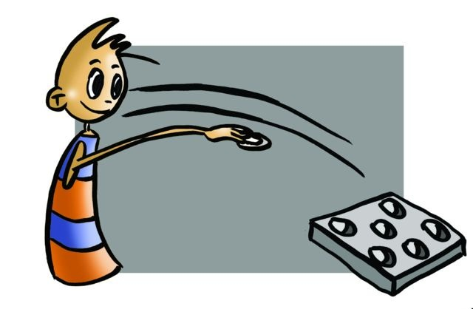
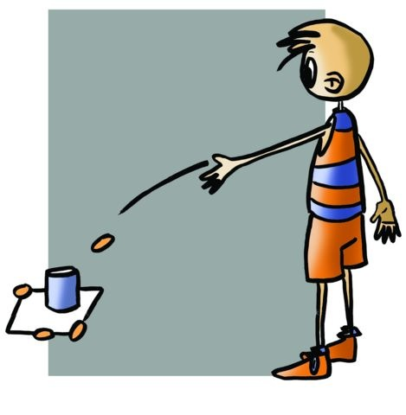
Precision.
Bowls is more than five thousand years old. This game is played in most of the autonomous communities in Spain. It gets special mention here because of its great variations.
Bowling was introduced in Spain by the Romans. However, not until centuries later did it receive official recognition. Due to royal interest (Charles II of Spain), interest in the game grew slightly in the sixteenth and seventeenth centuries, but it was not until the nineteenth century that it reached the peak of its popularity.
In Spain, bowls is most popular in almost all the autonomous communities, but especially so in Asturias, Cantabria, Basque Country and Castilla-Leon where numerous variants exist.
Some examples to be found are cuatreada and bolo palma in Asturias, bolo pasiego and pasabolo tablón in Cantabria, games of palma tres ribereños and palma salinero in Álava (Basque Country), bolo serrano in Andalucia or bolos maragatos and tres tablones in Castile and León.
Caliche is also known as calitx, chito or toka. The game involves throwing small iron discs at a small cylinder. The objective is to hit the cylinder out of the circle or square in which it is located.
Los hoyetes: This game is very rooted in the Basque Country, Navarra and Aragon. It is a game of marksmanship. Steel tokens are thrown into holes on a board. Each of the holes is worth points that are tallied as the gam e progresses.

Slide 11
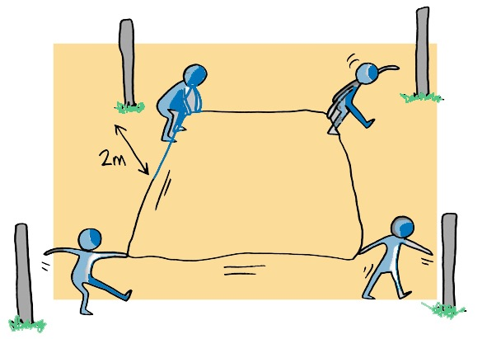
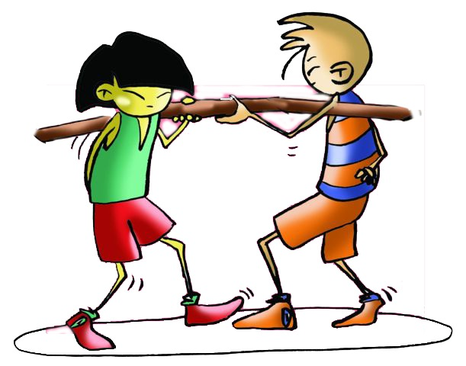
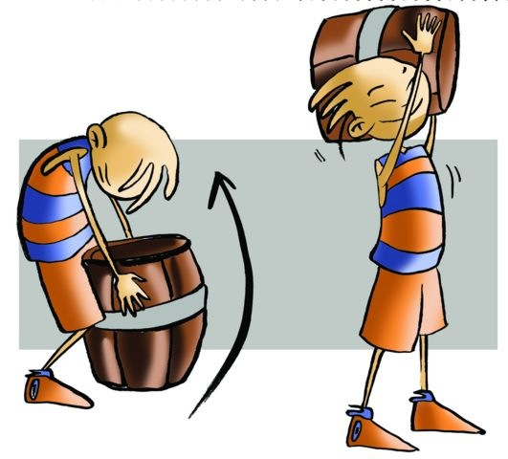
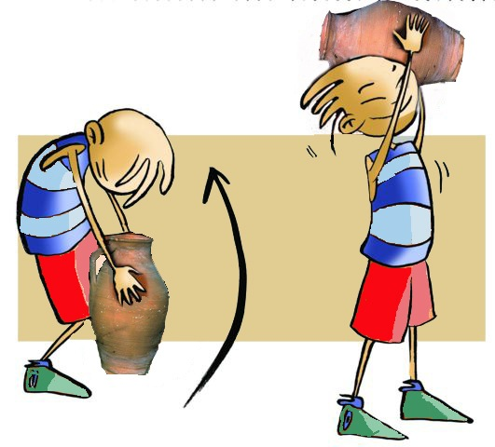
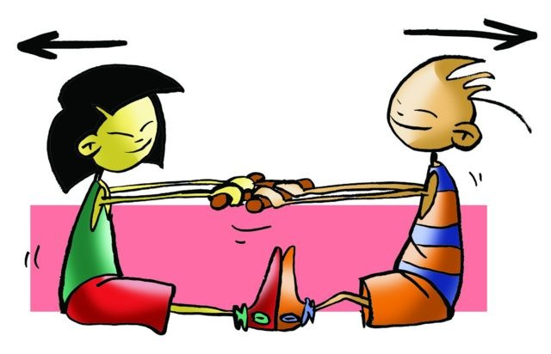
3. GAMES AND SPORTS OF STRENGTH
Stone lifting (arrijasoketa)
Lifting long narrow sacks
Lifting pitchers
Dragging
Tug of war (sogatira)
Pulling at the stick (tiro al palo)
Juego de pica
Tiro del cuadrado

Slide 12
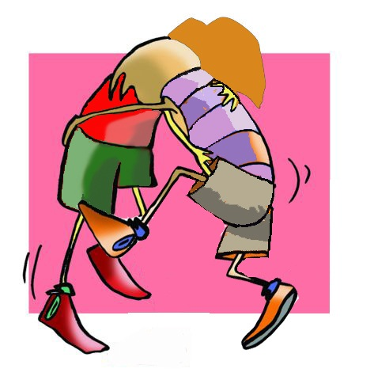
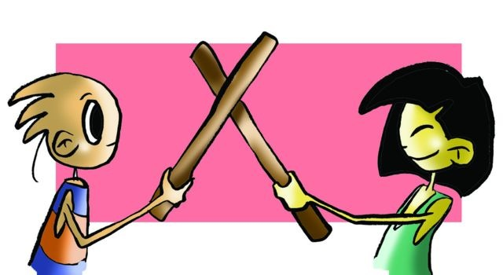
4. COMBAT GAMES AND SPORTS
Leonese wrestling
The fighters, within a circle of 8 metres in diameter, grab each other’s belt with two hands, one in front and one behind. They grapple in order to bring the other down and pin the opponent down.
Canary wrestling
Bouts may be held in a soft and sandy area, where two concentric circles of 5 and 6 metres radius are drawn respectively.
The wrestlers wear sleeveless tops, knee length shorts with a cloth belt and go barefoot.
Canary stick-fighting
The fighters meet on an unenclosed field. They stand with their sticks on the ground, or with their sticks crossed in the air. The sticks, which are 1.5 metres long and 3cm thick, should be used only to mark, never to hit the opponent.

Slide 13
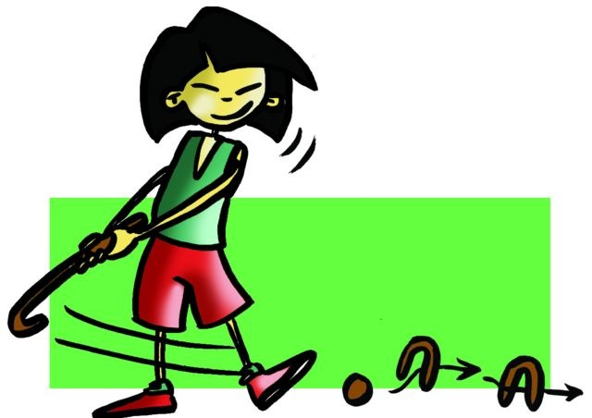
5. Mallet and Ball Games
Chueca or choca: In the past, it was played in Castile. The game consisted of hitting a ball with a playing stick that curves at the end. A goal is scored when the wooden ball is put into a goal called pina. It was a team game and may be a forerunner of hockey.
La Brilla: It is popular in Cantabria. La Brilla is a team sport that consists in trying to keep the ball (brilla) using a stick (cachurra) in the air, trying to take it to the opposite side of the field. The teams stand in two lines facing each other, i.e. two parallel lines, separated by a line waiting for the brilla so they can move it to their side.
La Lichona: It is played in the north, especially in Cantabria. It could be said that it is a variant of the above as a ball called brilla is hit by a cachurra so it drops into a hole in the ground. Each player has his/her assigned hole.
Los hoyetes: This game is very rooted in the Basque Country, Navarra and Aragon. It is a game of marksmanship. Steel tokens are thrown into holes on a board. Each of the holes is worth points that are tallied as the gam e progresses.
El mallo (straw game): It is a stick and ball game. El mallo is played by driving a wooden ball along a set path.
A Porca: It is played in Galicia and Castile, but in Soria it is called Gurría. It involves pushing or throwing a ball with the wooden canes into a hole in the centre of a circular perimeter defended by one or two players.

Slide 14
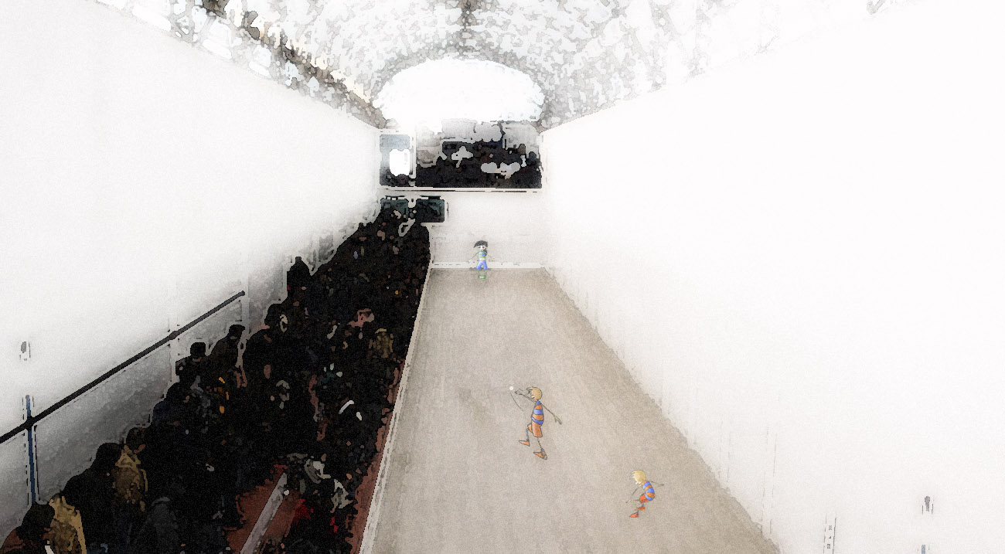
6. Ball Games and Sports
Basque pelota: played with a ball and hand, racket, or basket.
Valencian pilota: played in a trinquete (an indoor court).

Slide 15
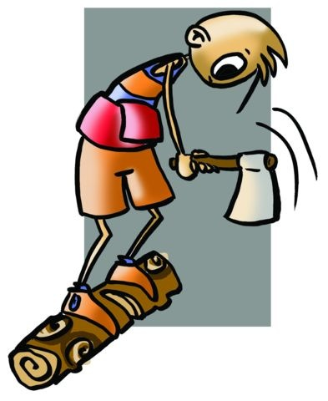
7. Popular Games of Skill at Work
Dragging: man, donkey dragging stone, etc.
Rural Work: aizcolari (wood chopping), segalari (scything), layador (laia competition), etc.

Slide 16
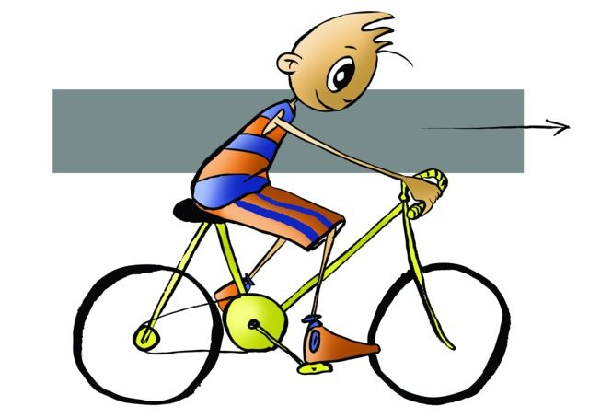
8. Games and Popular Sports with Animals and Vehicles
Equestrian: horse, donkey racing etc.
Cycling Games and Sports: bike, belt race, etc.

Slide 17
QUESTIONNAIRE AND ACTIVITIES
What is the throw of Aragonese bowling?
Do you know any traditional sport that has not been herewith presented? Rediscover it and play it with the class.
What is tir fona? Castell? Aizcolari?
How many variations of bowling do you know?
Check the Federation of traditional sports to monitor games and sports which undoubtedly part of your history.

