Slide 1
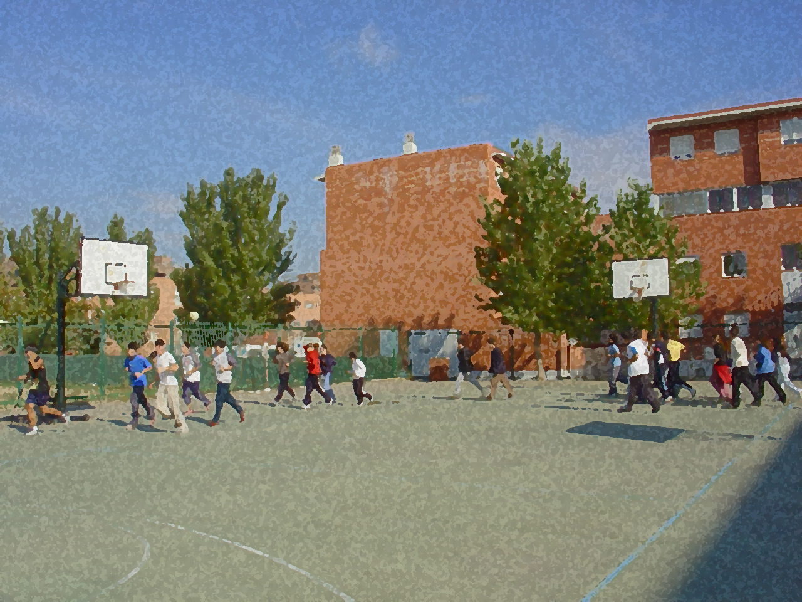

Fundamentals for Secondary School and Baccalaureate. Comprehensive and experiential learning
Good Habits and Posture

Slide 2
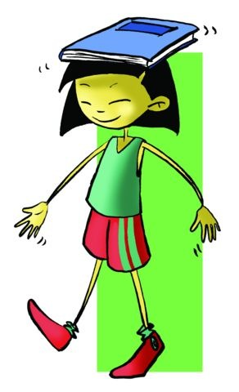
Good Habits and Posture
Objectives
Good Habits
Posture: Anatomy of the Back
  Correct and Incorrect Posture
  Exercise and Posture
Specific Exercises
Questionnari and Activities

Slide 3
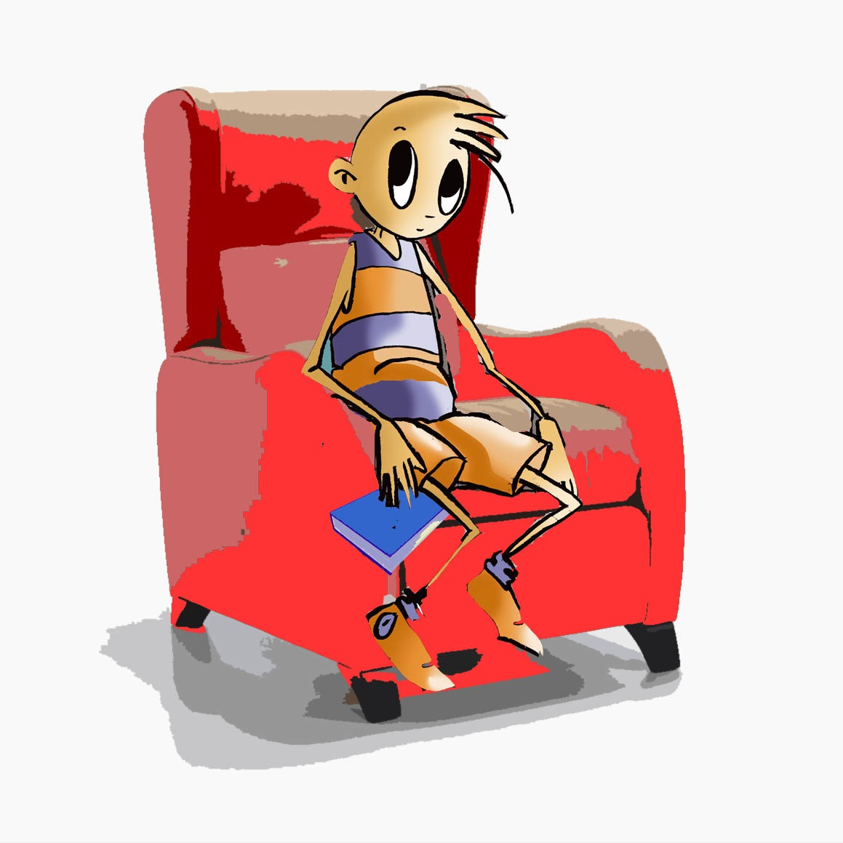
OBJECTIVES
To observe with the greatest precision possible the correct posture for our bodies in moments of activity and inactivity, to know our anatomy and its functions better.
To perform the most appropriate exercises for the prevention and/or correction of posture.
To raise everyone’s awareness to attitudes and habits that are both healthy for them and the environment.

Slide 4
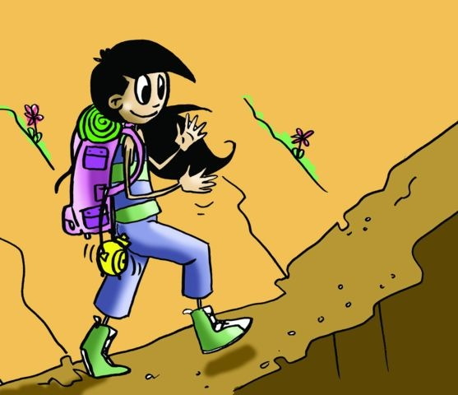

GOOD HABITS
We should live a healthy life maintaining sufficient levels of energy to complete our daily functions.
We have to avoid injury and sickness and try to balance our emotions improving where possible our relationships and engaging in healthy activities.
We should avoid situations or activities that can damage our health such as infections, toxic habits (e.g., smoking, alcohol, or drugs), an unbalanced diet and/or relationships that threaten our wellbeing

Slide 5
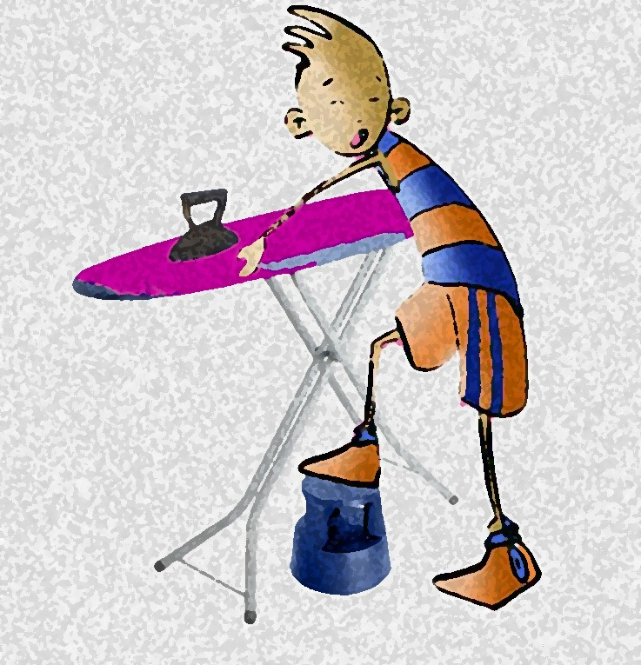
GOOD HABITS
A programme of exercise carried out regularly, never sporadic or unplanned, will ensure physical health:
it will contribute to the acquisition of good personal hygiene that ensure cleanliness, such as a change of post-exercise clothes, and
provide a psychological balance that favours self-control, self-esteem and creativity,
reducing anxiety and developing psycho-social values like the adaptation to success and failure, improvement, effort helping a companion and a healthy view of teamwork.

Slide 6
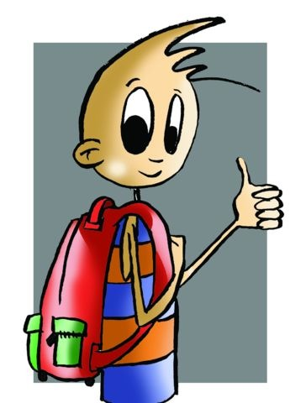
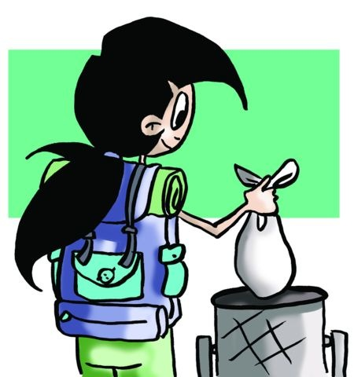
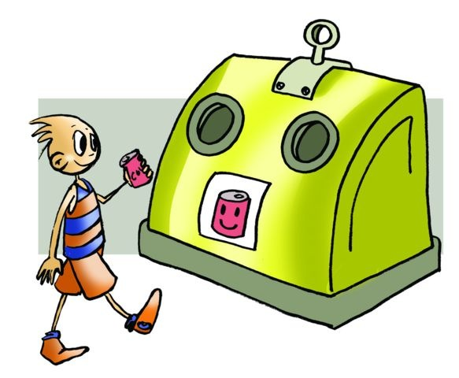
GOOD HABITS
Good habits also refer to the environment and the impact we make on it t:
for example light and noise pollution in cities,
disrespectful behaviour in nature that attacks natural cycles,
pollution of the environment and the abandonment of the recycling process,
be careful with the use of water which will in a few
years be a precious and expensive commodity,
take extreme care not to waste energy,
all of these attitudes will be fundamental to our future society.

Slide 7
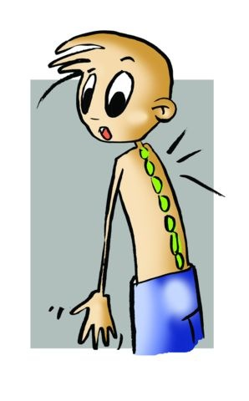
POSTURE
One day thousands of years ago we stood up and began to walk and the weight of our bodies was divided into two parts joined by our spinal column. Since then, correct posture has been essential to body movement. If at any time body weight is directed more to one side than the other its development and growth will be uneven finding comfort in inadvisable, irregular positions that will eventually cause intractable chronic pain.

Slide 8
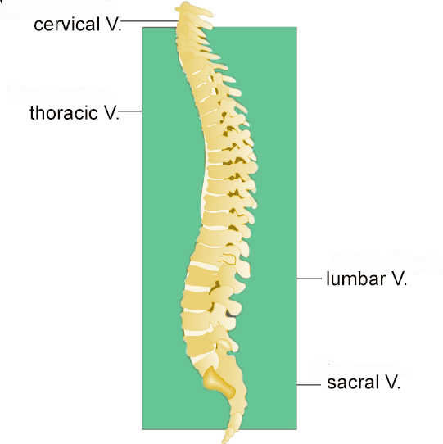
Anatomy of the Spinal or Vertebral Column
The spine is a vertical axis from the neck to the hip by the back of the body consisting of 33 vertebrae (very resistant bones) that are slightly separated by a ring or inter-vertebral disc
There are seven in the neck, and they are called cervical, which are so strong that the first was named symbolically after Atlas, the mythological hero who held up the sky. The twelve in the middle are called thoracic, five in the lower zone are called lumbar, the five below that are joined to form the sacrum, and finally, and also in one piece are four that make up the coccyx bone that is a relic of the past when we still walked on all fours using a tail as balance.

Slide 9
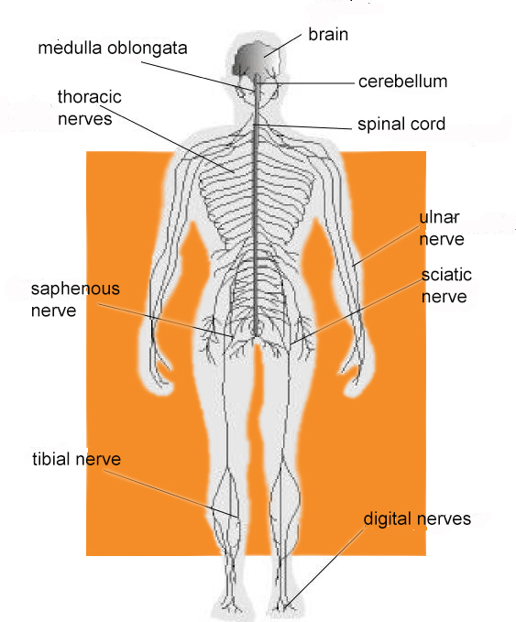
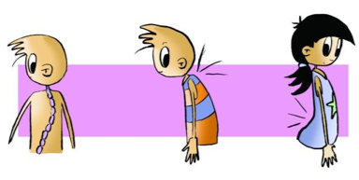
ANATOMY OF THE BACK
If we look from the front (antero-posterior view) we see that the column is straight, but if viewed laterally we can see some slight curves that serve primarily to prevent rebounding, jumps, bumps or impulses, and potential impact to the brain. The high cervical lordosis curve is situated in the lumbar and thoracic zone and sacral curve goes contrary and is called kyphosis.
Spinal Cord: The spinal cord is a nerve cylinder located inside the spine.
Peripheral Nervous System: It is the set of nerves that exits the brain and spinal cord and extends throughout the entire body. Through them the nerve impulse is transmitted.

Slide 10
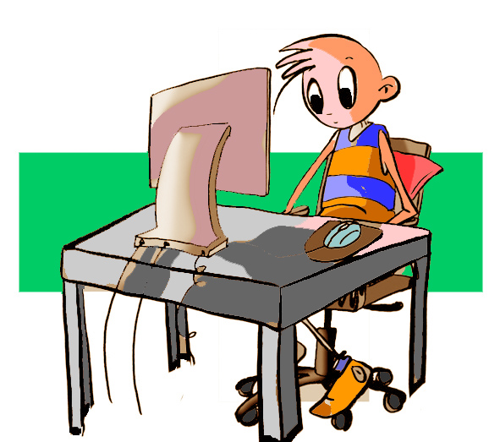
Correct and Incorrect Posture
ACTION | CORRECT POSTURE
Standing | Abdominal muscles tightened, shoulders slightly back and head up.
Lying down | The best is on your back with a pillow supporting your neck. On your side, with a pillow between your legs.
Sitting down | Torso straight, with a small cushion supporting your lower back if possible. Using the armrests helps to rest.
Studying | In comfortable chair, straight torso and monitor, if you have it, at eye level. Use a lectern or stand.
Reading on the sofa | Back straight and supported, do not sink into the sofa.
Making the bed | Try to bend evenly.
Carrying a backpack | Weight evenly distributed. Wear it high and closely fixed to your back
Pushing a trolley | Dragging it may cause difficulties as it forces your back to twist. Alternate pushing it with your arms or better pulling it with both your hands.

Slide 11
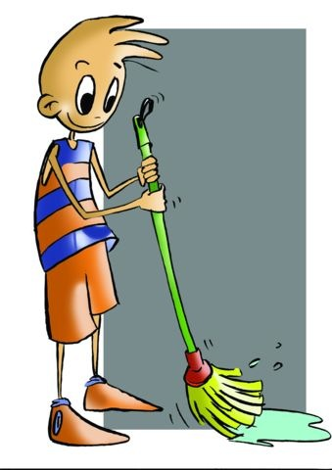
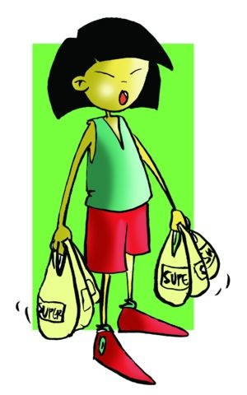
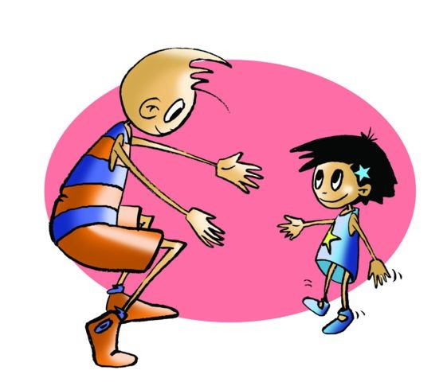
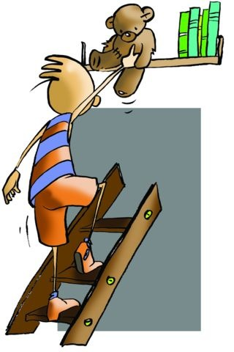
Correct and Incorrect Posture
ACTION | CORRECT POSTURE
Shopping | Distribute the load between both arms.
Transporting an object | Push using your legs more than your torso.
Lifting an object | Bend your legs, which is better than using your torso, when lifting an object.
Ironing | Alternate with other activities. Rest one foot, the opposite of the ironing hand, on something elevated.
Getting something from a high place | Use ladders with due care to gain access more comfortably
Washing your hair out of the tub | Do not bend from the waist, it is better to kneel on a pillow.
Grooming yourself | Rest your foot on a raised platform.
Sweeping, mopping the floor | Use long poles to avoid excessive bending of the torso.

Slide 12
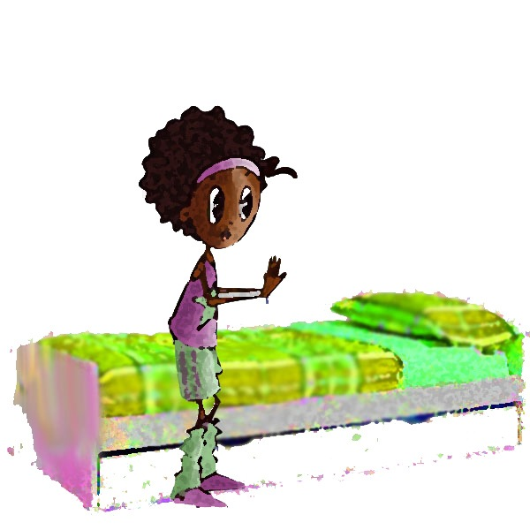
QUESTIONNAIRE AND ACTIVITIES
Do you know your spine?
Observe yourself in the mirror and see if your shoulders are aligned.
With a classmate measure your legs to check their dimensions.
Think of your most common routines, do you follow them properly?
In addition to exercise, do you know any habits which you should correct?
6. Write down in your notebook unknown vocabulary from this unit.

