Slide 1
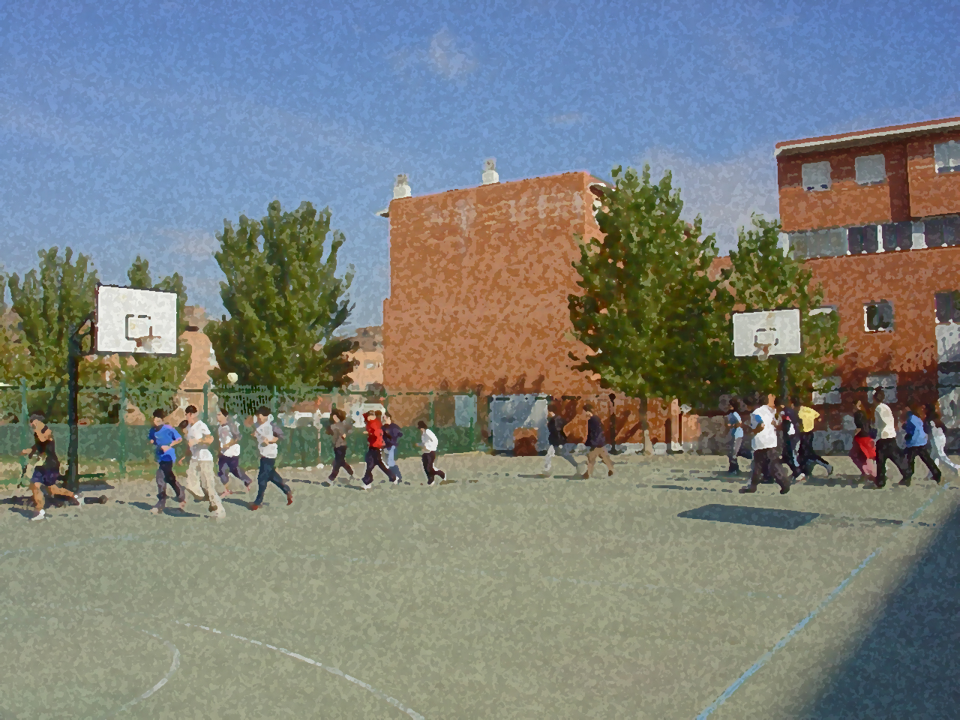
Fundamentals for Secondary School and Baccalaureate. Comprehensive and experiential learning
Hockey

Slide 2
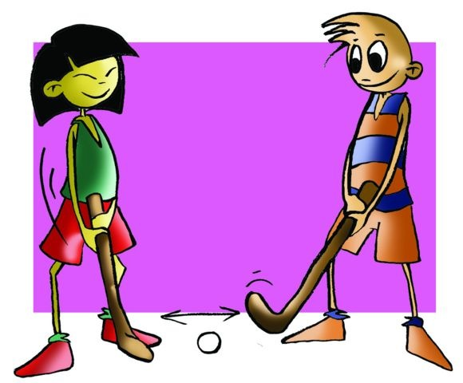
Contens
Objectives
Regulations, Facilities and Equipment
Basic Technical-Tactical Resource
Basic Exercises
Questionnaire and Activities

Slide 3
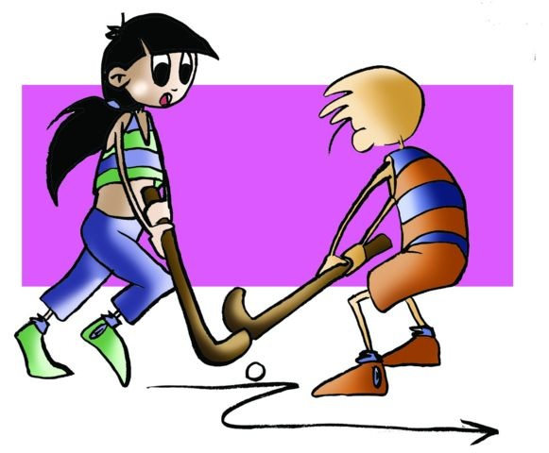
Objectives
To learn the basic technical-tactical and legal elements of hockey.
To understand of their application in real game situations while collaborating with your peers in the development and implementation of activities.

Slide 4
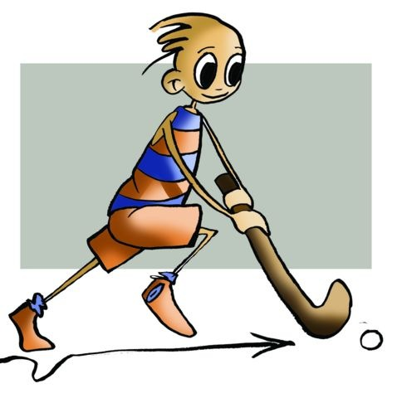
History
Games with a stick and ball date from pre-Christian times, and they were played in Greece, Persia, Egypt and Arabia. In the sixteenth century the Araucano Indians in Argentina had a similar game called cheuca.
In the 19th century they began to play a game similar to modern field hockey in English schools, developing similar rules to the current ones at the end of the century.
Hockey was included in the Olympic Games in 1908 and in 1924 the International Federation of Hockey was created.
India and Pakistan are the countries that dominated the sport from 1928 to 1968.

Slide 5
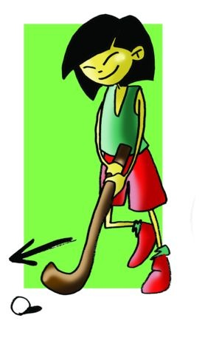
Basic Regulations
The focus of this unit will be on indoor hockey. The idea is that, on the basis of the facilities we are confident you have at your school and around your home, you can practise regularly, easily able to play on an indoor handball court or football pitch at your centre, even using skates if you and your friends wish.

Slide 6
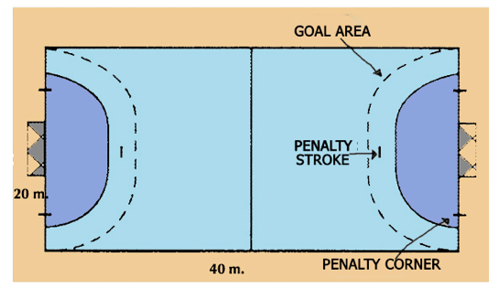
Indoor hockey is a team sport where two squads try to respect the established rules, pushing the ball with the stick and trying to score as many goals as possible.
The duration of the game will be two halves of 20 minutes and a half-time five-minute break.
Each team/squad has a maximum of 6 field players on the pitch and 6 on the bench.
You can do it with 5 players per team on a handball court.
Throughout the match players cannot let go of the stick or obstruct an opponent with their body or stick, and the ball can only be hit with the flat side of the stick. Players cannot raise the ball over their shoulder.
When a field player involuntarily commits any of these offences, they will be punished with a free push into their goal, and it will be signalled from the point of the pitch where it occurred. If a play is ruled a foul within the shooting circle, the team is sanctioned with a penalty corner where a player will take a free pass to a teammate outside the shooting circle. The field players of the other team will be in the centre line from where they will leave when the umpire signals, goalkeeper and a defence will stand inside the goal area, over the goal line.
When the offence is done on purposes within the penalty area or preventing a goal, it is punished with a penalty stroke, which is taken from 7 metres from the centre of the goal, allowing one step for momentum, and the ball may rise to a maximum height of the knee.

Slide 7
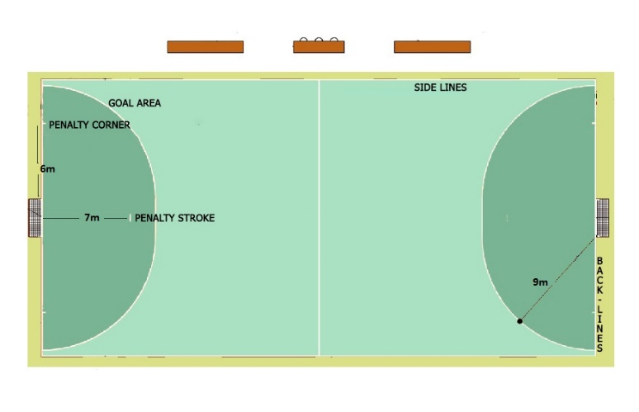
Facilities
Pitch: 40m x 20m. Two goal areas measure 9m radius and six metres from the goalposts that mark the penalty corner. Along the sides are 10 cm high boards and on which players may lean against while playing. The Penalty Stroke Line is 7m from the goal.
Ball: white and hard 165g, 22.4cm in circumference.

Slide 8
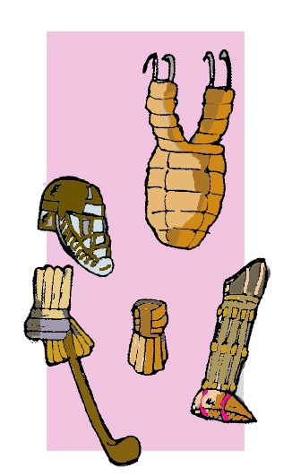
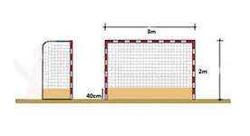
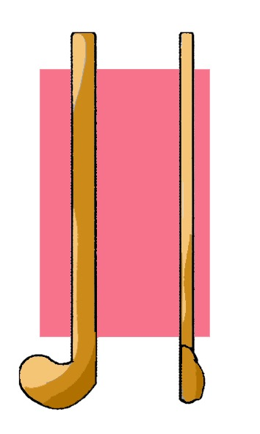
Equipment
Goal: 3m x 2m, with a base of 40cm of wood from which the net rises.
Stick: it has a handle and a head. It has a surface at the end of which one side is raised and curved and other flat. This is the part that makes contact with the ball. It has different dimensions de- pending on the height of the athlete, and may vary between 85cm and 97cm.
Goalkeeper’s Equipment: a helmet with neck and throat protection, leg guards to protect the legs and chest protectors if desired, as well as gloves. The goal- keeper is the only one that can play ball with the whole body.

Slide 9
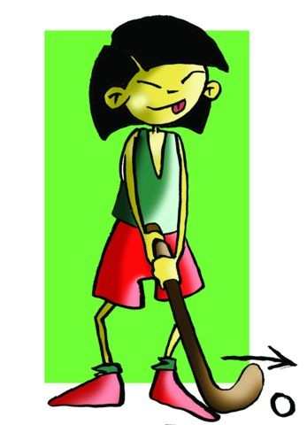
BASIC TECHNICAL-TACTICAL RESOURCES: HOCKEY
The basic hochey technical-tactical resources are similar to basketball, handbal,…
Passing and Receiving
Moves

Slide 10
BASIC TECHNICAL-TACTICAL RESOURCES: HOCKEY
Dribbling
Pushing

Slide 11
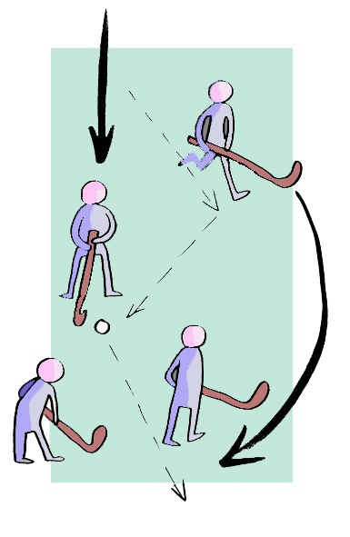
Joint Tactical Organisation
We define joint tactical organisation as the different possibilities that we have to act as a rational and organised team.
How can we distribute ourselves on the pitch taking into account the characteristics of the sport and co-ordinating team components?
Distribution on the pitch with 5 players playing on a handball court would be 2 defenders and 3 forwards (2:3) or vice versa (3:2), depending on our necessities and other equipment.

Slide 12
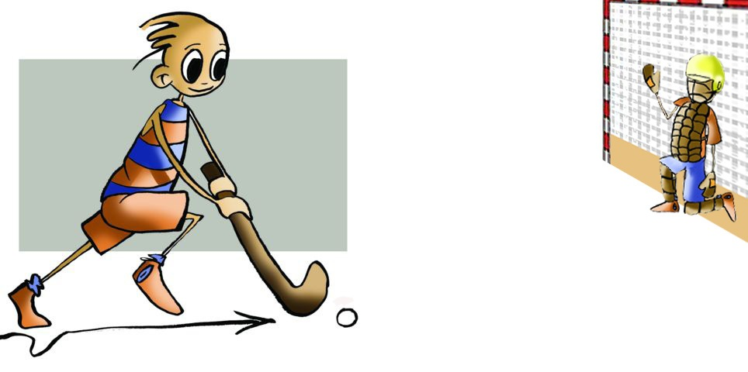
QUESTIONNAIRES AND ACTIVITIES
Write a brief summary about how to play indoor hockey.
Set out the basic tactical resources in this sport.
Describe such actions as dribbling and marking.
Discuss how to situate the field players on the pitch (handball court) and reasons.
Have you ever seen an indoor hockey match? Discuss it with a partner.
Write down in your notebook unknown vocabulary from this unit.
Check the Federation website or any sports association in your region and check for changes or modifications, if any, in its regulations.

