Slide 1
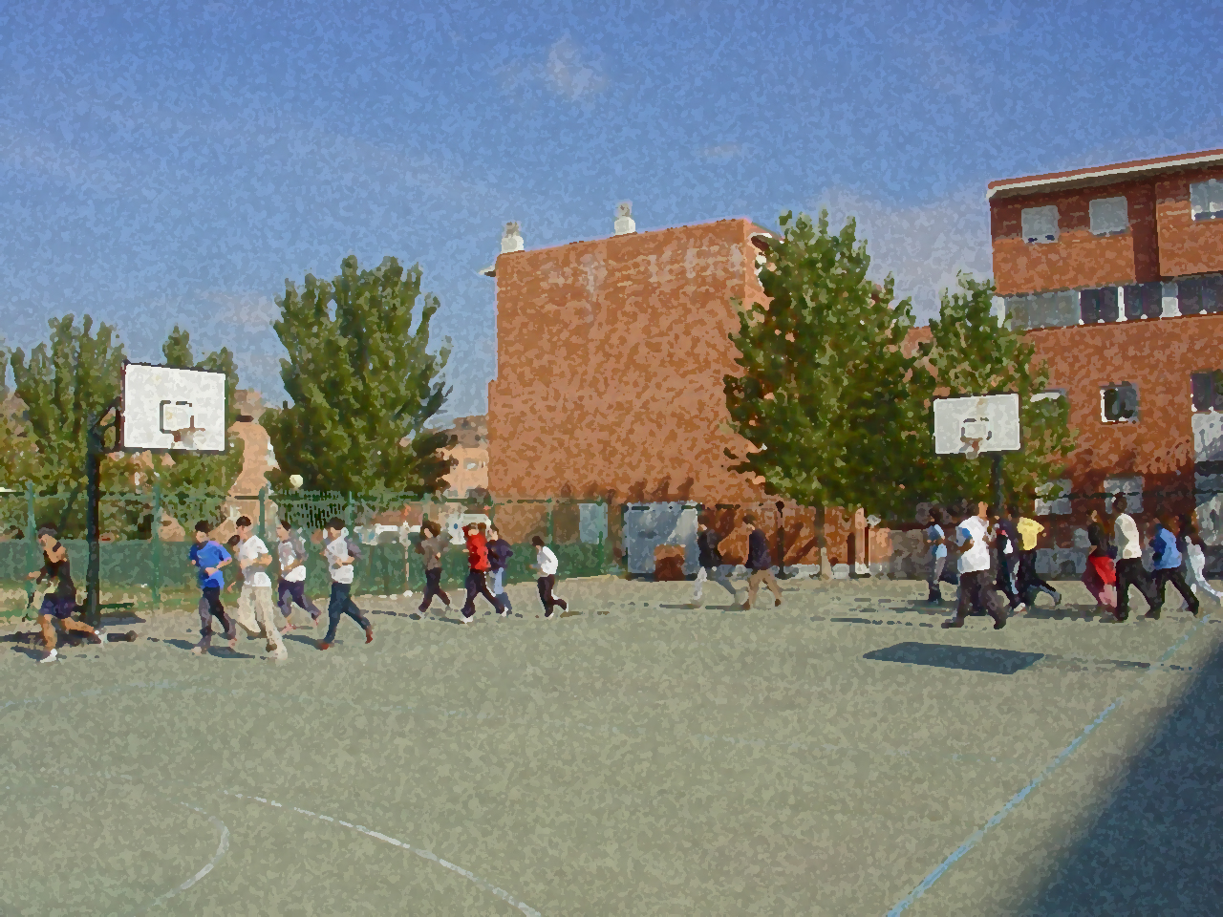
Fundamentals for Secondary School and Baccalaureate. Comprehensive and experiential learning
Physical Activity and Organic Systems

Slide 2
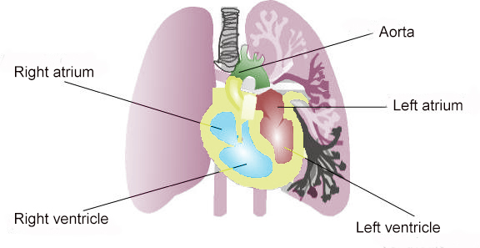
Contents
1. Objectives 2. Basic Principles of Organic Systems
Circulatory System
Respiratory System
Muscular System
Skeletal System
Nervous System
3. Basic and Fundamental Changes that Occur in
Different Systems with Continuous and Systematic
Practice of Physical Activity
4. Questionnaire and Activities

Slide 3
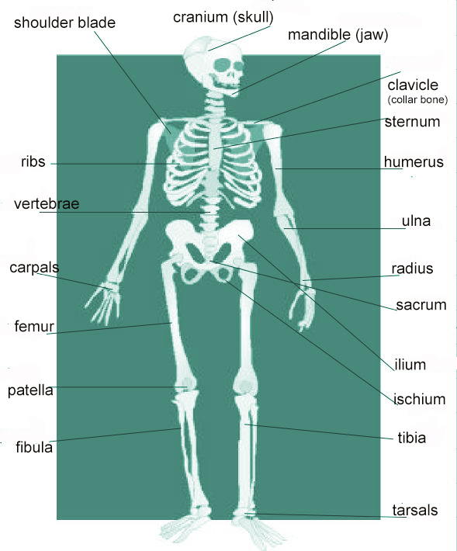
OBJECTIVES
To learn the basic components of the organ systems and their functioning, and the effects of controlled, systematic and continuous physical activity on them.
To view practical exercise as a suitable way to a healthy life.
To practise proper exercise to obtain secure benefits .

Slide 4
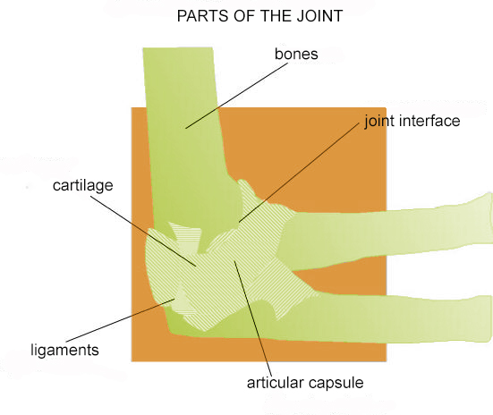
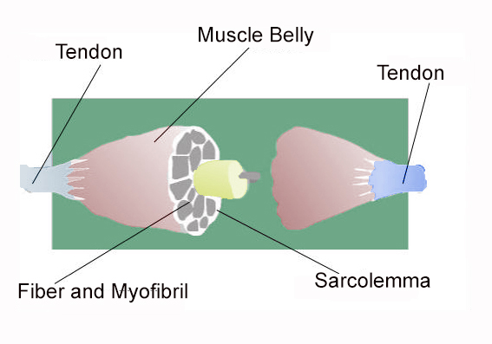
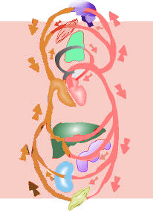
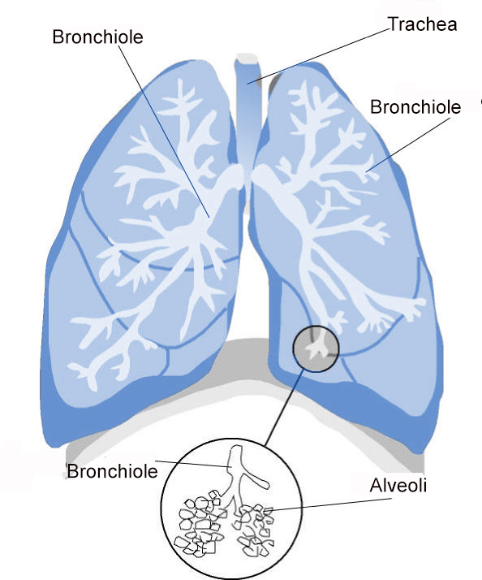
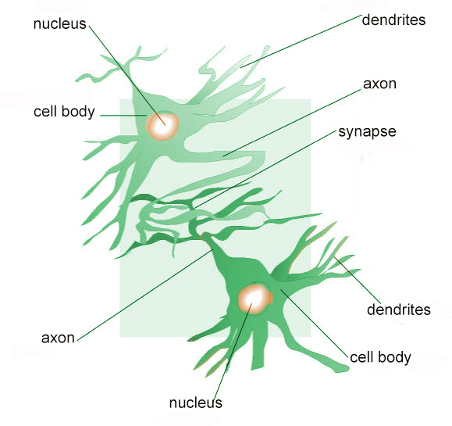
Physical Activity and Organic Systems
Muscular System
Osteoarticular System
Circulatory
System
Nervous System
Respiratory System

Slide 5
Circulatory System
In short, it can be said that the path of the blood is as follows:
from the left ventricle, blood departs via the aorta to the body, branching into many new arteries to irrigate the tissues, muscles, organs, etc.; blood passes from the arteries into the capillaries where there is an exchange of gas, O2 is shed and CO2 is absorbed, then moves through the veins; and back to the heart through the vena cava, which empties into the right atrium. As we know, the blood flows from the atrium to the ventricle, in this case the right to go through the mediation of the pulmonary artery into the lungs where it is oxygenated, returning to the heart through the pulmonary veins to the left atrium, and the process restarts.

Slide 6
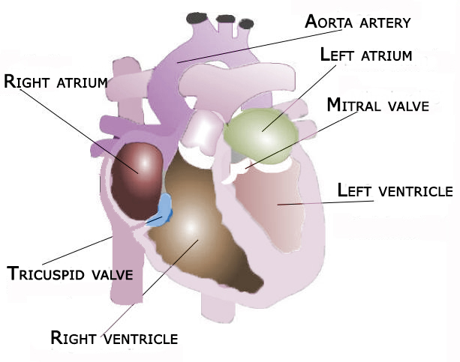
The Circulatory System during Exercise:
1. The heart chamber expands, allowing the heart to receive more blood, and consequently greater systolic volume.
2. The walls of the heart are strengthened, allowing it to push more blood at each systole.
3. The heart rate is lowered, which allows the heart to rest longer between systoles
4. The capillary network is increased and improved, which allows for better blood supply, and
5. The volume of blood is increased, such as red blood cells and haemoglobin, to carry more oxygen and nutritive substances.

Slide 7
Respiratory System
Air entering through the nose goes through the parts listed above until the alveoli. The alveoli, which are carefully irrigated by numerous very narrow capillaries, are designated for gas exchange (O2-CO2) area. This is where the blood is enriched and waste is eliminated, which is released with expiration or exhaling.
Blood rich in oxygen, recovers its direction to the heart, from where it will depart for the rest of the body.

Slide 8
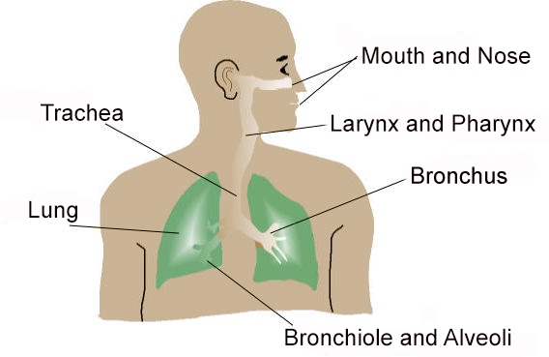
The respiratory system during exercise
Improvement in perfusion using greater number of alveoli in each breath.
Improved capacity increasing inspiratory air entering the lungs.
Increased dissemination of oxygen throughout the body, reducing residual volume.
4. Enhanced vital capacity, which is very important in sports performance recoveries.

Slide 9
Muscular System
Muscle structure
The muscle:
Muscles are striated fibres. Its functions involve the movement of the bones and maintaining body posture. They are elastic and extensible and return to their original state after stretching. We have approximately 696 muscles.
The Muscular System during Exercise:
The volume of the muscles involved increases.
Mobility in the muscle groups due to increased irrigation is improved.
The tendons, ligaments and muscle structure are strengthened, and
Contraction of muscle fibres is facilitated.

Slide 10
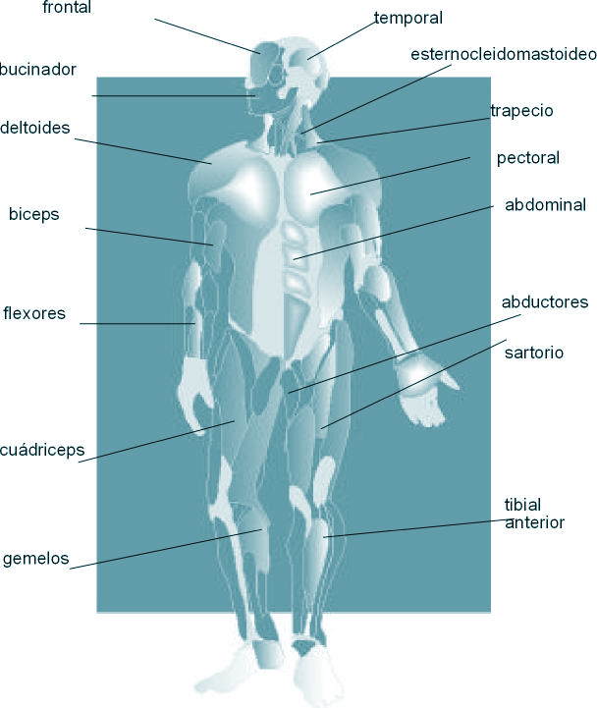
Anterior human body muscles

Slide 11
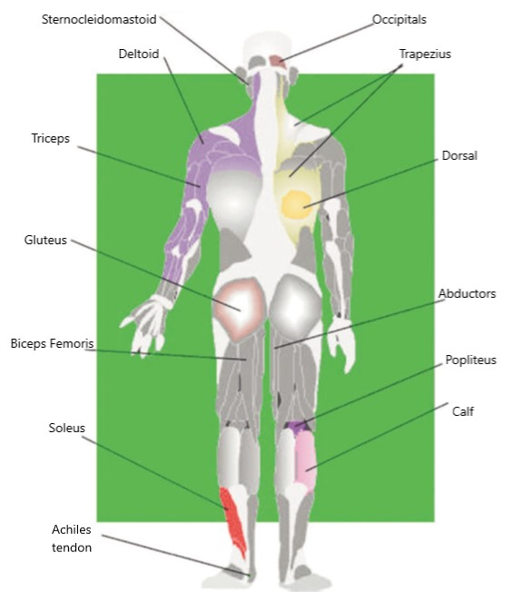
Posterior human body muscles

Slide 12
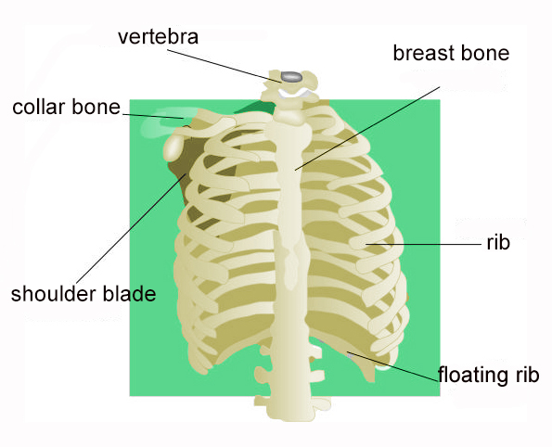
Osteoarticular System
It is a system comprising the skeleton, which is the hard part of the body, and joints, with its possibility of movement. The human skeleton consists of 206 bones at birth; some of which are found in cartilaginous phase.
Bone Types
The bones that make up the skeleton are classified into physical aspects:
long bones (generally thin and long some examples are femur, clavicle, tibia),
short bones (small, short and solid some examples are the bones in the wrist or ankle),
flat bones (some examples are the shoulder blades, knee cap), and
irregular bones (such classic examples are vertebrae of spine or vertebral column).

Slide 13
Articular System
Bones are those which move.
Joint interface is the area where the bones are attached.
Articular cartilage is the coating on the interfaces of the bones, so wearing does not occur as a result of friction.
Articular capsule is the connective tissue surrounding the entire joint.There are two layers: an outer fibrous membrane and an inner synovial membrane containing a liquid that bears its name.
Ligaments connect the bones and reinforce the joint capsule.

Slide 14
Some bones
of the human body

Slide 15
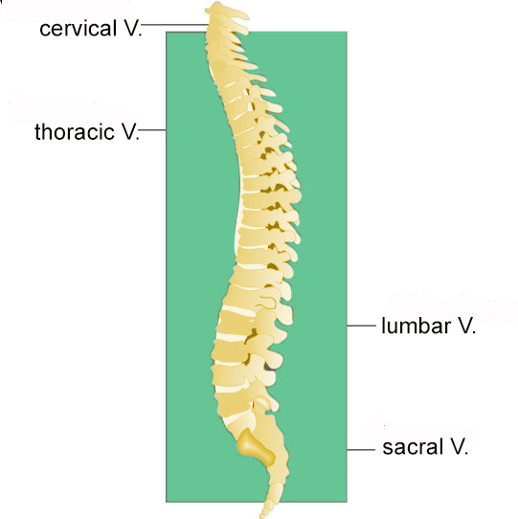
The Osteoarticular System during Exercise:
Facilitate joint activity and consequently their mobility, promote capillarisation of articular cartilage and deceleration of the onset of joint disease such as arthritis.
Prevent osteoporosis by enriching osteoblasts (bone forming cells).
Impede bone fractures, and
Improve absorption of calcium and potassium, which strengthen the skeletal structure.

Slide 16
Nervous System
This system is the most important in regard to control and communications by the body. It is in charge of receiving different information from outside and relaying it to a central nervous system. Once analysed there, these stimuli are sent to the various organs for the most appropriate response. The information from the exterior is received by the sensory receptors, transported by neurons and responses are produced by the effectors.
The structural and functional unit of the nervous system is the neuron. It may be sensory if nerve impulses are transmitted from the receptor to the nerve centre and motor if it is sent from the nerve centre to the effector.

Slide 17
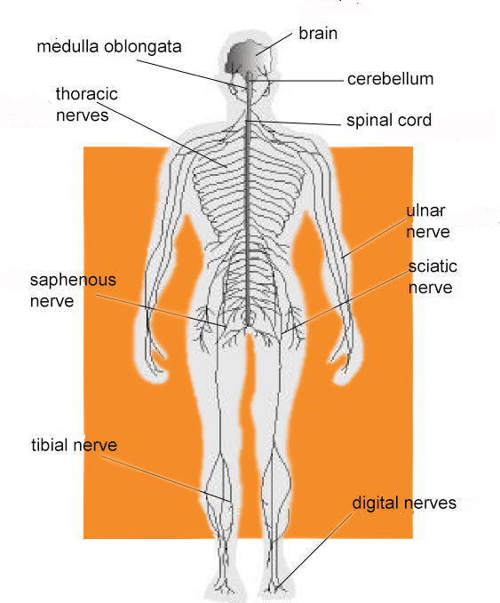
Composition of the Nervous System
Central Nervous System (CNS). The place where the integration of stimuli and responses originate. The following are components of the CNS: brain, and spinal cord.
Peripheral Nervous System (PNS). It connects the nerve centres with receptors and effectors. It consists essentially of nerves.
Automatic Nervous System. It connects the nerve centres with the spinal cord, but its role is to innervate the viscera, etc.
The Nervous System during Exercise:
Improve the neural connection providing quicker responses.
Analyse perception much more effectively.
Strengthen movements as muscle orders improve, and
Increase substantially the fine and gross motor co-ordination.

Slide 18
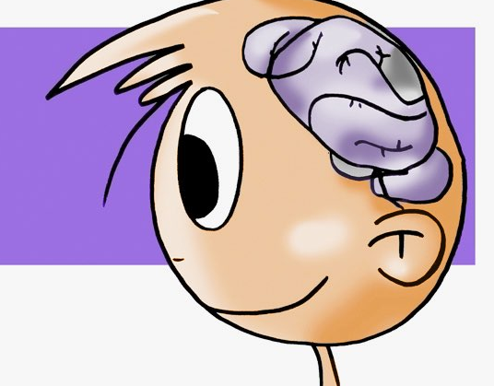
Function of the Peripheral Nervous System
Transmission of nerve impulses is performed by neurons as we know, and in this regard this system performs basically three types of movements:
Reflex. This type of movement is done unconsciously, that is, upon receiving the stimulus it responds. Its execution cannot be modified or stopped. Reflex centres are mainly in the spinal cord, the brain does not intervene.
There are many cases of reflex movements, for example, the plantar reflex, muscle reaction to bring warmth to the skin, the patellar or knee-jerk reflex, etc.
Voluntary. Conscious movement is controlled and co-ordinated by a number of specific muscles, according to motor planning and organisation. The nerve impulse, picked up by receptors or sense organs, is sent to the spinal cord and then to the cerebral cortex, where it becomes conscious. Here the response by pyramidal beams is conducted to the bone, where facing the effector (muscle), the resulting movement is made.
Automatic. It is the produced after many repetitions. At first, it is a voluntary movement which becomes automatic after being repeated, i.e., a very co-ordinated and controlled movement, which sometimes emerges without the intervention of consciousness or attention.

Slide 19
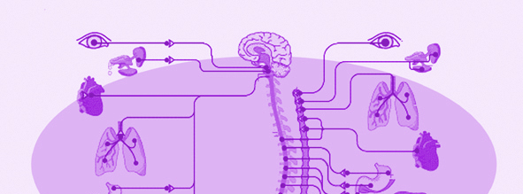
QUESTIONNAIRE AND ACTIVITIES
1. Briefly describe how the circulatory system functions.
2. Briefly describe how the respiratory system functions.
3. How does the circulatory system react when we exercise?
4. What is your maximum heart rate?
5. Identify the respiratory symptoms experienced with strenuous exercise.
6. What is the function of the agonist muscle?
7. Do you know what flight-or-fight response is about?
8. Write down in your notebook unknown vocabulary from this unit.

