Slide 1
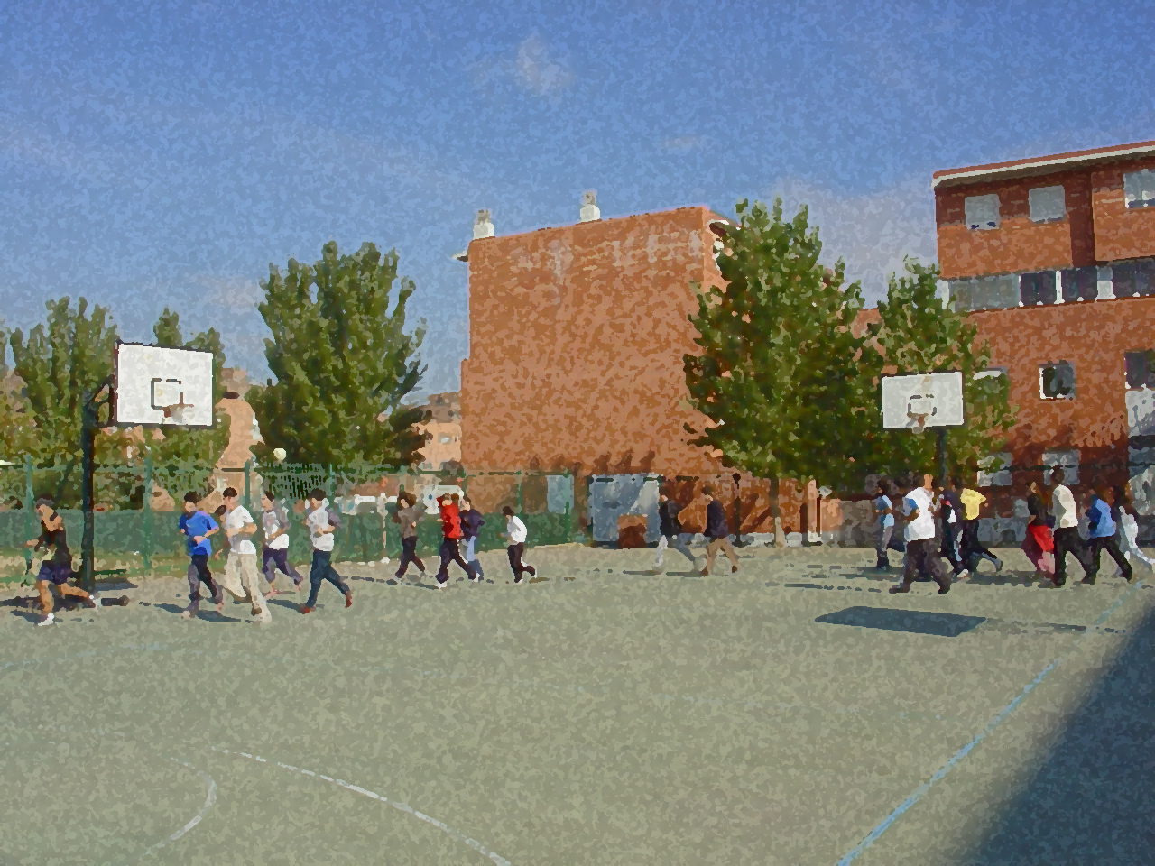

Fundamentals for Secondary School and Baccalaureate. Comprehensive and experiential learning
Physical Activity and Nutrition

Slide 2
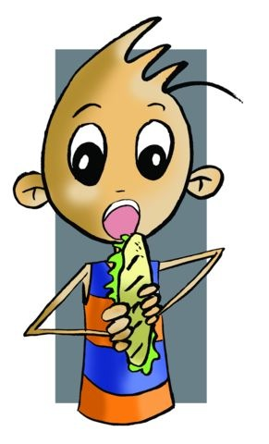
Physical Activity and Nutrition
Objectives
A Brief History
Principles in Nutrition
Nutrition and Exercise
Eating Disorders
A Balanced Diet
Questionnaire and Activities

Slide 3
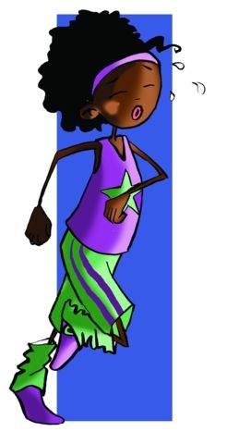
OBJECTIVES
To appreciate your body accepting it as it is, and not give in to stereotyping.
- To understand the elements and factors that are part of a balanced diet, preparing a sample diet and implementing it under the supervision of an expert.

Slide 4
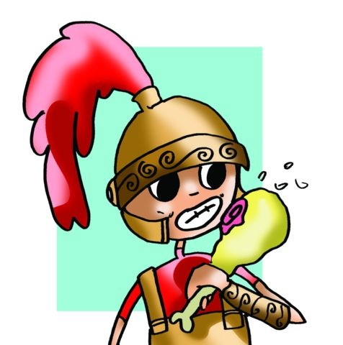
A BRIEF HISTORY
Food, in the beginning, was something linked to survival; mankind depended on hunting and fishing. Later, humans began to cultivate land and became farmers, which meant they stopped wandering from one place to another. They became sedentary, and stayed in fertile regions such as riverbanks, where they were guaranteed, by their own labour, their primary food production.
In ancient Egypt food went hand in hand with religious and funeral practices because, according to their beliefs, they had to be fed even after death.
By contrast, the Romans became true artists in eating and drinking. Food became something pleasant, even creating gods to justify it..
The Roman Empire fell and the barbarians, initially established culinary traditions like raw meat and fermented milk.
Charlemagne or Charles the Great equated food with health, and severely punished excesses in eating and drinking.
The Medieval period was characterized by pestilence and famine that ravaged unchecked and led to great malnutrition and death throughout Europe.

Slide 5
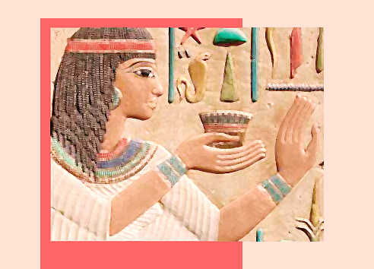
A BRIEF HISTORY
The appearance in the XVII and XVIII century of new foods, such as potatoes, spices, tea, coffee, corn, etc., elevated food to world class in European countries. However.
Nutrition as a science appeared in the early nineteenth century, along with studies of Calorimetry and the introduction of novel ideas regarding proteins. Discussion erupted about the essential principles of life.
Today nutrition paradoxically involves two significant problems:
There is still malnutrition in parts of the world.
There exists a pathology of either deficient or abusive eating with consequences such as obesity, hypertension and heart attacks among others.

Slide 6
PRINCIPLES IN NUTRITION
The food we eat every day is responsible for providing different nutrients to our body after suffering multiple internal transformations i.e. metabolism. Furthermore, they provide enough energy to maintain all our bodily functions perfectly.

Slide 7
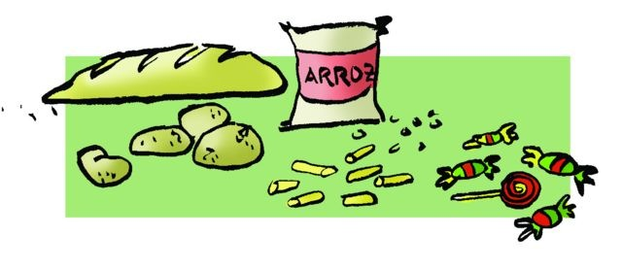
The following are the nutrients that are implicit in our food:
- It is the immediate quintessential principle from a calorific point of view, in a balanced diet 60% of calories should come from them (1g of carbohydrate contributes four calories, i.e., 1 lump of sugar is about 20 cal).
- Starches or sugars are also known as carbohydrates. They are divided into several groups, and the most important are the monosaccharides (glucose), disaccharides (sucrose) and polysaccharides (starch and cellulose). Emergency energy reserves are stored in the liver and muscles as glycogen. The source of carbohydrates is in bread, potatoes, rice, beans, pasta and sweets in general.
- A diet that overindulges in this nutrient can cause tooth decay, obesity or diabetes.
Carbohydrates

Slide 8
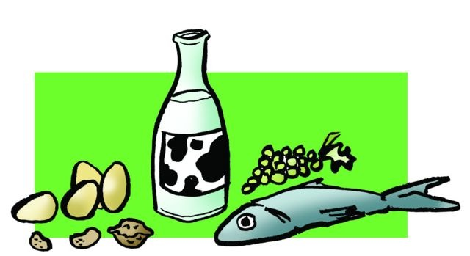
They provide 15% of the calories in a balanced diet, and yet it is the most important food in a balanced diet.
Its main component is amino acids of the 20 existing, eight are called essential and are obtained through food (1 gr. of proteins provides 4 cal).
No organ in the body has a reservoir of special proteins.
They have two different origins, vegetable or animal.
The deficiency of these nutrients is one of the world's ills today, leading to malnutrition.
Proteins

Slide 9
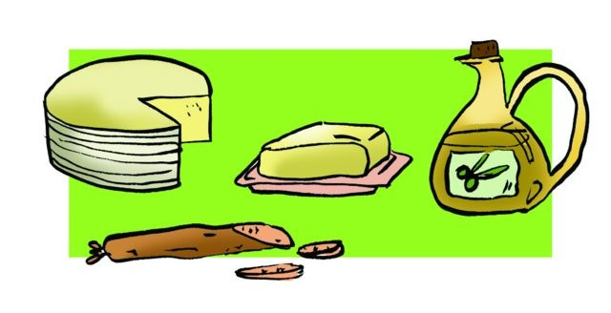
Lipids
Fat intake is essential, and in a balanced diet provides 25% of the calories.
Consumption is vital because they play a dual role:
  caloric (1 gr. of lipid or fat provides 9 cal), and the transport of fatty acid and fat soluble vitamins.
Fats can be of animal origin of which lard, bacon and butter are the most consumed, or plant origin, whose representative is olive oil.
The use of fats is almost complete and makes up, along with glucose, the most important source of energy storage.
Ketogenic diets have harmful effects on the health of individuals, which may result in obesity, increased cholesterol or the occurrence of atherosclerosis.

Slide 10
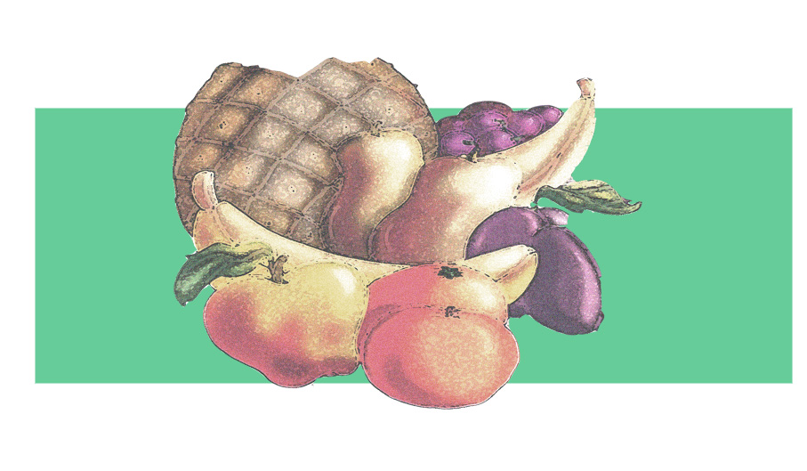
VITAMINS
HIDROSOLUBLE | INVOLVED IN... | FOUND IN... | THEIR LACK CAN...
Vitamin C | ... Bone formation | ... Fruits and salads | ... Cause bleeding gums, or slow healing
Vitamin B-1 or Thiamine | ... The transformation of carbohydrates and fats into energy | ... Pulses, vegetables, liver and meat | ... Cause tiredness, apathy, etc.
Vitamin B-12 | ... The formation of red blood cells and the prop- er functioning of the nervous system | ... Dairy products, vegetables, meat, fish and egg yolk | ... Cause anaemia, general fatigue
LIPOSOLUBLE | INVOLVED IN... | FOUND IN... | THEIR LACK CAN...
Vitamin A | ... The growth mechanism of vision | ... Egg yolks, butter, carrot, pepper and milk | ... Cause dry skin
Vitamin D | Regulate metabolism ... | ... Olive oil, butter and cod | ... Cause decreased muscle tone, tooth decay
Vitamin E | ... Muscle activity | ... Wheat germ, lettuce and vegetable oils | ... Cause weakness in muscle spasm
Vitamin K | ... Clotting mechanisms | ... Cabbage, spinach and tomato | ... Cause anaemia, or difficulties in coagulation
Vitamins
Vitamins are found in food, and although they provide no energy, they are vital to our body. To study them, they are divided into two groups: water soluble or hydrosoluble and fat soluble or liposolubIe.

Slide 11
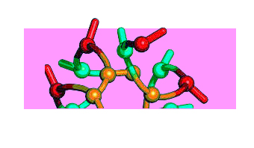
Minerals
Mineral elements fulfil the function in growth.
Calcium: It forms the basis of the human skeleton and teeth. Calcium has regulatory functions e.g. clotting and muscle contraction.
Iron: We have 4 to 5 gr. of this mineral in our body. It is involved in the peristaltic movements of the intestines, an element of haemoglobin, and you can get them from pulses, nuts, shellfish, etc. Its deficiency can cause anaemia, constipation, etc.
Iodine: It is essential for the production of the hormone produced by the thyroid gland.

Slide 12
Minerales
Let us talk about minerals that perform such important functions as the above: trace minerals. Deficiency is rare because any diet will provide the small amount we need.
Sodium, Potassium, Copper, Cobalt, Zinc and Magnesium: Primarily they are vital components in the formation of bone tissue as well as key ingredients in chlorophyll, which is found in plant-based elements. Our bodies have 25 gr. of magnesium, and a lack of magnesium, although rare, may cause weak bones.

Slide 13
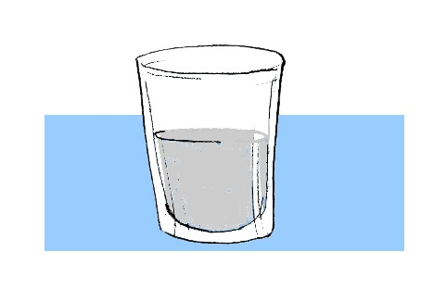
Water
Water is essential for life and the body. It is due to water that all chemical reactions are produced, as well as transport dissolved nutrients and wastes. It constitutes 70% of body weight.

Slide 14
NUTRITION AND EXERCISE
Nutrients in an athlete's diet:
Calories: While for those who everyday consume between 1,600 and 3,000 cal per day, depending on the degree of activity of the each person and their weight, the athlete needs 400-2000 extra calories per day.
Proteins: On the consumption of protein we can point two prevailing trends. One is the mistaken belief that their consumption is inevitably involved in improving muscle contraction, and the other, with a scientific base, is known for their involvement in the development of muscle tissue, which is why their intake during growth is fundamental.
Fats: A certain amount is needed to give necessary flavour to your diet. Their lack or excess consumption can be detrimental to the athlete for the loss or gain of body weight as there is a direct effect on their involvement in performance.
Carbohydrates: The influence of a diet rich in carbohydrates on exercise, is based on very solid foundations, since scientific research supports a diet rich in carbohydrates provides, prior to prolonged exercise, an increase in endurance.

Slide 15
Vitamins. In truth nothing has been proven on the question of vitamin supplement for the athlete.
Minerals: It does not justify its additional incorporation in food.
Water. When exercise is prolonged, such as in medium intensity efforts, more than 30 minutes or performed in high temperatures, intake should be 250cc before exercise, as it will facilitate the maintenance of body temperature and slow dehydration. During this type of taxing effort and under similar conditions, it is advisable to drink fluids every 15 minutes or so to delay or even prevent any type of pathology caused by the heat.
Beware of excessive fluid loss, replenish water and it will be enough. In strenuous activities surpassing one hour, it is recommended that the athlete drink isotonic beverages. Above 5% of our body weight loss can cause important illnesses and disorders or sometimes result in death.

Slide 16
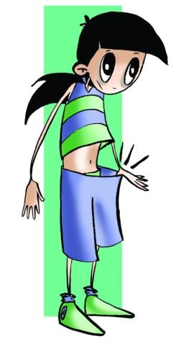
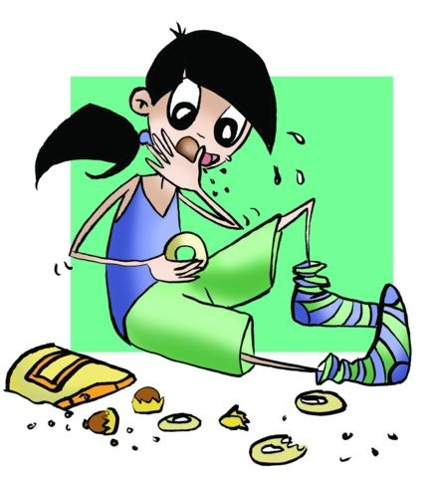
EATING DISORDERS
Anorexia Nervosa
In this challenging and demanding environment, young people and adolescents are becoming absorbed by a dangerous pressure; fashion, incessant information on dieting, magazines, being in shape (bigorexia), the perfect bodies, disregard for overweight people, etc., lead to certain anxieties that push youths to take such dangerous risks as dramatic weight loss, and fear of gaining weight, which are the first symptoms of anorexia nervosa.
Bulimia Nervosa
Their weight ranges between five and ten kilos more or five less; they can vomit after their binges, but not always, not to point of obesity, despite this their appearance can be healthy at all times. An important feature of bulimia is that patients eat alone and in secret even waiting for family or friends to leave, in record time, they may ingest a lot of calories.

Slide 17
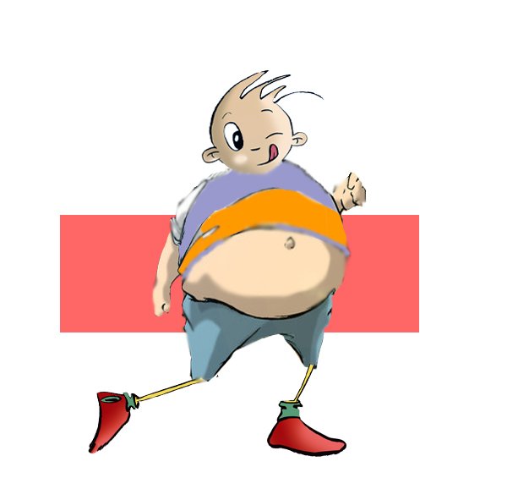
Overweight and Obesity
Excess weight and obesity are disorders and sicknesses that originate fundamentally as a result of an inadequate diet combined with a sedentary lifestyle. In Spain obesity is growing
among children at an alarming rate. 18% of Spanish people between the ages of 2 and 17 are overweight, with girls being the most affected, and 9% rate of obesity among boys.
However, recent studies show that this is stabilising. Both are factors in other illnesses that are equally if not more dangerous and can have dangerous effects such as cardiovascular or circulatory alterations, hypertension, and according to experts one out of every seven people ends up becoming diabetic. Due to this we should monitor our weight and our diet with an eye specifically on nutritional and metabolic (endocrinology) problems.

Slide 18
A BALANCED DIET
It is hard to know what to do or what not to do. In principle it is reasonable to restore balance and remember that everything we eat is useful, since it could be categorised more or less into any of the three essentials: proteins (15%), carbohydrates (60%) and fat (20-25%).
The diet must also be ingested in average quantities, diverse and several times. It must be taken in at least four to five meals during the day and in which each performs its role. The first one, breakfast, should never be forgotten. It should be composed of the basic nutrients: proteins (e.g. milk, cheese, eggs, yoghurt, etc.), carbohydrates (e.g. biscuits, bread, jam, chocolate, etc.), fats (e.g. butter, margarine, etc.), vitamins (found in fruits) and provided with few aromatic essences as they constitute the first calories of the day (25% of total).

Slide 19

QUESTIONNAIRE AND ACTIVITIES
What are the problems in nutrition today?
How many nutritional principles do you know?
What proportion of protein should be in your diet?
What types of lipids do you know?
What can cause insufficient iodine in the body?
When we exercise, does it increase our caloric need?
7. Do you know the term "fast-food” and “slow-food"? What about the Mediterranean diet? Find out about them and reach your conclusions.
8. Can you make some recommendations that relate to food before exercise?
9. What do you mean by a “balanced diet?”
10. Examine your diet and prepare a weekly list of available sources of energy. Check with your classmates to check the results, contrast his food plan and make adjustments to it to improve it.
11. Write down in your notebook unknown vocabulary from this unit.

