Slide 1
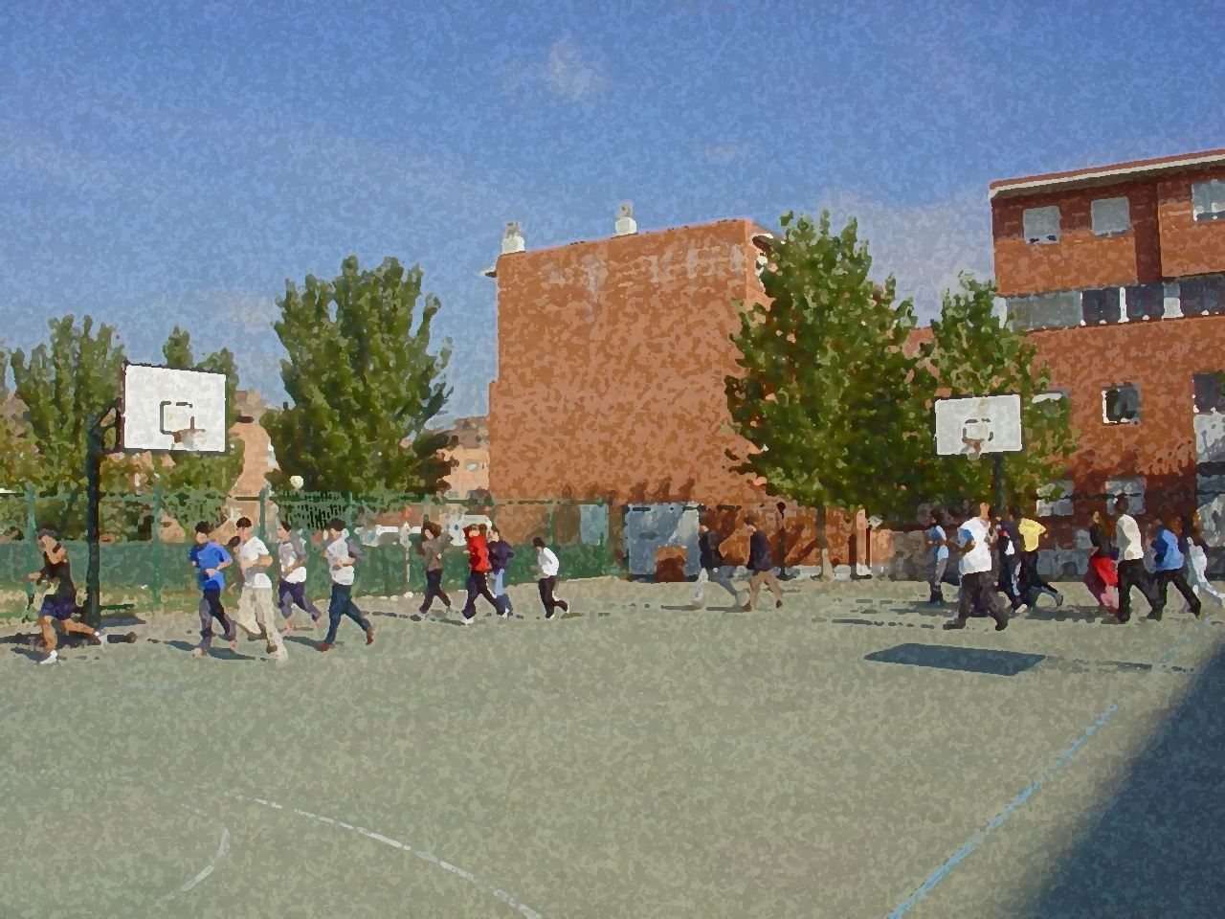
Fundamentals for Secondary School and Baccalaureate. Comprehensive and experiential learning
5-a-side football

Slide 2
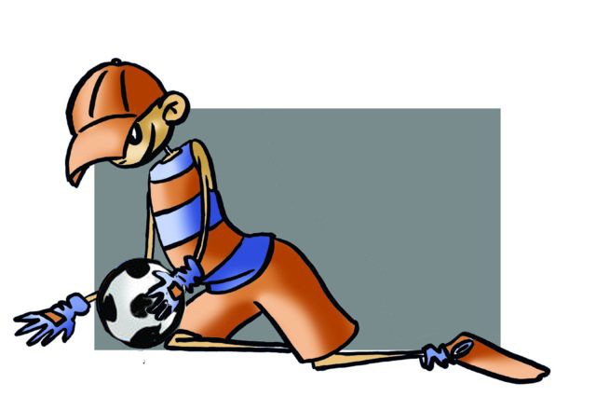
Contents
Objectives
Regulations, Facilities and Equipment
Basic Technical-Tactical Resources
Basic Exercises
Questionnaire and Activities

Slide 3
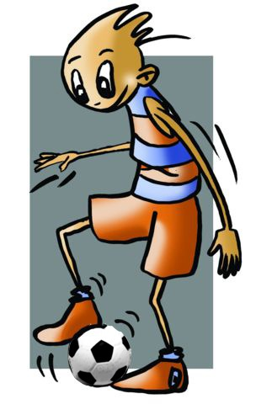
Objectives
To learn the basic technical and tactical and legal regulations of 5-a-side football.
To understand their application in real game situations.
To collaborate with your peers in the development and implementation of activities.

Slide 4
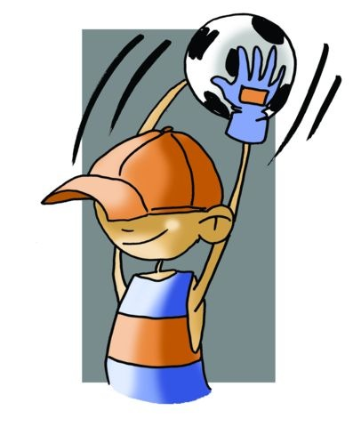
History
Indoor football was born in Brazil in 1930 through YMCA, which were responsible for popularizing football in America. However, Europe did not start taking interest until the 60s. In the UK, it is called 5-a-side football.
It arose because professional football teams, due to weather issues and lack of facilities, quite often had to find somewhere to train and started using the few covered spaces they had at that time to practise their technique and have training matches and so as not to stop.
As the years went by the sport gained momentum, more facilities were created, more activities and more free time was used to practise ... this is when 5-a-side football becomes a new sport, i.e., it passes from mere entertainment to acquire status as a sport.
The Liga Nacional de Fútbol Sala (Spanish Indoor Football League) in Spain was founded on 27 June 1989.

Slide 5
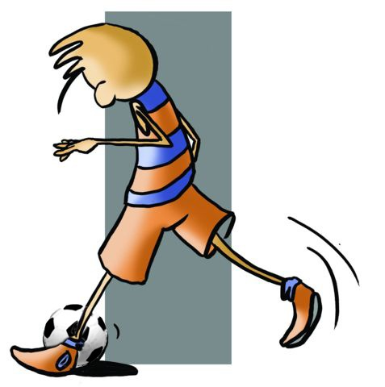
Basic Regulations
5-a-side football, like other sports, aims to get the ball into the opposing goal to score points. Two teams of five play against each other on a court of 40 x 20 metres.
The basic fouls are as follows:
Kicking or attempting to kick an opponent.
Tackling an opponent or trying to make him fall.
Jumping or falling on an opponent.
Dangerous play.
Holding an opponent to prevent him/her from performing an action.
Pushing an opponent with his hands or arms.
Playing the ball or hitting it with their hands or arms, unless either inadvertently or as the goalie.

Slide 6
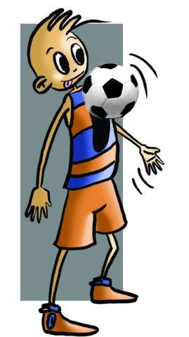
Schematically, the basic rules are as follows:
The goal is 6 metres wide.
The penalty spot is located 6 metres from goal and double penalty 10m.
The central line is a circle 6m in diameter.
12 players may be registered on the team sheet but the game is played 5 against 5, of which 4 are players and one is the goalkeeper or goalie, but everyone can play goalie and vice versa.
The duration of the game is two halves of 20 minutes with a 10-minute half-time interval. Each time the game stops so does the clock.
The match starts in the first and second half, as after a goal with a kick-off from the centre of the centre circle.
The ball is considered to have left the field of play when it completely crosses the sideline or end line, rolling or airborne.
To score the ball must completely cross the goal line between the goalposts.
The throw-ins and corners are done with both hands above his head.
The goalie throws the ball with his/her hand.

Slide 7
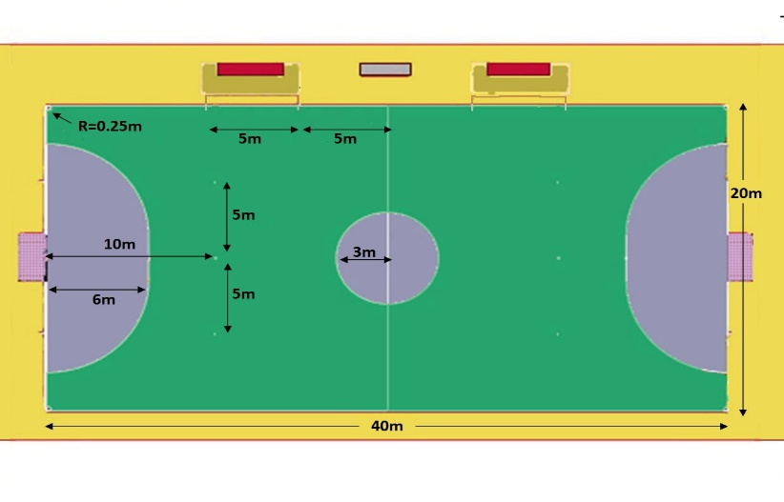
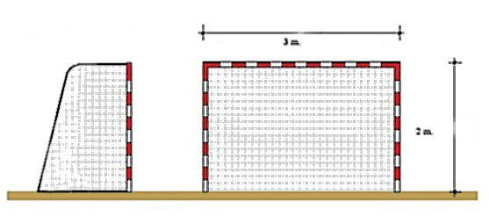
Facilities
- Smooth and obstacle-free rectangular court. The floor may be concrete, asphalt, parquet, artificial turf, etc..
- Two goals measuring 3 x 2 metres.
- Balls, which must be between 61 and 63cm in circumference and weigh between 410 and 430 grams.

Slide 8
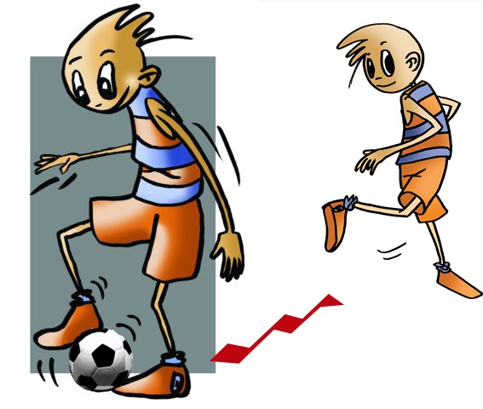
BASIC TECHNICAL-TACTICAL RESOURCES: 5-A-SIDE FOOTBALL
The basic technical and tactical 5-a-side football resources are the same as handball and basketball. In this sport, the strategic principles can be implemented with an important difference; passes and receptions, dribbling and running are done with the feet and by kicking.

Slide 9
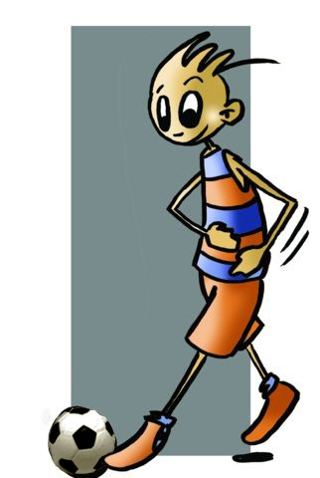
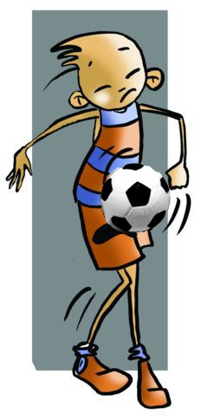
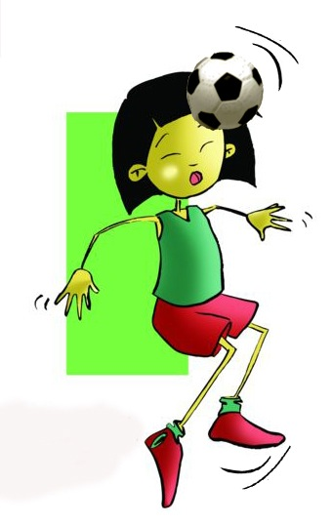
BASIC TECHNICAL-TACTICAL RESOURCES: 5-A-SIDE FOOTBALL
Types of Passes
Receiving and Controlling the Ball
Moving with the Ball
thigh
foot
head
chest

Slide 10
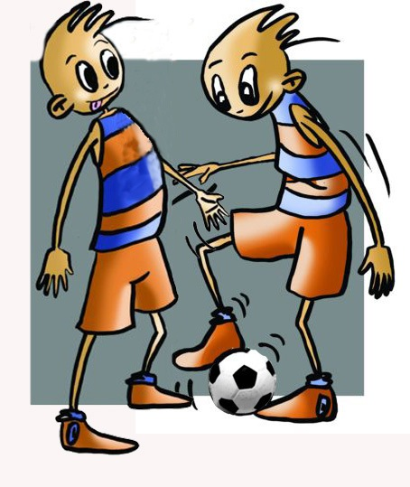
BASIC TECHNICAL-TACTICAL RESOURCES: 5-A-SIDE FOOTBALL
Feinting
Losing the Marker
Shots on Goal
Marking
They are the movements made by the player in possession of the ball to deceive the opponent and overwhelm him
These are the actions of a player without the ball as he approaches his opponent in order to prevent him from receiving the ball or from making a move with his team.
They are actions that are aimed at scoring a goal. It is similar to passes but usually done with more power and direction.
It is the action of moving away from the opponent.

Slide 11
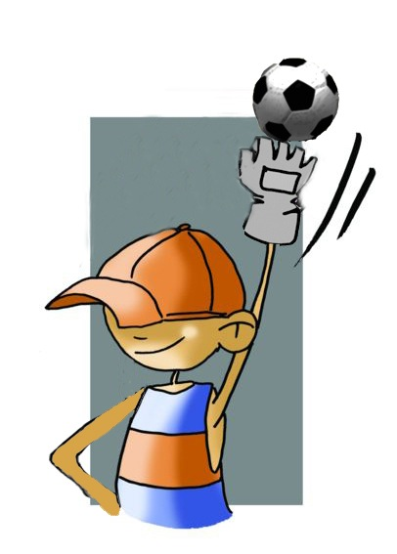
BASIC TECHNICAL-TACTICAL RESOURCES: 5-A-SIDE FOOTBALL
Goalkeeper Options
block or stop
coming out
clearing the ball

Slide 12
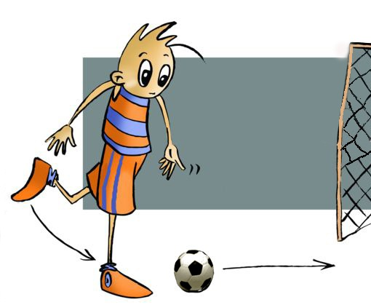
Joint Tactical Organisation
How can we distribute ourselves in the field taking into account the characteristics of the sport and co-ordinate the members of the team?
The first thing you have to do is distribute yourselves on the pitch with areas of personal responsibility, each player taking charge a portion of the pitch and all the balls that land there, as well as individual action that enables the game to continue.
We define joint tactical organisation as the different possibilities that we have to act as a clear thinking and organised team.
DEFENCE
ATTACK
man-to-man marking
zonal marking
2 - 2
1-2-1

Slide 13
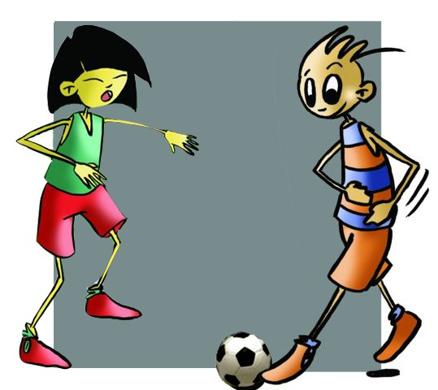
QUESTIONNAIRE AND ACTIVITIES
Where did 5-a-side football originate?
Describe with which body parts you can control the ball.
Discuss what the parts of the foot are with which you can move the ball.
What geometric figures form the tactical systems most used in football?
Watch a football match and identify major mistakes you have seen in maintaining possession of the ball.
Write down in your notebook unknown vocabulary from this unit.
Check the Federation website or any sports association in your region and check for changes or modifications, if any, in its regulations.

