Slide 1
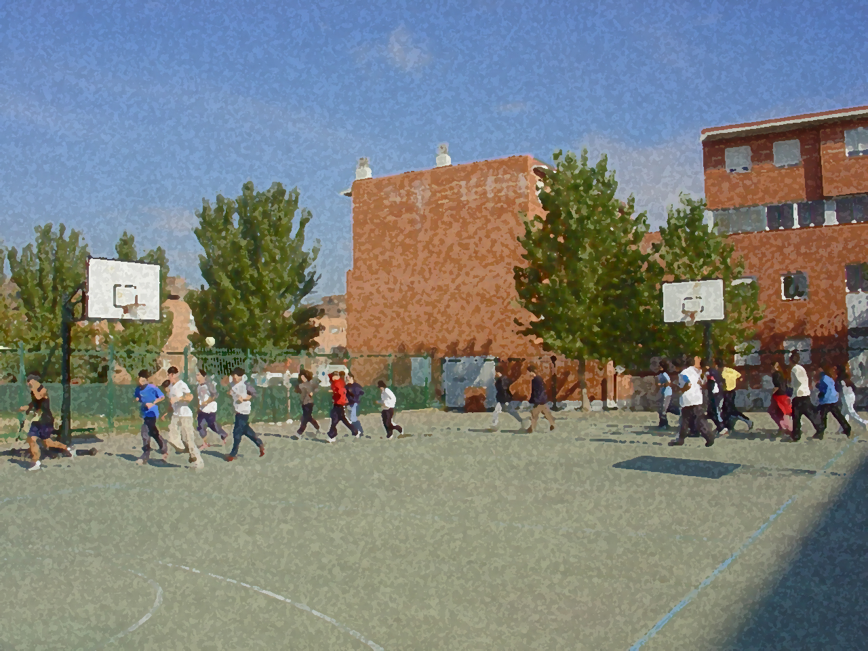
Fundamentals for Secondary School and Baccalaureate. Comprehensive and experiential learning
Outdoor Recreation

Slide 2
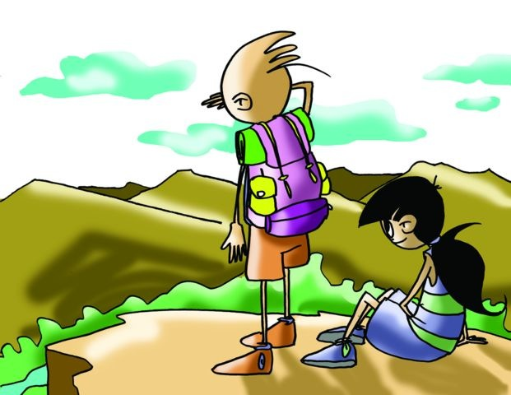
Outdoor Recreation
Objectives
List of Outdoor Activities
Hiking
Climbing
Orienteering: Tracking
Questionnaire and Activities
Nature, like it or not, is inherent in human beings, gradually filling most people’s leisure time, especially those living in large urban centres. They increasingly want to escape from the rush, tension and pollution, and replace it with peace, relaxation and health as only nature can provide.

Slide 3
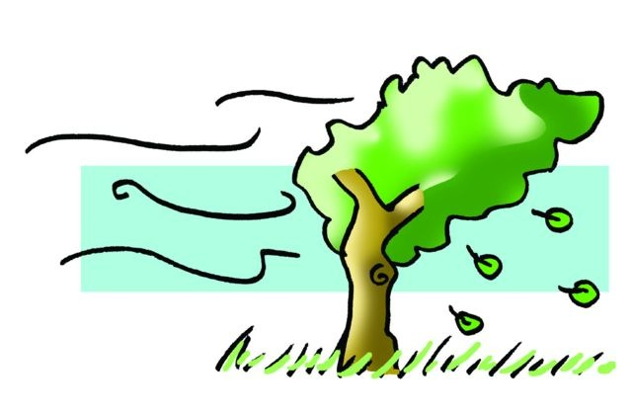
Objectives
To discover, enjoy and respect a different environment from everyday surroundings.
To enrich friendship and teamwork, especially to value each of the tasks performed. Nature gives us an extraordinary knowledge as we look closely into their special characteristics that, in the long run, enrich us and enhance our cultural knowledge.
To develop the overall physical fitness, predisposing toward reaching an objective and toward the realisation of making one’s intelligence, intuition and common sense work. Furthermore, it most notably promotes health as it affects, by its attributes, the respiratory and circulatory systems, favouring them dramatically.

Slide 4
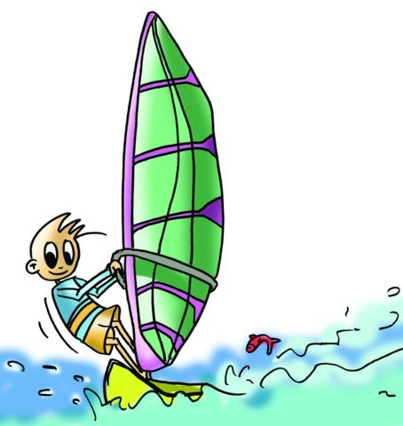
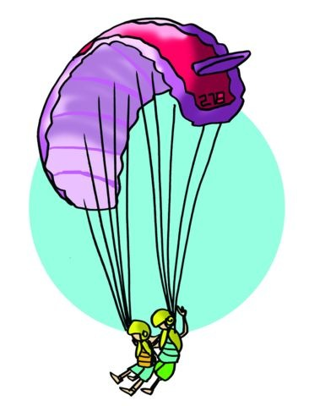
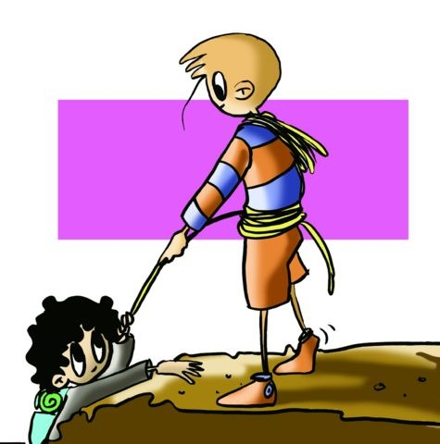
LIST OF OUTDOOR ACTIVITIES
Too numerous to relate the activities (sports) that can develop in a natural environment; they are countless and varied and may have a competitive nature or simply respond to the needs for leisure. For its organisation and clarification we will present some that are regulated by the environment in which they operate emphasizing the impact (low, medium or high) that each has on the environment.
LAND | WATER | AIR
Hiking, Climbing Orienteering, Alpine Skiing, Heli-Skiing, Snowboarding, Caving, Mountaineering, Cycling, etc | Skiing, Rowing, Sailing, Canyoning, Rafting, Hydrospeeding, Diving, Windsurfing, Funboarding, Long-Distance Swimming, etc. | Bungee Jumping, Paragliding, Gliding, Skydiving, Hang Gliding, Ballooning, Kite Flying, etc.

Slide 5
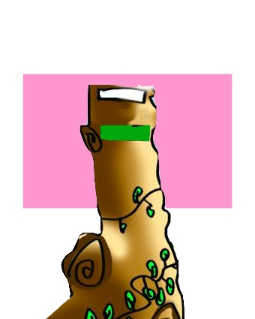
HIKING
Trekking (walking or hiking) up the mountain or in the countryside has become popular because it is easy, fun and a healthy form of exercise. You can follow marked trails, such as long paths of more than 50km (GR), marked with stripes of white and red paint so we have for example the legendary GR-1 Ampurdán to Finisterre, short paths (PR) of 10 and 50km,…, or go off on your own.
In any case we must take into account some aspects without being too technical that can help us undertake this activity safely and enjoyably:
Love of Nature
Fitness
Site Selection
Equipment
Climatology
Food

Slide 6
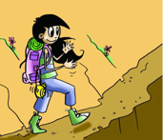
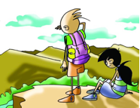
Love of Nature
n order to engage in an activity in a natural environment you should love, know and respect nature. It may reveal itself to be difficult, hard, enjoyable and beautiful, and once experienced, overcome and relished, they are also moments that greatly enrich you.
Fitness
Our physical condition should be adequate for the level demanded of the trail we follow, we must never venture to take a route that overexerts us from the physical point of view; it can be very dangerous

Slide 7
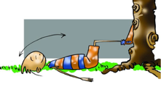
Site Selection
We must know or at least study guide books or maps, but we can also use the figure of the expert who will accompany us throughout the trail to give us their knowledge and provide security measures.
In any case it is advisable to tell friends or family where we are going, the dates and the day of arrival, we should always go in groups, never alone. It is also important to know the terrain and be informed as to what weather to expect.

Slide 8
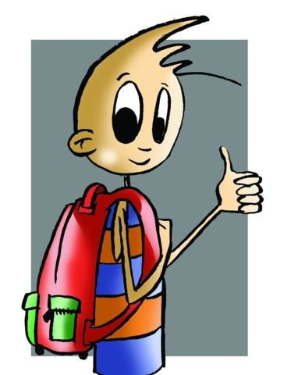
Equipment
Although the fact of going trekking for more than a day or doing it at a certain time of year may change, in these cases we will have to bring food and appropriate clothing. There are elements in the equipment that is common to any type of activity:
A good backpack to store everything, and leaves the hands free and the load perfectly distributed throughout the body.
Warm clothing is advisable even in summer.
Clothes that keep us dry and facilitate transpiration and insulates.
It is a good idea to take a raincoat and plastic and paper.
Our boots should comfortably accommodate our feet.
Thick socks or stockings must have the fewest possible seams.
A water bottle.
A hat.
Gloves and/or sunglasses
A small first aid kit with bandages, tape, round tip scissors, disinfectant, sunscreen and a thick elastic band..

Slide 9
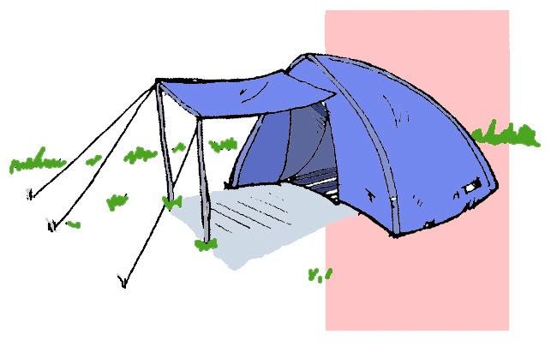
Equipment
If the excursion is for more than one day, you will have to adapt to its time span and bring necessary clothes and food. We must also secure the camping site if we do not, then a shelter is recommended. The use of a tent, either in the mountains, countryside or beach is considered the norm in this type of activity. In this regard you should know that free camping is not allowed in Spanish national territory and that for this there are large sites (camp grounds) where, upon payment, your stay is ensured during the days required.

Slide 10
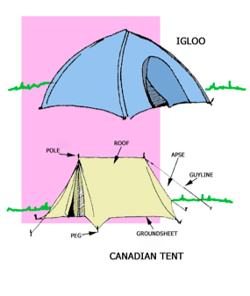
The tent. The shapes are varied: Canadian and igloo for any activities in the outdoors. Some tents have the option of installing a rainfly over the tent wall to reinforce protection especially against the wind and rain, called double-wall. Some tents provide shelter at the entrance with a piece of the same material called awning.
Safety in Camping. For proper and safe installation of a tent we must consider a few things:
Appropriate choice of the place. Sheltered from winds, slightly inclined,...
Correct procedure in setting up the tent. Do not tighten the guylines too tautly, nail pegs are to be angled inward, the door should never be oriented to the North or facing prevailing winds in the area.
Keep the surrounding area that is used clean.
Take care of living things as they are part of the natural cycle.

Slide 11
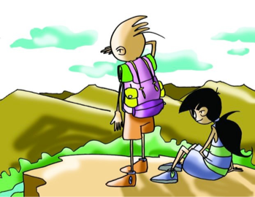
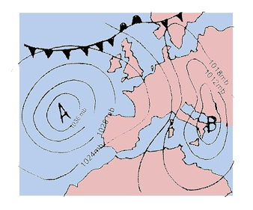
Climatology

Slide 12
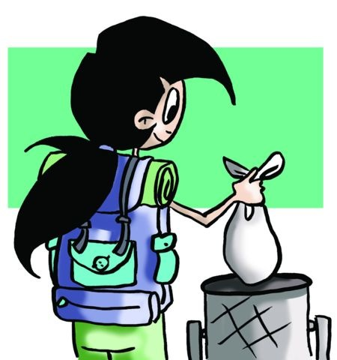
Food
The food we take must not be heavy neither for transport nor digestion. If it is a day trip, a sandwich and then some chocolate, candy or nuts will give us enough energy. If it is more than one day, consume the food that needs to be cooked (soups, purees, pasta, milk, etc.) early on, and have the sausage, cheese, nuts, candy, cookies, chocolate, some bread and water at a later stage.
The rubbish you generate during the days of trekking must be stored in bags and thrown into the containers meant for this purpose. Never leave it behind.

Slide 13
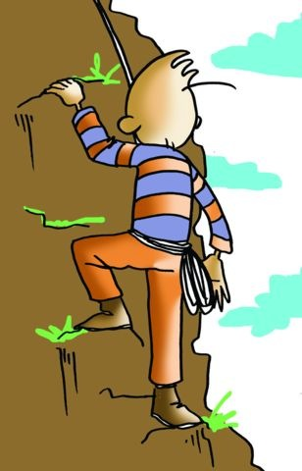
CLIMBING
Basic Ideas about the Sport of Climbing
Climbing is a specialty within alpinism that is beautiful and spectacular and lets us enjoy the mountain up close. The body moves up against her walls and our hands and feet caress the rock in suggestive complicity. Each step is vital and our concentration should be great, each support is a lifeline. Safety in this sport is very high, and to ensure it equipment is shared, because it is a team sport, as one ascends the other tracks their movements

Slide 14
Types of climbing
We can set different types of climbing and each with its own technique and unusual equipment:
In keeping with the equipment:
artificial climbing requires diverse protective gear,
free climbing requires safety equipment,
sport climbing is currently climbing on prepared routes of varying difficulty. In rock and wall climbing (artificial walls that mimic natural wall on which artificial grips are fastened to reproduce the different steps of the mountain wall), and
indoor climbing is scaling artificial walls of varying difficulty..

Slide 15
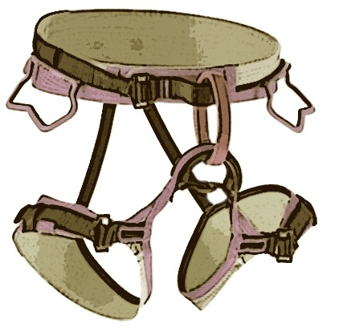
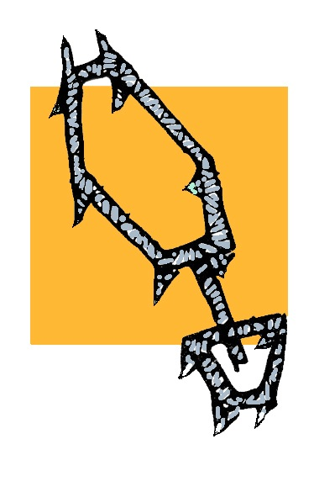
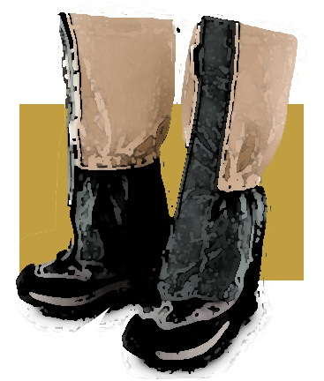
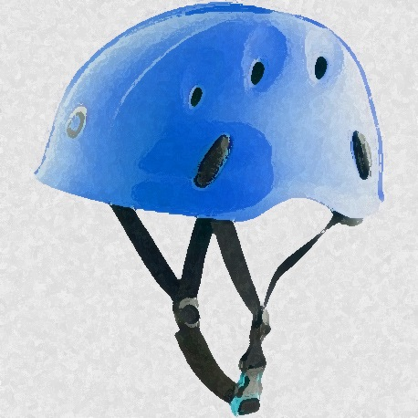
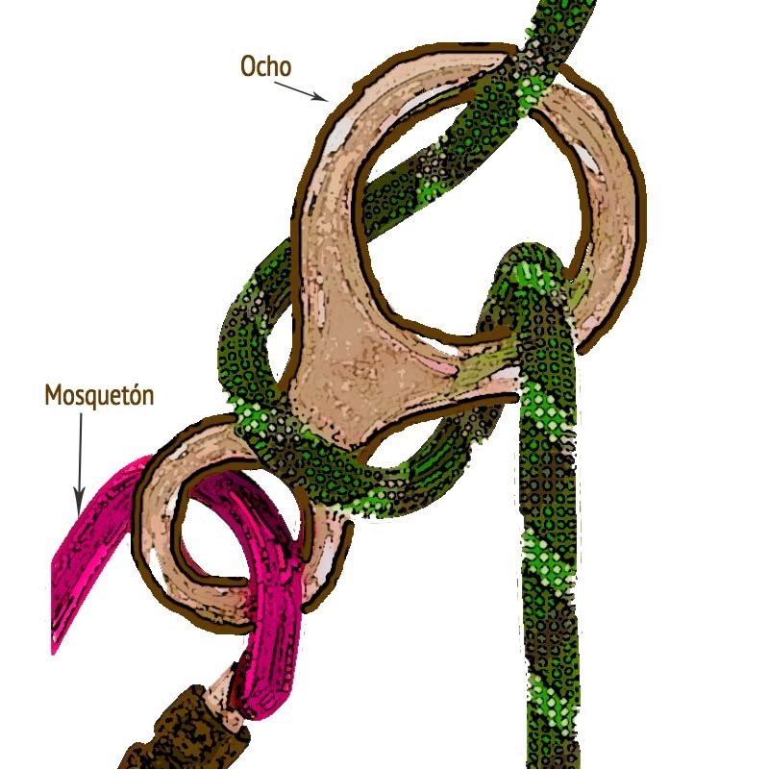
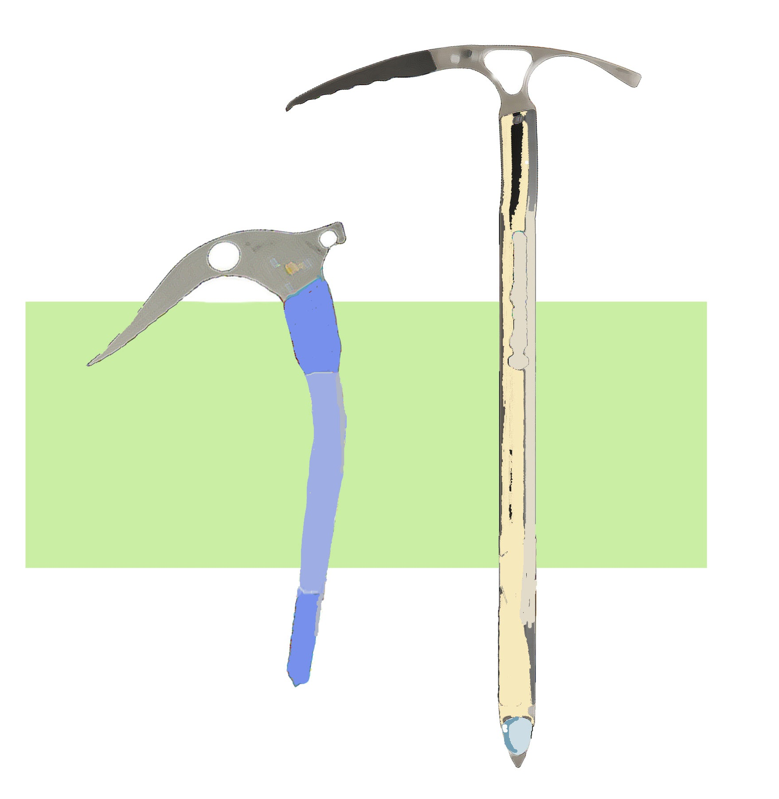
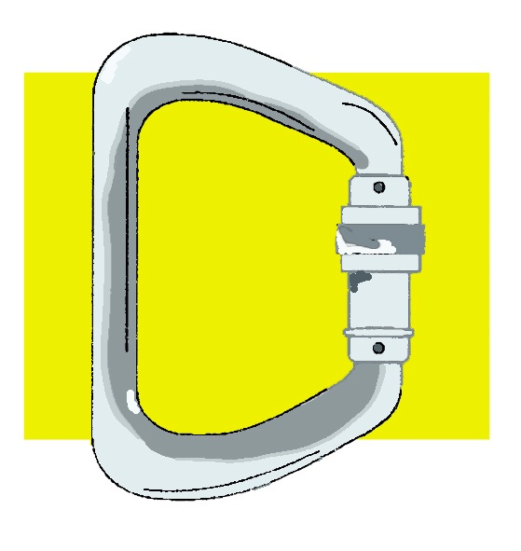
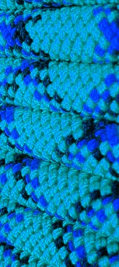
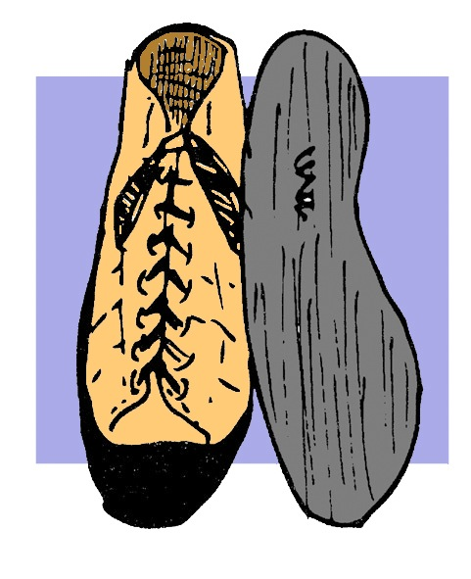
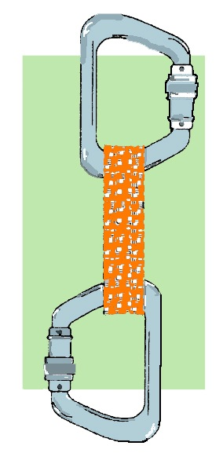
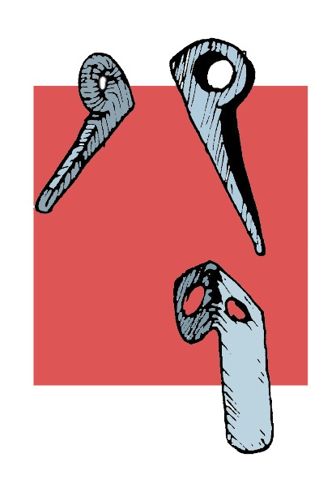
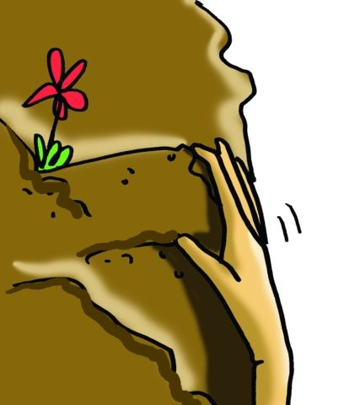
Equipment in climbing, here are some of them:
The rope
Harness
Carabiner
Nut/Chockstone
Piton/Pin/Peg
Ascender and Descender
Quickdraw
Axe
Crampons
Ice Screw
Footwear
Helmet
Goggles
Gaiters

Slide 16
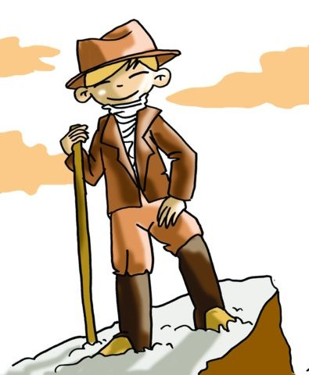
TRACKING
From an academic point of view tracking is a means, a way to get to an appointed place following some tracks, or a method to find the message or hidden treasure.
In tracking, there are two types in following a trail. One is natural trails also called sign tracking, i.e., the tracks that have been left in the field or forest for us to find. Another called trail-O (trail orienteering), also called precision orienteering, known by all and strategically placed to find a message or coincide at a given point on a road.

Slide 17
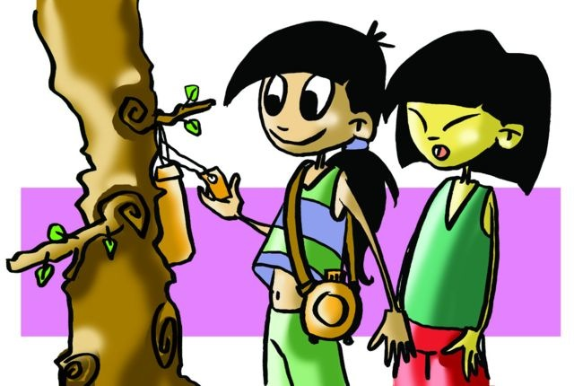
Requirements:
1. Signs are placed on the right of the road. 2. The distance between the signs should not exceed 50m. 3. They must be hidden, but visible at close range. 4. They must not be bigger than 15cm. 5. If using sign models, participants must be acquainted with them.
6. Everything must comply with regulations.

Slide 18
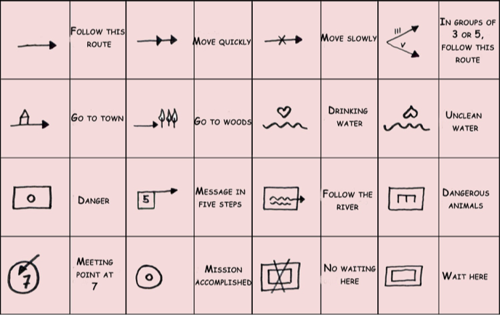
Examples of conventional tracking signs and trail orienteering are as follows:

Slide 19
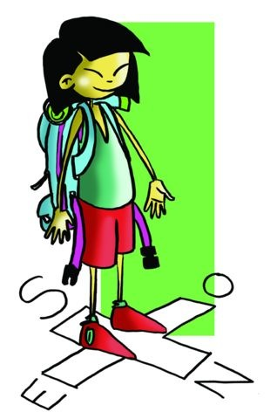
The Sport of Orienteering
What is the sport of orienteering?
At first, nature was responsible for providing sufficient signs to mark the paths going and coming back: the sun, moon, stars. Later, man would signpost the land in order to mark roads. Then came maps and charts and compasses, and so navigation became a little bit more technical, up to the present day, where GPS (global positioning system) is able to find a place or person the world with an error of approximately 10-15m.

Slide 20
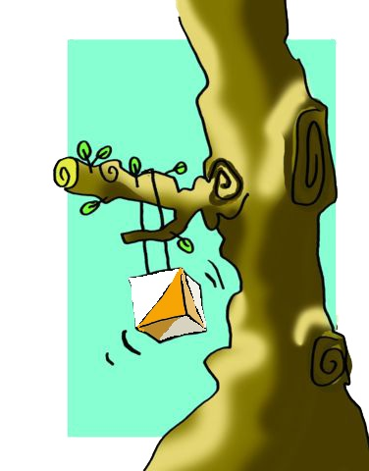
But what does the sport of orienteering involve?
The objective of the event is to follow a route either chosen by the participants or prearranged, and reach the finish line located at a specific distance. Throughout this route there are several control points, marked by flags or markers, by which the athlete with a map or control description sheet of the route and control points, a compass and a control card must pass.

Slide 21
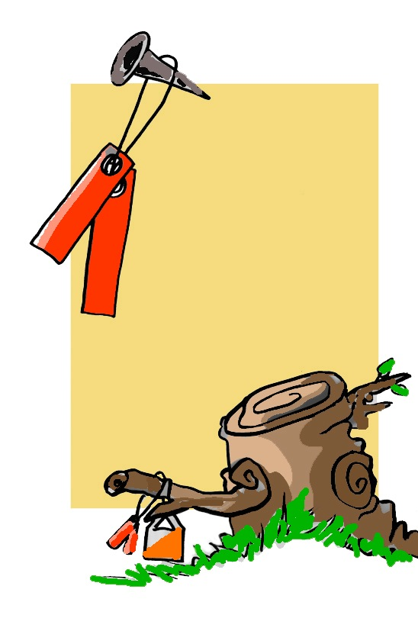
The start of an event is staggered, i.e., athletes come out in intervals, sequenced by a clock at the starting line (every x minutes). Everyone heads to the first control, taking any way they want and when they get to a control point, they punch their control card or write the control code of the control point in the corresponding box. The ticket/needle puncher, which has the purpose of proving the arrival at control points, marks the card by perforating it. Control points have different punch patterns.

Slide 22
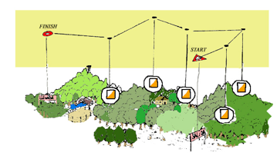
The athlete will search for the fastest and most suitable route between control points. He/she will have finished the race once he/she has crossed the finish line with the time of arrival annotated, and handed in his/her control card, which contains all the markings from the various control point punchers as well as the starting time.
The winner of an orienteering race is one who has correctly completed the control card with the punchers found at each control point. In case of a tie, the time spent in the race is the criteria that will determine the final classification.

Slide 23
The Equipment for Orienteering
Maps. The scale being 1:15,000 and 1:20,000
The symbols and conventional signs
The compass. It consists of a transparent and smooth plate where the direction of travel arrow is used to determine paths, a small magnifying glass to read maps and a scale or more at its edges
The control card should be marked at each control point.
Sports clothing should be comfortable and appropriate to the activity that is to be tackled.

Slide 24
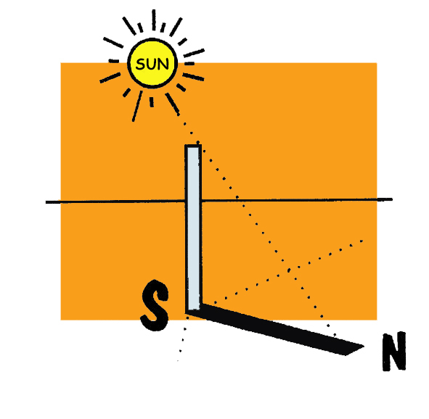
Other Modes of Orienteering
"a sense of direction" sometimes occurs when supplied by details that nature itself constantly provides. It will help us in all the activities we face in this environment that is both spectacular and dangerous at the same time.
We can be guided by the following:
The Stars
In navigating by the stars we must consider whether it is to be performed during the day or at night
During the Day. In this case it is the sun that will help us in navigating, but it always depends on certain factors:
We know that the sun rises in the east (around 6 am), that at 12 it is in the south and around 6 pm it sets in the west. Knowing this we can know at any moment the cardinal point where the sun is, and consequently our position.

Slide 25
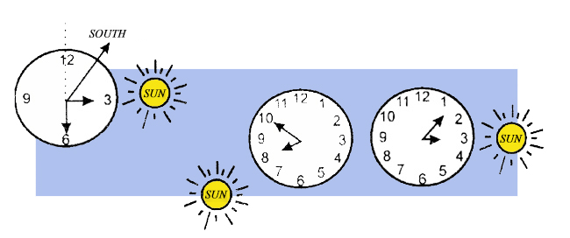
– Determining one ́s location is easy using a watch and the sun. Since we know where south is at all times, the procedure is simple:
a) Place the watch with the dial facing up and in a horizontal position. b) Point the hour hand to where the sun is.
c) From the centre of the watch, draw a line so that it passes through the 12o’clock mark.
d) Then draw a line bisecting the angle between the hour hand and a line drawn from the centre at 12 (the smaller angle will serve).
e) The bisector will indicate where south is.

Slide 26
At Night.
In this case we will use the moon and stars as guides.
In the case of the moon, it is important to
know its current position in its cycle or the
phase it is entering. It should be noted that as
the days pass, the complete lunar cycle
progressively lags behind calendar months:
- Full moon: at 6 pm in the east; at 12 pm in the south; at 6 in the morning in the west.
- First Quarter: at sunset in the south; at midnight in the west; it does not shine at dawn.
- Third Quarter: it does not shine at sunset; at midnight in the east; at dawn in the south.

Slide 27
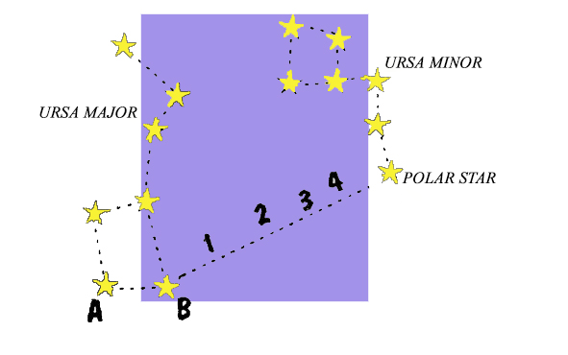
In the case of stars, the Polar Star always points north. To locate it, a constellation called the Big Dipper or Ursa Major must be found first. Observe the distance between its two lowest stars, multiply that distance by four and move to the right, and you will find a small but bright star, called the North/ Polar Star, part of another constellation called the Little Dipper or Ursa Minor.

Slide 28
By Signs
When there are no precise instruments, and it is cloudy, we can make use of nature itself or of the man-made constructions to determine, with relative accuracy, the direction of the cardinal points.
Natural.
- Trees: in the part of the trunk facing north, the bark is rougher or has moss.
Stumps: they are felled trees. Where we see that the growth rings are offset to one side, this points north.
Other elements: snow like ice tends to disappear earlier in the south-facing slopes.

Slide 29
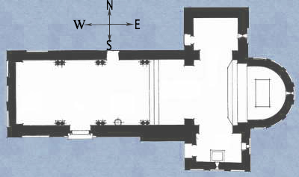
Man-Made
Wall: its northern side is wetter.
Church: the shape of a Latin cross, usually arranged so that the apse of the central nave faces the east.
Mosque: its main facade always looks east.
Weather Vane: although its mission is to determine wind direction, there is a cross with cardinal points at its base.
Windmill: moss covering its walls or presence of higher humidity of it is indicative of north-south direction.

Slide 30
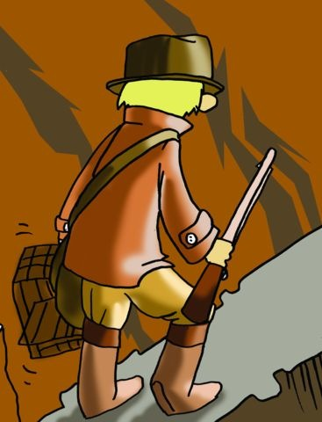
QUESTIONNAIR E AND ACTIVITIES
Do you know the parts of a tent? Would you be able to pitch one?
List the foods you would bring along to the mountain on a three-day hike in summer.
List some safety equipment that is used in climbing.
What is a climbing wall?
Practise making the most basic knots
What should an orienteering map contain?
Map out your classroom and draw a cross where your desk is.
Could you find your bearings inside a church?

