Slide 1
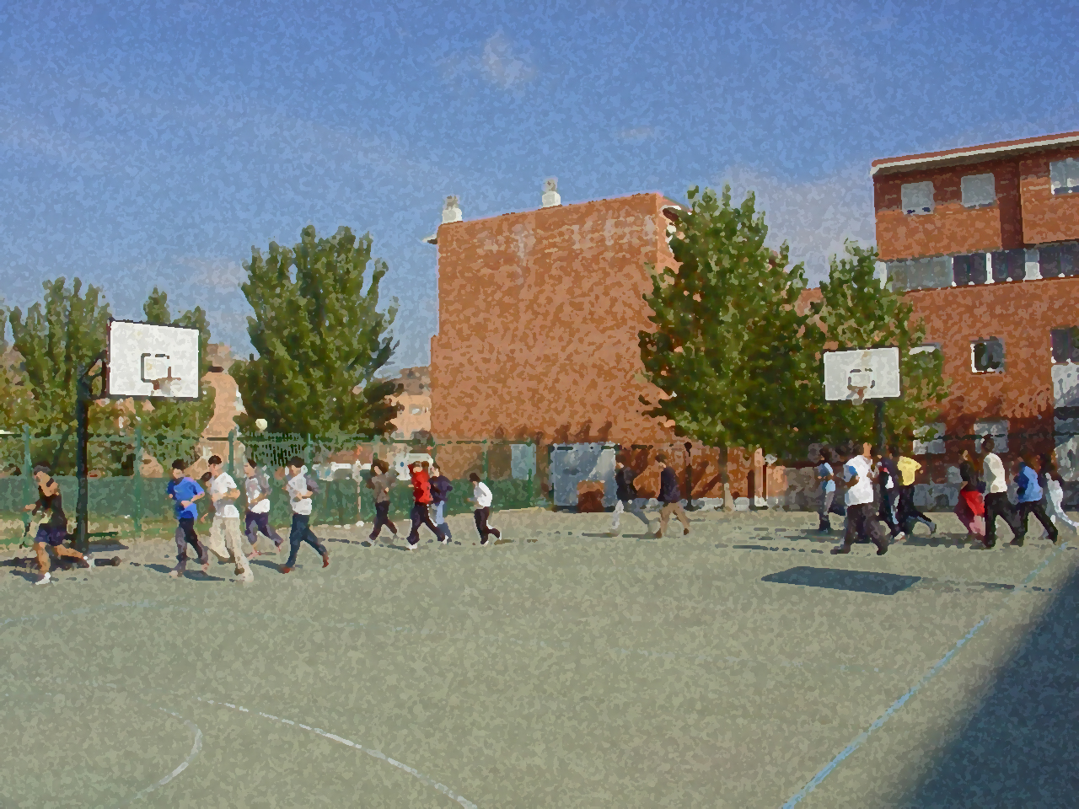
Fundamentals for Secondary School and Baccalaureate. Comprehensive and experiential learning
Body Language

Slide 2
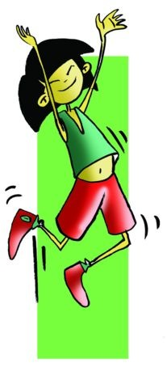
Body awareness and use of skills and abilities in students generates confidence and personal autonomy, while favouring an increased level of social skills and positive personal relationships, contributing to mental health in students.

Slide 3
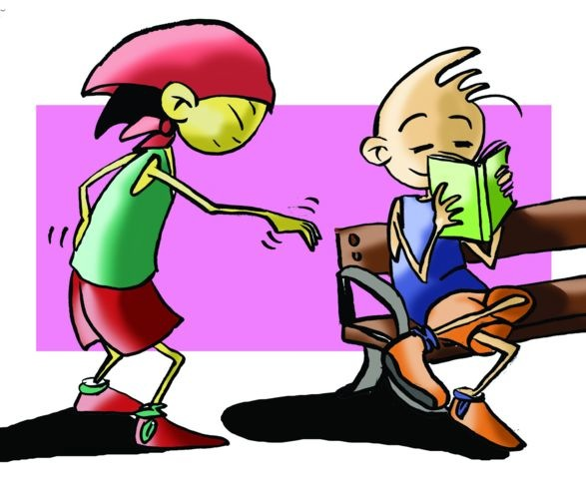
Objectives
Body Language
Mime
Questionnaire and Activities
Body Language

Slide 4
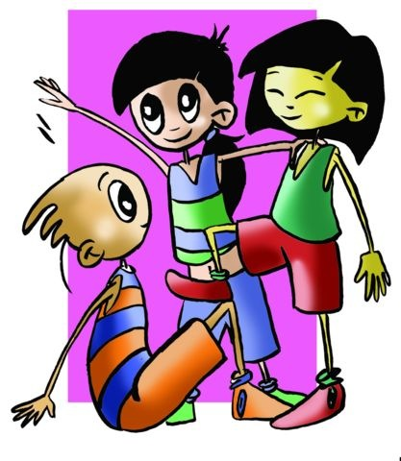
OBJECTIVES
To participate in games and exercises where body language is the protagonist, to become uninhibited in situations involving a sample of feelings.
To use gestures and the whole body to express situations or feelings, collaborate and learn from your peers in the circumstances concerning this point.

Slide 5
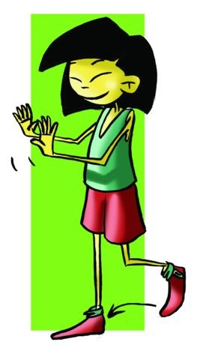
Body language
The body is an excellent, live mode of communication. There is no end to its motor responses and unintentional expression is crystal clear.
Body language is, without major adornments, a bodily manifestation and as such does not need to be learned, and, as such, inherent to human beings. When we greet, talk, quote, or scream, for example, we not only verbally express what is applicable in each case, but we accompany it with a certain hand signal that, at first, is very particular. Gestures are ultimately generalised, and understood, i.e., shaking someone’s hand, raising one’s arms or frowning have a universal and precise meaning.

Slide 6
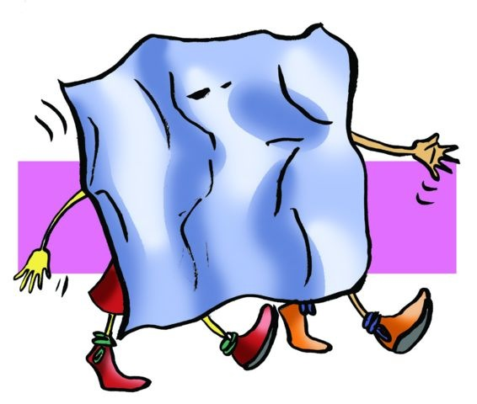
MIME
Gesture is an expressive resource of great communication skills. We are able to express pain, joy, surprise, satisfaction, trust, fear, or tenderness with only a gesture, without moving any part of the body other than the face.
The mime a fundamental medium in the field of communication and entertainment. Curiously it appears to retain some early characteristics of its origins.

Slide 7
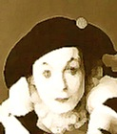
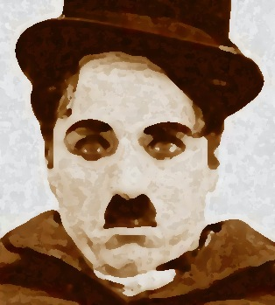
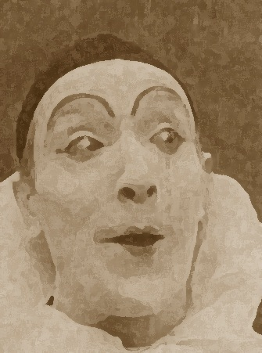
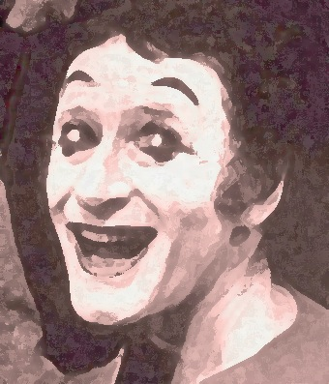
ALGUNOS MIMOS
Charles Chaplin created an iconic icon of the silent cinema called Charlot, who with his cane, moustache and gait is recognised as the world symbol of humour.
Etienne Decroux profesor de M. Marceau es considerado con sus representaciones como precursor del movimiento dramático.
Marcel Marceau with his character Bip toured all stages of the world with his ironic representations.
Gaspard Debureau recovered the roots of the mime with his character Pierrot back in the nineteenth century.

Slide 8
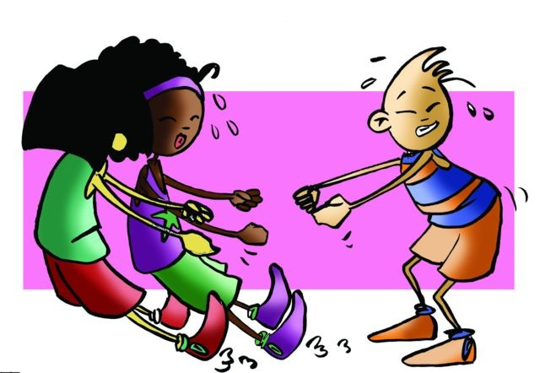
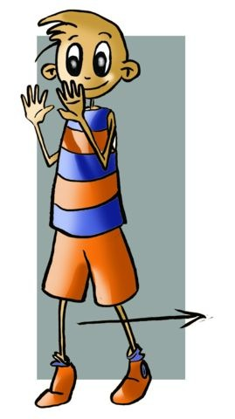
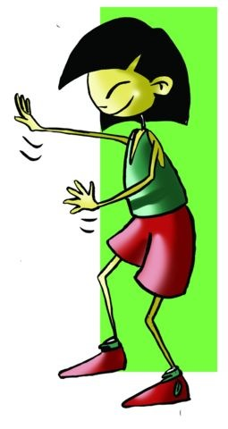
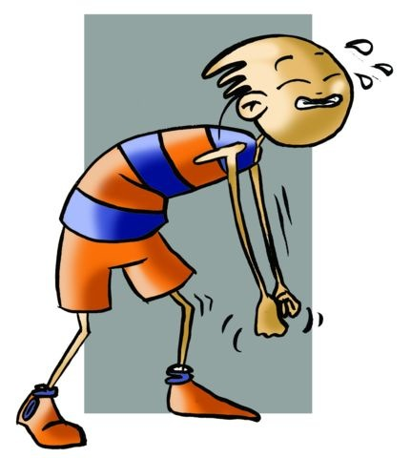
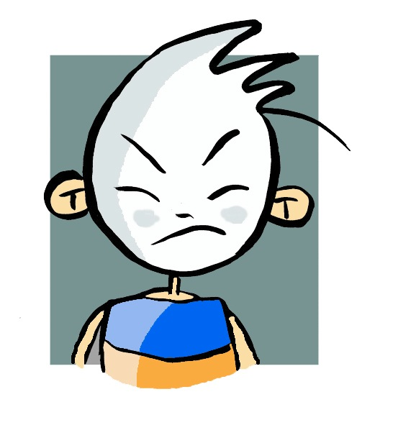
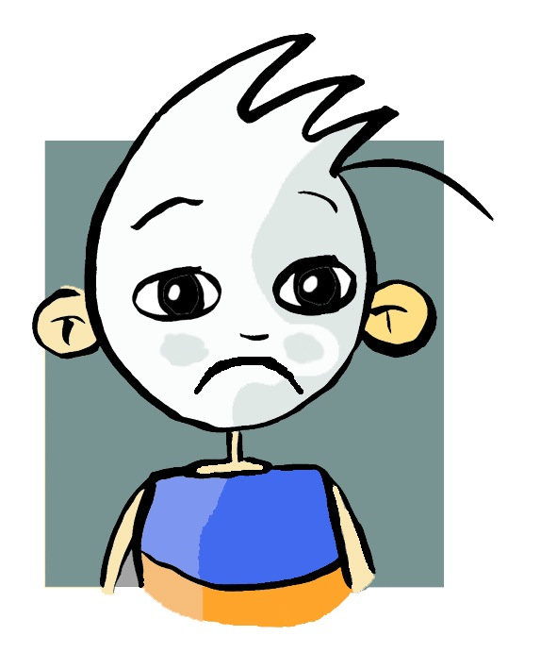
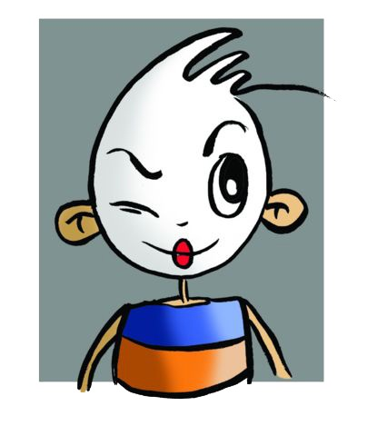
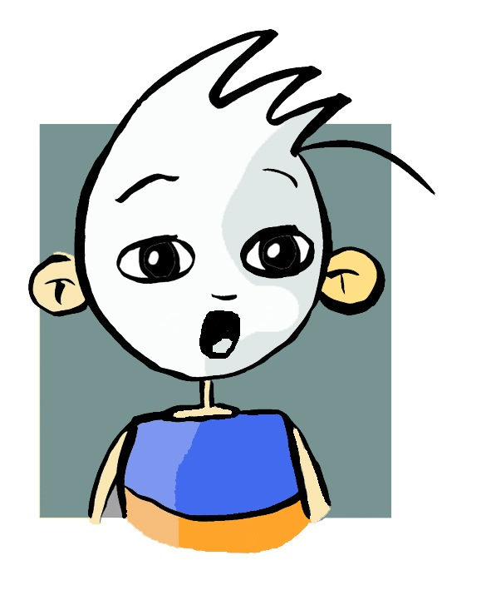
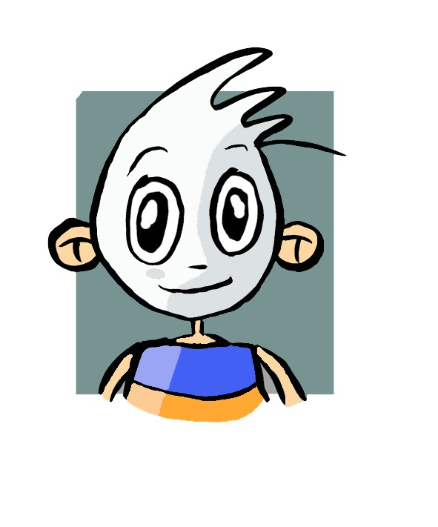
Alguna técnicas básicas:
Double zero technique. Initial position means no action that is to say no movement and no expression.
The gripping or manipulation technique. is based on making you see an object and its manipulation.
Facial Work, Gestures. To define the movements the face is painted white highlighting the eyebrows, eyes and mouth.
Compensation Technique. Below you will use the compensation technique behind consisting of placing arms outstretched with palms wide open hands on the "glass," giving a step up while without moving the bent arms showing that there is indeed a wall…

Slide 9
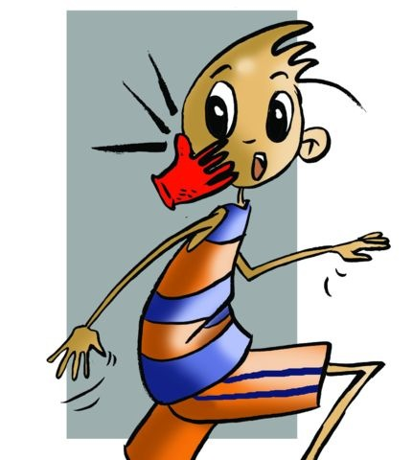
Pantomime
A story developed with an ending and using gestures is a pantomime. Thus pantomime uses movements and specific techniques but you should know that that some sounds are possible. We present some ideas that will make the proposed task possible.

Slide 10
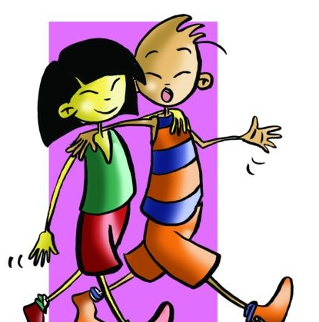
QUESTIONNAIRE AND ACTIVITIES
Do you know some basic considerations about body language?
Describe some basic aspects of body language.
What is compensation technique?
Describe pantomime.
Make facial expressions that represent an argument.
Make up a story and act it out using gestures.
Observe a group in your class and analyse what they have done.

