Slide 1
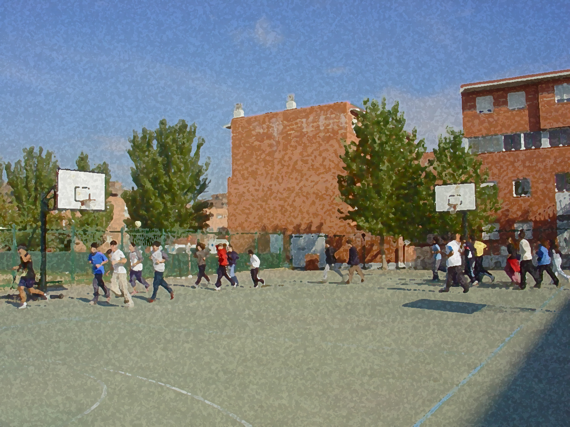
Fundamentals for Secondary School and Baccalaureate. Comprehensive and experiential learning
Baseball

Slide 2
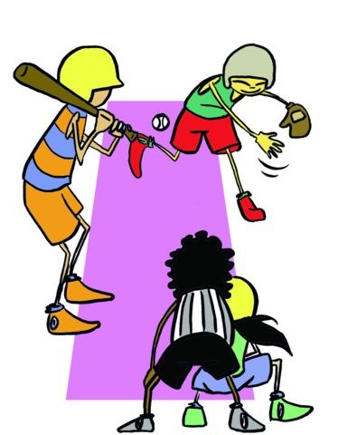
Baseball
Objectives
Basic Rules, Equipment and Facilities
Basic Technical-Tactical Resources
Basic Exercises
Questionnaire and Activities

Slide 3
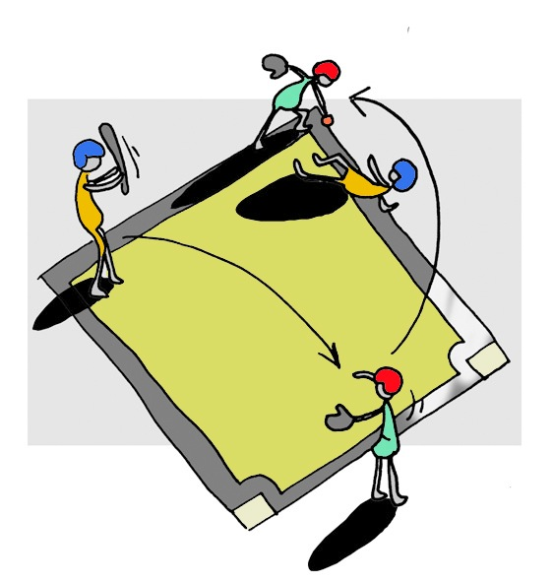
OBJECTIVES
To learn the basic technical-tactical elements and rules of baseball.
To understand their application in real game situations.
To collaborate with one’s peers in the development and implementation of activities.

Slide 4
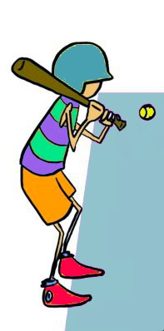
ORIGIN
Towards the middle of the 18th century, English settlers introduced, among others, two games to the US: rounders and cricket, both consisting of hitting rubber balls with a stick. Rounders became popular in the city of New York and roughly consisted of throwing a soft ball to an opposing player so he could hit it with a bat and set off running on an established circuit. Cricket became rooted in the city of Boston. It consisted of hitting a ball with a bat and running over grass through a circuit with some obstacles.

Slide 5
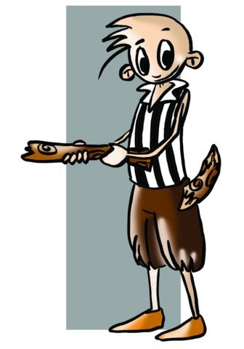
In the middle of the 19th century, A. Doubleday invented baseball, and, together with, A. Carywright constructed the first fields. The first teams like the New York Knickerbockers pioneered the game of baseball creating competitions and regulations, after some minor modifications it has today become, along with American football and basketball, one of the most popular sports in the US.
In this sense we can speculate on the influence that another sport could have had on baseball, a popular game developed in the north-east of Spain known as estornija.

Slide 6
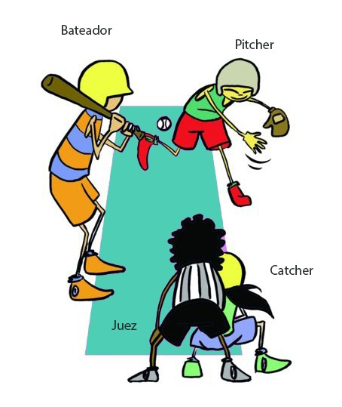
BASIC RULES
In the game of baseball, nine players are on the field and you can have 9 or more as reserves. Field players, depending on their (offence or defence) position have a predetermined location and mission. Whenever a team has been in both defence and offence, an “inning” is said to have been played.

Slide 7
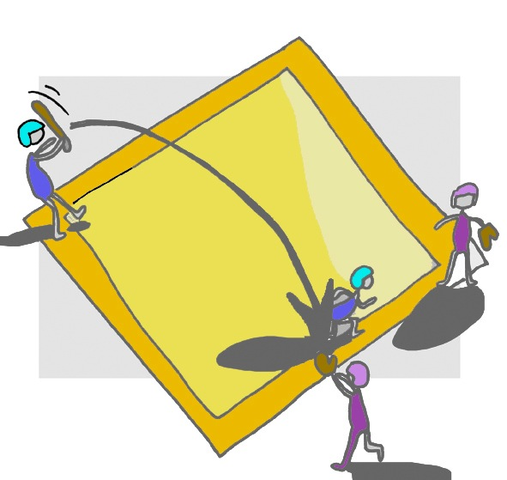
The terrain is peculiar. It is arranged at right angles to the four bases linked by lines and a back-court bounded by the sides with lines out where the ball should always be directed. The fourth base is called "home" coinciding with the base for hitting the ball.
Players:
Batter
Pitcher
Catcher

Slide 8
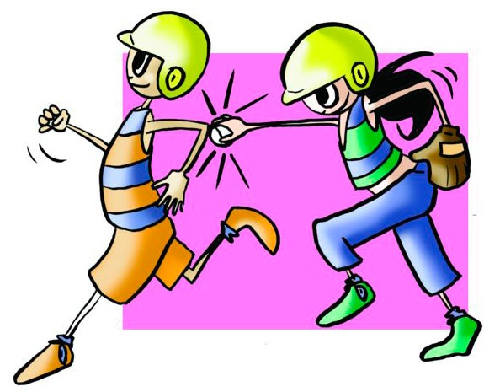
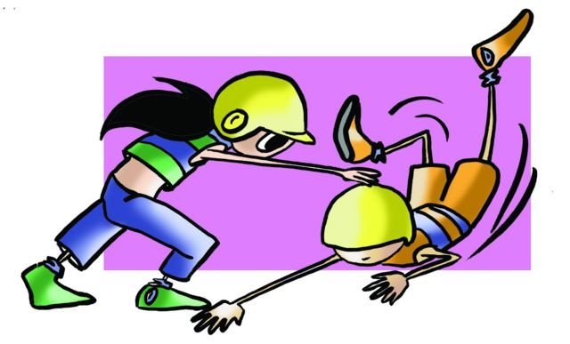
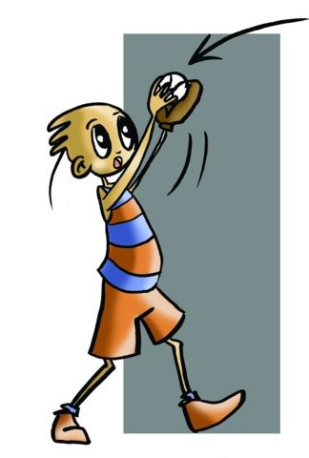
Eliminating a Player:
- When the ball, hit by the batter, is caught in the air by a defensive player.
When the ball thrown by the pitcher (defensive player at 18.44m from the batsman and slightly elevated at 40cm from the field on a small mound must always throw — with one foot on a 60x15cm platform) enters the strike zone three times without the batsman hitting it.
When the batter tries to hit the ball even though it has not entered the strike zone, and fails three times.
When the ball comes to a base before the runner and he/ she is caught by the defender who has one foot in.
When a base runner reaches more than 90cm away from the line connecting the bases.
When a runner is touched by a defender with ball in his hand whilst running.
When a team has eliminated three players they change to an offensive play.

Slide 9
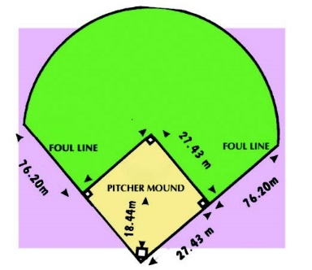
FACILITIES
Field: the terrain is peculiar. It is arranged at right angles to the four bases linked by lines and fair territory (composed of an infield and outfield), where the ball should always be directed, bounded/delimited on the sides by foul lines.

Slide 10
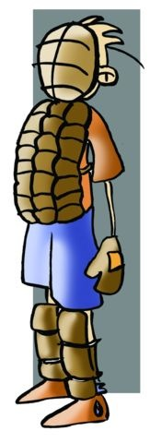
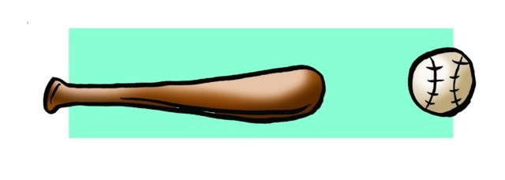
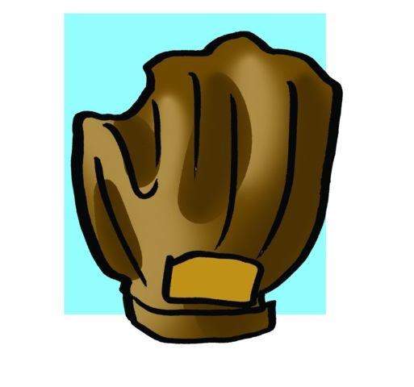
EQUIPMENT
The ball: 150g and 23cm in circumference, constructed from a rubber ball rolled in wool and covered with stitched leather.
The bat: made of wood and 90cm long.
Glove/mitt: all defensive players use large leather gloves placed on non-dominant hand to gather the ball and protect the hand. The catcher’s glove of the defence player, who is located behind the batter, is thicker and has only one finger, the rest have five.

Slide 11
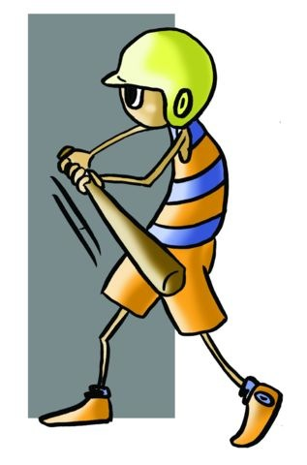
BASIC TECHNICAL-TACTICAL RESOURCES
Offence:
Batter | 1. Hit the ball: Hit it quickly. There is less than 1 second to take a strong and accurate shot. Batting must be performed in two phases: a) Starting Position: put the bat behind and over the shoulder. The player should have all his/ her weight perfectly balanced, with both feet set on the ground. b) Swing: it is the rotation of the hip and a rapid forward movement of the bat to strike.
 | 2. Touch the ball: It is a movement that involves gently touching the ball with the bat sending it 8 or 10m to catch defenders by surprise and achieve 1st base safely. In this case the batter does not rotates much or too fast.
 | 3. Run to the base: Once the ball has been hit, run at high speed toward the base. Therefore, it is called a base run and win.
Baseman | The player should be aware of every movement of the batsman to get to the next base or race, and the pitcher can eliminate the player before throwing if the batter is outside his/her base.

Slide 12
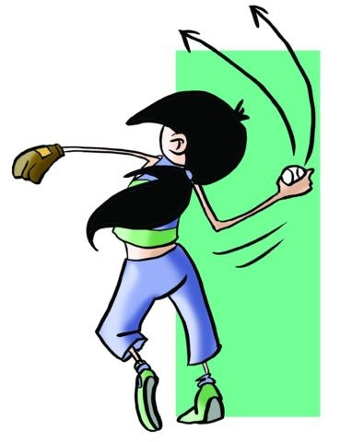
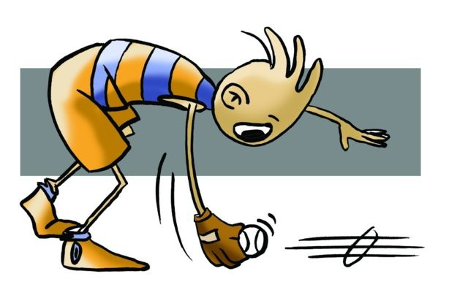
Defence | Catching the ball consists in catching it in flight or as it rolls on the ground. What is important is to continue the game as quickly as possible. Throwing the ball consists of the pitcher releasing the ball, instead of toward the batter, to a base to catch a runner out and eliminate him/her.

Slide 13
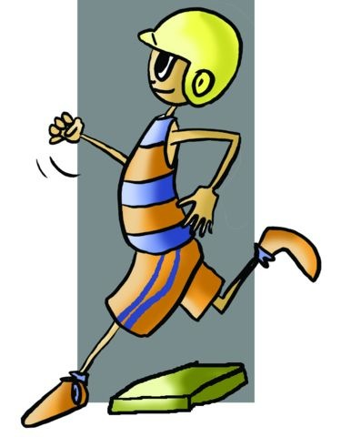
Joint Tactical Organisation | The joint organisation in this sport is very complex although we will try to explain two types. Tactics are signalled, before the batter hits the ball, by coaches using hands and face, they perform signs, signals or gestures studied by all and with specific meanings. The most important and common tactical offensive is called run and hit. In it, the moment the pitcher throws the ball to the batter, the runner on first base, for example, runs quickly to second base while the batter hits the ball in the other direction. If the opposing team has detected this the defensive tactic is called counter run and hit that tries to compensate for that attack while not displacing any defender to cut the runner who wants to go to second base thus not losing sight of first base to which the batter undoubtedly will run.

Slide 14
QUESTIONNAIRE AND ACTIVITIES
Baseball originates from...
How many players are there on a field during a baseball match?
What is an inning? What is a run?
What ways do you know to eliminate a player?
Invent a way to play baseball without specific equipment.
Write down in your notebook unknown vocabulary from this unit.
Check the Federation website or any sports association in your region and check for changes or modifications, if any, in its regulations.

