Slide 1
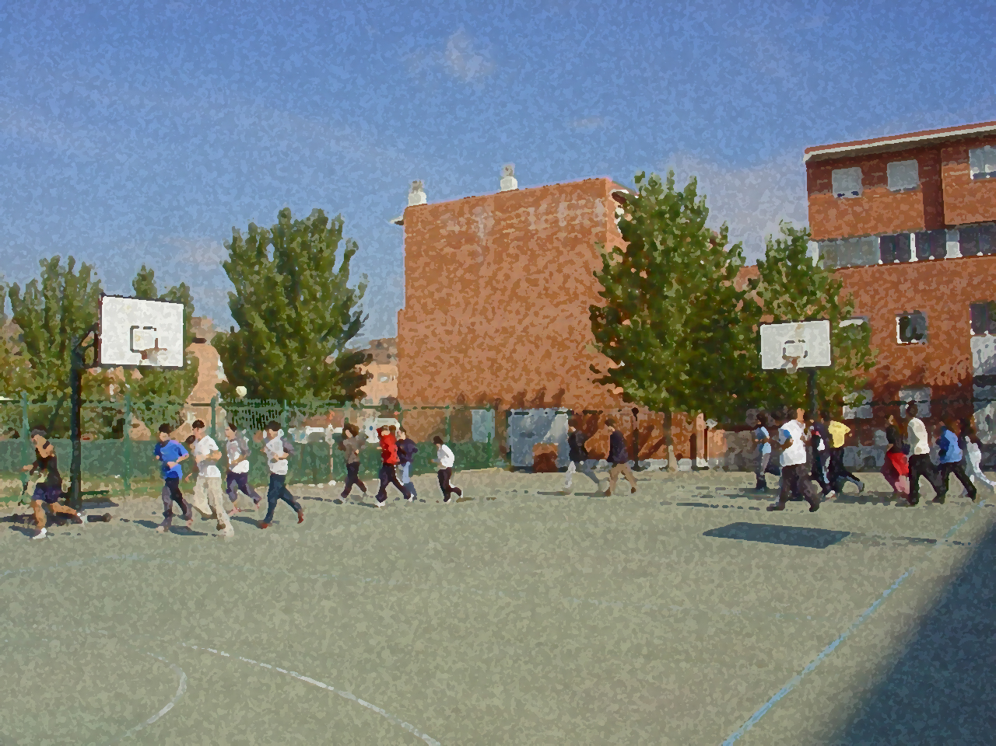
Fundamentals for Secondary School and Baccalaureate. Comprehensive and experiential learning
Indiaca

Slide 2
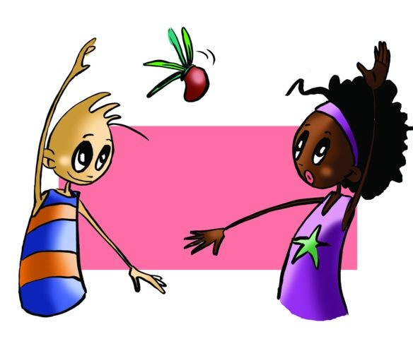
Indiaca
Objectives
Basic Rules and Regulations
Basic Technical-Tactical Resources
Questionnaire and Activities

Slide 3
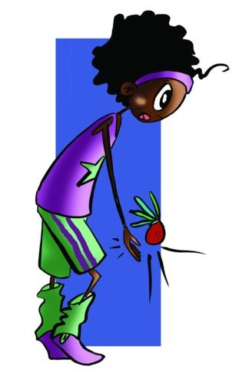
OBJECTIVES
To learn the technical-tactical elements and basic regulations of indiaca.
To understand the application (of these elements and regulations) in different situations during the game and collaborate with one’s classmates developing and putting into practice the activities.

Slide 4
ORIGIN
Indiaca is a game played with a feather ball (indiaca) that has its origins in the Inca civilisation, and it is a popular game in various countries in South America mostly in Brazil where it is called Peteca. It formally became a sport in Germany in 1936 and the feather ball was called indiaca.

Slide 5
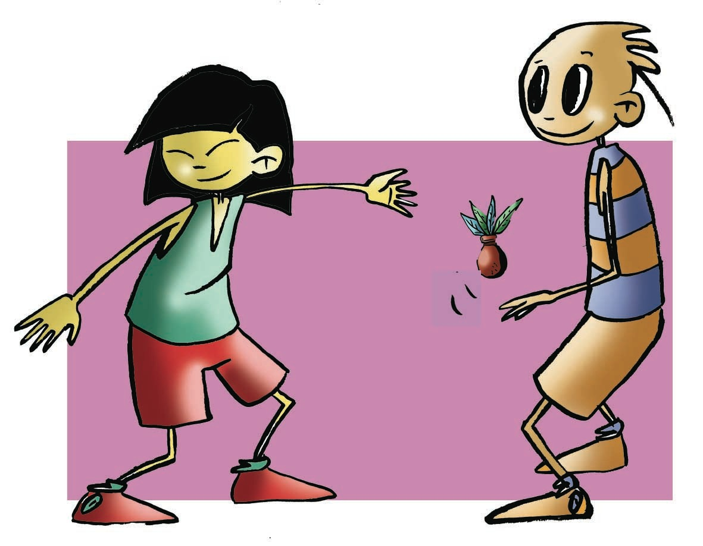
BASIC RULES
The game consists of hitting the feathered ball with the hand trying not to let it fall to the ground on one’s side of the court but that it hits the ground of the opposing team’s side. One can play as individuals, doubles or in teams – this being the most often played version of the game.
The team is made up of five players: three attackers and two defenders.
So that all the players can play in every position, the players are rotated in a clockwise direction. The player who finds him/herself in the right hand zone of defence takes the first service.
The service is taken by holding the ball at hip height and hitting it from below sending it in an upward trajectory to the other side of the court. Players are permitted two attempts to complete the serve.

Slide 6
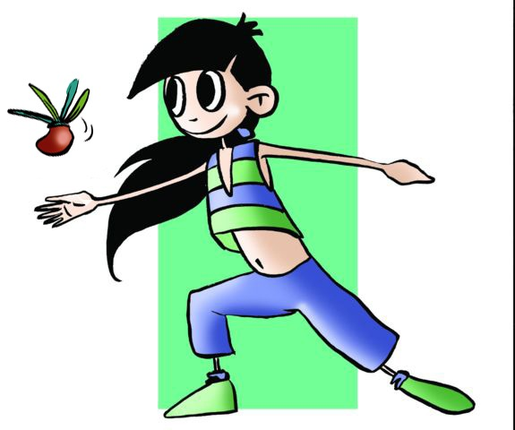
The games consist of three sets of twenty-five points. A point is scored in the following cases:
If an opposing player hits the ball out of the court, it falls on their own side of the net or passes under the net,
if a team touches the indiaca more than three times,
if a player hits the indiaca twice,
if the indiaca is hit with a part of the body that is not the hand, and
if a defender hits the indiaca over the net.

Slide 7
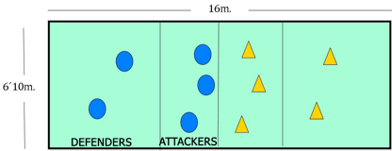
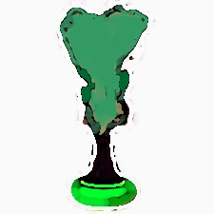
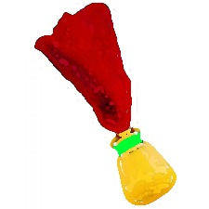
Equipment
The Indiaca is made of two parts: the lower part is a foam base and the upper part is made of four 20cm long feathers. The American version is shorter, made with a small cushion of leather and shorter feathers. The court is rectangular measuring 16 x 6.10 metres. It can be adapted to a court of 18 x 9 metres (volleyball court). There is a net that separates the two sides of the court hung at a height of:
- Men – 2.25 metres
- Women – 2.15 metres
- Mixed – 2.15 metres
- Children (under 14) - 2 metres.

Slide 8
BASIC TECHNICAL-TACTICAL RESOURCES
The technical and tactical resources of this game are very simple. The idea is that you participate in the game in a natural manner, hitting the ball in the ways described below:
The serve to complete the serve you should hit the feather ball upwards from below, starting from below the hip. The legs should be bent and the opposite arm placed slightly forward.
During the means of hitting the ball depends on the height at which you hit the indiaca. There are three different ways: low, body height and above the head.

Slide 9
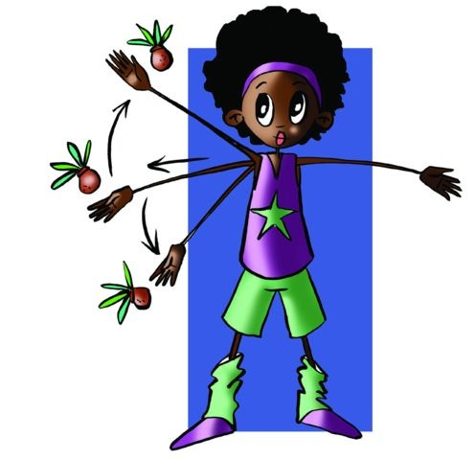
The Game of Indiaca and Decision-Making
The decisions involved in the game are related to those that were described in the unit on badminton. Remember the roles of offence or defence, taking decisions should go as follows:
ATTACKER
DEFENDER
Where are the opposing players positioned?
Where am I positioned?
Which strike can I use to send the feather ball to the other side of the court with the possibility of scoring a point?
What should I do once I have hit the indiaca?
Where are the players of the other team positioned?
Where am I positioned?
What are their characteristics and how can I send the indiaca?
What move should I make once the attacking player has hit the indiaca?

Slide 10
QUESTIONNAIRE AND ACTIVITIES
1. Can you say where the game originated?
2. The rules of Indiaca are based on another sport. Which one?
3. Can a player in the attacking zone perform a serve?
4. With which part of the body should you hit the indiaca?
5. Play a game with a hacky sack or footbag. Take a ball the size of a tennis ball that does not bounce and that is covered in rubber. You can only hit it with your legs and feet. You can use the inside and outside foot, the heel and the instep and the same with the knees and thighs. The games are to fifteen points played in doubles on a badminton court. Give it a try.
6. Invent another version of this game and explain the new rules.

