Slide 1
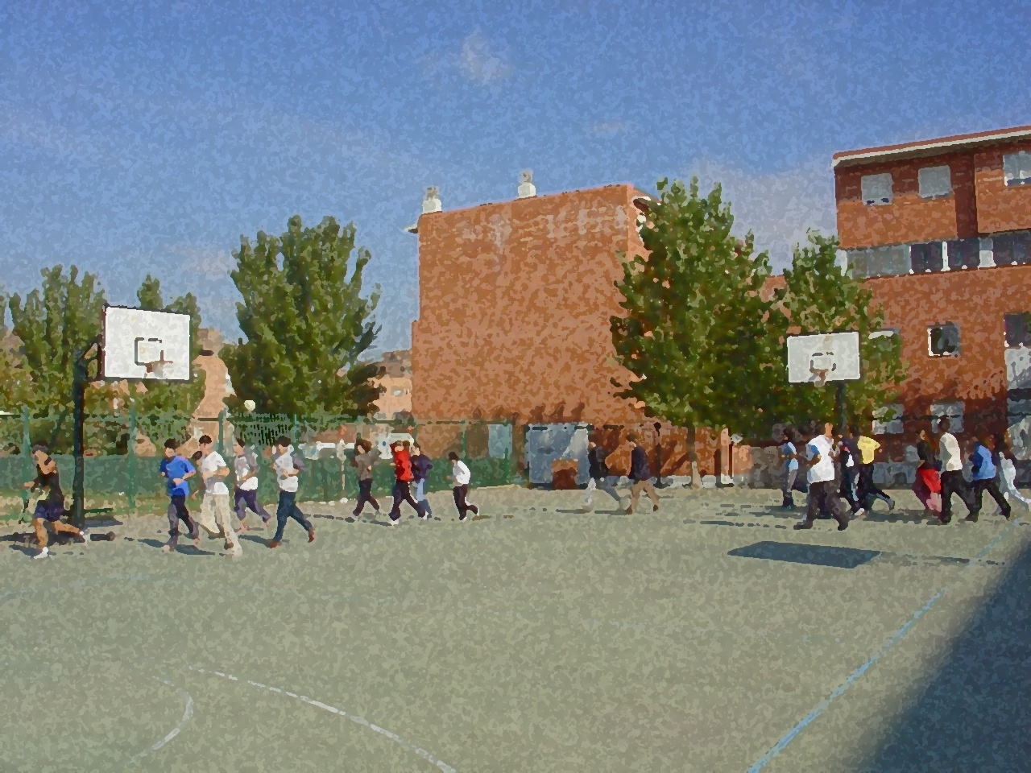

Fundamentals for Secondary School and Baccalaureate. Comprehensive and experiential learning
Artistic Gymnastics

Slide 2
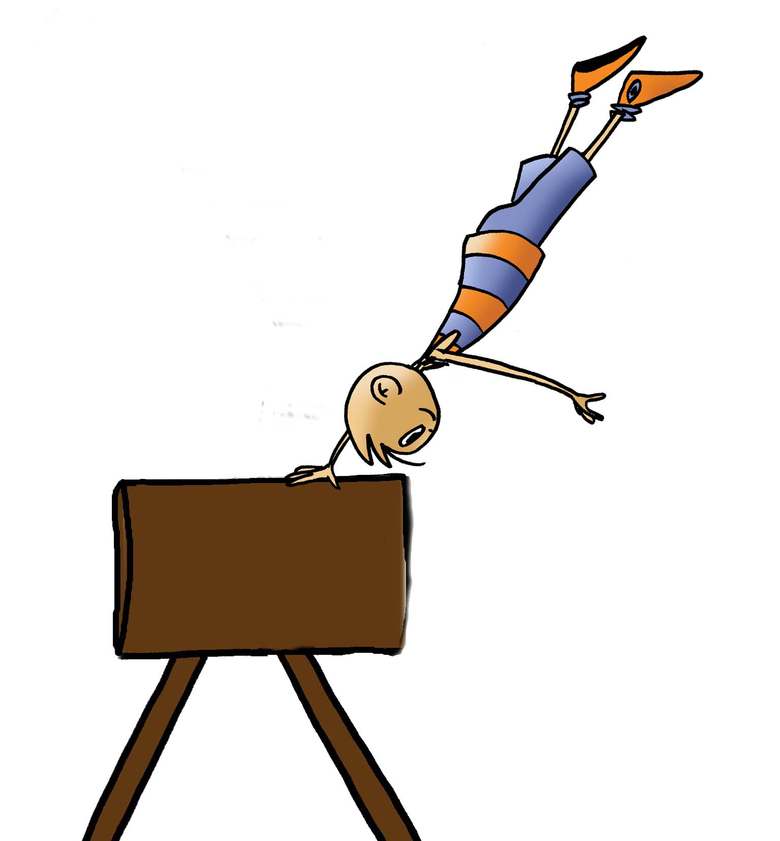
Contents
Objectives
Basic Rules
Technical Exercises for Basic Levels
Practical Exercises and Progress
Acrosport
Questionnaire and Activities

Slide 3
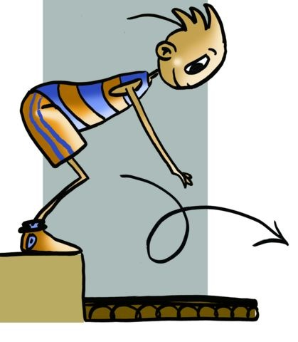
OBJECTIVES
To learn gymnastics as a regulated sport, the basic exercises that make it up and its regulatory aspects.
- To understand the applicability of the various gymnastic movements, taking into account one’s own personal characteristics and participating in the learning process of other classmates.

Slide 4
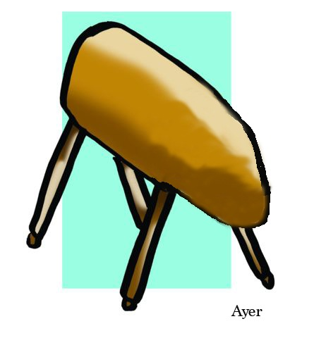
BASIC RULES
For the secondary school programme, the focus will be on activities with two apparatuses only, common to both genders, which are the floor and vault.
Exercises on this equipment entail two types of exercises as well as in the other apparatuses:
- Free Exercises developed by the gymnast in his/her workouts, you can watch the developments and challenges of each exercise building up to executing more difficult and risky moves to achieve a maximum score.
- Compulsory Exercises are the ones the FIG dictates gymnasts perform in competition.
Floor exercises should last 1 minute with a margin of more or less 10 seconds. If a gymnast does not fill the time he/she will be penalised. The girls perform floor exercises to music which should reflect the routine.
Gymnastics scores are based on three factors:
1. degree of difficulty,
2. connection, brilliance and the artistry of the movements, and
3. technical execution requirements.
Judges start with the score of 10 and subtract points, 1/2 points or tenths of a point if the gymnast commits an error. The final score is an average of the scores given by each of the judges.

Slide 5
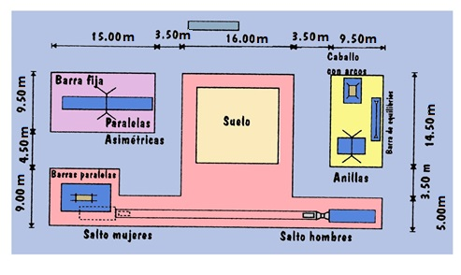
Facilities
Gymnastics takes place in large indoor facilities where the apparatuses gymnasts must use in the competition are placed.
Floor: The exercises in this section are performed on a square mat covered with a carpet 12m x 12m side, framed by a border that cannot be crossed during the competition. Exercises performed on this mat cross from side to side and from one corner to another.
Vault: The jumps are done with a run-up not exceeding 20m and jumping from a springboard of German origin called Reuther. The height of the apparatus, today with a spectacular design, is 1.35m for boys and for girls 1.25m, between 95 and 105 in length and 95cm wide. Only one supporting hand is allowed on the apparatus.

Slide 6
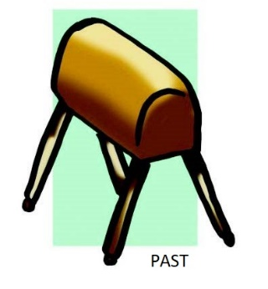
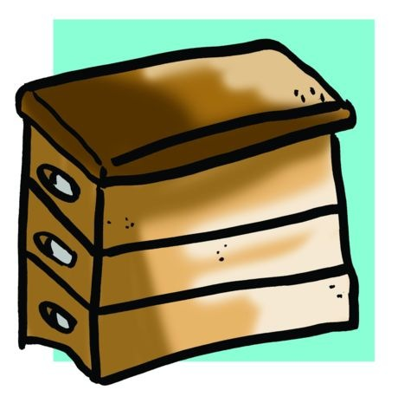
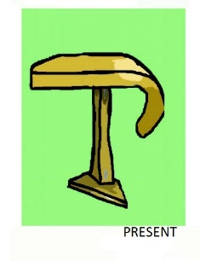
Equipment
Vaulting box
Vaulting horse
Modern vaulting table

Slide 7
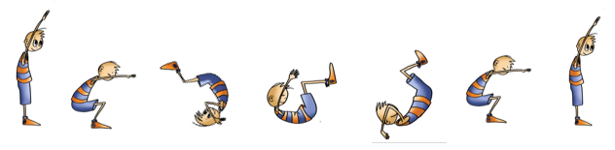
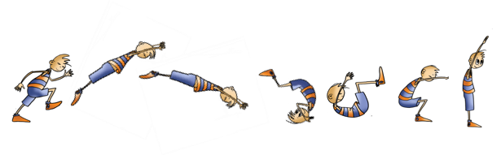
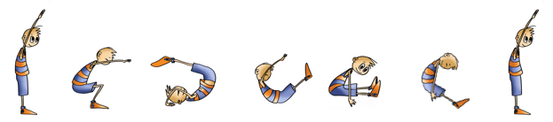
TECHNICAL EXERCISES FOR BASIC LEVELS
Floor
Forward and Backward Roll
Dive Forward Roll
Front Flip (with legs
straight and together)

Slide 8
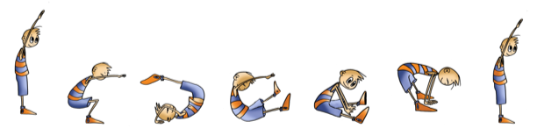
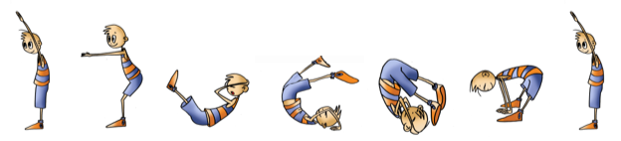
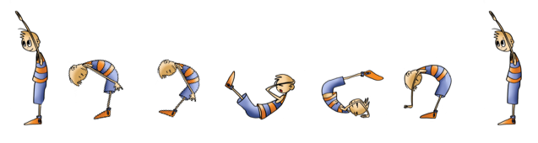
TECHNICAL EXERCISES FOR BASIC LEVELS
Floor
Forward Roll – Straddled (with legs spread and extended)
Back Flip (with legs straight and apart)
Back Flip (legs spread and extended)

Slide 9
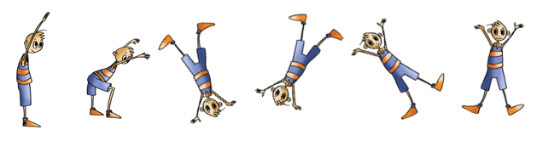
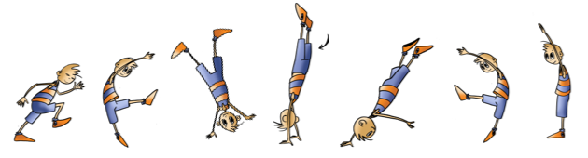
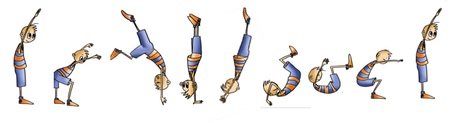
TECHNICAL EXERCISES FOR BASIC LEVELS
Floor
Cartwheel
Arab Spring or Round Off
Handstand, and Handstand Forward Roll

Slide 10
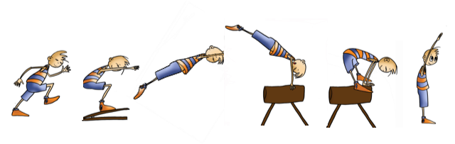
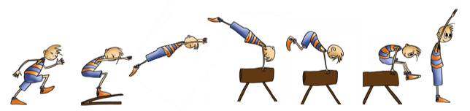
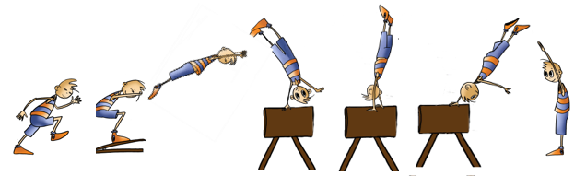
TECHNICAL EXERCISES FOR BASIC LEVELS
Vault
Straddle Vault or Leapfrog
Squat or Through Vault
Cartwheel Vault with 1⁄4 Turn

Slide 11
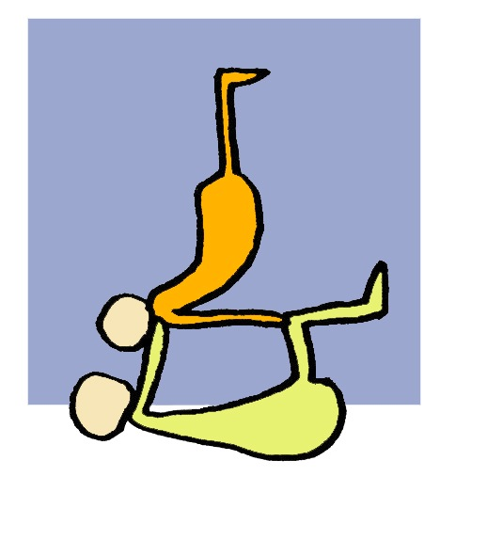
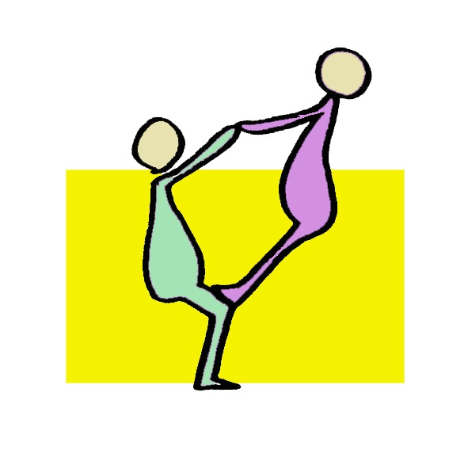

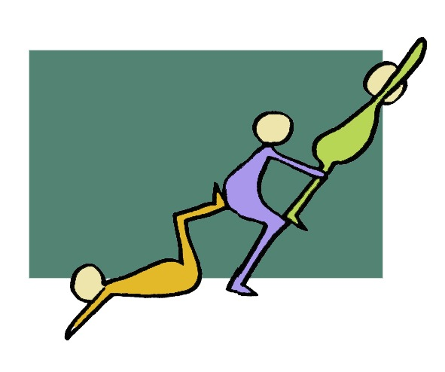
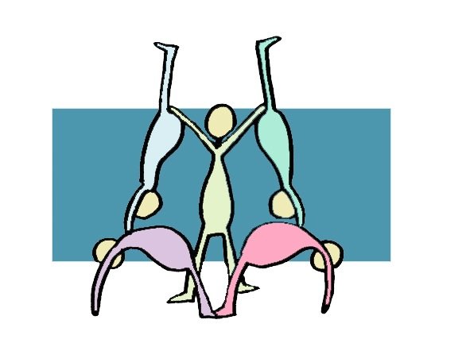
TECHNICAL EXERCISES FOR BASIC LEVELS
ACROSPORT
The combinations of simple exercises of balance and imbalance with some gymnastic moves gives us spectacular results in practice framed within what is called acrobatics or acrosport.
We have presented some possibilities as a benchmark, so that they may be based on them or not, so you may put them into practice or modify, creating new and magnificent moves.

Slide 12
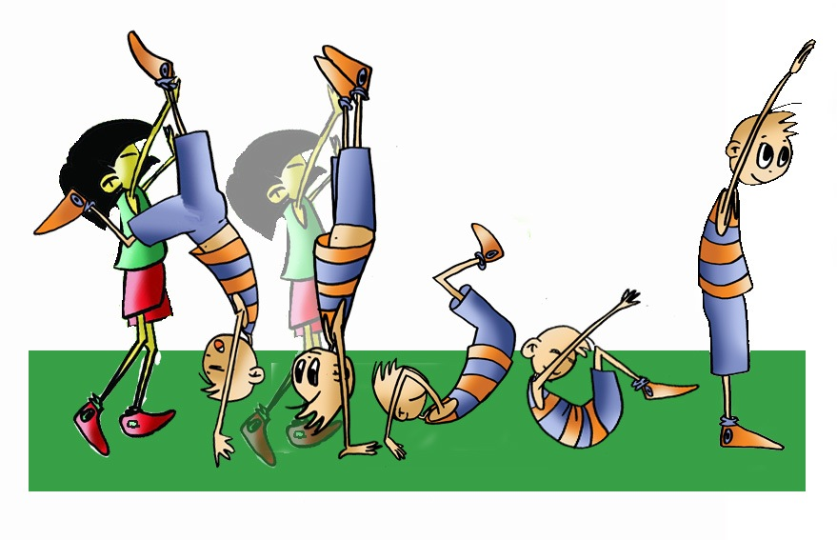
QUESTIONNAIRE AND ACTIVITIES
What is the origin of gymnastics?
Who imposed changes in techniques and regulations of gymnastics?
What apparatuses are used in men and women’s competition?
What are the differences between floor exercises for males and females?
Discuss with your partner or classmate the difficulties you have found in the exercises done in class as well as the means to overcome them.

