Slide 1
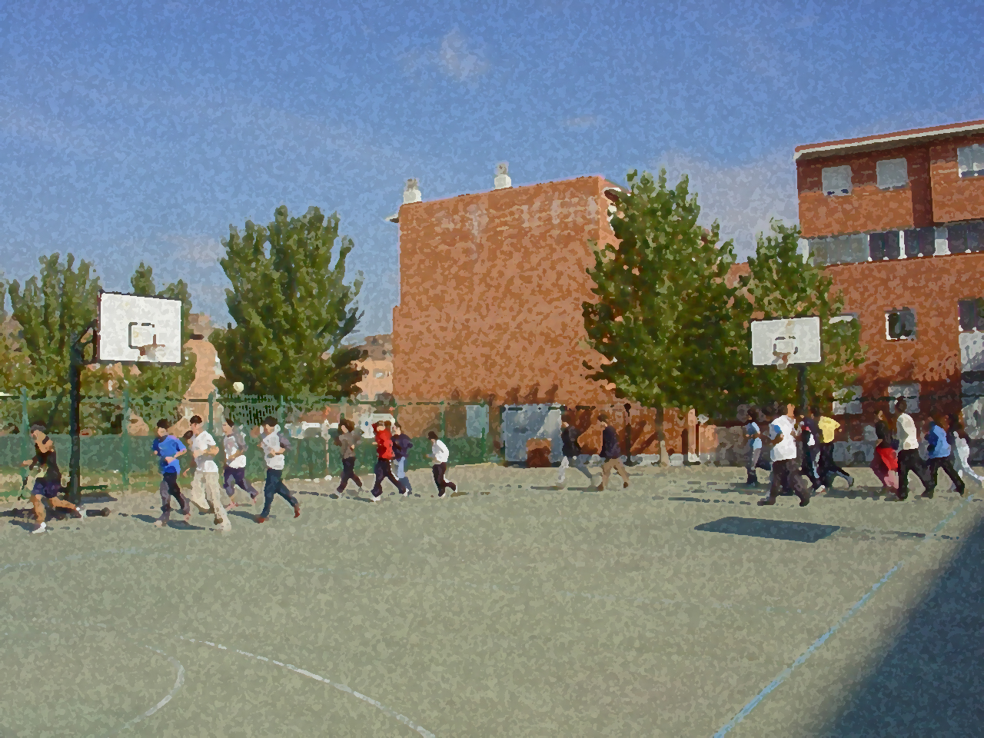
Fundamentals for Secondary School and Baccalaureate. Comprehensive and experiential learning
SPEED

Slide 2
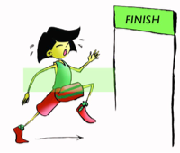
SPEED
1. Objectives
2. Speed: Concepts and Types
3. Factors Affecting Speed
Physiological
Physical 4. Measurement of Speed
5. Development of Speed
Reaction Time
Acceleration
Maximum Speed
Speed Endurance
5. Questionnaire and Activities

Slide 3
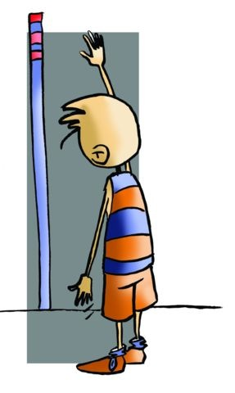
OBJECTIVES
- To learn new terms related to this physical capacity and its impact on fitness.
- To practise different systems that improve and enhance our speed and testing to inform us of our state.
- To learn how to develop systematic exercises that foster the development of our physical condition with a healthy approach.

Slide 4
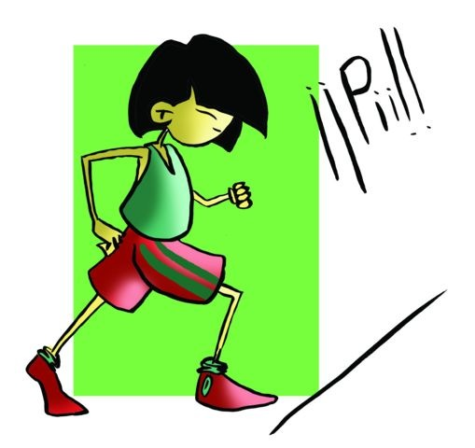
Concept
“The ability to produce a response to something as quickly as possible”
Speed is an important physical capacity in any sport. Velocity of movement in sport is paramount, since its effectiveness depends largely on the speed with which it is executed.

Slide 5
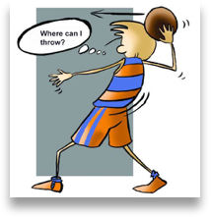
Types of Speed
It is that which corresponds to non-verbal communication. It is a gesture that calls for, in a certain sport situation, in the shortest time possible a reaction, for example, an action telling a player to shoot or pass as quickly as possible.
It is what we can also consider a 4th kind of speed, which after being processed in the central nervous system (latency time), and against the established proposition enables us to make the right decision in a particular sporting situation
Displacement
Response
In the distance we cover in the shortest time possible, for example, in a 100- meter race.
Gestural
It is the time it takes an individual to respond to a given stimulus. If the answer given to a single stimulus is called simple reaction time, from starting blocks for example, and if the answer is to various stimuli, such as in sport situations of attack or defence as well as combat sports. This is called choice reaction time. Reaction time can be varied depending on light, sound stimuli, etc.
.
Mental

Slide 6
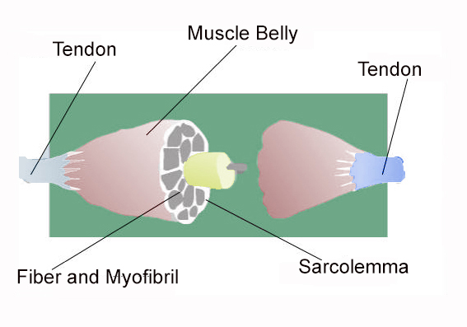
FACTORS AFFECTING THE SPEED
fibre length
Physiological
the degree of muscle mass
the structure of the muscle fibre
stride length
Physical
amount of support
co-ordination

Slide 7
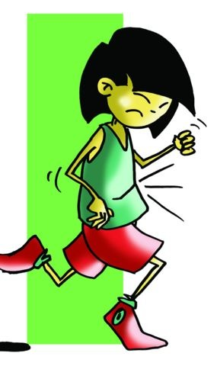
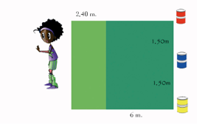
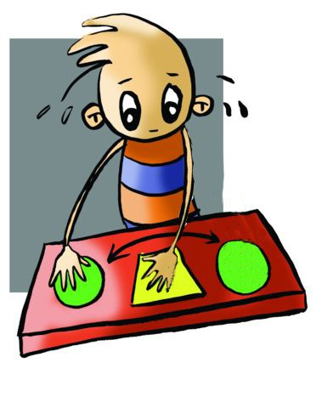
MEASUREMENT OF SPEED
Velocity with a 50-metre sprint; a 100-metre dash; and flying 40-metre test, in which you run 60m but you are timed for the last 40m.
There are several tests that can measure reaction time. Here we will discuss the test advised by Letwin in his "Measurements and statistical evaluations in Physical Education"
Co-ordination with test Plate Tapping.

Slide 8
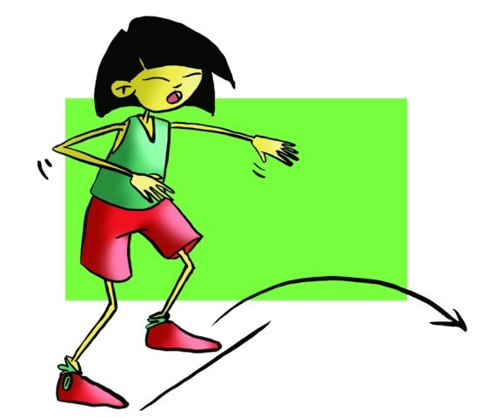
DEVELOPMENT OF SPEED
Paradoxically, in the short time that a race lasts or a sprint against the clock attack in football lasts, we will find there are several phases
Velocity
- jumping with one or two feet
- lifting knees and heels enhancing motor co-ordination speed
- lunges with light loads, and - squats with and without jumps.
- slopes (30 and 50m.)
Reaction speed.
Acceleration
- doing downhill starts (a 20-metre race).
racing with elastic bands
Plyometric exercises.
- using audio signals, - using visual cues, and - specific responses (technical), which are fast
Maximum speed
interval - progressive - regressive - alternating sets or overload
Speed endurance

Slide 9
QUESTIONNAIRE AND ACTIVITIES
1. Is speed the ability to move in the shortest time possible?
2. What is body language speed?
3. Do you know what the flying 40m test is?
4. Check with your partner, who reacts faster?
5. Describe an example that allows you to verify reaction when in response to auditory-visual stimulation.
6. Write down in your notebook unknown vocabulary from this unit.

