Slide 1
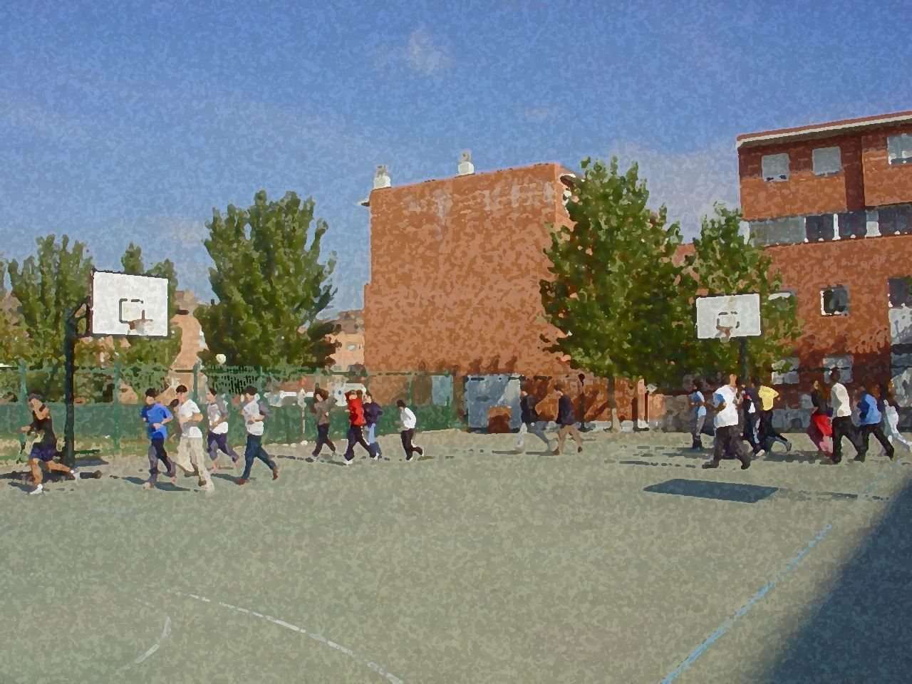
Fundamentals for Secondary School and Baccalaureate. Comprehensive and experiential learning
Motor Learning

Slide 2
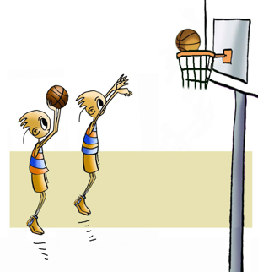
Motor Learning
Objectives
Concept
Theories of Learning
Learning Stages
Factors To Be Used in Learning
Skill Level
Analysis of Motor Movement
Questionnaire and Activities

Slide 3
OBJECTIVES
To learn the factors involved in the learning of motor movements.
To understand their link to the practice of physical activities and relate it to your participation in the tasks performed in both PE and beyond.

Slide 4
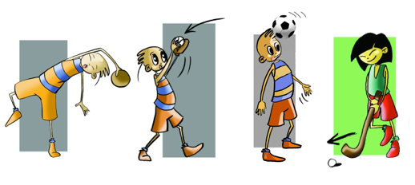
CONCEPT
If you think for a moment about how you learned to pass the ball when playing basketball, or shooting a goal in handball, or how to do a somersault, you are likely to remember using your cognitive abilities. It is either by watching or thinking about how a classmate or friend did it, in a match or video, or even how you think you should do something according to your own perception. Once you have a more or less clear idea of what you want to do, you may put your motor skills into action, i.e., muscles, body segments, organ systems, etc. to carry out the motor action you have chosen to do. Furthermore, you will remember having activated your attitudinal capacity, with interest, enthusiasm and motivation.
In short, we understand motor learning to produce permanent changes in motor behaviour as a consequence of the intervention of cognitive abilities, motor skills and attitudinal capacity, and where practical, previous experience and the mediation of the environment play an important role. With this in mind, the intention is that students can construct meaning from new acquisition and attribute sense to new input.

Slide 5
THEORIES OF LEARNING
Information Processing Theory
Information |  | Perception Mechanism (input) |  | Decision-Making Mechanism (central processor) |  | Execution Mechanism |  | Motor Response (output)
 |  |  | Feedback

Slide 6
LEARNING STAGES
COGNITIVE (primary or initial): This is a reflective phase, we usually have a lot of stimuli, and it is very difficult to concentrate on the important aspects of learning.
ASSOCIATIVE (intermediate): Understanding what to do and associating the elements related to performing the activity.
AUTONOMUS: Acquiring the skill sought. This means being able to process the information without any glitches and doing the activity automatically.

Slide 7
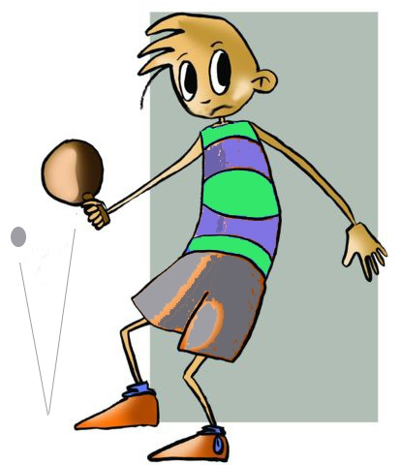
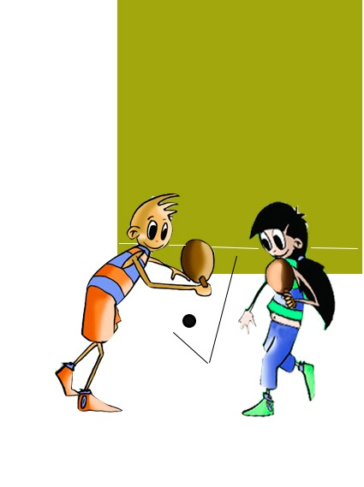
FACTORS TO BE USED IN LEARNING
Transfer: It is understood that transfer is the relationship between learning from previous activities and new tasks that we want to learn, or viceversa.
Retention: It is the ability to retain what has been learned and reproduce it at the time of the test.
Feedback: Is understood to be the information received through the senses once the motor action has been executed. This information is analysed and used to adjust those aspects that have not been realised as planned, which will allow for more effective implementation at a later date.

Slide 8
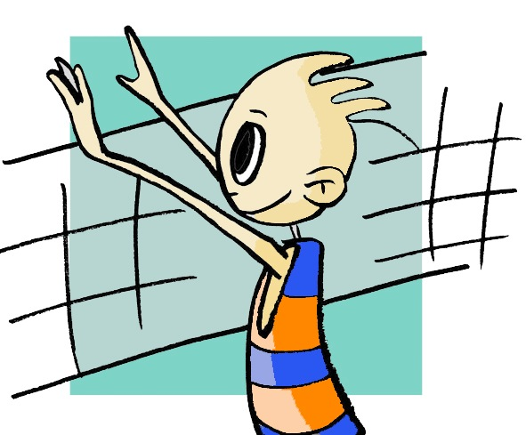
SKILL LEVEL
The main objective of motor learning is attaining a sufficient level of performance in an activity to be executed with maximum efficiency and economy of energy.
When we start a new activity we appear awkward, uneasy. We do not fix our attention on the most important points. Furthermore, too much energy is expended so we get tired quickly.
Attainment of certain skills could be proportional to the development of the following competencies:
focus on the most important aspects of the activity,
use transfer properly,
make use of feedback, and
motivate oneself with the activity sufficiently to work steadily in order to induce retention.
In order to improve one’s level in the task begun, progressing beyond the initial level and acquiring the skills and abilities needed to enjoy the activity and continue learning.

Slide 9
ANALYSIS OF A MOTOR MOVEMENT
Perception The activity starts with the reception of a pass from a running teammate. What part of my environment am I going to centre my attention? Through my sense of sight I see that my teammate is going to send me the ball and I have no opponent near me so I can get the ball. I can also observe the characteristics of my opponent and the goalkeeper’s as I intend to take a shot as I am near the goal area.
Decision From the information perceived, I have to analyse it, deciding which is the best option based on what I know and what could be a good alternative in this situation. What am I going to decide? The options I am weighing whether to feint, pass the ball to a teammate or do a jump shot. I decide to do a jump shot as I have overtaken the opponent and am able to surprise the goalkeeper by shooting hard.
Execution Once I have decided to execute the shot, I position my body to initiate the throw, moving through all the steps needed to take the shot.
Feedback Once I have carried out the motor action, I observe that the defence has intercepted my shot; I should have opted for a different alternative as this was a mistake. No doubt I did not take into account the speed and height of my opponent’s jump.

Slide 10
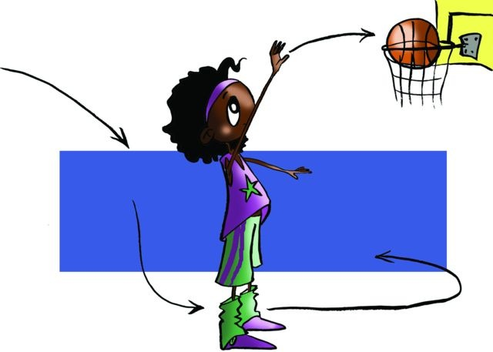
QUESTIONNAIRE AND ACTIVITIES
1. What is the definition of motor learning?
2. Explain the theory called information processing and cybernetics.
3. What is learning transfer?
4. What stage of motor learning do you think corresponds to your level in the sport that you do?
5. Observe a teammate or classmate and at what stage of learning are they in your opinion?
6. Write down in your notebook unknown vocabulary from this unit.

