Slide 1
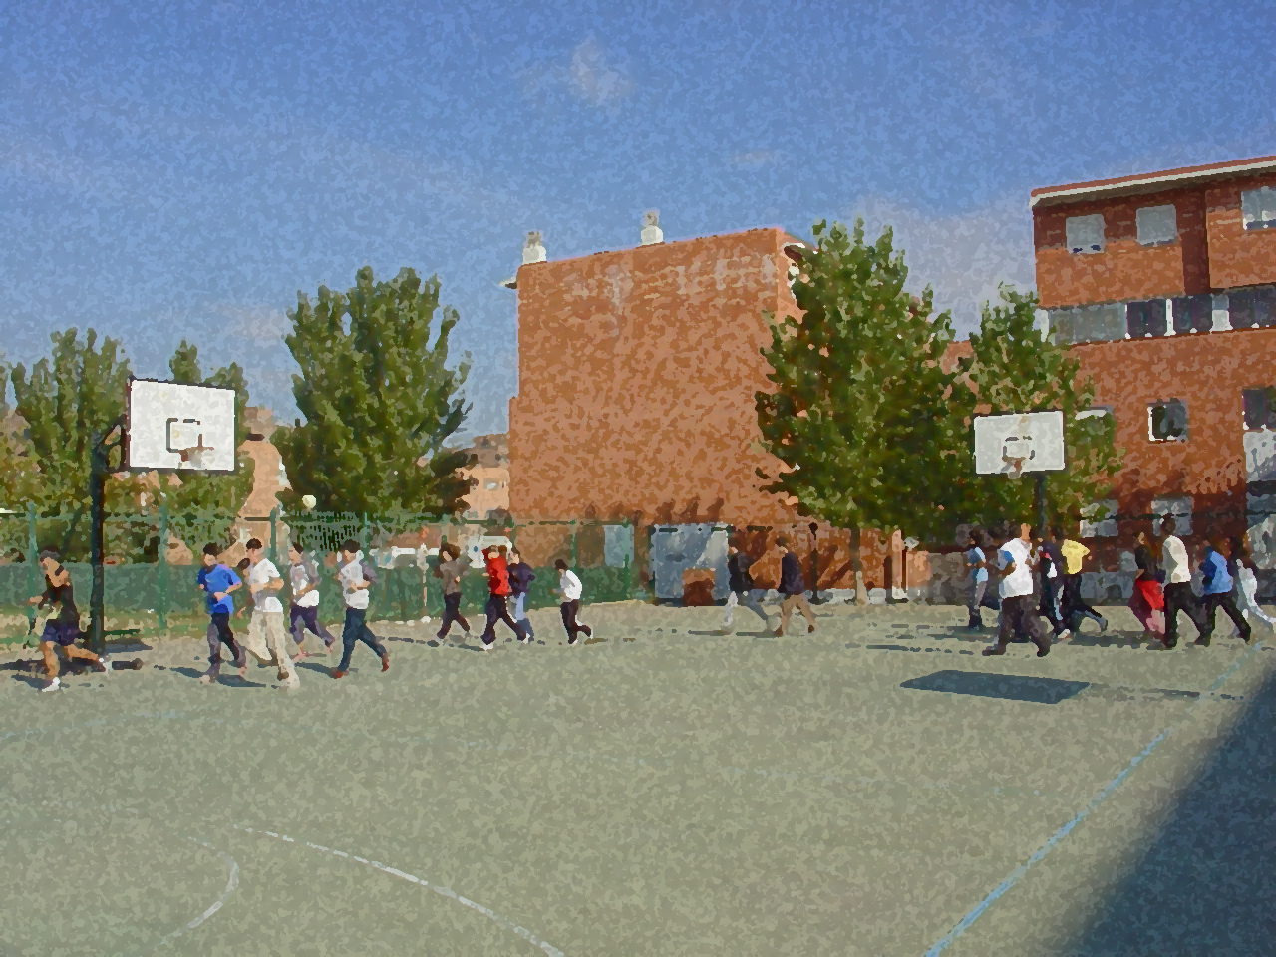

Fundamentals for Secondary School and Baccalaureate. Comprehensive and experiential learning
Recreational Fencing

Slide 2
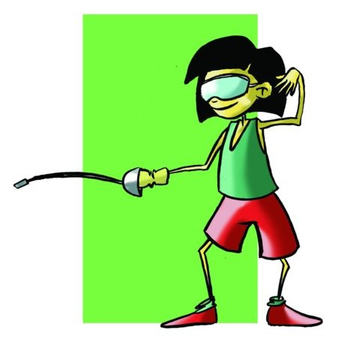
Recreational Fencing
Objectives
Significant Adjustments in Fencing
Basic Regulations
Equipment and Facilities
Basic Moves
Practical Exercises
Questionnaire and Activities

Slide 3
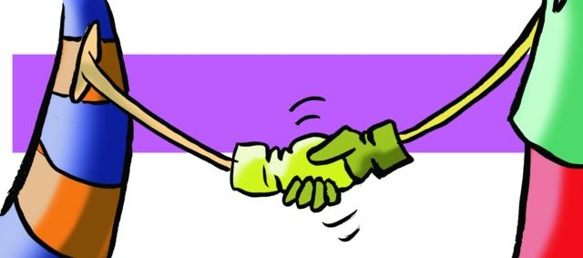
OBJECTIVES
- To fundamentally improve leg strength and flexibility as well as improve response time and gestural velocity.
- To learn the basic techniques of this specialty, applying, in this martial arts sport, key aspects of fair play.

Slide 4
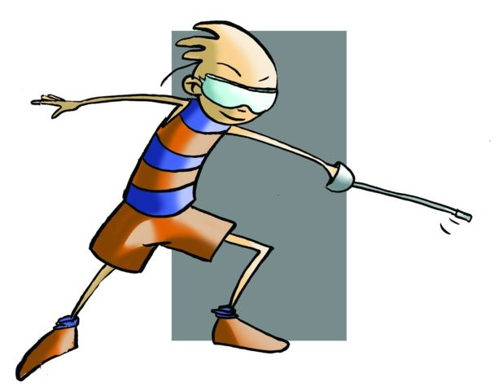
Egypt welcomed "fencing" but it was not until the ancient Greeks when it was accorded, with its exercises and paramilitary games, a special status.
The Myrmidons in Roman times, trained rigorously with the sword for gladiatorial game. In the Middle Ages, with the appearance of body protection (armour). Sword making underwent major changes due to new materials used; it became more resistant and harder against the armour. The technique employed in sword fighting centred on the speed of movement and dexterity, which were fundamental in defence, especially for those who could not easily acquire swords made from this material.

Slide 5
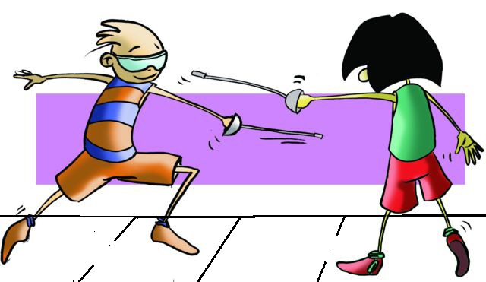
From the fifteenth century fencing made significant advances and extended to the middle class schools, proliferating there. Over the next years fencing treatises were written in Spain, and later in Italy and France, countries considered to be the creators of modern-day fencing.
By the mid-sixteenth century the first fencing masters and the florets appeared. In the nineteenth century, sport fencing halls or clubs were created, which used the foil (widely used in duals) sabre and sword. In the early twentieth century the three weapons used were settled and their use in duels disappeared, what remains is schooling, honour and courtesy of the sport, features that still lives on today as pillars of sport fencing.
In 1913 the International Fencing Federation was created in Paris and the first steps were taken in the regulation of this beautiful sport. Today it is an extraordinary sport, elegant, respectful and polite.

Slide 6
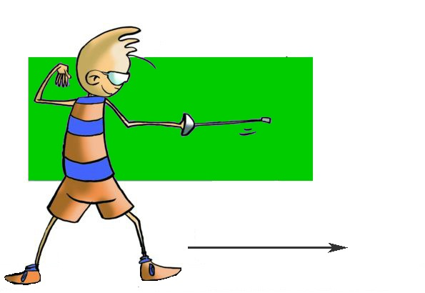
SIGNIFICANT ADJUSTMENTS
Clearly, this sport requires very specialised facilities and equipment. There is specific regulatory clothing that is essential and specified to the fencers (those who practise fencing): jacket for sword or rapier modality; a plastron (required interior protector); electric equipment essential to detect a touch by opponent’s blade; and the weapons themselves, e.g., foil, epée and sabre.
No doubt it is complicated and not inexpensive to offer fencing in your secondary school in these conditions. We have taken the adaptations made by Alberto and Yolanda Turon.
Participants also called fencers.
The referees are judges who decide whether the hit is valid and give the words of preparations, “On guard” and “Play.”
The bouts are made up of 5 touches or the best in four minutes.

Slide 7
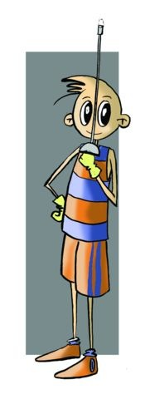
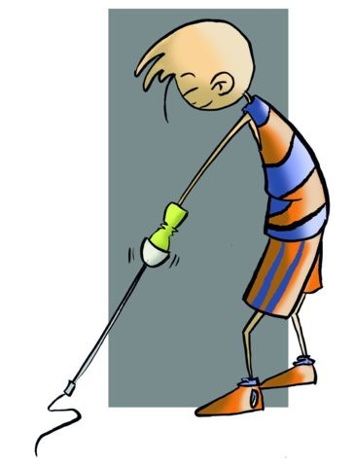
The beginning of the bout is carried out with the greeting, without masks. It is performed as the sword is unsheathed, the arm extends out with the palm up, and the arm is bent, the fist under chin and blade upright. The fencer salutes the opponent, the judge and the public, and then a Z is made with the tip of the sword in the air and makes as if to sheath the sword. Then the fencer puts on the mask and awaits the judge's orders, which are:
    En-guard - on guard position behind line B.
    Ready - at the start of a bout and/or
    Halt - to a penalty, touch or end of combat.

Slide 8
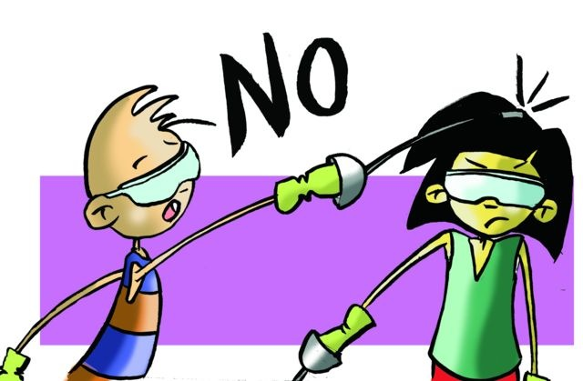
Basic Regulation of Alternative Fencing
Valid touches | Non-valid touches
• When the fencer crouches to make contact with the opponent’s trunk. • When the fencer crosses the side-line or end line with both feet. | • Rubs the tip of the weapon on the opponent’s trunk. • Touches on arms legs and head. • Hits hard or executes a whip-over on the opponent. • Touches the floor or opponent’s weapon.
Warnings | Rules regarding courtesy
• The judge will stop the bout should a player step outside the side or the bottom of the piste. | • Hits properly and honestly. • Acknowledges the touches received in the case the bout has no referee. • At the end of the game shakes the opponent’s hand.
Prohibited
• Turns his/her back on the opponent, touches or grabs the sword of a companion, executes a whip-over with the weapon, verbal behaviour detrimental to the opponent or the judge, does not acknowledge a touch.

Slide 9
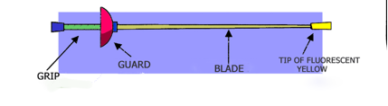
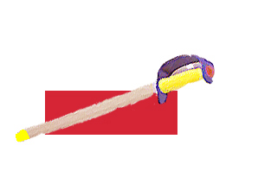
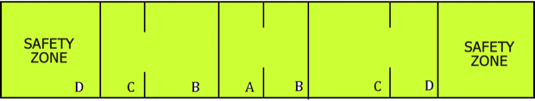
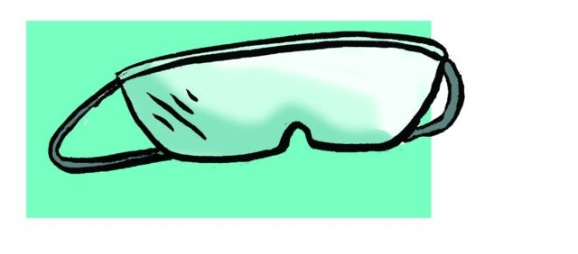
Equipment and Facilities
Fencing equipment consists of a sword and mask. The sword has a length of between 80 and 95 centimetres, depending on the category, it is formed by the grip or hilt, the guard and blade.
The strip should be a smooth, flat surface, whose dimensions vary but we suggest the following:
A. Centre
B. On-guard line
C. Warning line (2m)
D. End of piste or rear limit
Between A and B there is 1.5m; C and D 1m; B and C 3.5m; D and D 10m

Slide 10
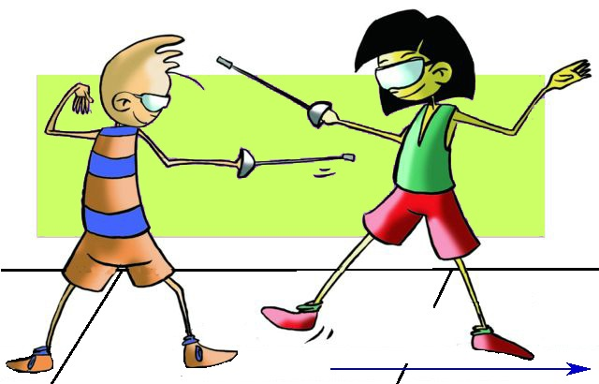
BASIC MOVES
Grip | Take the sword with the palm up, thumb and forefinger together and other fingers clasp the handle reaching the palm.
On guard position | Basic position from which most of the movements begin; knees slightly bent and legs apart, the front foot pointed towards the opponent, back foot placed perpendicular to the front. The trunk is upright and turned to the side to protect the largest contact surface. The fencer faces the opponent, but his/her attention directed to the opponent’s movements, never directed towards the face, as in the professional fencing it is more than obvious since the face is hidden by a mask.
Advance | It is the movement of attack that is performed with step by step forward movements and on guard position.
Breaking ground | It is the movement taken to defend oneself from attack, in which one steps back without losing on guard position.

Slide 11
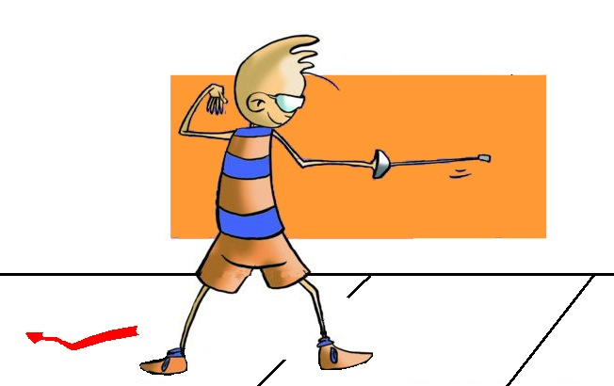
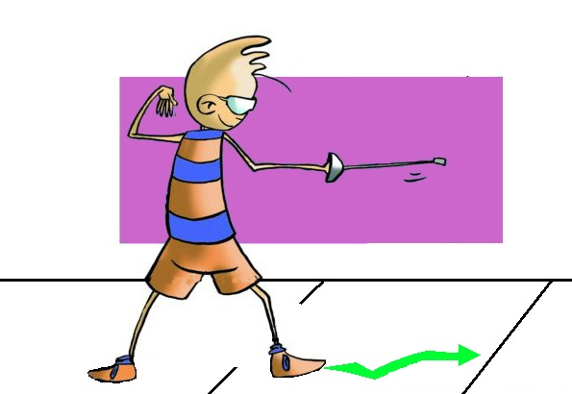
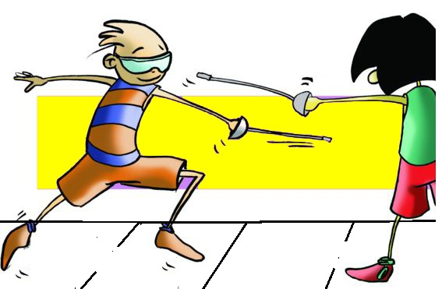
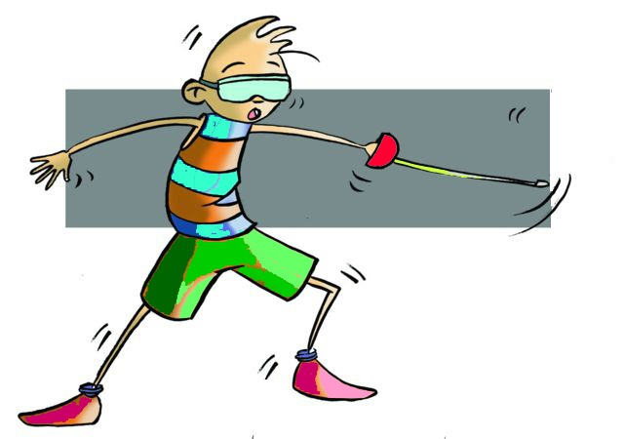
Attack | Known as the movement of attack against the opponent, it is a long step taken with one foot forward, the sword arm extended, to reach as much as possible
Jump back | It is a rapid movement in which a backward jump is made by the movement of the back leg, throwing one’s weight on the back foot, and moving the forward foot in an on guard position.
Balestra or Jump Lunge | It is a movement in which a foot is thrown forward, the body is balanced and the guard position supporting the back foot.
Lunge | it is a very fast forward movement, with the sword arm outstretched and with the clear conviction that the objective will be touched, so much so, that if it is not made, there is no going back and it will be you that is hit.
Feint | rapid movements that seeks to deceive the opponent, in the face of an attack from one’s opponent or one’s attack.

Slide 12
QUESTIONNAIRE AND ACTIVITIES
In which territories was the practice of fencing originally recorded?
What are the pillars on which the practice of fencing as a sport stands today?
How long is the piste?
Which, in this sport, are the valid hit zones?
Identify four basic moves in fencing.
Write down in your notebook unknown vocabulary from this unit.
Check the Federation website or any sports association in your region and check for changes or modifications, if any, in its regulations.

