Slide 1
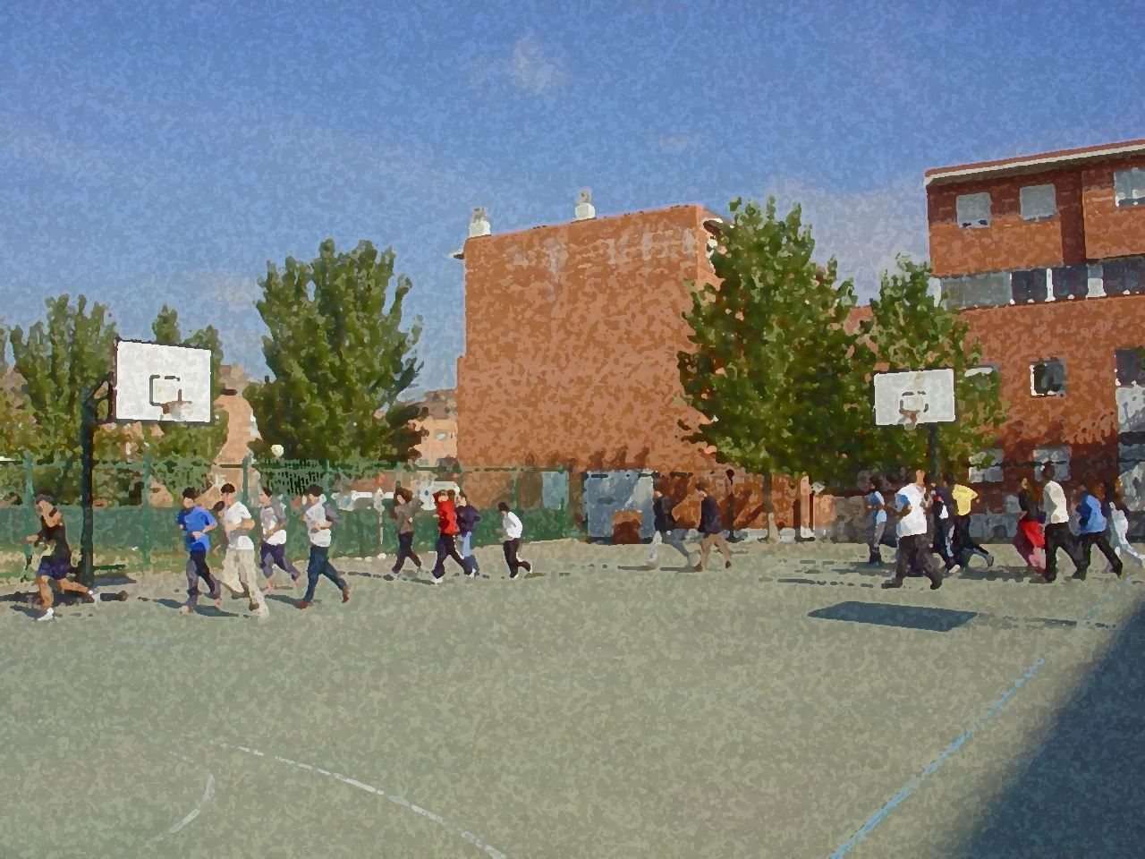
Fundamentals for Secondary School and Baccalaureate. Comprehensive and experiential learning
ENDURANCE
2/14/15

Slide 2
ENDURANCE
Objectives
Concepts to Consider in the Development of Endurance
Types of Effort Required: Features & Activities
Concept and Types of Endurance: Aerobic and Anaerobic
Benefits of Endurance Training
Some Tests to Measure Endurance
Methods to Develop Endurance

Slide 3
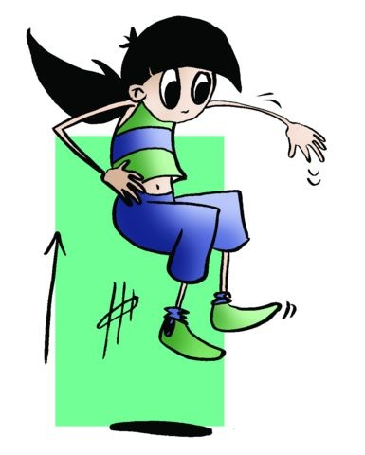
OBJECTIVES
- To learn the peculiarities of the capacity of physical endurance, and the changes it produces on our body.
- To understand how it may be used in terms of our characteristics and level of physical fitness, developing and implementing sessions or exercises, following the objectives of the course, where it improves endurance and develops it following a healthy approach.

Slide 4
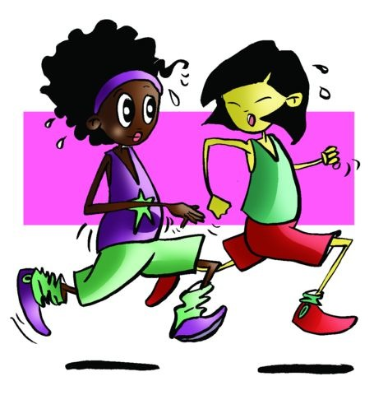
Concepts
The ability of a muscle or body as a whole to repeat an activity many times.
But will this use of energy always be the same?

Slide 5
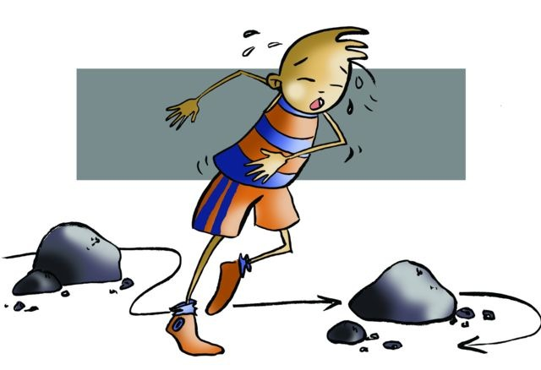
Obviously not,
it will vary in its intensity and according to the characteristics.

Slide 6
EFFORTS HAVE DIFFERENT INTENSITIES
TYPES OF EFFORT | MAXIMUM I. | SUBMAXIMAL I. | MODERATE I.
ACTIVITIES | 100m. and/or jumping - throwing,… | middle distance races, team sports,… | 3000, 5000 and marathon
DURATION | 10” - 15” approx. | 1´ - 4´ approx. | more than 4´
ENERGY SOURCE | ATP, CP RESERVES | O² RESERVES ATP(glucose, fat, etc) | O^{2 ATP}

Slide 7
O2 debt | 95 % | 60 - 70% | approx. 5%
BEATS PER MINUTE | + 180 bpm | 140 - 160 bpm sometimes + 180 | 140 - 160 bpm approx.
BREATHING | maximal | submaximal | normal
FATIGUE | without reserves | lack of O2 and reserves | Loss of liquids and reserves.
RECOVERY | after 1—2 min when the heart rate has dropped to 120 bpm. | after 4—5 min when the heart rate has dropped to 90bpm | practically not needing recovery from such a short workout

Slide 8
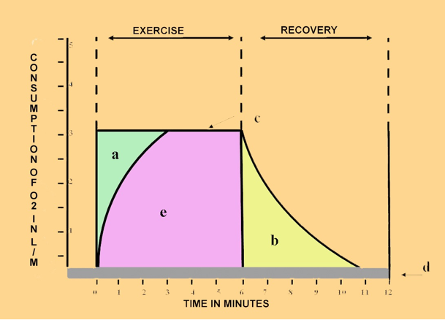
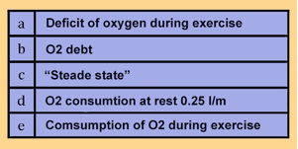
CONCEPTS TO CONSIDER FOR THE DEVELOPMENT OF ENDURANCE
O2 consumption | It is "the O2 used by cells in exercise through breathing” David R. Lamb
Oxygen deficit | is the lack of required oxygen the body needs during the expenditure of energy.
O2 debt | We understand O2 debt by the excess of O2 consumed by the body during recovery period to settle the deficit incurred in expending effort.
Steady State | Steady-state concept, it is applied during light exercise. The oxygen consumption increases upon exercise onset to attain a steady level, which can be maintained for a long period of time. The aerobic metabolism sustains the entire energy requirement of the exercising body.

Slide 9
CONCEPT AND TYPES OF ENDURANCE
AEROBIC ENDURANCE | ANAEROBIC ENDURANCE
Which is defined as the ability of the body to prolong as much as possible a workout of light intensity, maintaining a balance between use and contribution of O2 with a negligible oxygen deficit. Usually the initial training for any sport employs aerobic endurance as it prepares the body to withstand prolonged efforts. | It is the body's ability that allows for an intense activity causing an imbalance between the supply of O2 and needs of the organism. The O2 deficit brings about a cessation of effort. We can define anaerobic endurance as the ability to maintain a high degree of intense effort as long as possible.

Slide 10
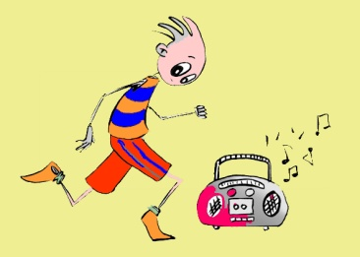
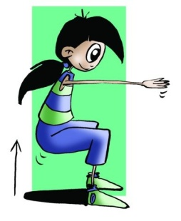
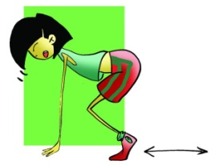
SOME TESTS FOR MEASURING ENDURANCE
RUFFIER TEST
COOPER TEST
COURSE NAVETTE (Bleep Test)
1500 metre race
BURPEE TEST
300-metre race

Slide 11
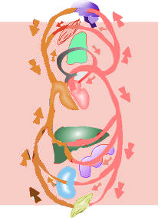
BENEFITS OF ENDURANCE TRAINING
strengthens the muscular system
increases cardiac output
strengthens and thickens the walls of the heart
activates metabolism in general
improves and increases capillarisation
reduces heart rate

Slide 12
METHODS TO DEVELOP ENDURANCE
Finnish School
Continuous Training
It consists of running at a steady pace and at a moderate intensity. The runner’s pulse may range between 60, 70 and 85% of the MHR. The main objective of this method is to improve aerobic endurance.
German School
Interval Training
It is running relatively short distances at great speed combined with recovery periods. The main objective of interval training is to improve anaerobic endurance. Five factors: Distance, Interval, Time, Repetitions and Action (DITRA).
Swedish School
Fartlek
This method consists in continuous running, often alternating changes in pace. As a "main objective" we have the development and improvement of both types of endurance (aerobic and anaerobic)
French School
Total Training
The origin of this system is the natural movements of primitive man, running, jumping, climbing, crawling, throwing, etc. the French G. Hebert adapted in so-called "Natural Method". Aerobic
English School
Circuit Training
This training system is performing a predetermined number of exercises (stations), with pauses between them. The main objective of this system is to improve aerobic-anaerobic endurance.

Slide 13
Key Aerobic Training Zone
AEROBIC TRAINING
15 years old
Continuous Training: 20´
HRmax = 220 - AGE = 205 bpm
Pulse aerobic training: 70 - 85% MHR
Approx 143 y 174 bpm

Slide 14
pulse
ANAEROBIC TRAINING
15 years old
Circuit Training: 20´
HRmax = 220 - AGE = 205 bpm
Pulse anaerobic training: > 85% MHR
Approx > 174 bpm
200
190
180
170
160
150
140
130
120
100
60
time
5
10
15
20

Slide 15
QUESTIONNAIRE AND ACTIVITIES
Why do the muscles involved in an exercise receive more blood than those at rest?
Identify the differences between aerobic and anaerobic endurance.
Are you able to comfortably perform a continuous run of 12 min?
Briefly describe an example of a test to measure aerobic endurance and one for anaerobic resistance.
Measure your endurance with your partner using one of the tests.
Write down in your notebook unknown vocabulary from this unit.

