Slide 1
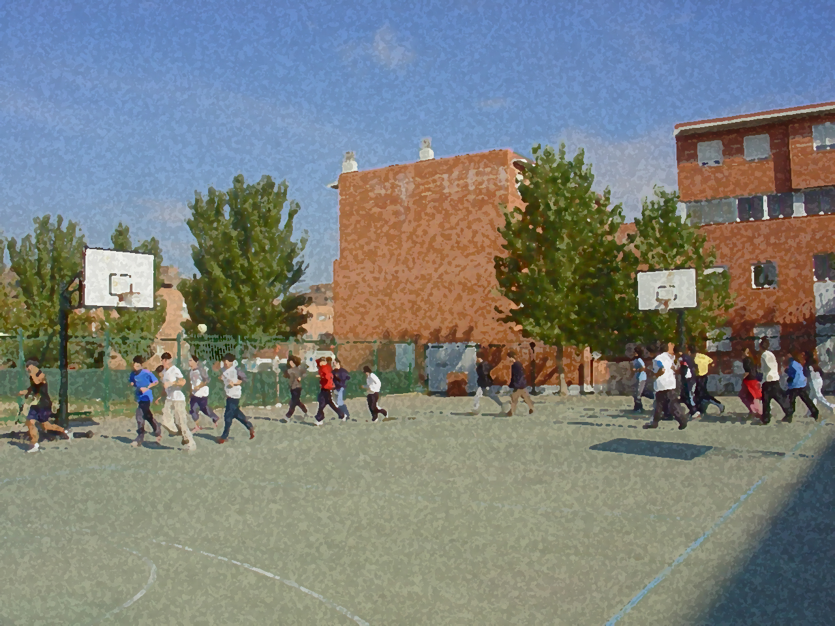
Fundamentals for Secondary School and Baccalaureate. Comprehensive and experiential learning
Athletics

Slide 2
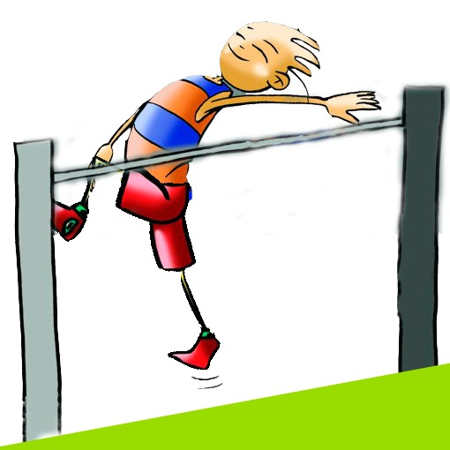
Contents
Objectives
Track and Field Events in Athletics
Basic Rules
Equipment and Facilities
Technical Exercises for Basic Levels
Basic Exercises
Questionnaire and Activities

Slide 3
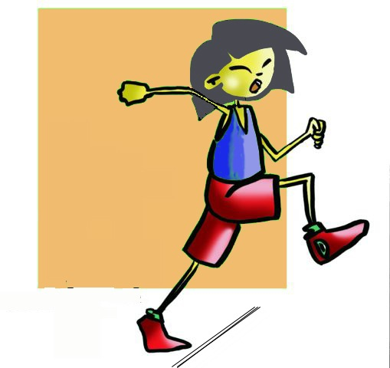
OBJECTIVES
To learn athletics as a regulated sport according to the various modes of which it is composed and its regulatory aspects.
To understand the applicability of the various athletic movements, taking into account the personal characteristics, and participating in the learning process of other classmates.

Slide 4
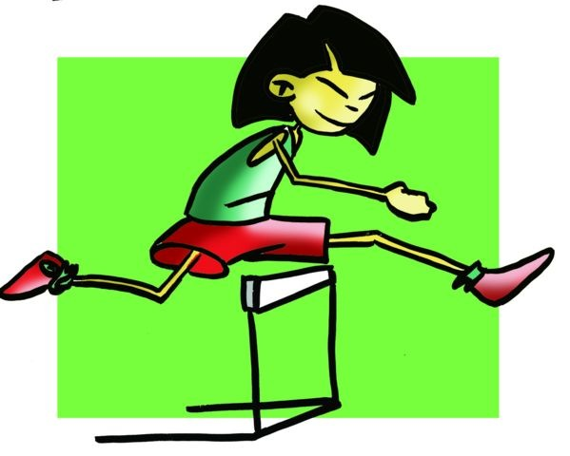
LIST OF ATHLETICS EVENTS
Races | - Sprints: 100, 200 and 400 metres and 60 indoors. - Middle-Distance: 800 and 1500 metres. - Long-Distance: 5,000, 10,000 metres and marathon. - Hurdles: 110 metres (male), 100 metres (female) and 400 metres (both categories) and indoor 60 - metre hurdles. - Steeplechase: 3000 metres. Relay Race: 4 x 100 and 4 x 400 metres. Race walk: 10, 20 and 50 km. - Cross Country: Cross country racing with different distances ranging between 8 and 12 km.
Jumps | – Long Jump; Triple Jump; High Jump; Pole Vault.
Throws | – Shot Put 7.26Kg/4Kg, Discus 2Kg/1Kg, Hammer 7.26Kg./4Kg. and Javelin 800g./600g.

Slide 5
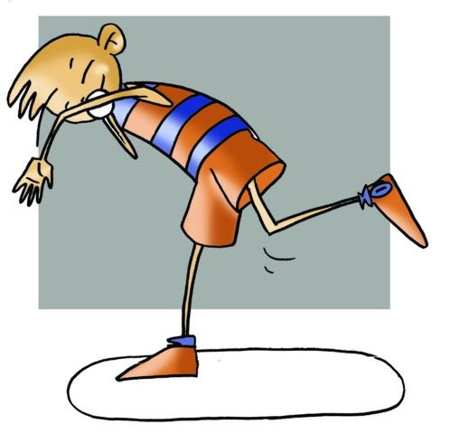
COMBINED EVENTS | In athletics there are some competitions called combined events consisting of uniting running, jumping and throwing in the same meet. Although this book we do not look at them specifically, they are:
 | Decathlon | -100, 400 and 1500 metres; - 110 metres hurdles; - Long Jump; - High Jump; - Pole Vault; - Discus; - Shot Put; - Javelin
 | Heptathlon | - 200 and 800 Metres; - 100-Metre Hurdles; - Long Jump; - High Jump; - Javelin; - Shot Put

Slide 6
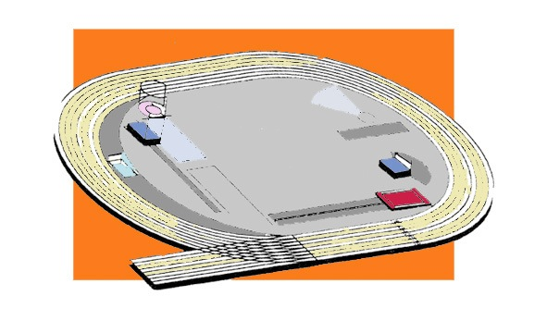
EQUIPMENT AND FACILITIES
That which pertains to athletics refers to races; hardly any equipment is needed to realise it. What is needed is only an outdoor or indoor space which is flat or even, trainers, shorts and a tank top. As one improves, each will improve their gear, footwear with spikes, tracksuit or special running tights that conform to the body to eliminate friction and run faster.
Anyway, let us draw an outdoor racetrack and where the areas provided for each of the specialities are.
As a general rule the outdoor track is a smooth, oval surface with two straight sides and two curves of 100 metres each.
The area within the track is for such field events as jumping and throwing such as javelin, and then there are some circles for shot put, discus and hammer, the latter two are surrounded by a protective mesh.

Slide 7
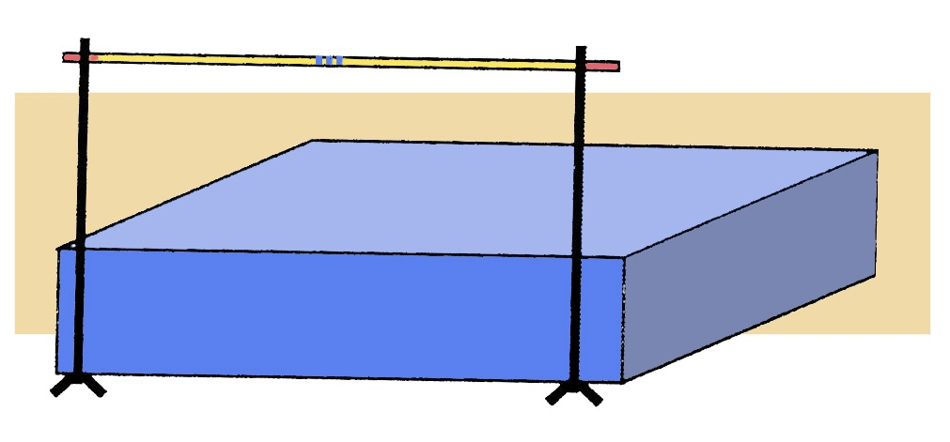
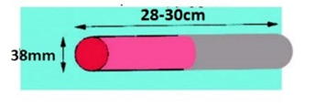
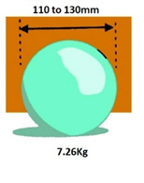
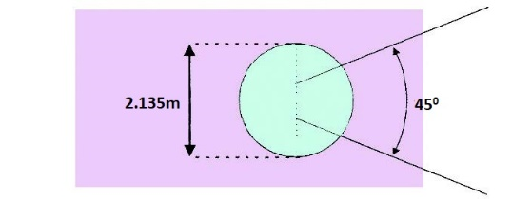
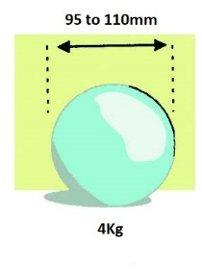
Equipment
Relay
Hurdles
High Jump
Shot put men´s
Shot put
Shot put women´s
Long Jump

Slide 8
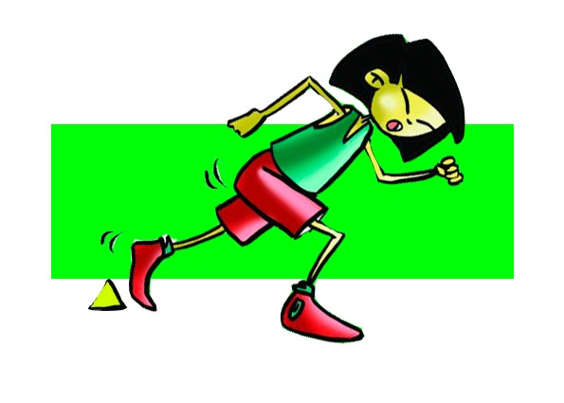
BASIC RULES: Running
In some specialities, so that athletes do not disturb each other, races are performed in lanes 1.20m wide. The track usually has 6-8 lanes. If they leave their lane, the athlete is disqualified. Also the urban environment is used for marathon running and the field for cross country. These specialities of running and marathon sometimes start at the track, continue into an urban environment and end on the track.
- In walking races one foot should always touch the ground.
- As hurdles are tests of speed, the starts are done using starting blocks and athletes run in lanes.
- When an athlete accidentally knocks down a hurdle they are not disqualified. However, if a judge believes that the athlete has kicked the barrier deliberately, either by hand or foot, they will be disqualified.
If an athlete jumps over a hurdle in another lane they will also be disqualified.
There are 10 hurdles in each race.

Slide 9
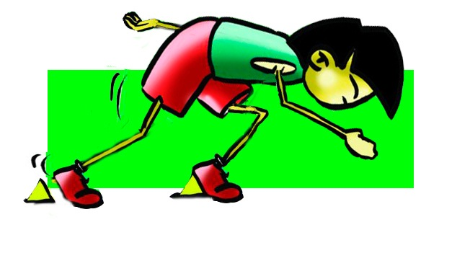
BASIC RULES: Running
- The relay event is run by teams of four athletes that must hand over a baton.
- To pass a baton, there is a handoff zone of 20 metres and an acceleration zone of 10 metres so the receiving runner can pick up speed.
- In cross country, races can be short or long; this classification is being questioned by the International Association of Athletics Federations (IAAF). It is held outdoors, on varied and rough terrain. The course is marked with tape in stretches which are difficult to monitor.
- In the 4 x 400 relay there is no acceleration zone, and how the first leg is run in the lanes, the baton must be passed in changeover zone; the remaining laps and deliveries are free lanes.
- The baton must be taken in hand, if the athlete drops it, he/she that drops it must pick it up.
- In races that are carried out in lanes and go round some bends, the start should be staggered (runners do not start from the same point) because otherwise athletes in the outer lanes would run more metres.
- Departures are as follows: a judge will say "On your marks, set!” and a starting pistol is shot to signal the start of the event.
- When an athlete commences running before the signal, he makes a "false start;" a repetition of such by any competitor will mean being disqualified.
- The judge determines that the race is finished when the shoulder line of the runner crosses the finish line, regardless of any other body part.
- In all events of more than one circuit, a judge will ring a bell as a warning that it is the last lap.

Slide 10
Running
techniques
circular
pendulum
The head: remains upright aligned with the shoulders
and face muscles relaxed
The trunk: remains practically vertical, with a slight
forward tilt of the shoulders.
The arms: perform a forward-backward movement with the elbow
bent almost at right angles and fingers relaxed.

Slide 11
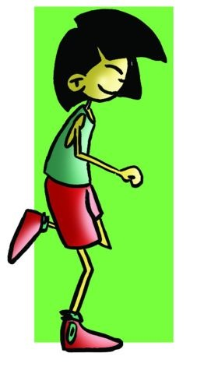
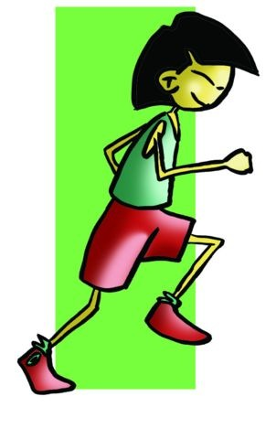
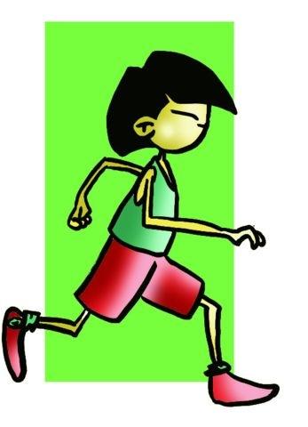
Running
Phases
Contact and shock
Drive
Suspension or air

Slide 12
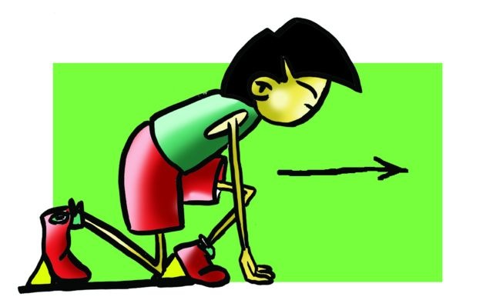
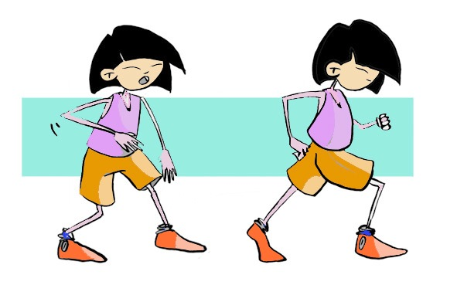
Running
Starts
Crouch start
Sequence
Standing start
"on your marks"
"set"
“go”

Slide 13
Running: races
Sprinting
Hurdles
Race Walking
Medium and Long-Distance
Important: the pace until the 1st hurdle, the lead leg, trunk and the opposite arm, the trail leg.
Phases: Impulse-
Double Support-
Drive
The psychological factors outweigh the physical and physiological.
They have several phases: reaction speed, acceleration, speed and endurance speed.
60m, 100m, 200m, 400m
60m 100m, 110m, 400m
10Km, 20Km, 50Km
800m, 1500m, 5000m, 10000m, Marathon

Slide 14
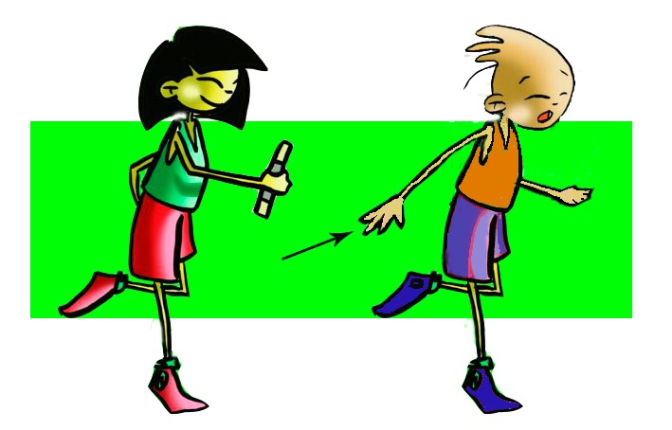
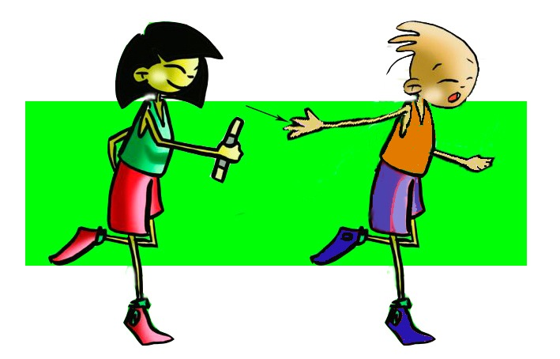
Relay
Downsweep
Handover techniques
Upsweep
Exchage zone 10m
Changeover zone 20m
4 x 100
DISTANCIAS
No Exchage zone
Changeover zone 20m
4 x 400

Slide 15
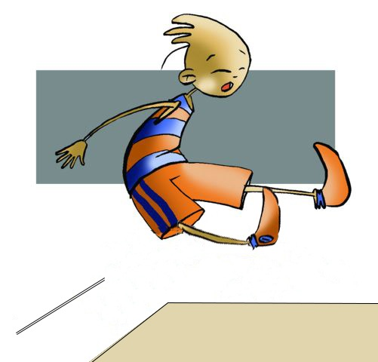
BASIC RULES: jumping
Long Jump:
- In a jumping competition all athletes are entitled to 3 attempts, afterwards 8 competitors with the best scores have 3 more attempts for a final round.
- If the competition only has 8 jumpers or fewer, everyone is entitled to 6 jumps.
- A jumper has two minutes to take the jump.
- The place of the jump is indicated by a take-off board. To find out if you have passed this mark (or foul line) there is, immediately behind it, a substance called plasticine (a type of "clay") that if stepped on, a mark/print is left making the jump invalid.
- The measurement of jump is done from the take-off board to the first imprint that is in the sand pit.
In case of a tie between several athletes, the second best record will be considered and so on until a winner is found.
High Jump:
- It is always performed by starting with one foot. If the jump is performed with both feet, it is declared invalid.
- It is also a null jump if the bar is pulled down or if it moves from the two supports but does not fall.
- If the bar moves by being touched by the competitor, but does not rise from the supports, the jump is considered valid.
- A high jumper is disqualified when he/she makes three consecutive failed jumps, although not at the same height.
- If there is a tie, the winner will be the one with the fewest failed jumps made at maximum height. If there were a tie, the winner would be the one with the fewest number of misses throughout the competition.

Slide 16
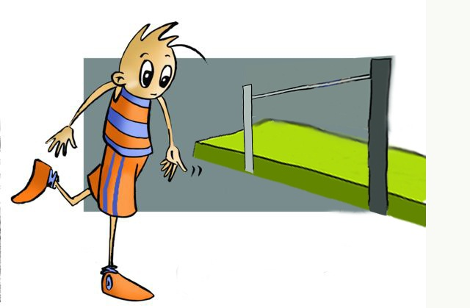
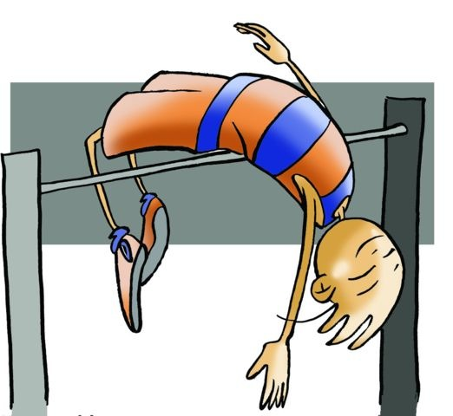
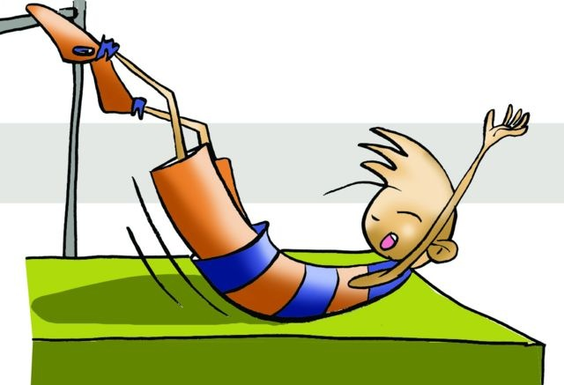
JUMPING
High Jump
Scissors jump
Western roll
approach
Fosbury Flop
flight
landing

Slide 17
JUMPING
Long Jump
Approach
Takeoff
Flight
Landing

Slide 18
JUMPING
Triple Jump
The penultimate step of the race is the longest and the shortest the last
Approach
Once the jumper have stepped on the board he/she will allow the raised knee of the impulse leg to drop back on track and make the second jump. In this second jump, he/she will try to push forward to cover as much distance as possible, this time landing on the other leg.
Takeoff
It comes with legs extended forward and trying to make the imprint mark as far as possible in the pit avoiding falling backward.
Landing

Slide 19
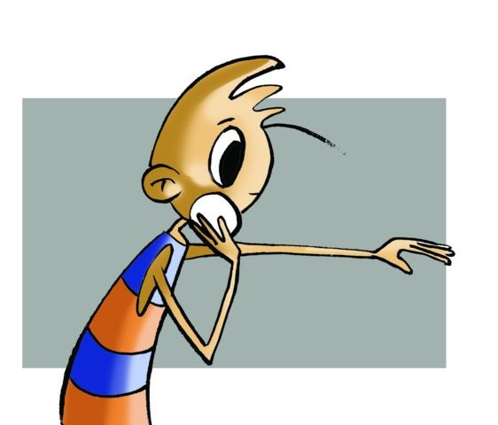
BASIC RULES: Throwing
Shot Put:
The release of the shot is made from a circle of 2.135cm in diameter and it must fall within the landing sector, which is formed by two stripes forming a 45° angle.
As in long jump, the athlete is entitled to 3 throws and 3 more for improvement if they are among the top 8 ranked.
The shot putter cannot leave the circle before the shot hits the ground.
He/she must leave the circle from behind.
The shot will weigh 7.257kg for men and 4 kg for women.

Slide 20
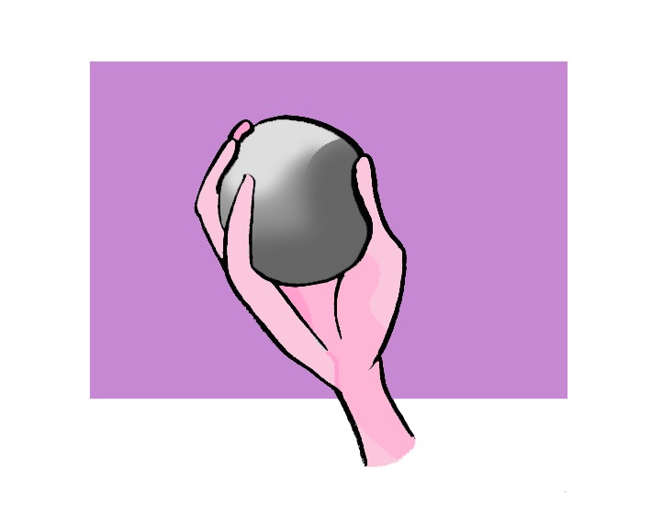
Throwing
Shot Put
Phases:
initial placement grip, drive and launch.
Spin (or rotary) technique
Glide technique
The shot is held in the palm held upward, the three middle fingers behind, thumb in front and little finger resting separately and on the side, preventing the ball from falling.

Slide 21
Throwing
Shot Put: technique
Glide technique
Spin (or rotary) technique

Slide 22
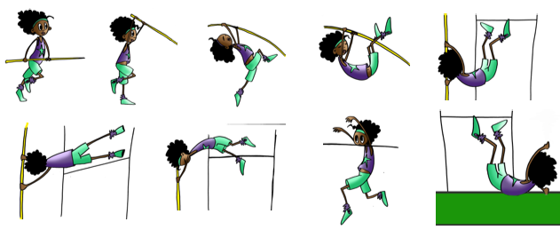
Other specialties
Discus throw
Javelin
throw
Hammer
throw
Pole vault

Slide 23
QUESTIONNAIRE AND ACTIVITIES
In what three basic motor skills tests is athletics?
What are the races that are done in lanes and what are those performed in free lanes?
The baton is a fundamental piece of equipment for...
Name the different phases legs undergo when taking a stride.
Do you know the name of the shortest lane of a running track and how long it is?
Place two classmates, one performing standing start and a crouch start. See who goes faster in ten repetitions.
On which leg does the high jumper lead the jump if he/she runs from the right?
What movement does the opposite arm that grips the shot put perform at the end of the throw?
What are the stages of a jump?
Write down in your notebook unknown vocabulary from this unit.
Check the Federation website or any sports association in your region and check for changes or modifications, if any, in its regulations.

