Slide 1
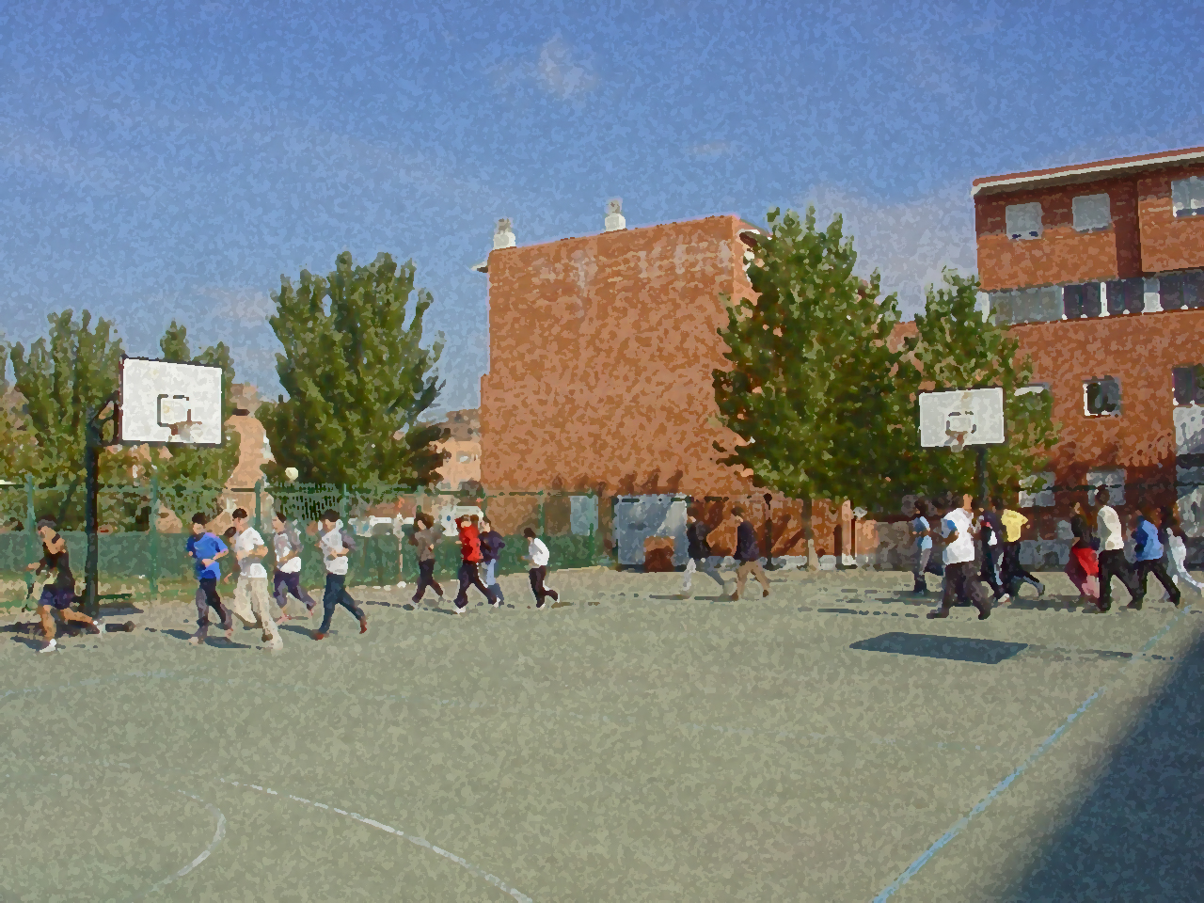
Fundamentals for Secondary School and Baccalaureate. Comprehensive and experiential learning
Basis for a Programme of Physical Activity

Slide 2
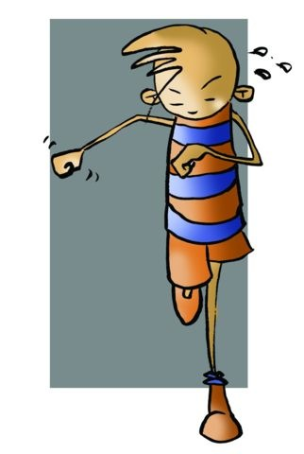
Contents
Objectives
Adaptations an Organism Undergoes
Types of Physical Fitness Programmes:
Anaerobic Approach
Aerobic Approach
Factors to Consider in a General Fitness Programme
Annual Plan
Programme to Improve Physical Fitness
Programme to Improve Sports Performance
Elements that Comprise a Session
Fatigue
Sample Sessions in an Annual Planning Programme
Questionnaire and Activities

Slide 3
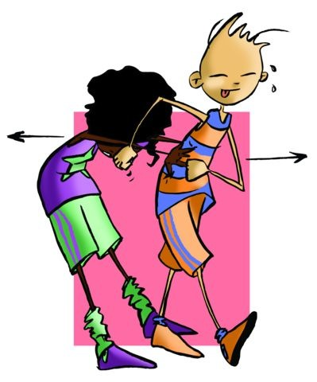
OBJECTIVES
To learn the elements involved when developing a work programme that has an impact on fitness and health.
To understand their application (of elements) to build our own programme to stay physically fit.

Slide 4
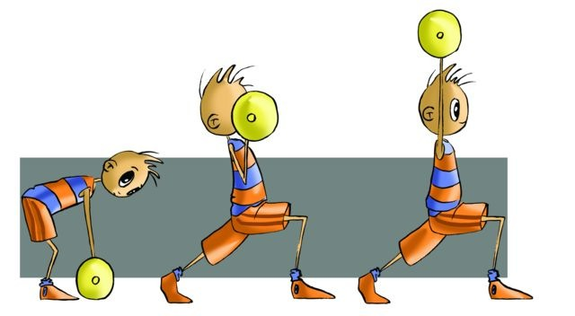
ADAPTATIONS AN ORGANISM UNDERGOES
Muscular System | Respiratory System | Cardiovascular System
Changes in the muscular system: It improves strength, speed, endurance, and flexibility. Regular exercise that is properly done results in an increase in the size of muscle fibre (proportional to the intensity of effort), improved co-ordination of movements and a broader distribution of oxygen to muscles due to increased capillary network. | The respiratory system provides oxygen to the blood so that it can perform its function. With continued physical activity the benefits which this system obtains are greater e.g., increasing the surface area for exchanging gas (CO2-O2) and enhancing lung capacity (vital capacity). | At rest, the heart pumps about 3-5 litres of blood per minute, at a rate of between 50 and 100 beats per minute (bpm). When we start to do exercise, our muscles need more oxygen, as a result more blood, so the heart has to beat faster, pumping 25 litres per minute, at about 200 beats, depending on age. The benefits of physical exercise to this system are among others: effectively lowering at rest heart rate, and increased surface of irrigation (i.e., vascularisation).

Slide 5
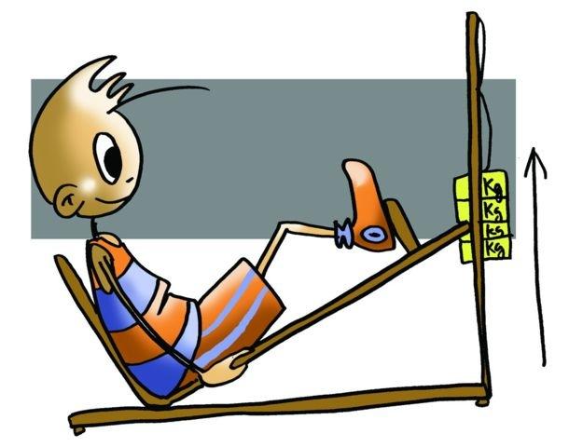
TYPES OF PHYSICAL FITNESS PROGRAMMES
Aerobic Approach | Running, swimming, cycling, etc. The heart rate is between 60% —70% and 85% of the theoretical maximum heart rate (MHR) HRmax = 220 - AGE
Anaerobic Approach | Sprints, jumps, throws, strength exercises, etc. The beats per minute should be above 85% of the theoretical MHR
Stimulus for Training = (mhr-rhr)60%+rhr (rhr=resting heart rate)

Slide 6
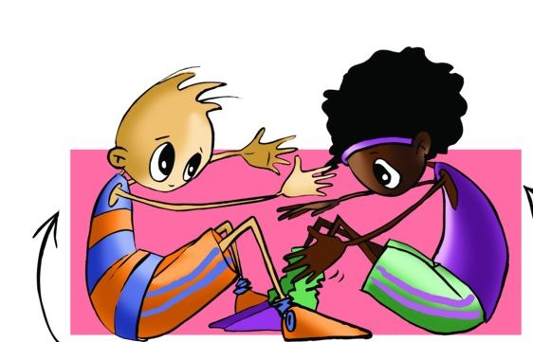
FACTORS TO CONSIDER IN A GENERAL FITNESS PROGRAMME
Weekly Frequency | We need to do at least three weekly sessions, which could be extended to five as advised by WHO
Duration or Volume | The initial duration range from 10-15 min at the beginning and increase as our condition improves to 60 min each session depending on various factors such as age, fitness and sport played, etc.
Intensity | The first thing to do is find our MHR with the formula that you know (220 – age). For an exercise to be sufficiently intense heart rate has to be between 60% to 70% and 85% of MHR

Slide 7
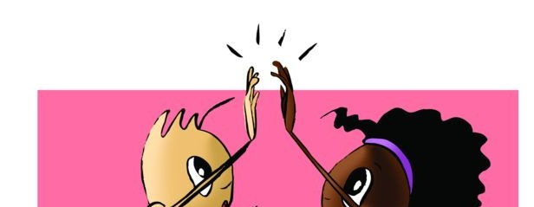
ANNUAL PLAN
Period of Physical Conditioning | Period to Become Physically Fit | Period to Stay Physically Fit
Endurance: Continuous run, Fartlek, Aerobic and Circuit training. Strength: exercises with one’s own weight, lifting light loads (weights) and circuits. Flexibility: general exercises in articular range of motion, active and passive methods. Speed: only exercises and drills reaction speed assimilation. Duration is approximately two months. 60-70% of MHR | Endurance: Continuous and interval training, and specific circuits. Strength: submaximal loads, isokinetic, specific and multi-jump circuits Flexibility: active, passive and isometric stretching. Speed: pure speed and speed endurance. The duration is approximately four months. 70-85% of MHR. | We cannot decrease the volume or intensity already achieved. We can switch to a squash, basketball, or football match, swimming, cycling, etc., as it is within our possibilities The duration is about five months. 75% and 90% of MHR
Programmes oriented towards improving your health

Slide 8
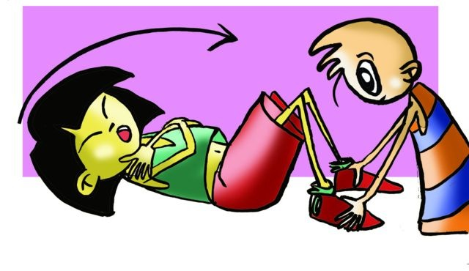
PROPOSAL FOR AN ANNUAL PLAN
Physical Conditioning 1/IX to 30/XI | Becoming fit 1/XII to 30/III | Staying fit 1/IV to 30/VII | Transitioning 1/VIII to 30/VIII
Test: | Test: | Test: | Summer Sports
M: Flexibility | M: Strength | M: Strength
T: Rest | T: Rest | T: Rest
W: Endurance (Sport) Flexibility | W: Endurance Speed (sport) | W: Endurance Flexibility (sport)
Th: Rest | Th: Rest | Th: Rest
F: Endurance (General Circuit) | F: Strength and Flexibility | F: Speed and Strength
Sa: Rest | Sa: Rest | Sa: Rest
Su: Rest | Su: Sports | Su: Sport and Flexibility

Slide 9
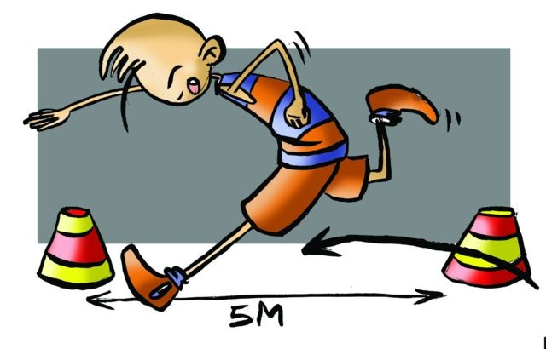
Before planning any training programme, we must consider some basic principles:
Programme to Improve Sports Performance
Multilateral development | we must develop all physical abilities.
Adaptation | it is super-compensation of the body to constant stimuli that training suggests.
Overload | We must increase in intensity, gradually increasing effort to prevent dangerous strain.
Individuality | We must train by adjusting the tasks or exercises to the characteristics of the person.
Self-motivation | We must maintain keen interest that predisposes us to train and improve.
Efficacy | We must always know the how, what, when and why in the selection of a suitable method

Slide 10
Training Cycles:
By training cycle we understand the time period or periodisation we use to work the different physical abilities and motor skills, with the same objectives.
Depending on the duration of the cycles, we will find macrocycle, mesocycle and microcycle.
Macrocycle | is a long training period, which usually lasts between 1 and 4 years. In some sports that have two seasons (winter and summer), it could take 6 months.
Mesocycle | varies in duration, but it usually lasts 1 month.
Microcycle | is a period of short-term training ranging from 1 to 2 weeks.

Slide 11
Performance, Intensity and Volume of a Macrocycle

Slide 12
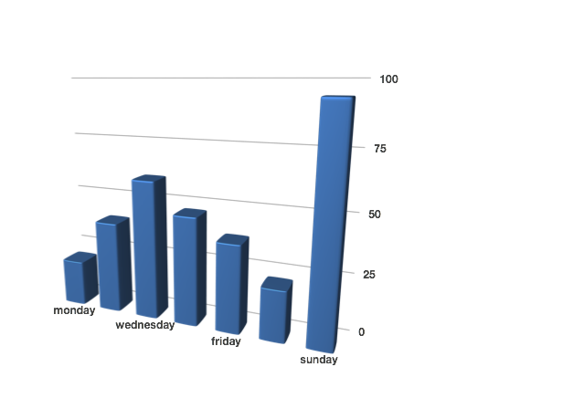
Intensity of a microcycle

Slide 13
Periods of Training
General Physical Preparation (GPP) | or Accumulation corresponds to the period of general fitness training .
Specialised Physical Preparation (SPP) | or Intensification corresponds to the period to developing physical abilities, which includes sports-specific training.
Competition Period (CP) | corresponds to the maintenance period of physical condition. During this period, it is very difficult to sustain a high level of preparation, both physical and athletic, over a long period so there are usually small slumps in the physical condition. For this reason it is advised that two microcycles of reconstruction or "battery charging" be established. In this period the quality of work is primary, i.e., retaining physical abilities and working more technical and tactical aspects of the activity that we are developing. Also the competition schedule should be taken into account in order to establish corresponding mesocycles or microcycles.
Transition Period (TP) | corresponds to the rest period or "time off" within the training programme. It is the active rest as it still involves some form of exercise; it is when the athlete recovers from all the effort exerted during the season.

Slide 14
Graph of physical abilities in relation to training periods
Endurance
Strength
Flexibility
Speed

Slide 15
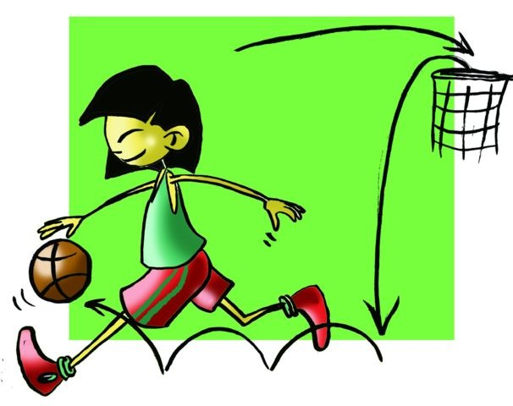
ELEMENTS THAT COMPRISE A SESSION
Initial Phase | It is warm-up where all systems are activated.
Conditioning Phase | A fundamental part in which the ob- jective is achieved and developed.
Warm-Down Phase | Gradual return to normal.

Slide 16
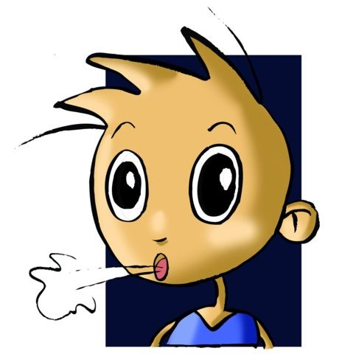
FATIGUE
Dr Alvaro Garcia defined fatigue as "a feeling of tiredness, lack of energy or complete exhaustion, which occurs in people subjected to intense and prolonged physical or intellectual work, and disappears with rest.”
Fatigue, whether it is acute or chronic, will affect physical performance. Body stores fall significantly in a fatigued state, with muscles accumulating large amounts of lactic acid. Also, the interrelation between the nervous system and muscular system is affected in times of fatigue, so that co-ordination is going to be altered as well as other physical qualities.

Slide 17
QUESTIONNAIRE AND ACTIVITIES
1.Briefly discuss the adaptations that occur in the body to carry out an ongoing training plan. 2. Between what percentages must the heart rate be for the training session to be intense enough?
3. How many periods are there within an annual plan and what are their characteristics? 4. In which period should more volume be done? How about intensity? 5. Aerobic endurance should be done more in the period... 6. What is the purpose of that specific period? 7. What are the characteristics of a warm-up? 8. Draw up two different types of warm-up activities. 9. Develop two different Conditioning Phase exercises. 10. Design four different types of sessions, one for each annual period. 11. Prepare an annual plan to improve your physical fitness. 12. Write down in your notebook unknown vocabulary from this unit.

