Slide 1
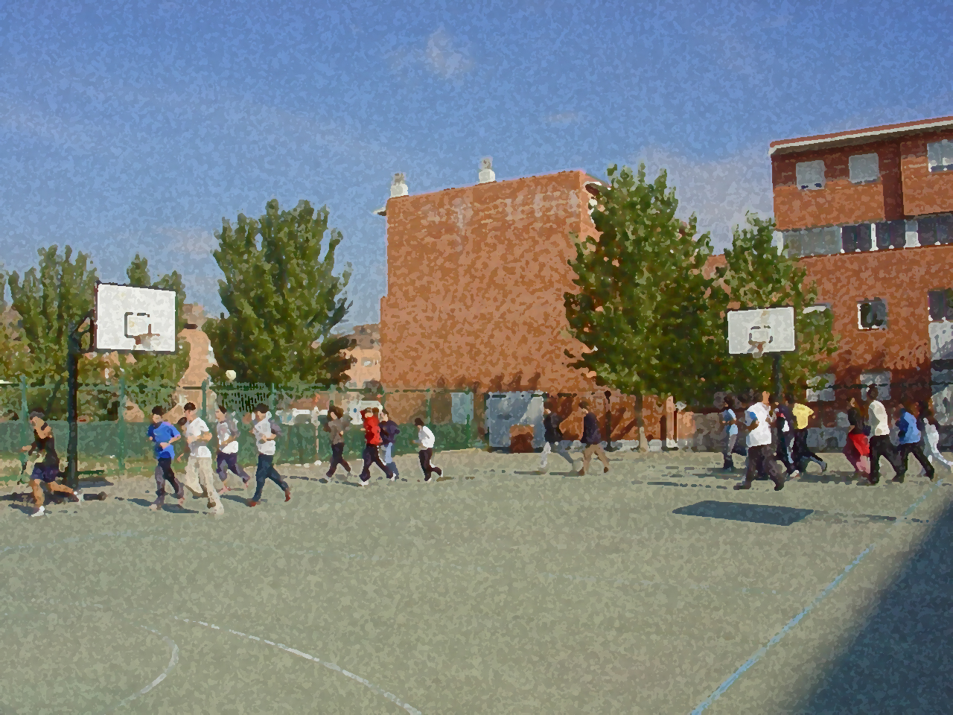
Fundamentals for Secondary School and Baccalaureate. Comprehensive and experiential learning
Analysis of Physical Exercice

Slide 2
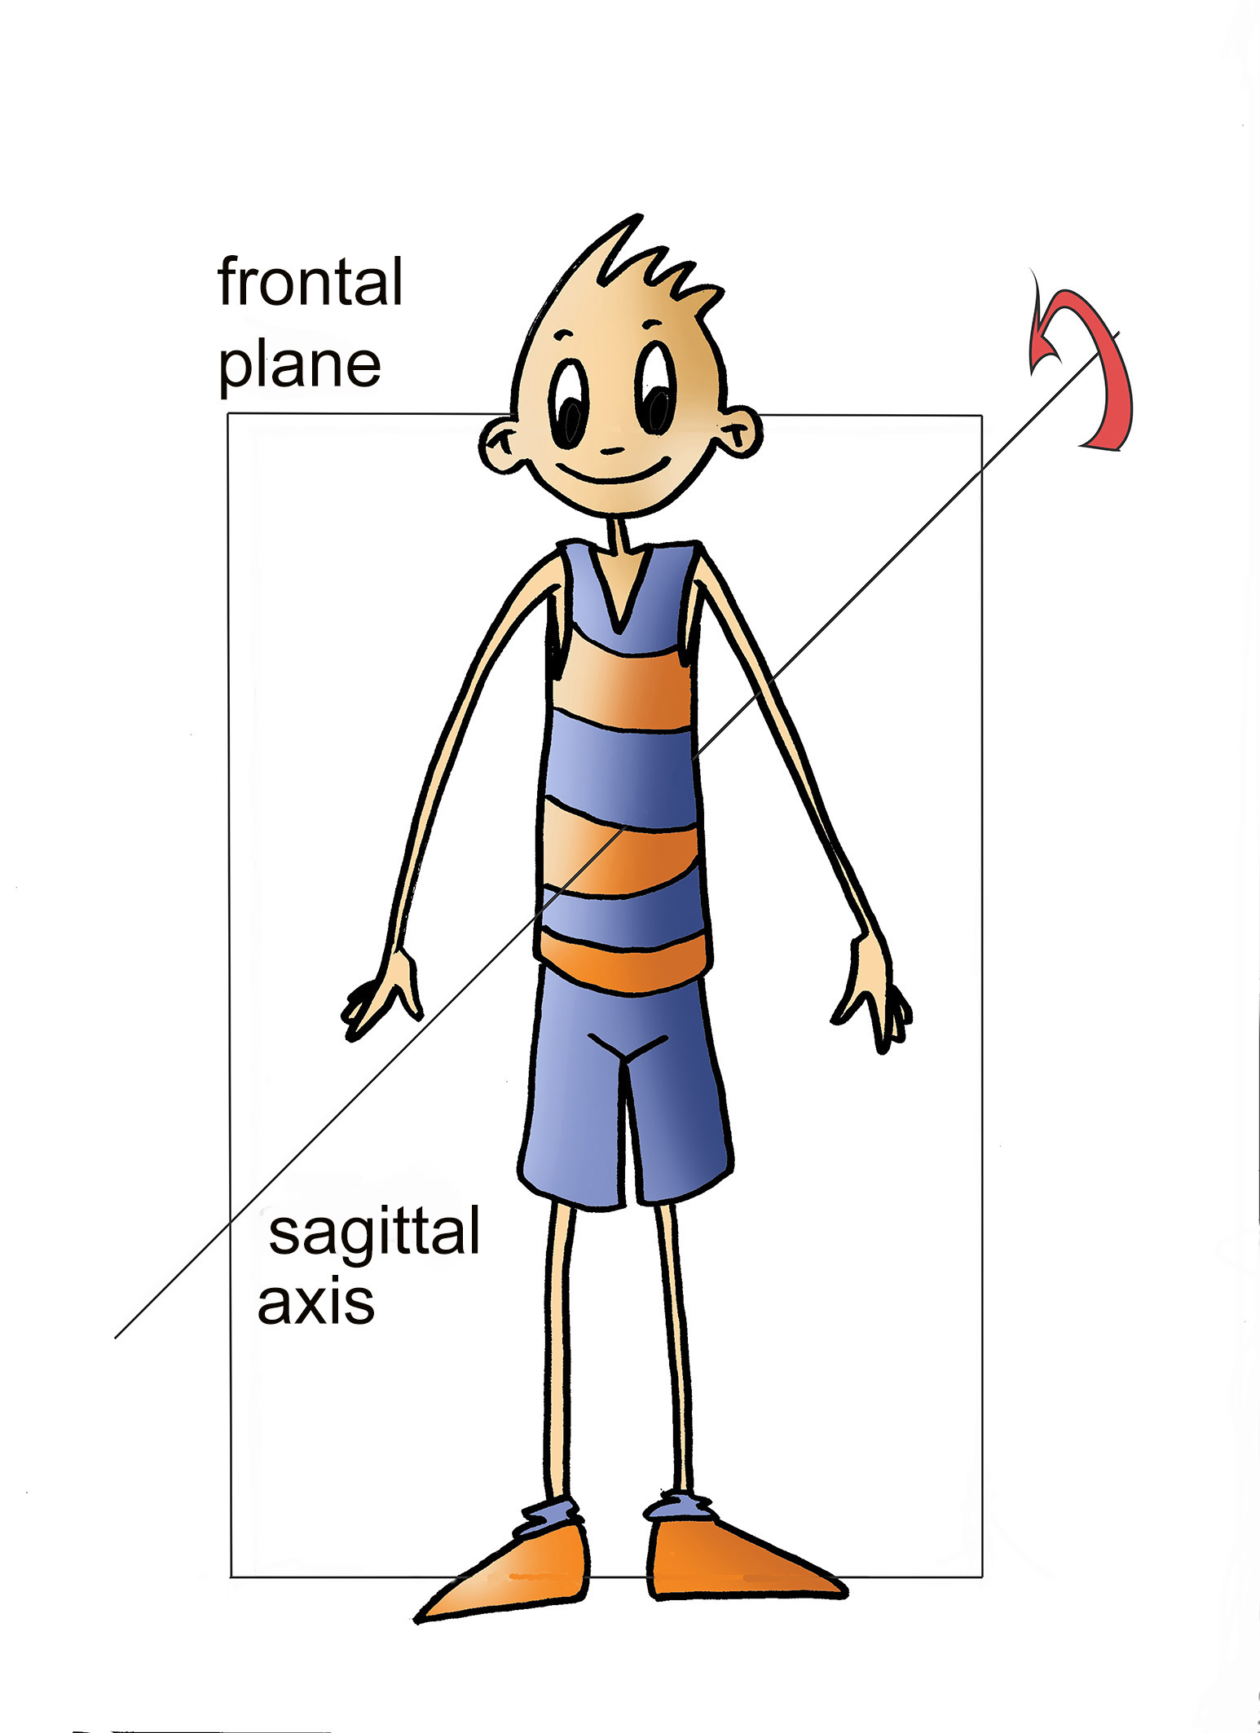
Analysis of Physical Exercise
1. Objectives
2. Three-Dimensional Analysis of Physical Exercise
Anatomical Dimension
Mechanical Dimension
Functional Dimension
3. Relation among the Different Dimensions
4. Questionnaire and Activities

Slide 3
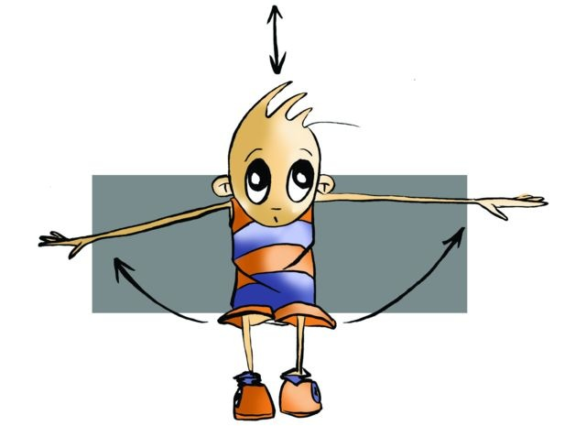
Currently, properly executed physical exercise is health, and it is conceived as a fundamental component of the education system through the subject of PE.
OBJECTIVES
To learn some elements which permit a detailed analysis of the different possibilities of physical activity.
To implement a three-dimensional analysis of exercise to practical proposals that you could consider during PE lessons.

Slide 4
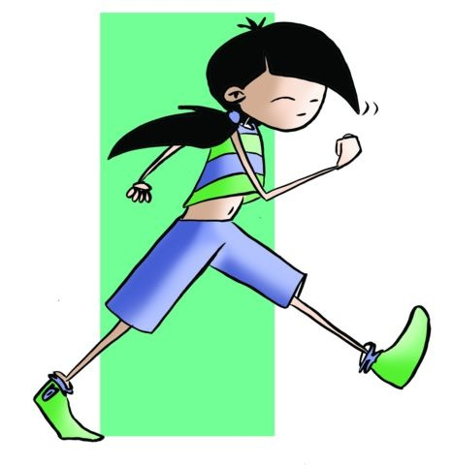
Analysis of Physical Exercice
The three dimensions that Muska Mosston makes reference to are the anatomical, mechanical and functional dimensions.

Slide 5
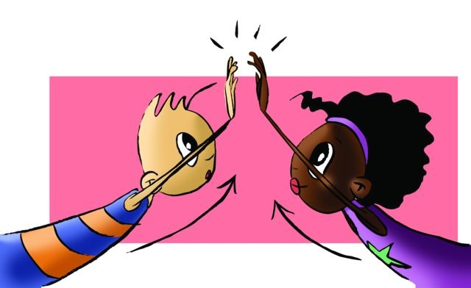
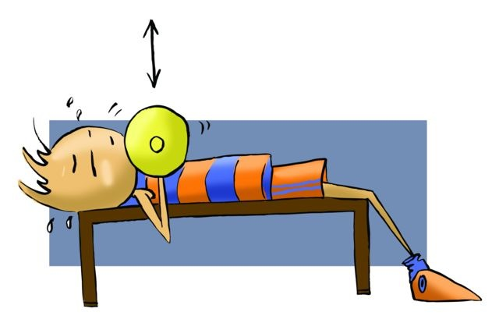
Anatomical Dimension
This dimension localises the part of the body that intervenes in a concrete movement. Therefore, there are exercises for arms, legs, abdominal, lumbar, etc.

Slide 6
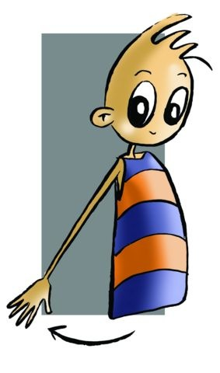
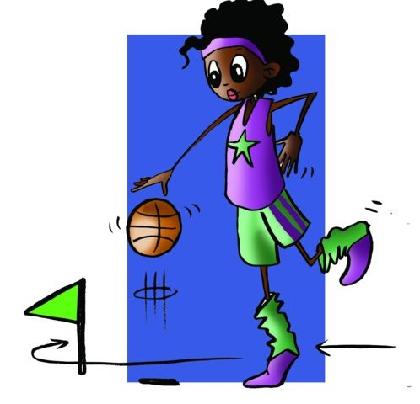
Mechanical Dimension
This dimension analyses the types of movement we make.
On this basis, the two most common movements in the physical activity are as follows.
- Simple or when a joint is put into operation. Examples of which may be seen in the chart.
Complex. It puts several joints into operation which make their analysis more difficult, such as running, throwing, climbing, etc.

Slide 7
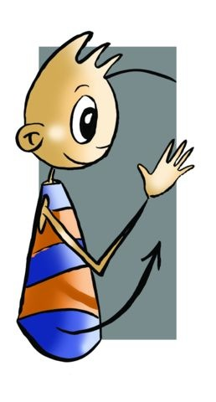
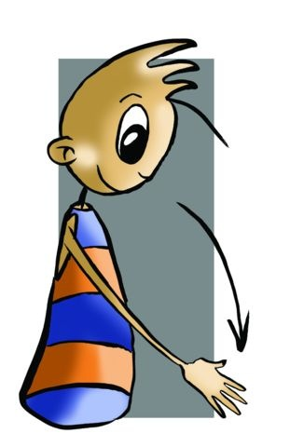
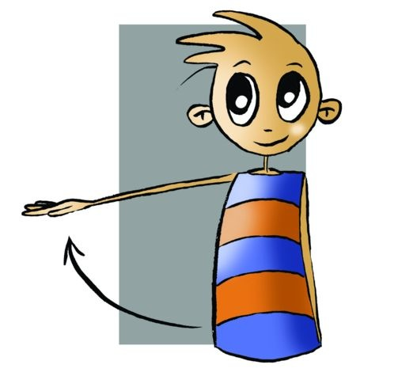
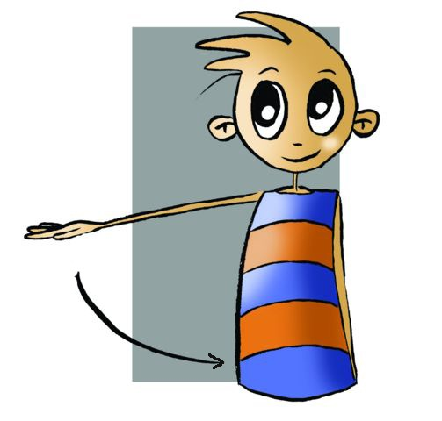
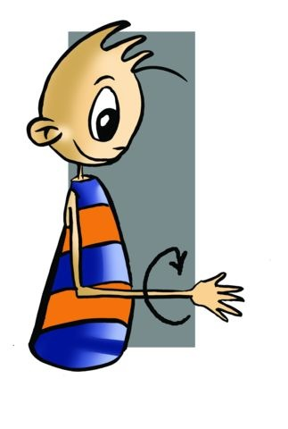
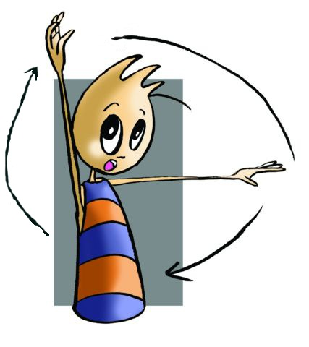
Mechanical Simple
Flexion | It is the movement in which two segments with a same joint approach their distant extremities, for instance, the arm, leg or trunk flexion.
Extension | It is the opposite movement to flexion; it is produced when segments tend to put themselves in continuation or line.
Abduction or Separation | It is the movement of the segment or member, which rotating on the closest extremity to the joint, is separated laterally moving away from the vertical axis of the body, for example, a lateral rising of the arm.
Adduction or Approaching | It is the opposite movement of the one mentioned above, in other words, when a segment or body member approaches, rotating on the proximal end, to the vertical axis of the body.
Rotation | Movement in which the member or segment rotates on its vertical axis. This segment can rotate in two ways: - inwardly or internal or pronation, and - outwardly or external rotation or supination.
Circumduction | It is a circular movement of a segment or member in such a way that one of its ends forms a circumference of a circle rotation with the other end acting as a pivot.

Slide 8
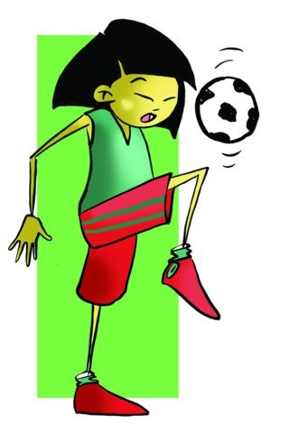
Functional Dimension
This dimension analyses the physical exercise from a point of view of the adaptations or transformations which our body, its systems and functions will undergo.
In particular, it refers to the effects physical exercise has on a person’s physical fitness. In the functional dimension we have the following:
- strength, flexibility, endurance, co-ordination, speed and balance.

Slide 9
Upper Extremity | Shoulder |  | Flexion-extension
 |  |  | Flexion-extension
 |  |  | Rotation external and internal
 |  |  | Circumduction
 | Elbow |  | Flexion-extension
 |  |  | Rotation external and internal
 |  |  | Circumduction with previous flexion
 | Wrist |  | Flexion-extension
 |  |  | Abduction-adduction
 |  |  | Circumduction
Trunk | Area | Cervical Dorsal Lumbar | Flexion-extension
 |  |  | Lateral flexion
 |  |  | Rotation
 |  |  | Circumduction
Lower Extremity | Hip |  | Flexion-extension
 |  |  | Abduction-adduction
 |  |  | Rotation external and internal
 |  |  | Circumduction
 | Knee |  | Flexion-extension
 |  |  | Rotation external and internal
 |  |  | Circumduction with previous flexion
 |  |  | Passive abduction-adduction
 | Ankle |  | Flexion-extension
 |  |  | Rotation external and internal
 |  |  | Circumduction

Slide 10
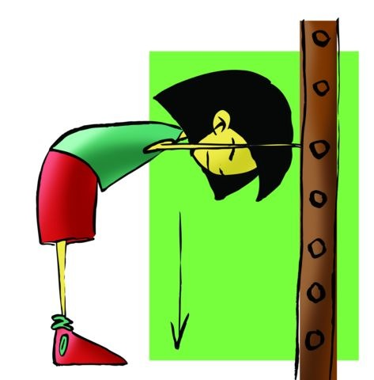
Analicemos este ejercicio
Anatomical |  | Mechanical
Upper Extremity | Shoulders | SIMPLE | Extension
 | Elbows |  | Extension
 | Wrists |  | Flexion
Lower Extremity | Hips |  | Flexion and Extension
 | Knees |  | Extension
 | Ankles |  | Flexion and Extension

Slide 11
QUESTIONNAIRE AND ACTIVITIES
1. From which three dimensions can we study physical exercise?
2. What movements can hips make? What about the wrist? 3. What dimension do speed races belong to? 4. Describe the movements of the knee.
5. Write down in your notebook unknown vocabulary from this unit.

