Slide 1
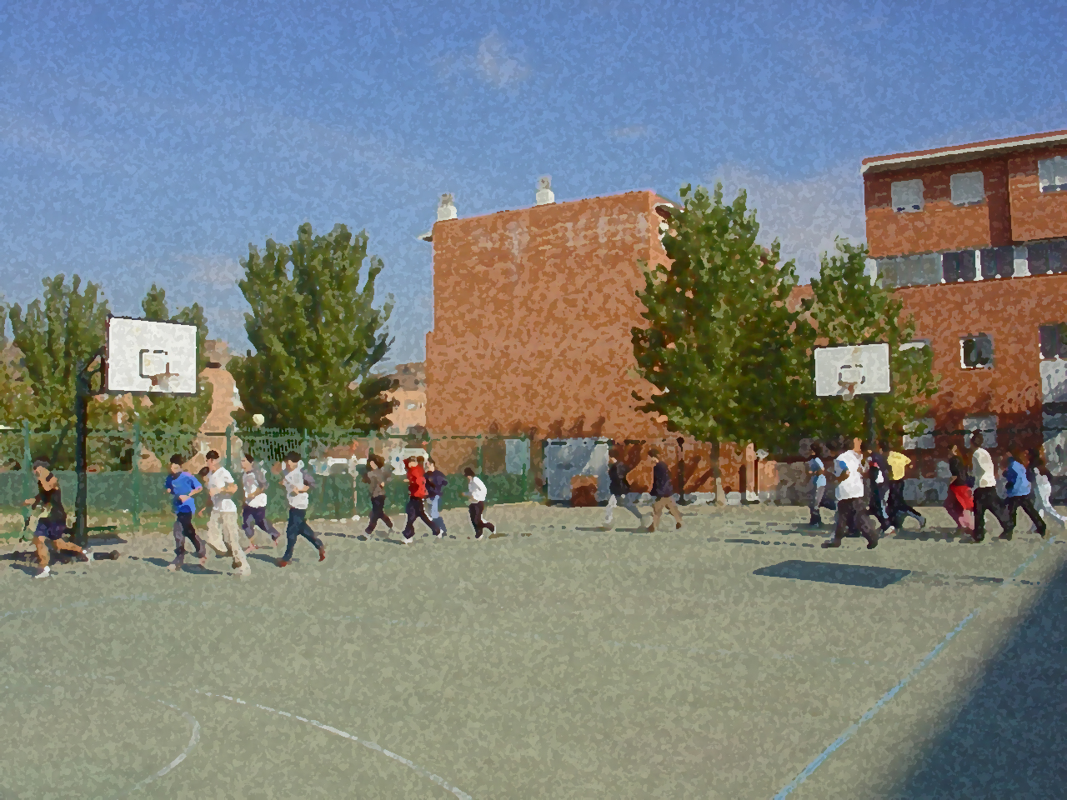
Fundamentals for Secondary School and Baccalaureate. Comprehensive and experiential learning
Basketball

Slide 2
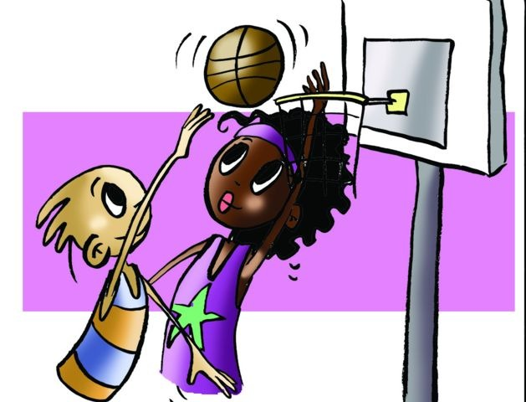
Basketball
Objectives
Regulations, Facilities and Equipment
Basic Technical-Tactical Resources
Basic Exercises
Questionnaire and Activities

Slide 3
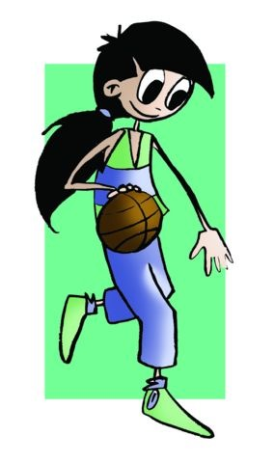
Objectives
To learn the basic technical-tactical and legal elements of basketball.
To understand their application in real game situations.
To collaborate with classmates in the development and implementation of activities.

Slide 4
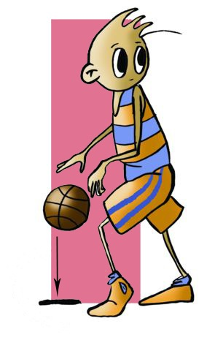
History
Basketball was born in the United States thanks to a group called the YMCA (Young Men’s Christian Association) that helped adolescents. Professor Naismith liked football, but needed a game that would enable him to train children in winter. He needed an indoor venue with a floor that was not too hard so players would not get hurt in falls and one that would allow the ball to bounce in a controlled fashion. This was how basketball began in 1891. It arrived in Spain thanks to a priest who taught at the Escuelas Pías de San Anton who was in Cuba and saw the game. On his return to Barcelona he began to spread the practice in the Pías Schools in 1922.

Slide 5
Basic Regulations
The objective of basketball is to get the ball through the hoop of the opposing team and have them try to stop this. To move the ball from one place to another, players can throw it with one hand or pass it amongst themselves. The team with the most points at the end of the match wins. Points are earned as follows:
– A basket from within the three-point line is 2 points
– A basket from more than 6.25 metres from hoop or outside the three-point line is 3 points
– A free throw is 1 point.
The time of game is four ten-minute quarters. Between the first and second periods and between the third and fourth, there will be a break two-minute time-out while between the second and third, the time-out period is 15 minutes long.
The team is made up of five players on a court. The reserve players or substitutes will enter and exit the court as many times as the manager deems appropriate always advising the referee first.

Slide 6
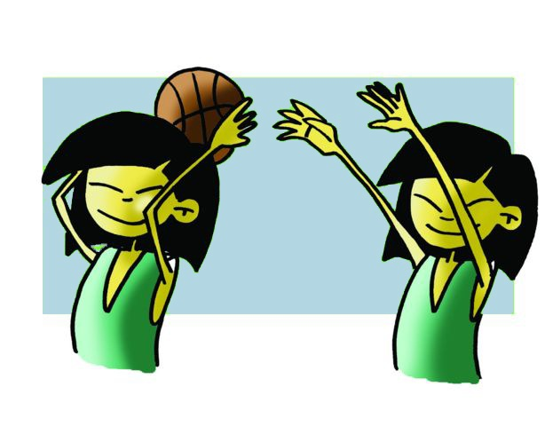
Violations:
dribbling the ball with two hands (i.e. double dribbling); dribbling, stopping and continuing to dribble; taking the ball in both hands and moving with it (i.e., travelling).
A personal foul is committed when a player touches, hits, pushes or slows down the advance of an opponent by grabbing the player, but if an offensive player does this, it is called an offensive foul. If the foul is committed when the opposing player is shooting, they can perform two free throws from the free throw line. If a player is shooting from beyond 6.25 metres, 3 free shots are made; if the ball was not going to be shot, then a throw-in is called that means a player passes from the sideline.
If the foul is committed when the opposing player is shooting, they can perform two free throws from the free throw line. If a player is shooting from beyond 6.25 metres, 3 free shots are made; if the ball was not going to be shot, then a throw-in is called that means a player passes from the sideline.

Slide 7
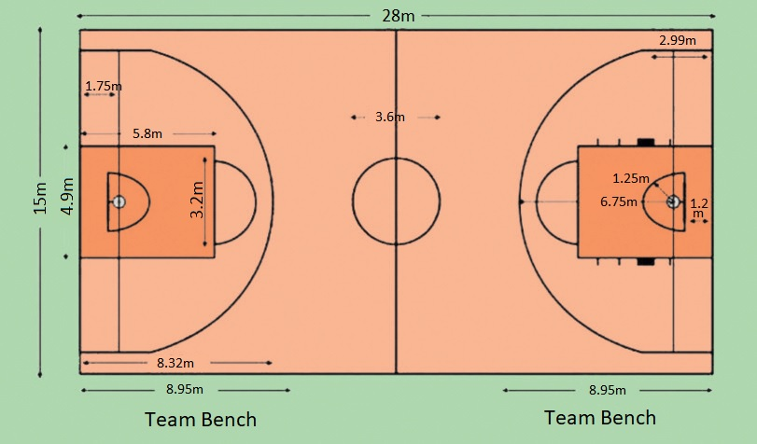
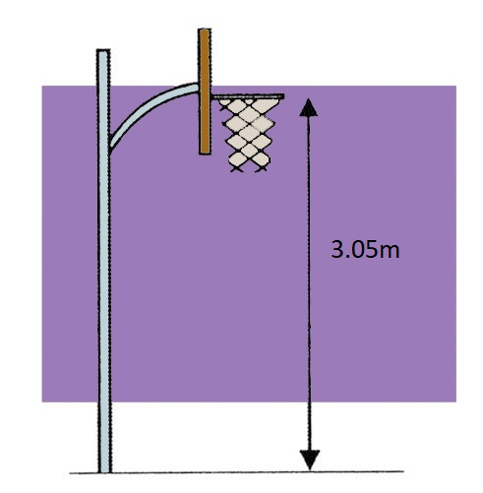
Facilities
- Rectangular court 28 x 15 metres, with a central circle of 1.80 m radius.
-Two baskets located 3.05m from the ground and surrounded by an area 6 metres wide and 5.80 metres long.
-The balls are round and should be between 75 and 78cm with a weight of between 600 and 650 gr.

Slide 8
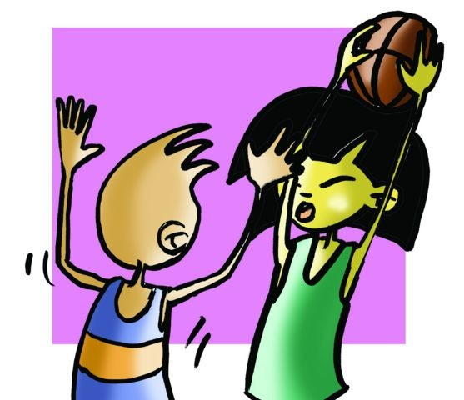
BASIC TECHNICAL-TACTICAL RESOURCES
In basketball, like other invasion sports there are some resources that allow you to implement the strategic principles that you use depending on the decisions that you take in the game such as throwing, passing, shooting baskets....…
As we have seen in "team invasion sports," we believe that the best thing is that, based on the skills you already have e.g. throwing the ball, moving, jumping ... more attention should be placed on which resource to use, rather than how.

Slide 9
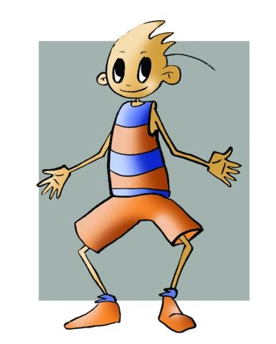
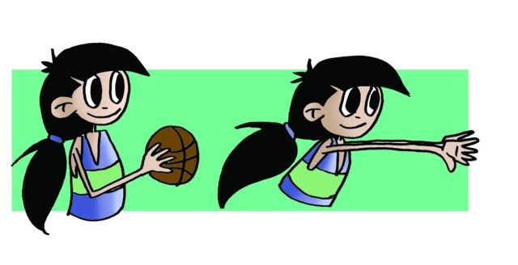
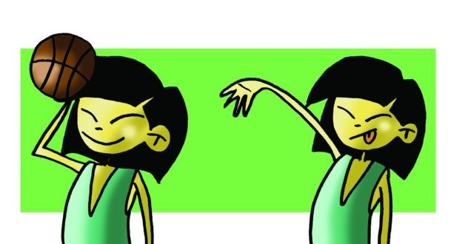
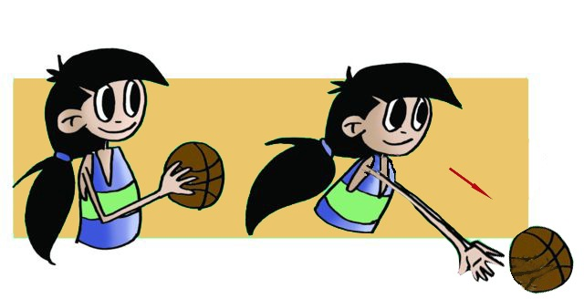
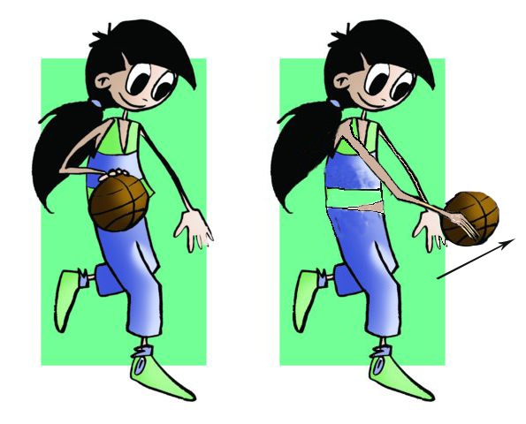
BASIC TECHNICAL-TACTICAL RESOURCES BASKETBALL
basic fundamental stance
Passing
Chest Pass
Overhead Pass
Baseball Pass
Bounce Pass
Dribble Pass

Slide 10
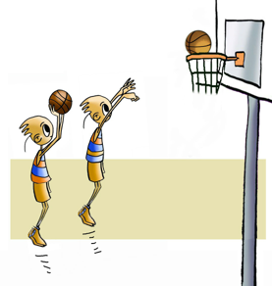
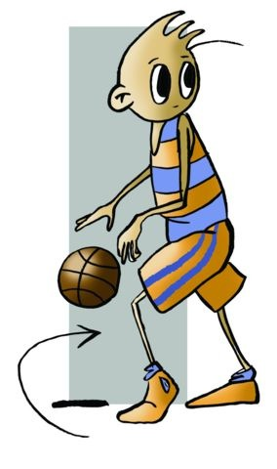
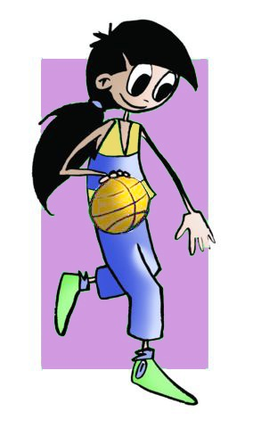
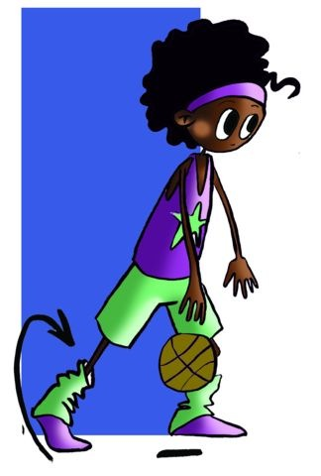
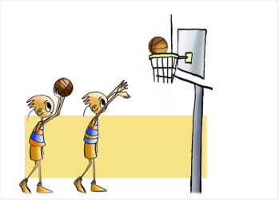
BASIC TECHNICAL-TACTICAL RESOURCES BASKETBALL
Dribbling
Shooting
Jump Shot
Control Dribble
Change-of-Pace Dribble
Reverse or Spin Dribble
Speed Dribble
Set Shot/Free Throw

Slide 11
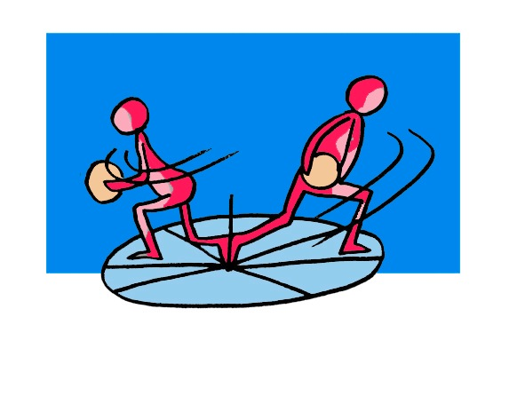
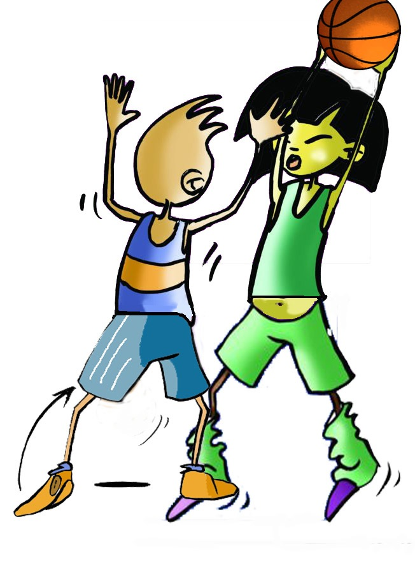
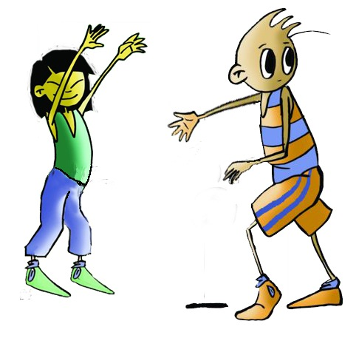
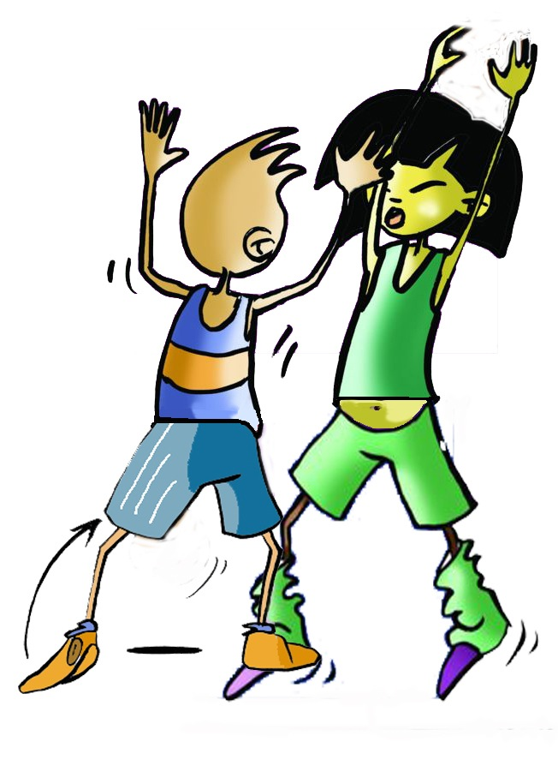
BASIC TECHNICAL-TACTICAL RESOURCES BASKETBALL
Pivot
Open
Marking
Opponent without a ball
Opponent in possession of the ball
When a player is not in possession of the ball, he/she can separate him/herself from the opponent that is marking him/her so as to be able to intervene in the game more easily,
Close man-to-man defense so prevent a pass.
Close man-to-man

Slide 12
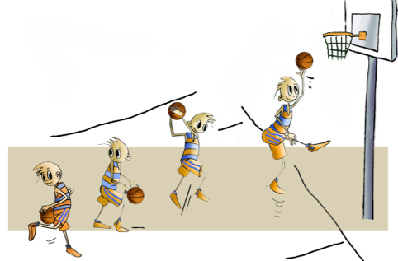
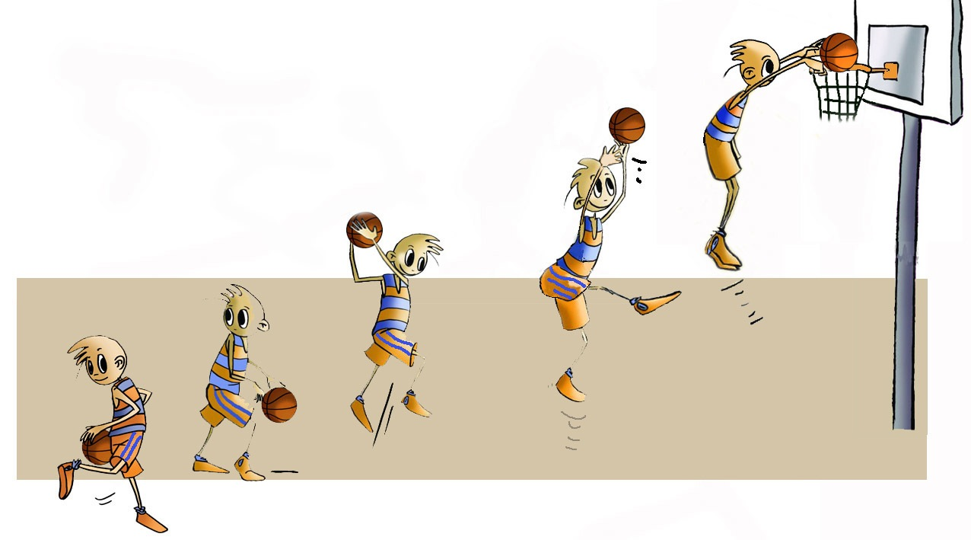
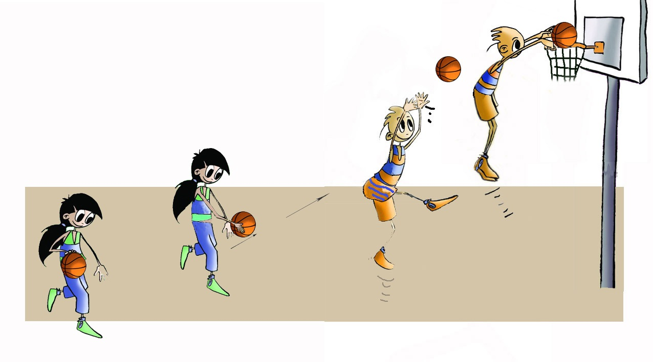
BASIC TECHNICAL-TACTICAL RESOURCES BASKETBALL
Lay-Up
Fast Break
Screen or Pick
It requires skill and speed to execute, as well as co- ordination among various players.
Pass and Screen-Away
Off-the-Ball Screen
Rebound
Dunk
Alley-Oop Pass

Slide 13
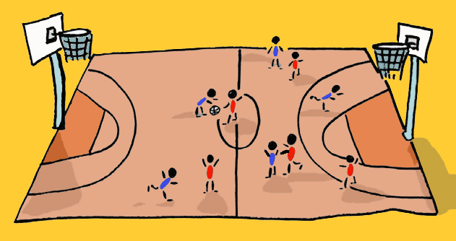
Joint Tactical Organisation
With the term joint tactical organisation, we may be able to realise the different possibilities that exist to act collectively in a rational and organised fashion.
How can we spread the floor taking into account the characteristics of the sport and co-ordinate the team members?
The first thing you have to do is distribute the players on the court with areas of personal responsibility, each player taking care of a zone and all the balls that enter it as well as individual action or tactical resources that allow the game to continue.
The movements of the players will depend on the positions they occupy...
Pivot: It is said that they play in the position of low post when around the basket and high post when they are up to the free throw line. Sometimes a player holding this position is called a post or pivot.
Power Forwards: They are good at handling the ball as well as outside shooting.
Guards: They are usually the "small people". Their mission is to lead the team, control the tempo of the match, and be responsible for transmitting on the court what the coach wants at all times.

Slide 14
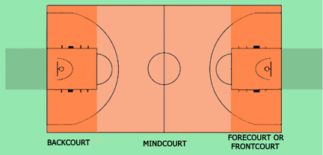
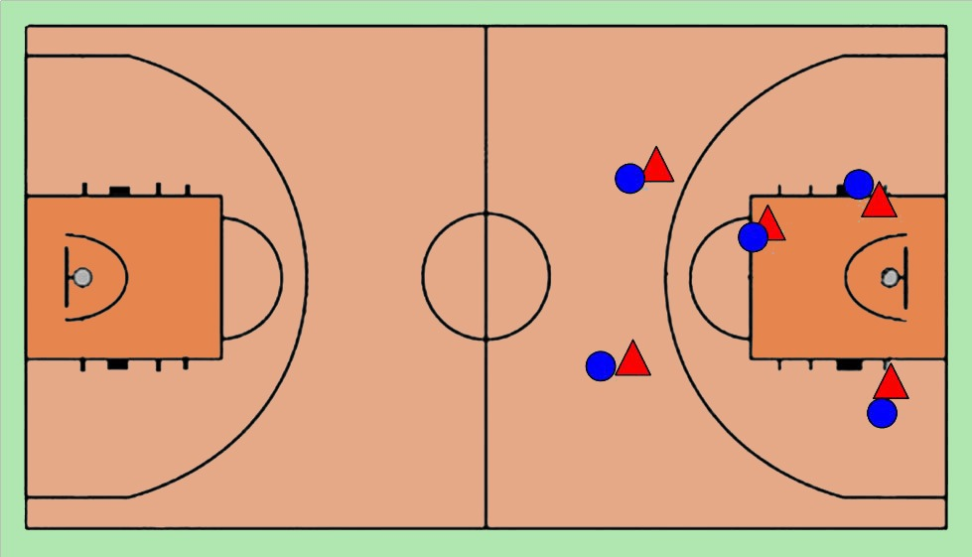
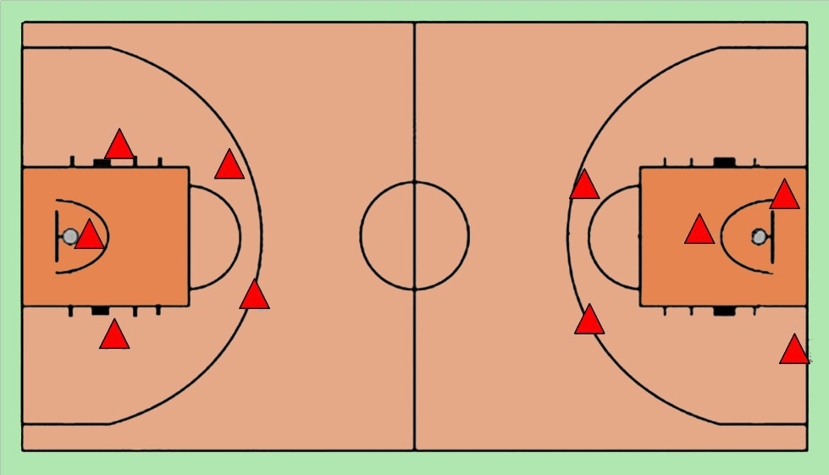
Joint Tactical Organisation in Defence
ZONE
INDIVIDUAL
To select zone defence for the following tactical reasons:
The opponent’s pivots are better than the other team’s.
The opposing forwards have poor success rate on shots from middle and long distance.
The opposing forwards have poor success rate on shots from middle and long distance.
Analyze: 2 - 3 and 2 -1 -2
It involves having every defensive player mark an attacking player in any area of the floor.

Slide 15
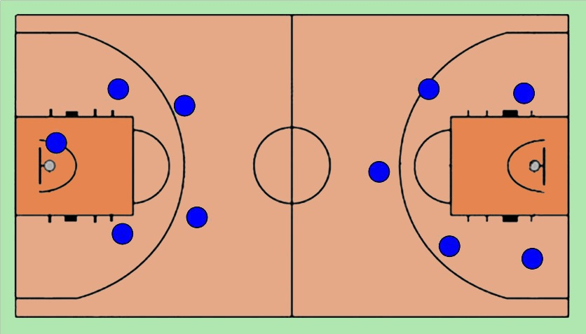
Joint Tactical Organisation in Offence
Basic Requirements:
When a player intercepts the ball in the frontcourt, the player should look quickly to the basket to assess the possibility of a field goal.
The player should give a target or signal for the ball with his/her hand.
The teammate who receives the ball should concentrate on any movement that the teammate, who has passed him/her the ball, makes in case a second pass has to be made.
Use change of directions. Fake with the body and protect the ball with the body and elbows.
Analyze: 2 - 2 -1 and 1 - 2 - 2

Slide 16
QUESTIONNAIRE AND ACTIVITIES
Write a short summary on how to play basketball.
Discuss with your partner the main rules of basketball.
Describe five basic technical-tactical resources.
Discuss the differences between these joint organisations: individual and zone defence.
Have you seen a basketball game? Discuss it with a partner.
Write down in your notebook unknown vocabulary from this unit.
Check the Federation website or any sports association in your region and check for changes or modifications, if any, in its regulations.

