Slide 1
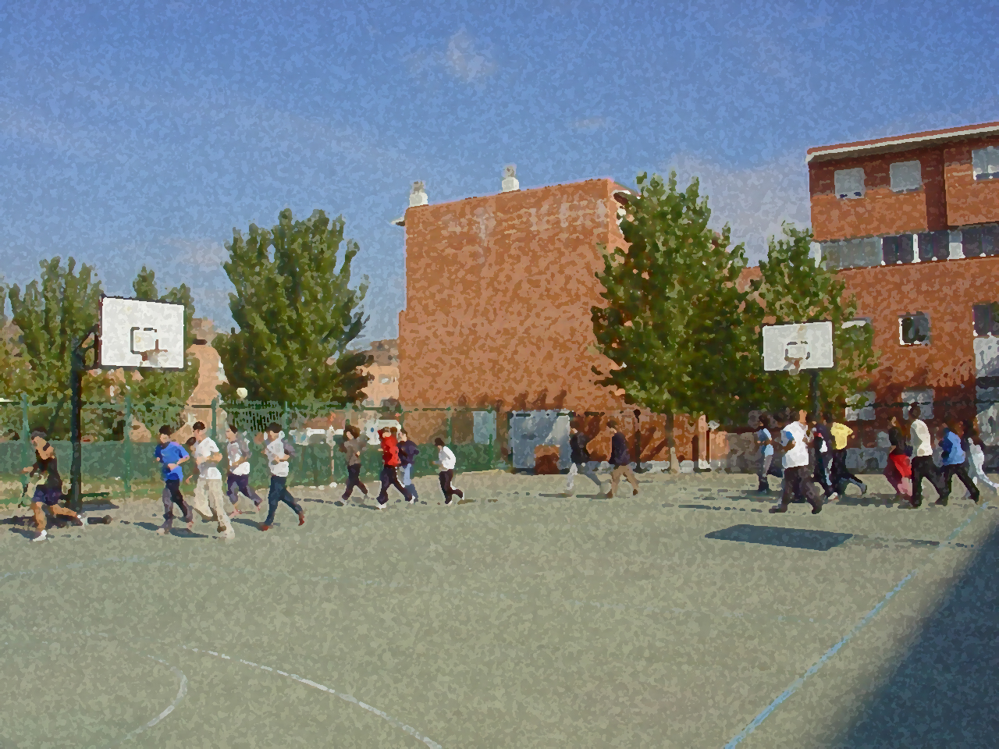
Fundamentals for Secondary School and Baccalaureate. Comprehensive and experiential learning
Paddleball Games

Slide 2
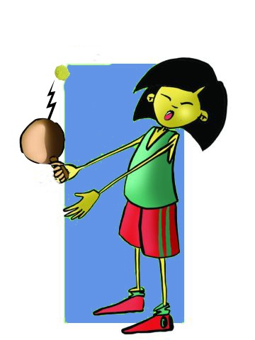
Paddleball Games
Objectives
Equipment and Facilities
Basic Technical-Tactical Resources
Types of Games
Questionnaire and Activities

Slide 3
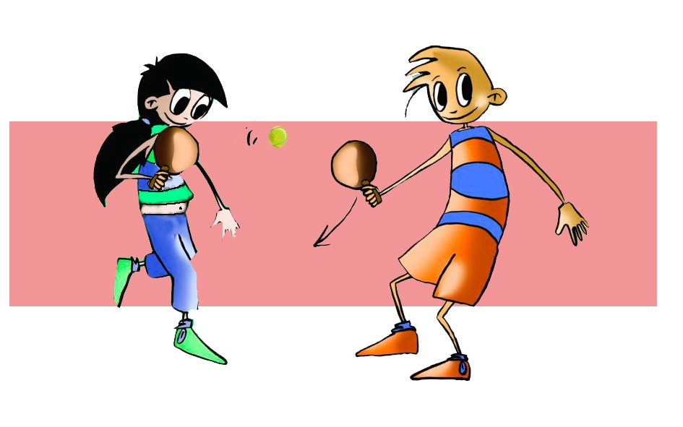
OBJETIVES
– To learn the basic technical-tactical components, apply them to real-game situations, and collaborate with your classmates in drawing up and putting them into practice.

Slide 4
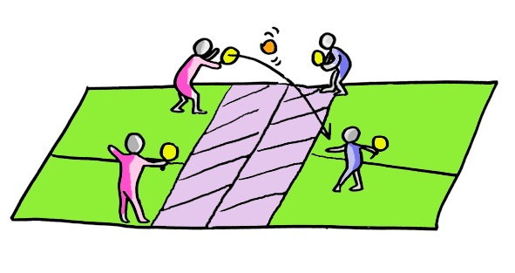
ORIGIN
Paddleball games were played as early as the 15th century in countries such as France and Italy. The Jeu de Paume seems to be the forerunner of modern racket and paddle games.
In Spain, these games were first played in the Basque Country, Cantabria and Navarra, as well as Valencia and Castile, and spread later on to the rest of the country.
The variety of games with paddles is great, and depends on the shape of the paddle, and the play area. Evidence indicates that these samples share a great deal of common characteristics..

Slide 5
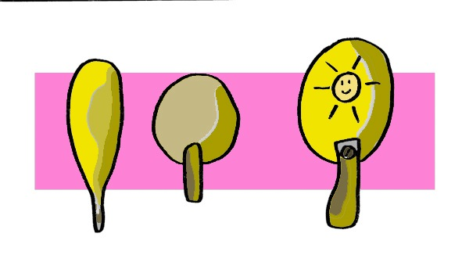
EQUIPMENT AND FACILITIES
A paddleball game could be defined as a game in which two or more players participate, using some common rules, and hitting a flying object with paddles.
The characteristics of the paddles used will depend on the type of game. However, the recreational approach, which we would like to present, permits the use of a variety of paddles ranging from solid wood to ones for table tennis. Likewise, the type of ball can be either hard or soft, or range from the one used in tennis to the one used in table tennis.

Slide 6
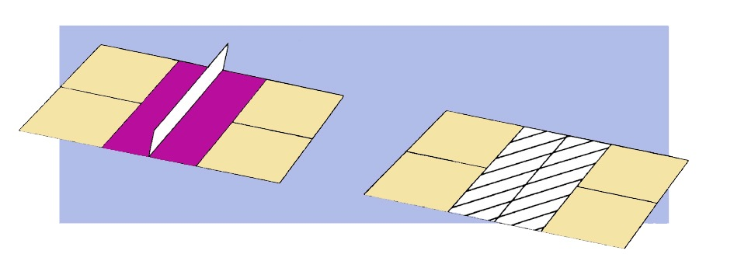
Facilities
The facilities will equally depend on the type of game or the area of Spain where the match will be held. The beach may provide an unlimited playing area, hitting the ball back and forth for a predetermined number of times or in such playing fields as a badminton court or a wall.

Slide 7
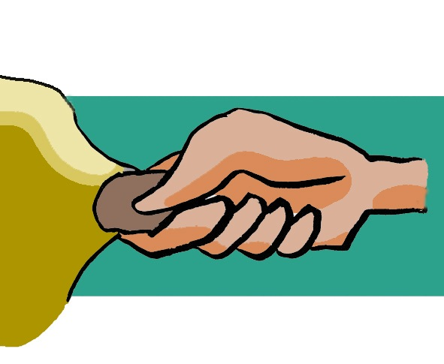
BASIC TECHNICAL-TACTICAL RESOURCES
Grip: The way which you have to hold the paddle is very simple and natural as closing the hand gently, flexing all your fingers except the thumb which should rest on the index finger.

Slide 8
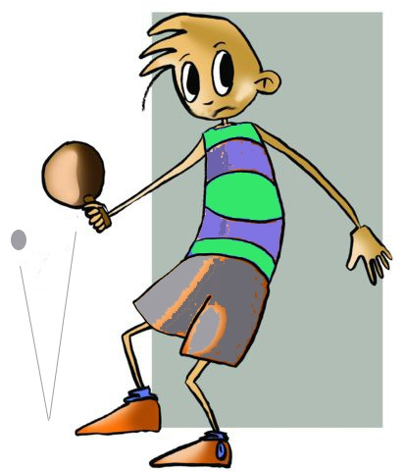
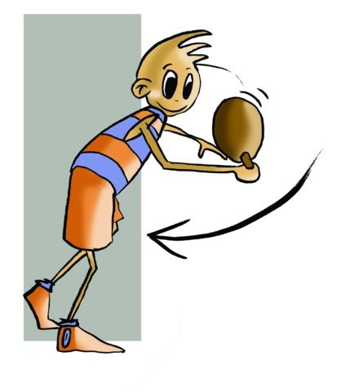
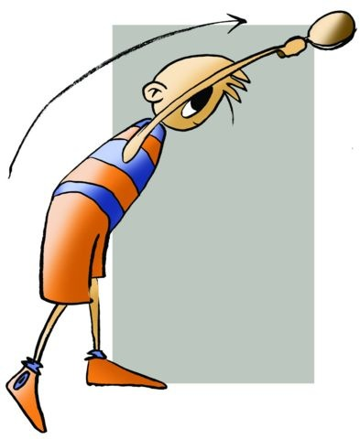
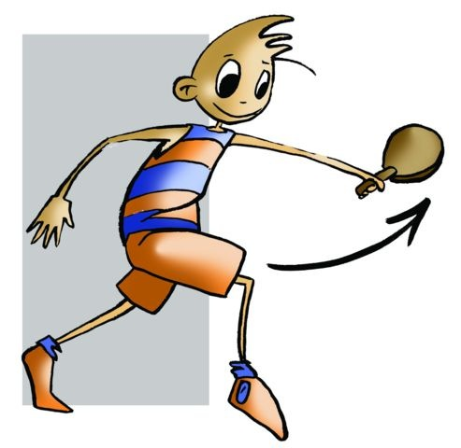
GOLPEOS EN FUNCIÓN DE LA ALTURA
INTERMEDIATE
HIGH
LOW
DRIVE
BACKHAND
SMASH
DROP SHOT

Slide 9
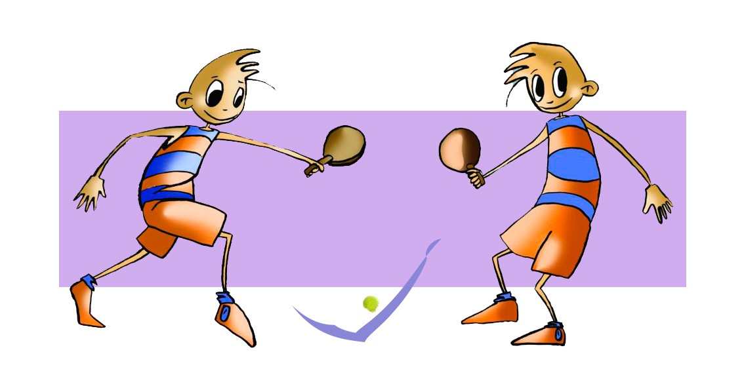
Tipos de juegos
WITHOUT BOUNCING
IN A DEMARCATED SPACE/AREA
BOUNCING

Slide 10
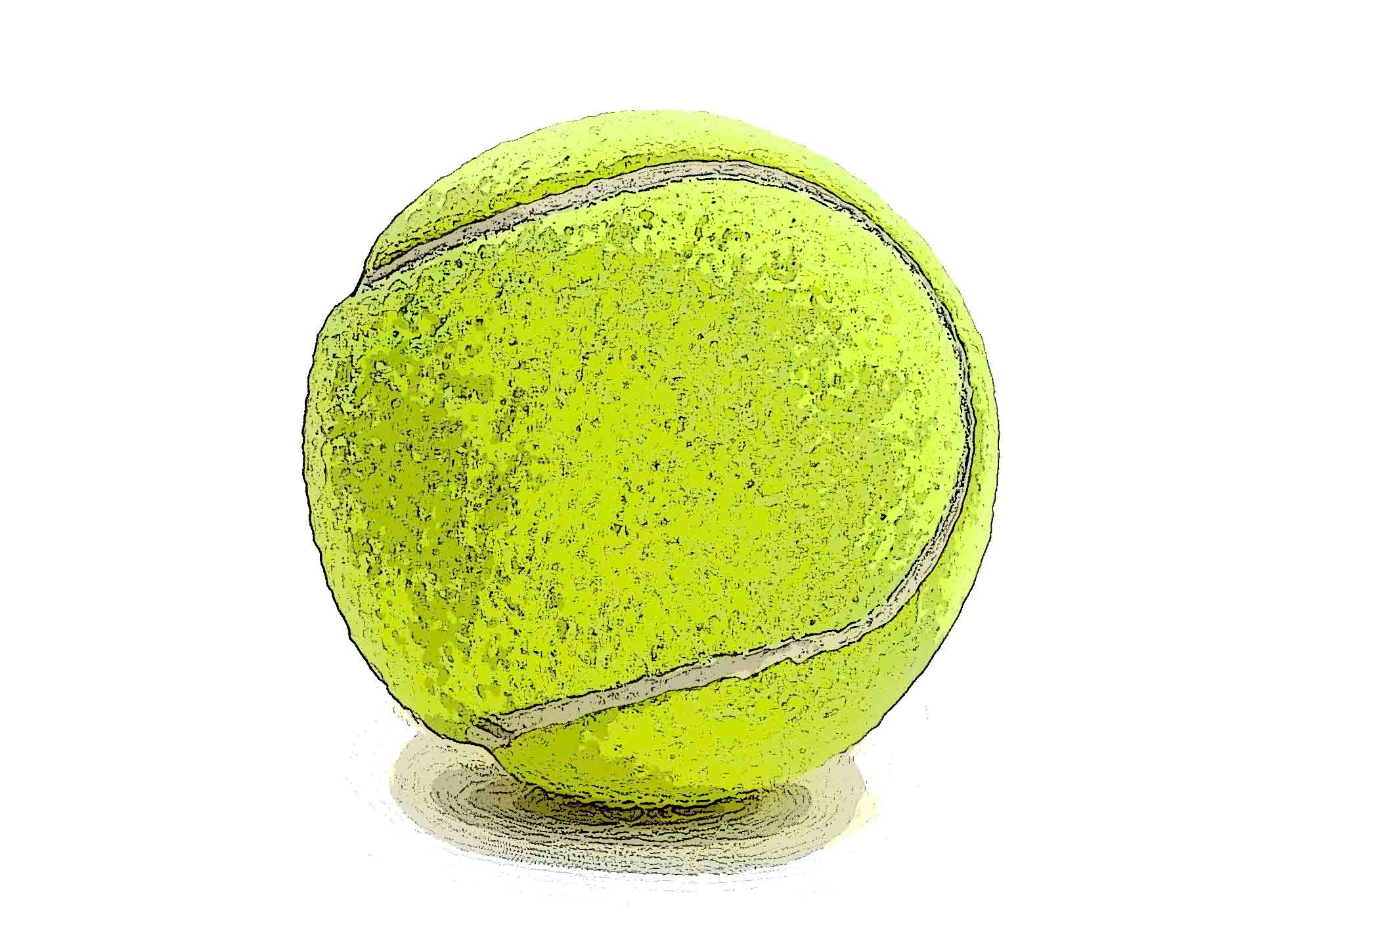
The Game of Paddleball and Decision-Making
The basic tactical resources, which have been previously mentioned, coincide with those presented in the game of badminton which has been studied earlier. Therefore, the resolution of potential problems which you could encounter when playing a paddleball game are based on the same possible decision-making described in badminton and which are as follows:
PLAYER IN OFFENSIVE PLAY | PLAYER IN DEFENSIVE PLAY
Where the player or players of the other team are located. Where I am. Which strike can be used to effectively hit the ball to send it to the opponent’s side of the court and possibly score? What should I do once I have hit the ball or shuttle? | Where the player of players of the other team are located. Where I am. Which are their characteristics and how can I strike the shuttle or ball? What movement can be made once the offensive player has hit the ball?

Slide 11
QUESTIONNAIRE ON ACTIVITIES
Briefly comment on the origin of paddleball.
Discuss the basic tactical resources of this game.
Describe an exercise to improve your backhand.
Briefly describe the decisions which one could take as a defensive player.
Watch a classmate play in a match and correct those aspects which you consider to be relevant.

