Slide 1
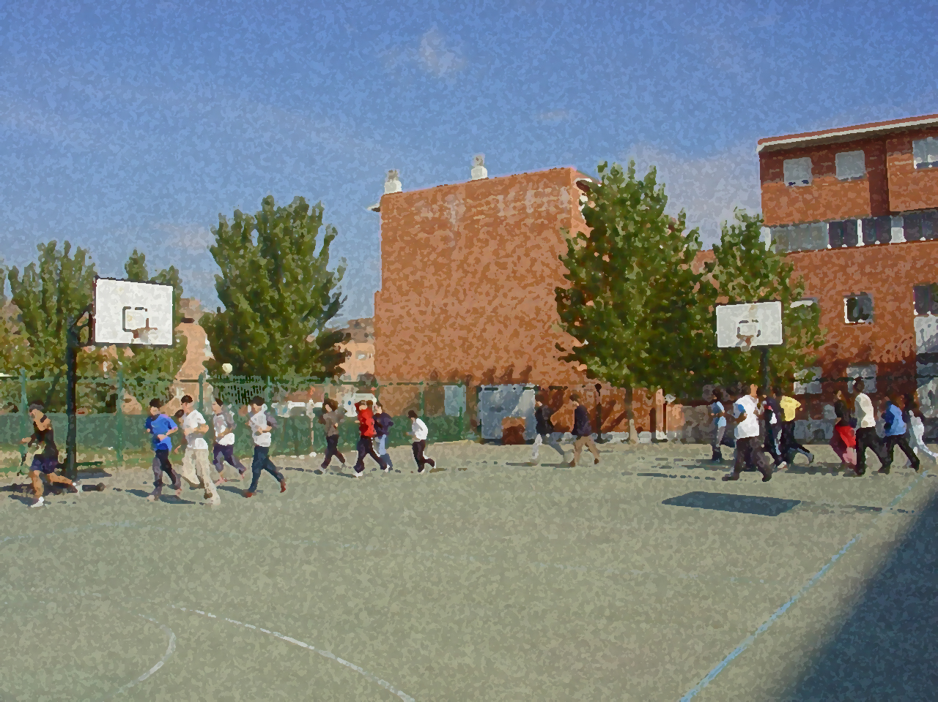
Fundamentals for Secondary School and Baccalaureate. Comprehensive and experiential learning
Badminton

Slide 2
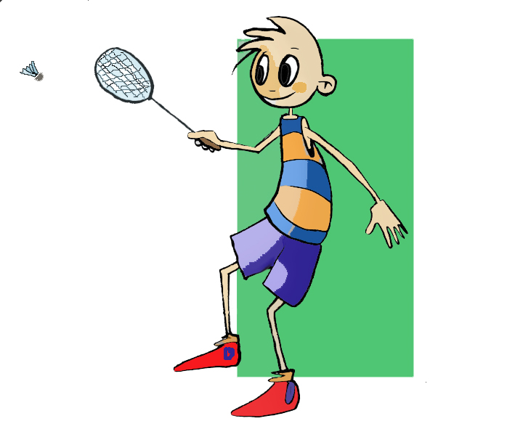
Contents
Objectives
Regulations, Facilities and Equipment
Basic Technical-Tactical Resources
Basic Exercises
Questionnaire and Activities

Slide 3
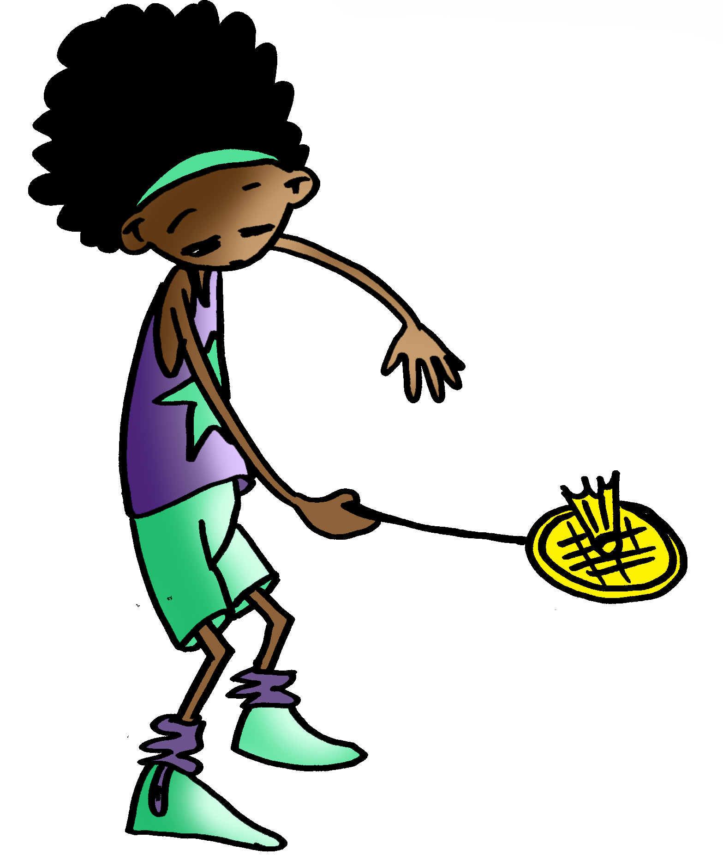
OBJECTIVES
To learn the technical-tactical resources and basic regulations in badminton.
To understand how to apply this knowledge in real game situations and collaborate with teammates in the preparation and execution of these tasks.

Slide 4
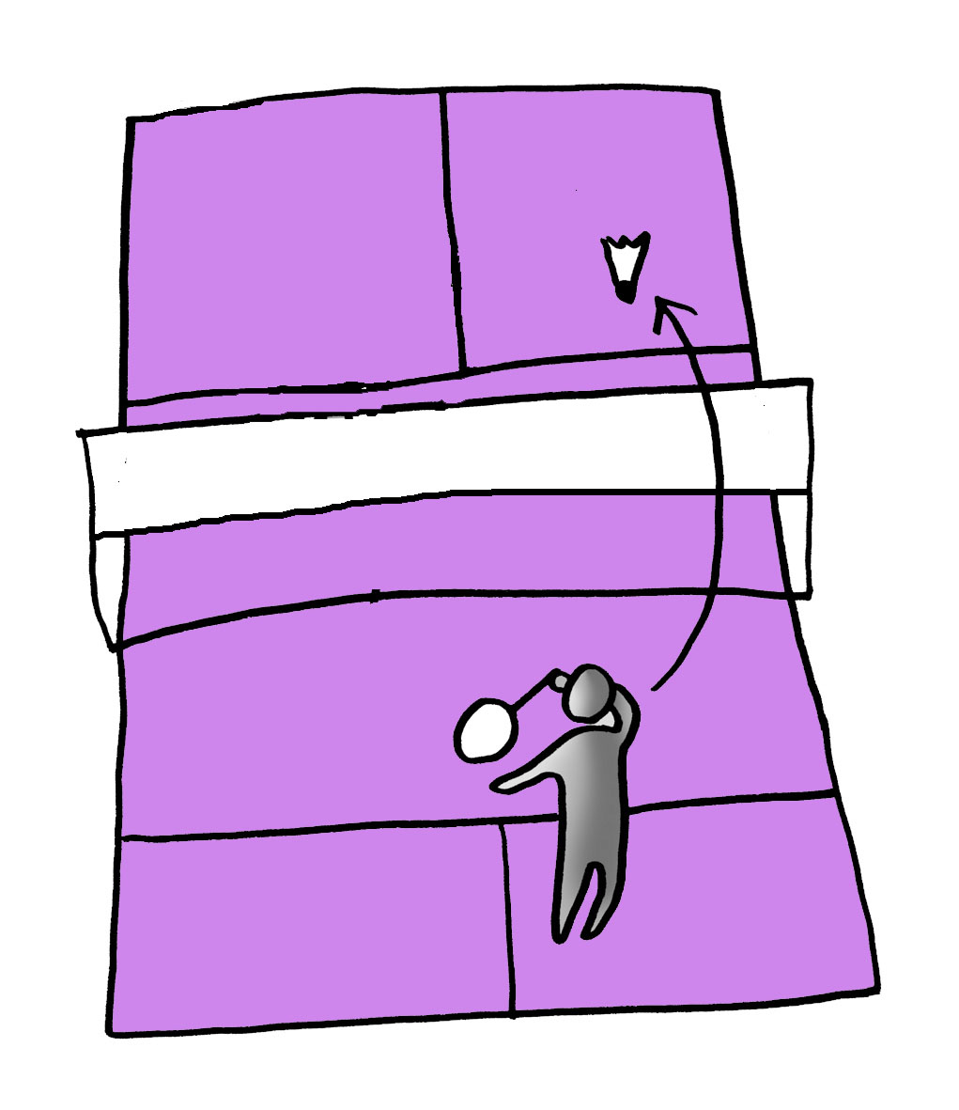
Basic Regulations
Badminton is a racket sport in which two or four players (individuals or doubles) face each other attempting to send the shuttlecock or shuttle over the net in such a way that it will land on the opponent’s side.

Slide 5
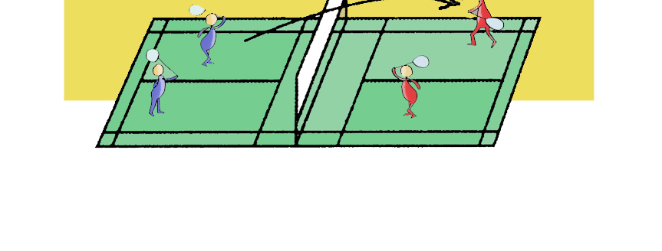
Basic Regulations
Score:
To win a set, it is necessary to score 21 points. If there is a tie at 20 points, the game continues until there is a difference of two points when one of the players stands at 29 in his/her favour. The winner is the first player to get a score of 30.
The player or team to win two sets or games wins the match.
Where the serve takes place is determined by the score of the set.
When the score is zero or even, the server plays in the right service court or right-hand side of the court. If the score is an odd number, then the player serves from the left service court or left-hand side of the court. The service should be directed diagonally across to the opponent player.

Slide 6
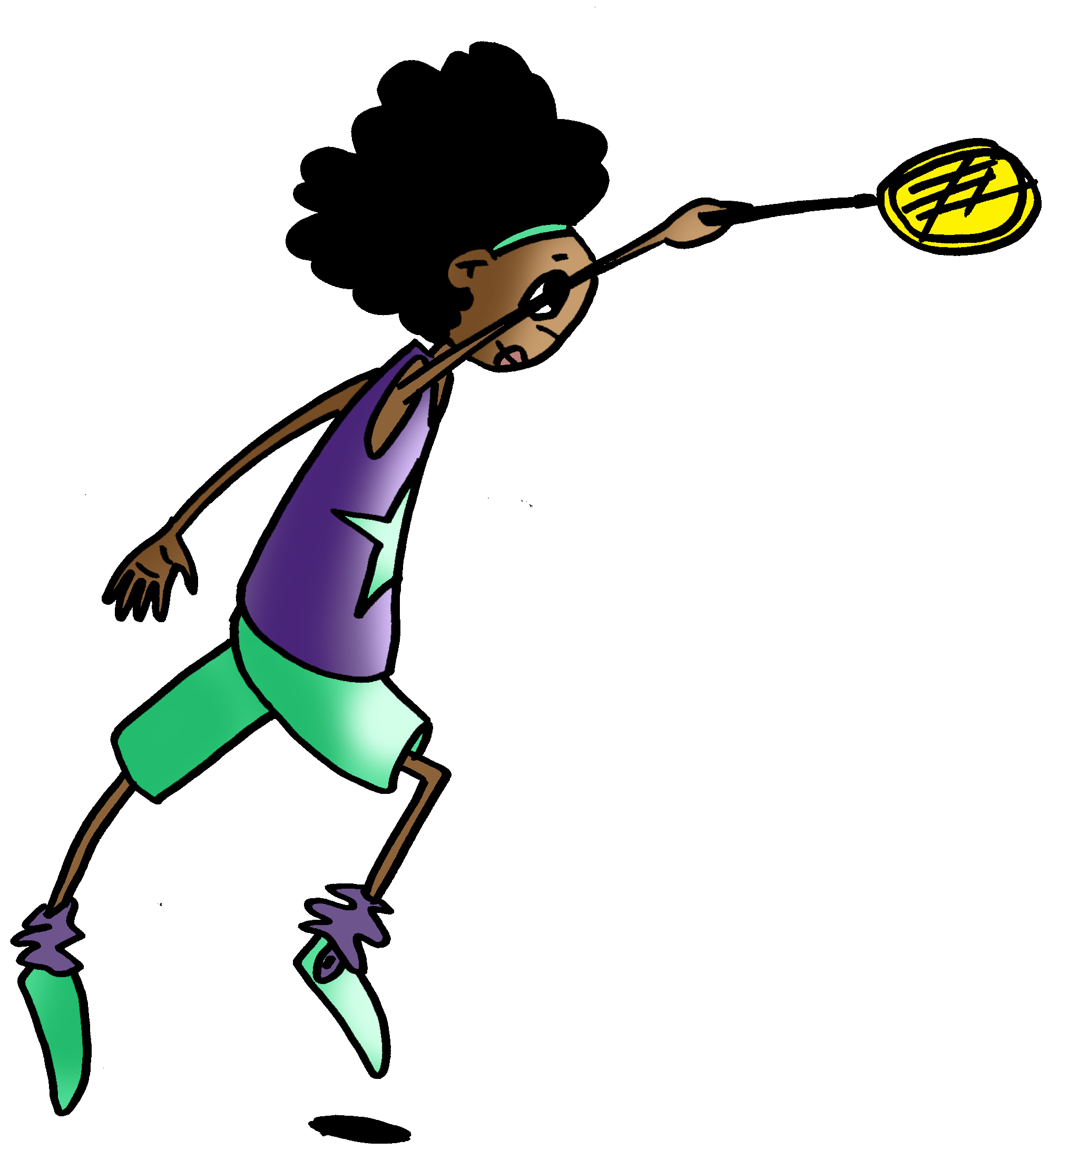
Basic Regulations
It is considered to be a fault | when the shuttle does not pass over the net,
 | if the shuttlecock does not fall in the area diagonally across from the server,
 | if the server steps on the boundary lines or serves above the hip, and
 | if the serve has been initiated before the opponent is ready.

Slide 7
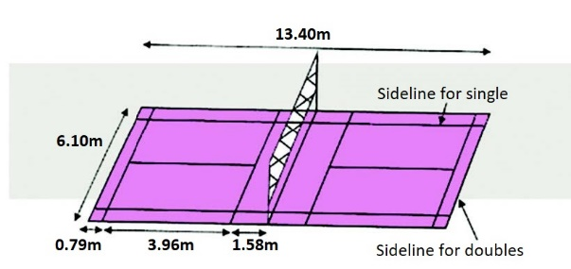
Facilities and Equipment

Slide 8
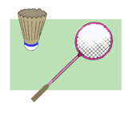
BASIC TECHNICAL-TACTICAL RESOURCES
In order to effectively use the racket, a period of adaptation to this piece of equipment may be needed. While the shuttle is in play, the player’s movements require adjustments. Firstly with regards to the execution of the stroke, or the player’s movements directed to hitting the shuttlecock. Secondly, the control exerted to determine the directionality of the shuttle. This adaptation does not require specific movements, however, through various exercises which will be put forward, sufficient control of the racket may be achieved to the player’s complete satisfaction.

Slide 9
BASIC TECHNICAL-TACTICAL RESOURCES: BADMINTON
Holding a Racket
Moves
Theuniversalgrip
The backhand grip

Slide 10
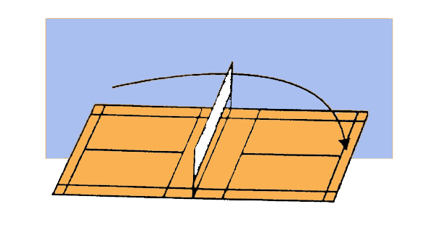
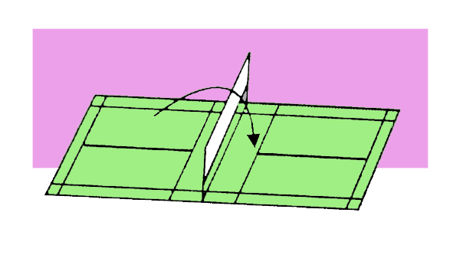
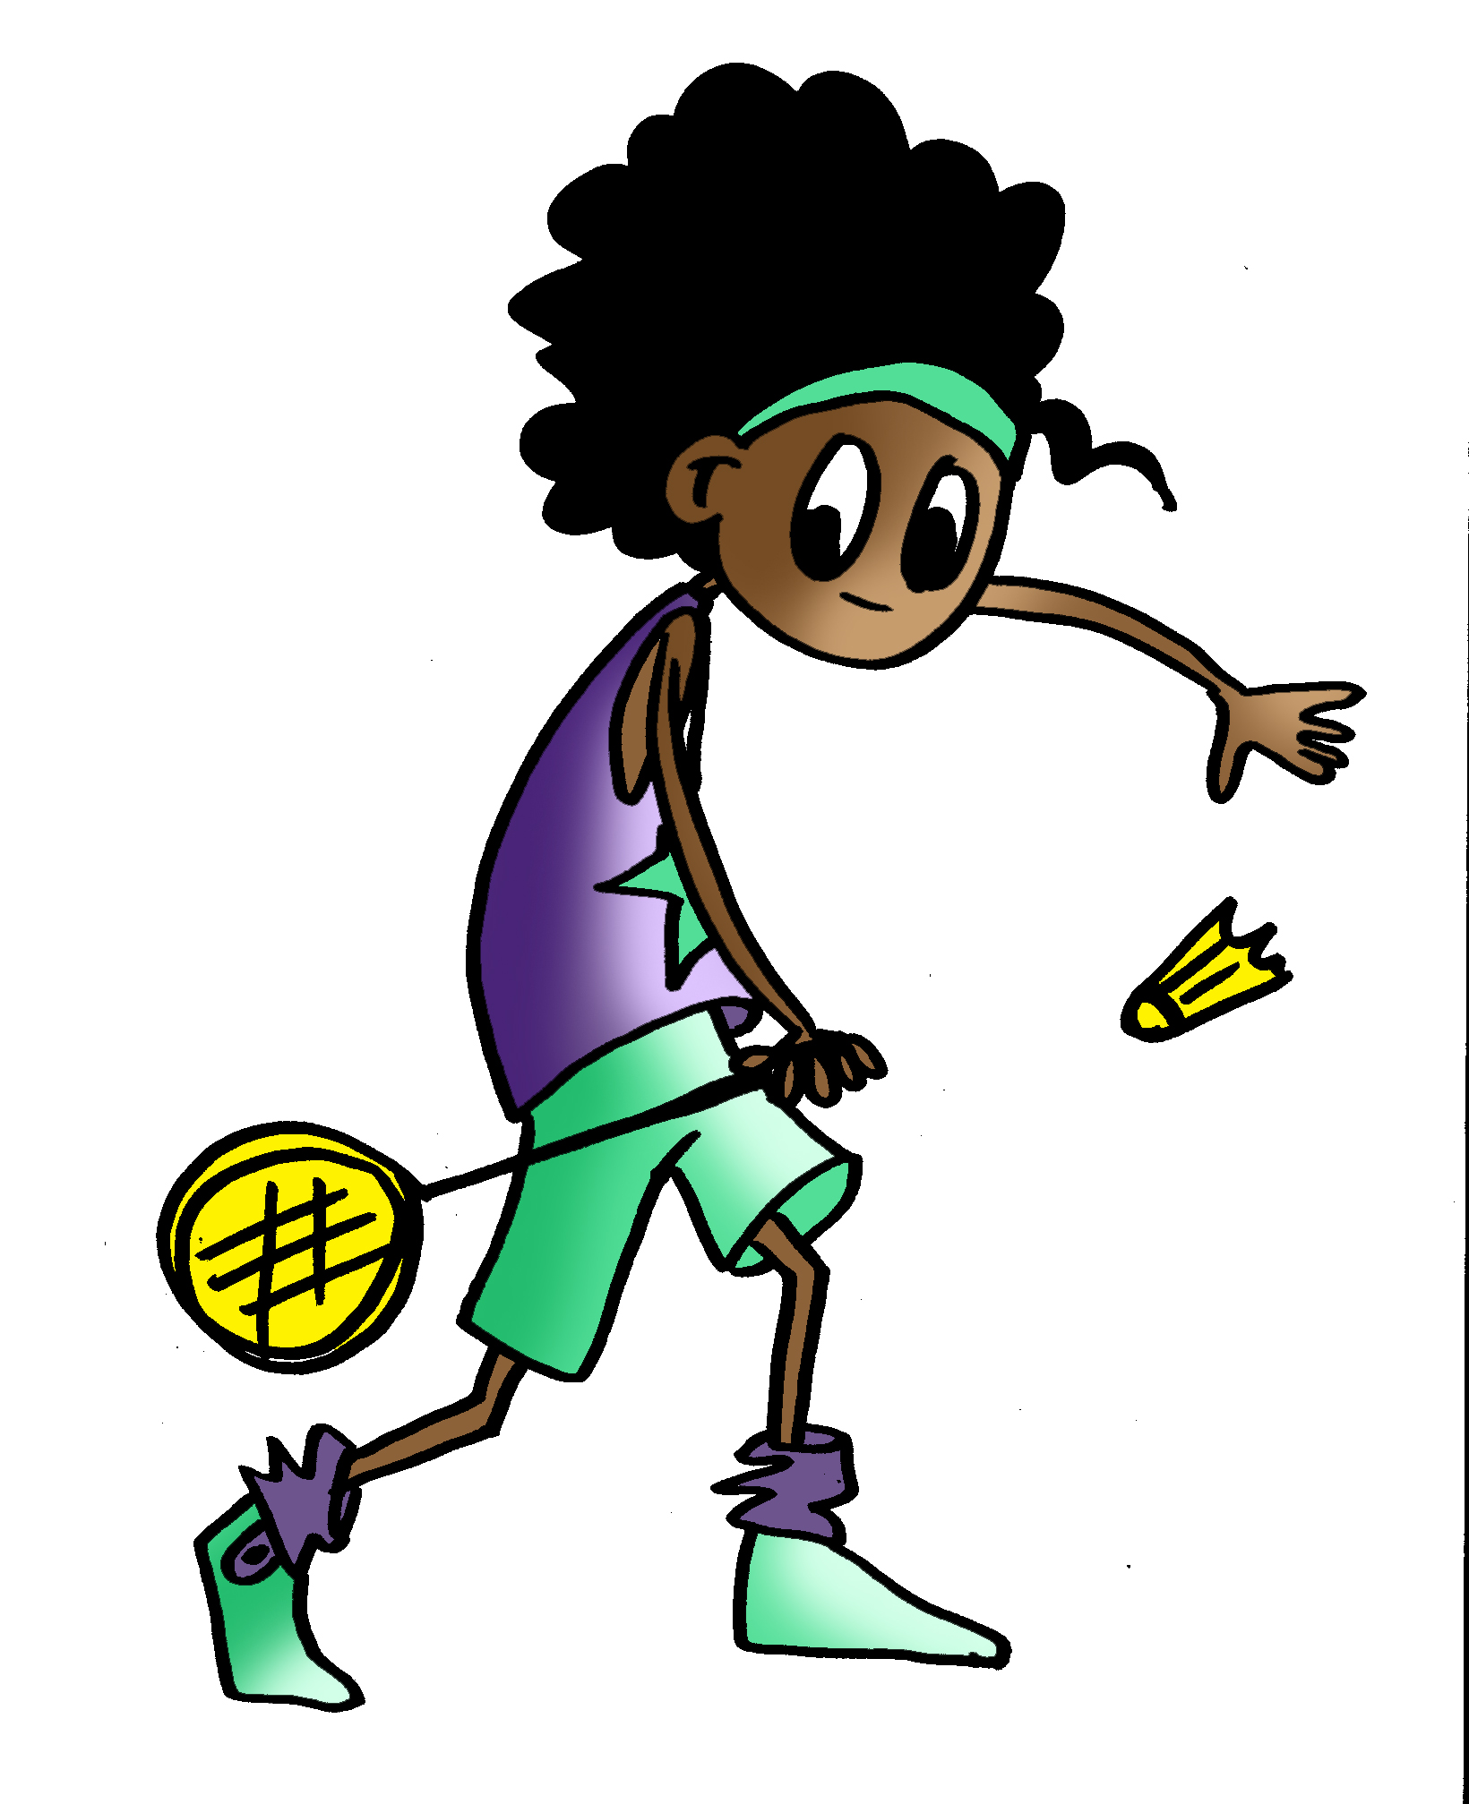
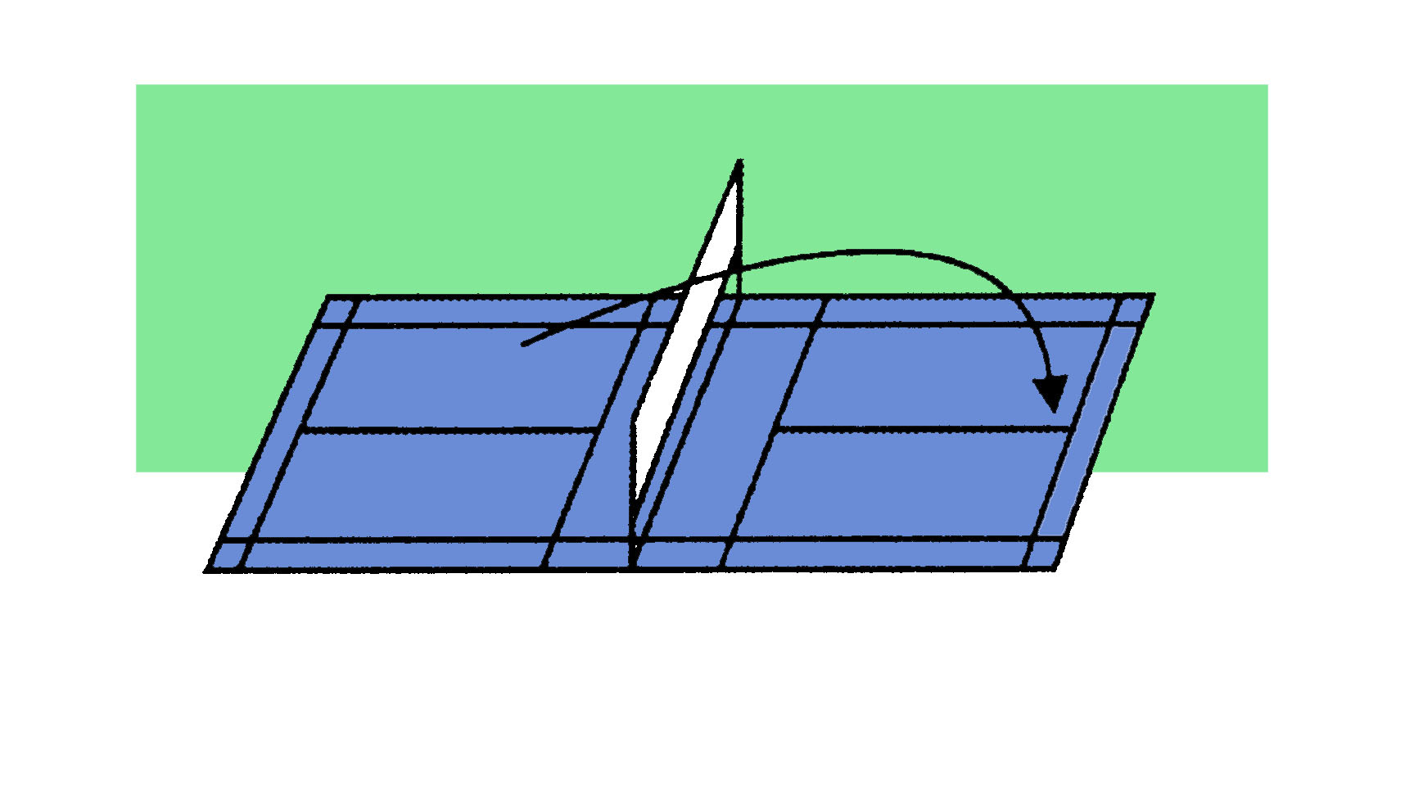
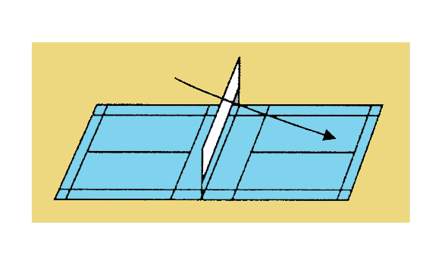
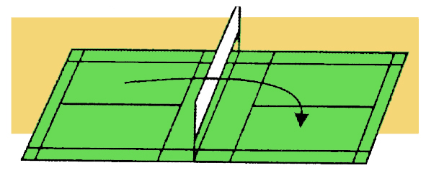
BASIC TECHNICAL-TACTICAL RESOURCES: BADMINTON
Types of hits
Service
Clear
Drop Shot
Lob Shot
Smash
Drive

Slide 11
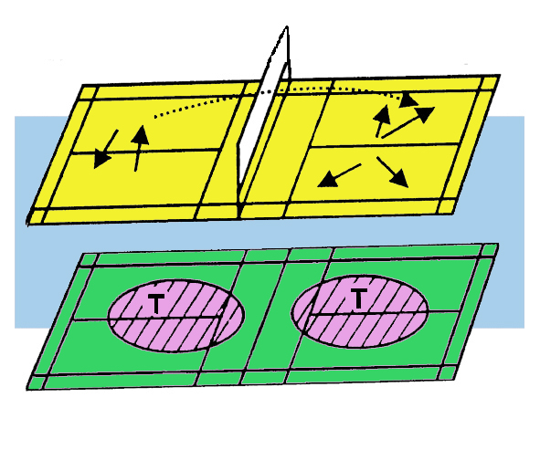
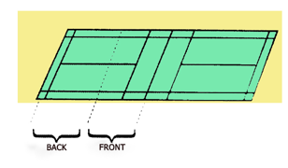
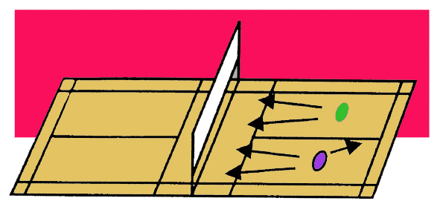
BASIC TECHNICAL-TACTICAL RESOURCES: BADMINTON
In badminton, co-ordination action is determined by the type of match:
Individual
Doubles
In this type of event, the basic tactical actions which should be learned are those which force the opponent to move in any direction. What is taken as a norm is that the player should return, after each hit, to the general area in the centre of the court where the centre line forms a 90º angle with the short service line on the court. This is called the centre position. “T zone”
There are two basic tactical actions which are principally taken:
“Front-back”
“Parallel”

Slide 12
BASIC TECHNICAL-TACTICAL RESOURCES: BADMINTON
Depending on a player’s position, whether as offence or defence, decision-making may be summarised in the following way:
OFFENSIVE PLAYER | DEFENSIVE PLAYER
Where the opponent (s) of the other team is/are situated. Where I am located. What stroke can best be used to send the shuttle to opposite end of the court and the possibilities of scoring? What I should do once I have hit the shuttle or ball. | Where the opponent player(s) is/are situated. Where I am situated. What its characteristics are and how I can return the shuttle or ball. Which direction to take once the opponent has hit the shuttle?

Slide 13
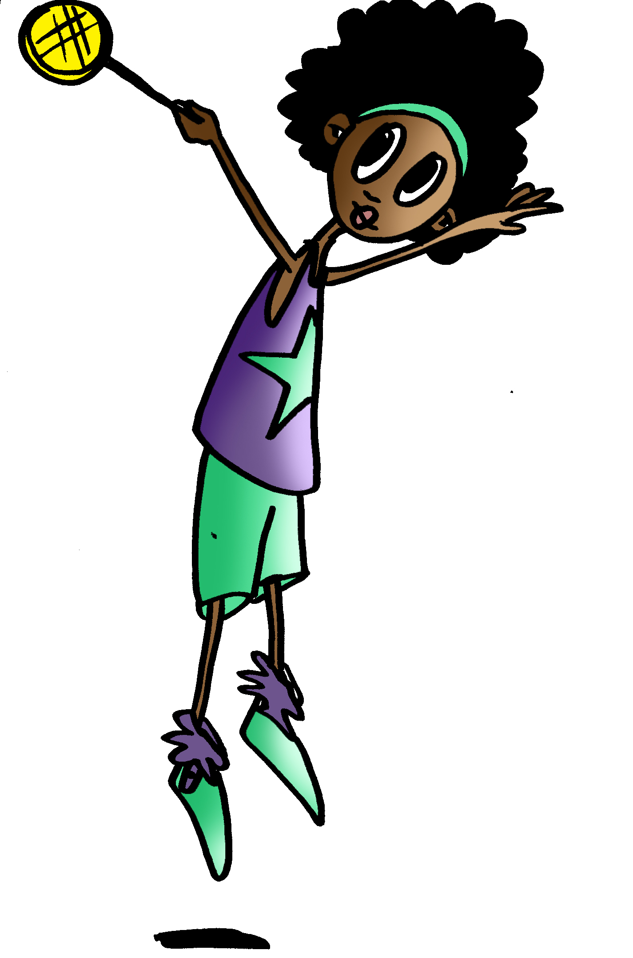
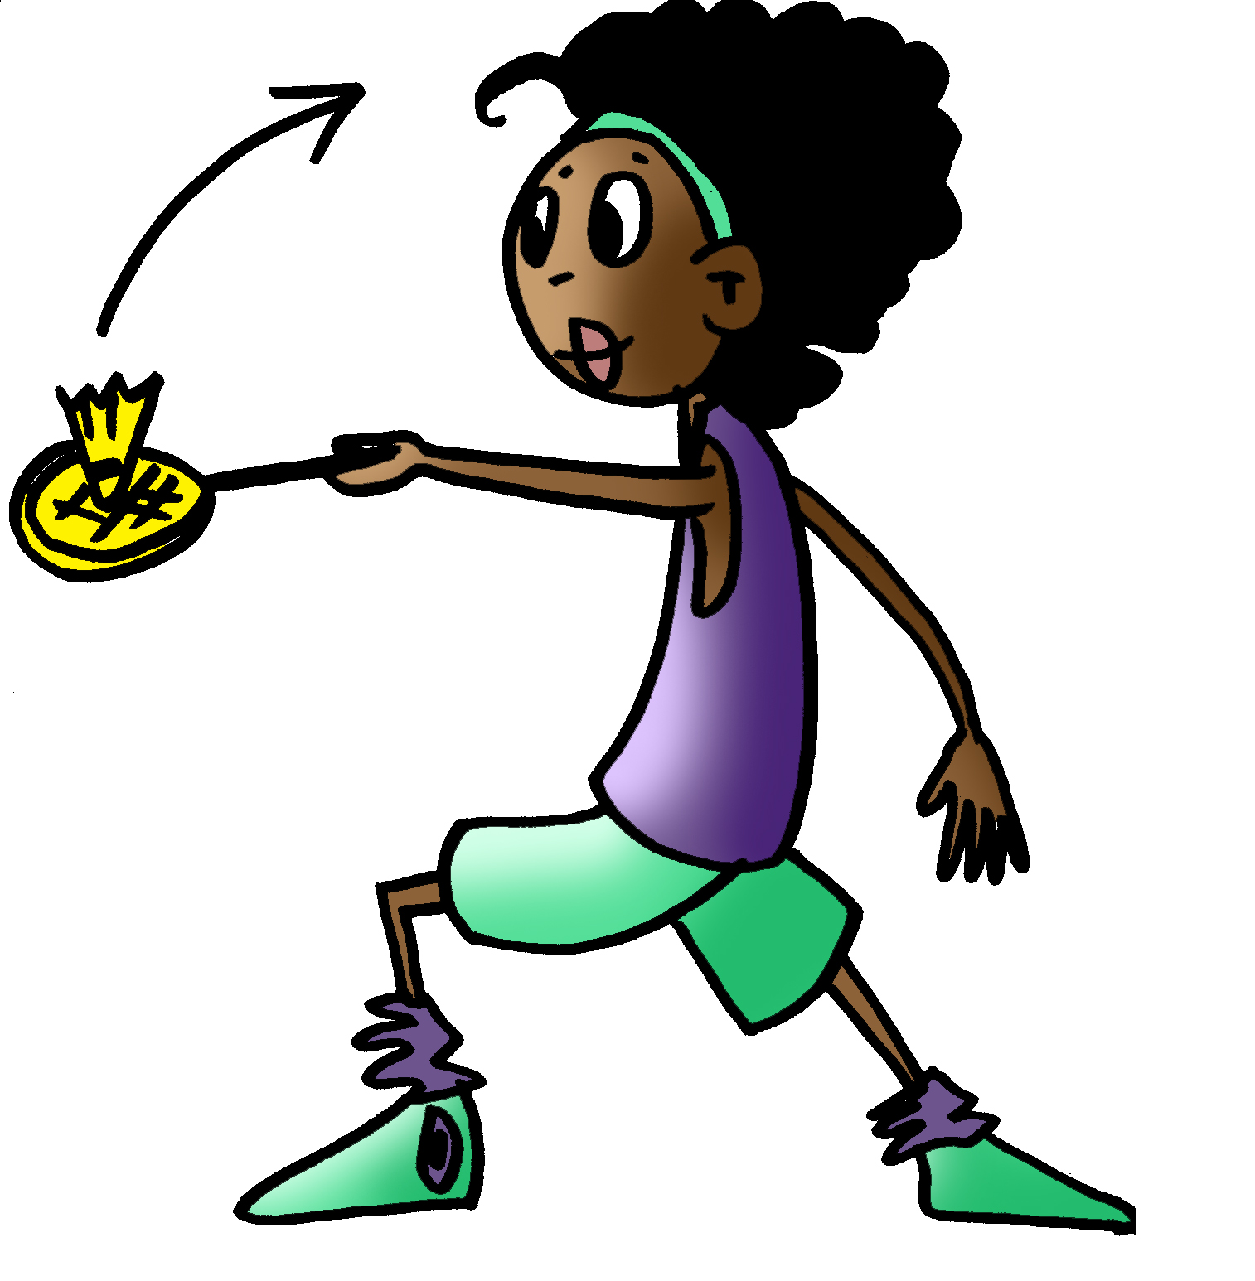
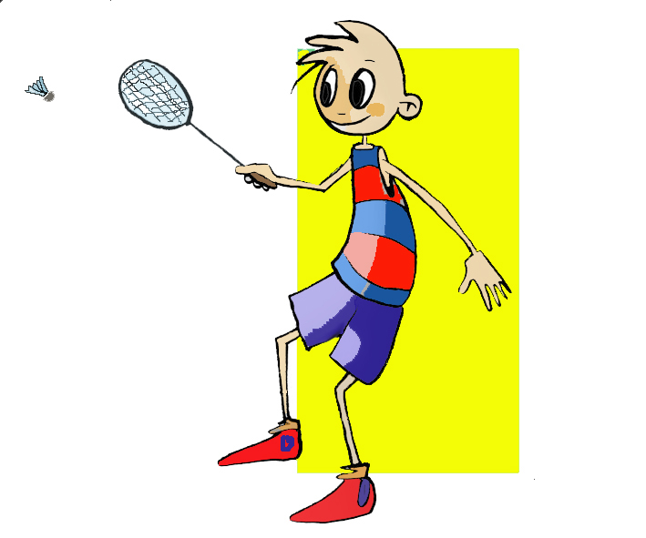
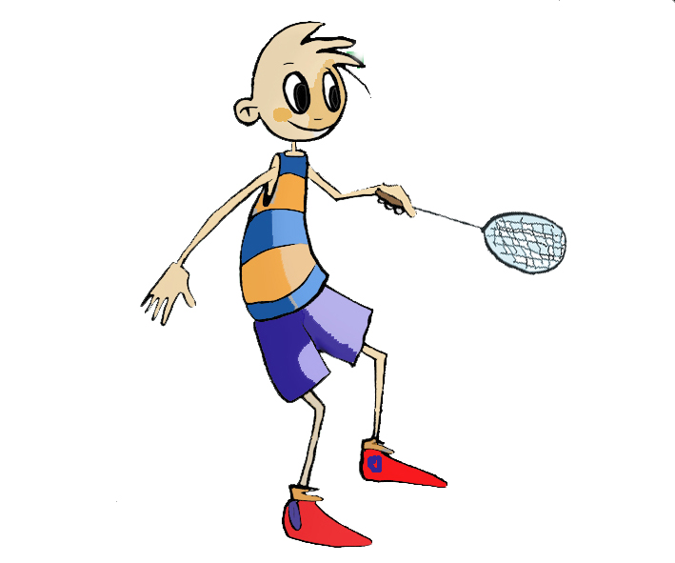
Questions and answers: could you describe….?

Slide 14
QUESTIONNAIRE ON ACTIVITIES
Briefly comment on the basic rules of badminton.
Comment on the tactical resources of a match you have seen in your school, league, TV, etc.
Give a short description of the decisions which you can take as an offensive player.
Describe what a lob entails.
Watch a match, choose a player and take notes on the number of shots the player makes during the first set.
Write down in your notebook unknown vocabulary from this unit.

