Slide 1
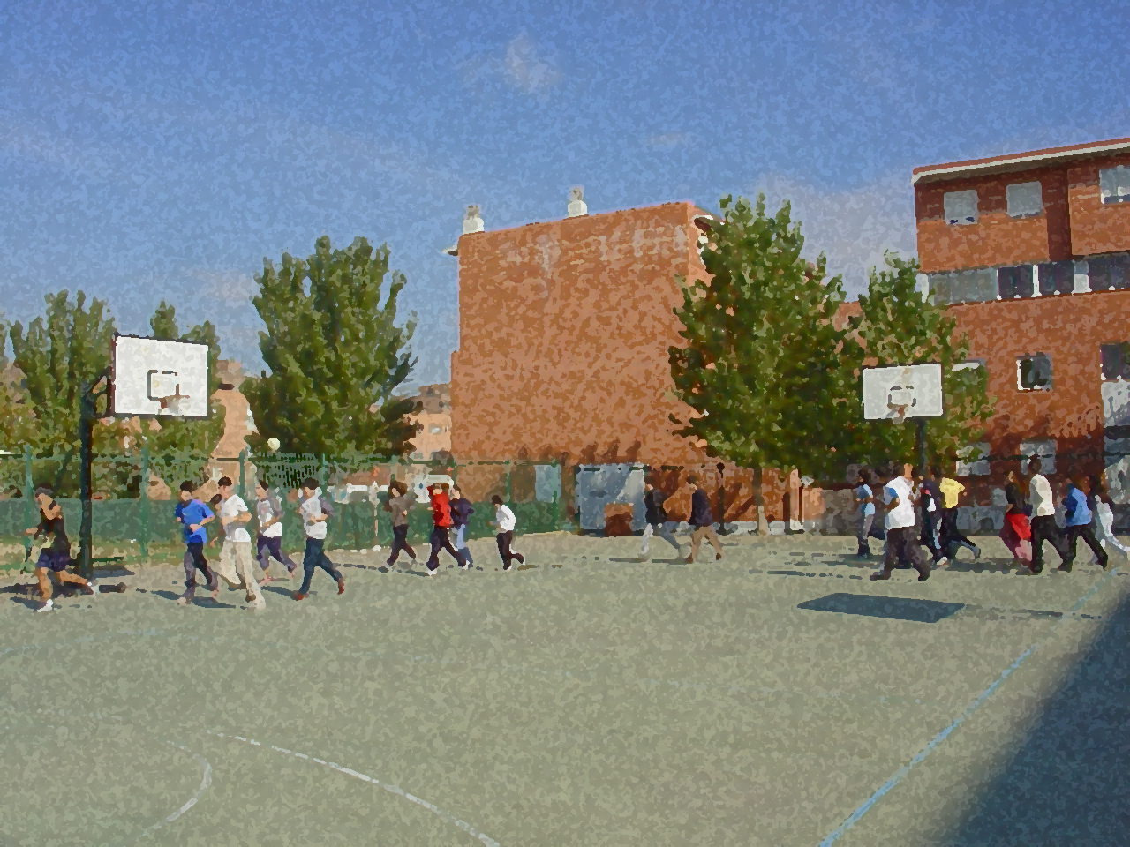

Fundamentals for Secondary School and Baccalaureate. Comprehensive and experiential learning
Relaxation

Slide 2
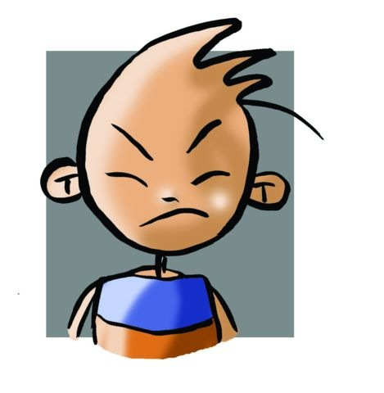
Relaxation
1. Objectives
2. Relaxation:
Brief Historical Background
3. Schultz’s Autogenic Training
4. Jacobson’s Progressive Muscle Relaxation
5. Other Schools of Thought
6. Questionnaire and Activities
Nowadays a human being is subject to almost constant and unconscious stress that can provoke grave physical problems such as, cardiovascular and digestive problems as well as mental problems. These may sometimes be untenable, and result in depression, anxiety etc. and emotional problems like irritability and rapid changes in moods up to the point where one may become unsociable.
All of the above could provoke, as is logical, tense relationships at home, work and, in general, any type of situation. Therefore, we may sometimes look for quiet places and ways so that the body and mind can relax.

Slide 3
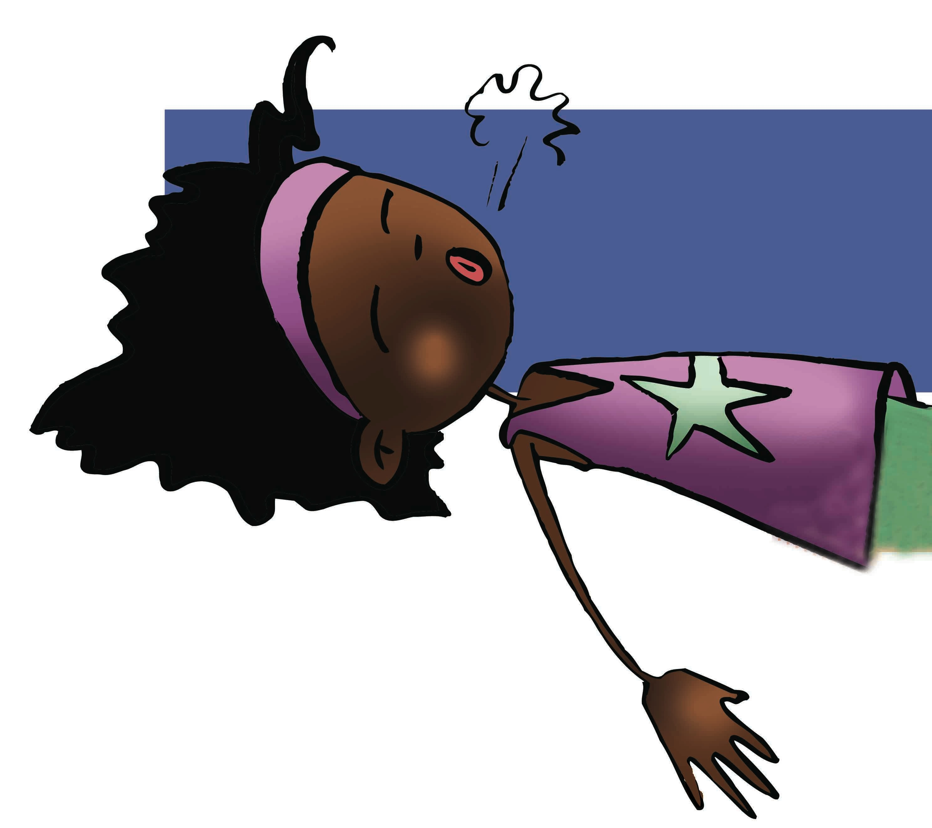
OBJECTIVES
To apply different relaxation techniques with a positive attitude, and helping classmates in the completion of these exercises.
To understand how correct breathing can promote relaxation and use the techniques learned to overcome moments of tension that arise daily.

Slide 4

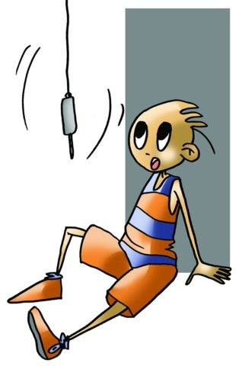
Relaxation
A Brief Historical Background
When talking about relaxation we need to take a look at the time when some scientists and doctors started to look at hypnotherapy.
Although by the middle of the 17th century a Jesuit in Rome had hypnotised a hen, we can say that it was not until the early 18th century when an Austrian named Mesmer became the first key figure in the history of human hypnosis. Through his brilliant diagnosis, hypnosis created innumerable followers and detractors, achieving its highest point at the end of the 19th century.
Later, Sigmund Freud used hypnosis on his patients, but abandoned it when he became convinced it lacked credible results; however, it later became the precursor of a new important technique — psychoanalysis. Hypnosis was experimented with and abandoned until the middle of the 20th century, when psychiatry in Europe and the USA began to reassess it; it was not this way in the Soviet Union where it was never eclipsed.
Relaxation was born in the 20th century, and it is J.H. Schultz who initially became interested in the techniques of suggestion and hypnosis. Nowadays, it seems our lifestyle is doomed to create unsatisfactory situations of tension and anxiety making relaxation techniques great therapy.

Slide 5
The methods that are explained in this unit, are merited on their importance and ease of application. The majority of which are based on this work, whose objective is to relax the body and mind. This is the J. R. Schultz’s Autogenic Training and Edmund Jacobson’s Progressive Relaxation Technique.
SCHULTZ’S AUTOGENIC TRAINING
Without disparaging Freud’s psychoanalysis, this Englishman observed that his patients experimented sensations of heaviness. He explained that it was due to the fact that musculoskeletal relaxation had been achieved, that the heat was caused by the increase in peripheral circulation along with the dilation of the blood vessels.
J.H. Schultz deduced that certain perfectly executed relaxation exercises produced inattentiveness and distraction something initially desired, these being the result of these perceptions, and giving origin to autogenic training, which is to say, exercise done by oneself.

Slide 6
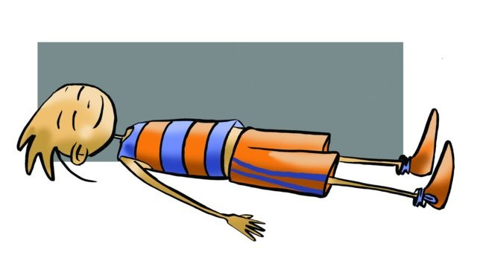
This technique was introduced in 1932, and consists of 2 cycles: the first is inferior, and the second is superior.
There are certain factors to bear in mind in the practice of this technique:
Place — it should be quiet and softly lit,
Position — lay on one’s back with the head slightly elevated, arms slightly flexed, palms of hands down, and the feet pointing slightly outwards. Another position could be what Schultz called ‘the coachman’s position’. The eyes remain closed,
Frequency — training should be practised, if possible, twice a day. The initial sessions are to be brief (from 10 to 15 min), and subsequent sessions to last around 30 min, and
Duration — three to six months.

Slide 7



First Cycle
It is directed at six predetermined phases
Muscular system (experiencing heaviness)
Circulatory system (feeling of warmth)
Muscular-cardiac system (control and perception of one’s movements)
Respiration (control and perception of breathing)
Abdominal zone (control and feeling of warmth)
Head zone (perception of temperature)
Second Cycle
Only aimed at specialists in Neuropsychiatry, it is hardly used. It is a form of hypnotherapy or daydream.

Slide 8
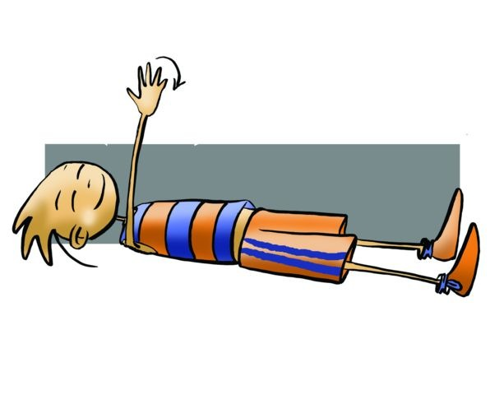
JACOBSON’S PROGRESSIVE MUSCLE RELAXATION TECHNIQUE
At the same time, from the other side of the world, a technique appeared that abandoned any form of psychotherapy, an educational technique based on the sensations of muscle contraction followed by relaxation, which leads progressively, impacting on the central nervous system, to a calm attitude and mental peace. We are talking about the technique of progressive muscle relaxation by Edmund Jacobson. Developed in the early twentieth century, at the universities of Harvard and Chicago, he investigated emotions and observed that the more nervous the subject was, the more intense the shock. This led him to create an "electroneuromyograph" apparatus capable of detecting the slightest electrical-muscular response, even caught the effort that the word produced, causing electrical impulses of action in the corresponding muscle group. Following these studies, Jacobson came to define relaxation as the state in which the existence of muscle movements is equal to the next action potential to zero in the "electroneuromyograph". It was the beginning of what today is a basic method of relaxation.

Slide 9
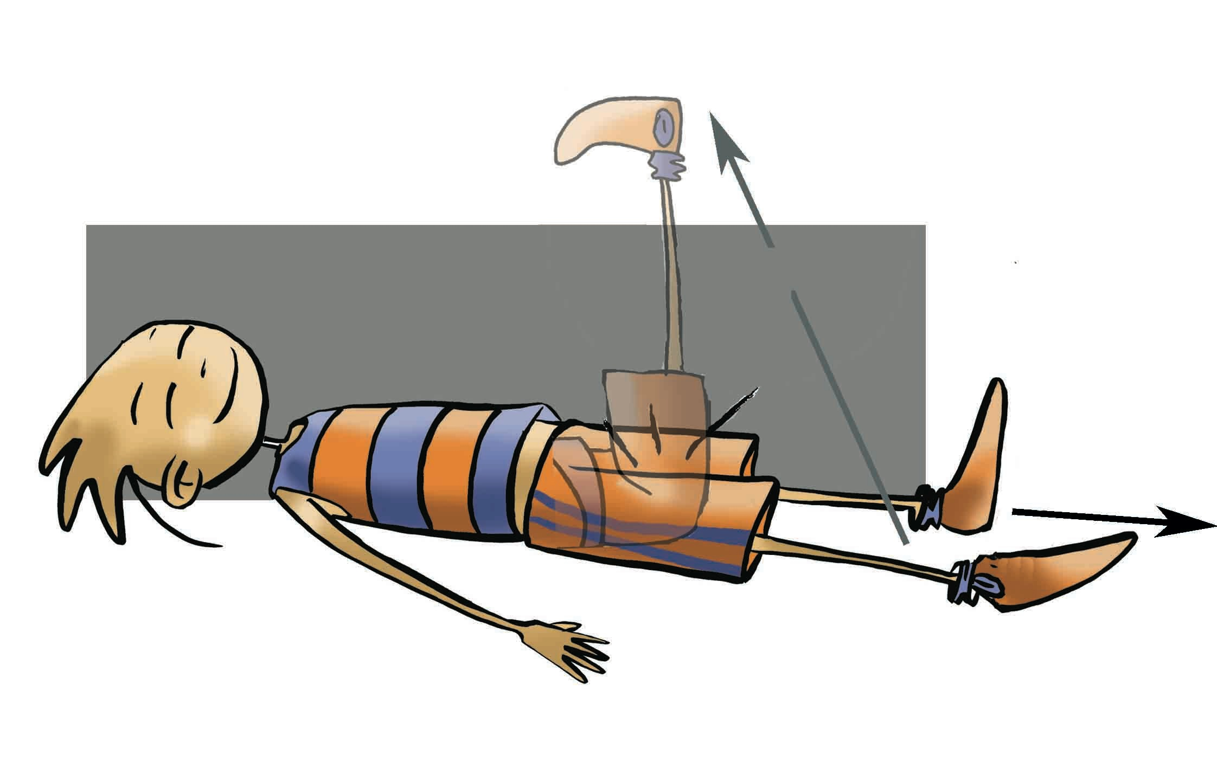
The technique is recommended by Jacobson himself should not be more than one session per day, and last an hour at most, but let us delve deeper and move on to describe it:
Place— it should be quiet and dimly lit, avoiding any interruption,
Position—lying, face up, arms and legs apart, look at the ceiling and after that the patient closes the eyes,
Frequency—30 minutes to 1 hour, once a day, and
Duration—it depends on the age and habits; however, it may range from six months to a year.

Slide 10
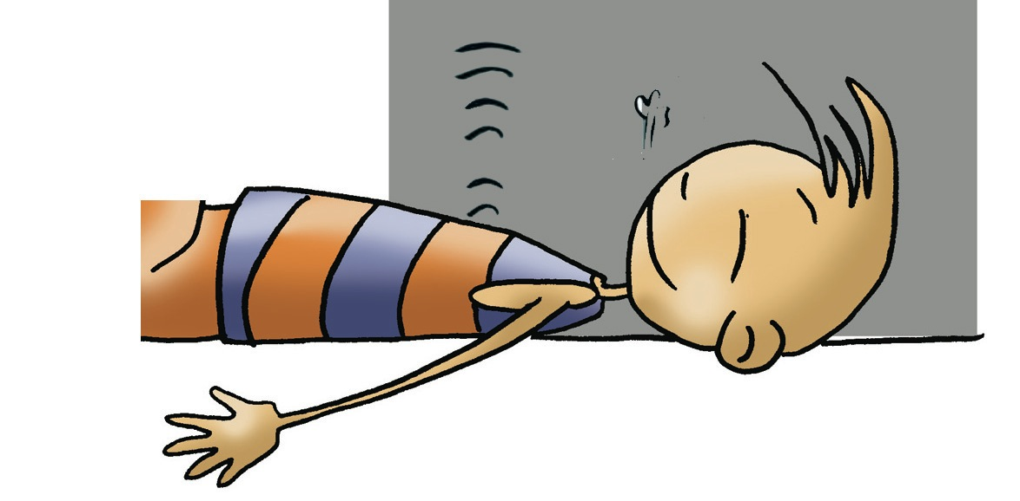
Edmund Jacobson’s Progressive Muscle Relaxation is aimed, as noted in his book Progressive Relaxation, at the reduction of tension in the muscles involved in the actions of mental activities:
arms, legs, trunk, shoulders, neck, eyes, muscles that intervene in human phonation or voicing, including the muscle tension caused in the act of thinking.
For example: Raise the left arm, flex the hand and close it. After performing the flexing motion, the patient drops the arm and opens the hand. This is repeated 2-3 times, this exercise may take approximately three minutes to complete each time. During contraction we can clarify, in greater or lesser extent, the process of muscle contraction to raise awareness.

Slide 11
OTHER SCHOOLS OF THOUGHT
Rééeducation Psychotonique. Its name is due to Doctor JG Lemaire, who was inspired by a study of J. Ajuriaguerra, a psychiatrist who used autogenic training techniques..
Relaxation by Multiple Types of Induction. Promoted by Michel Sapir, it is based on Rééeducation Psychotonique.
Relaxation Response. This technique is inspired by the methods of concentration of East and West. Its precursor is Dr H. Benson, and characterised by certain elements:
  - a calm and quiet atmosphere,
  - a repetition of a sound or word, which the patient must focus on and repeat aloud or always softly so attention or thought is not distracted,
  - a sitting position as on the couch is perhaps the most appropriate, and - the duration of each session will range between 15 and 20 minutes..
Eutony. A Danish professor, Gerda Alexander, set up this method to regain muscle tone whenever it is necessary.
Yoga. Originating in India, it offers various specialties and seeks a balance, mainly the well-being of the body, mind and soul. It means "joining" the physical and spiritual values.
T’ai Chi Ch’uan. The story told is that it was created by a Taoist monk called Zhang Sanfeng while observing an endless fight between a snake elegantly dodging with slow, agile and continuous moves the attacks by an eagle.
Sophrology. A system created in Spain around 1960 by Dr Alfonso Caycedo. It is a science that studies human consciousness; it fashioned a new philosophy and applies therapeutic systems wherever possible to reinforce the personality and achieve greater harmony.

Slide 12
QUESTIONNAIRE AND ACTIVITIES
1. Who used hypnosis in the beginning and was the precursor of psychoanalysis?
2. The pioneer of relaxation as psychotherapy is…
3. Do you know a progressive relaxation exercise?
4. What is the first cycle of autogenic training by Schultz?
5. Would you be able to identify the characteristics to be fulfilled in Edmund Jacobson’s Progressive Relaxation and the proper body position?
6. Do you know any other relaxation techniques?
7. If you practise some form of relaxation, compare it the rest of your classmates and check it.
8. Write down in your notebook unknown vocabulary from this unit

