Slide 1
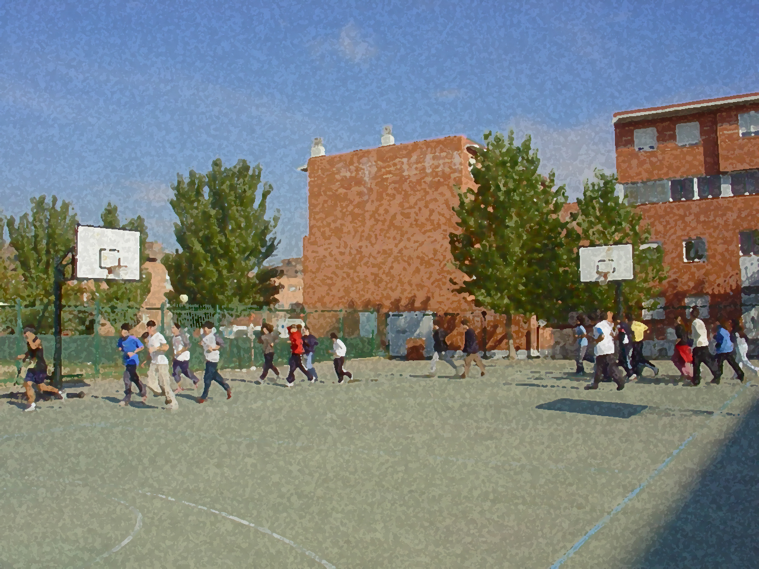
Fundamentals for Secondary School and Baccalaureate. Comprehensive and experiential learning
Populars Games

Slide 2
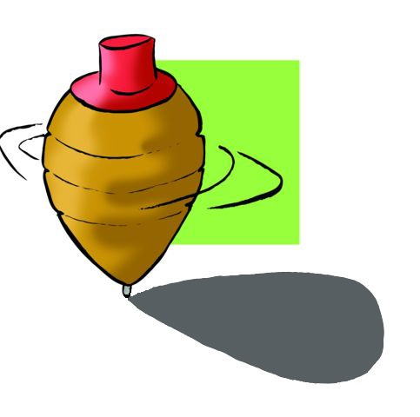
Populars Games
Objectives
Popular Games
Questionnaire and Activities
Long ago, boys and girls your age, at break time, on holiday, in towns or cities spent time playing many different games that have appeared and disappeared over time.

Slide 3
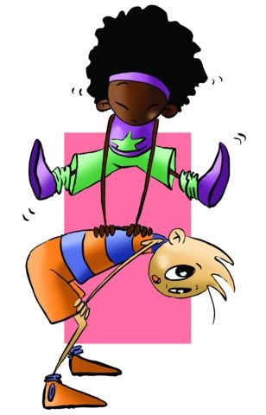
Objectives
To improve physical and motor skills through popular games and become acquainted with the background and circumstances of those games from the past.
To respect the rules established by the members of the group and enjoy the games played by our parents and their parents.

Slide 4
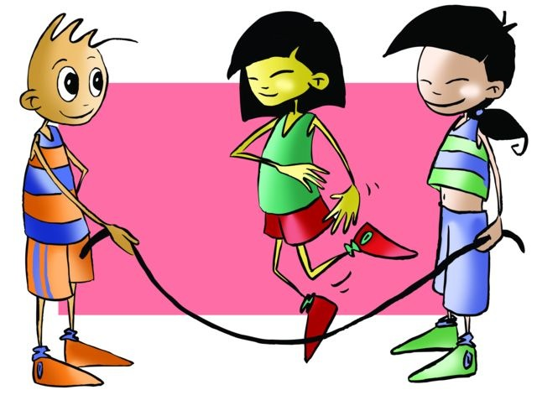
Games are fun activities that occupy the leisure time of boys and girls. They also favour relationship-building and they help us understand each other. They are regulated by very specific rules that are accepted and respected by all, offering suspense-filled, lively entertainment.
Populars Games
La Comba (Jump rope)
Two of the group turn the rope and the rest of the jump to the beat of a song. The jumper that misses has to turn the rope.

Slide 5
A la una andaba la mula (Leapfrog)
Leapfrog used to be a jumping game for winter months. It consisted of jumping over another i.e. "leapfrogging" over another player who stooped over or put his/her hands on his/her knees while bending the trunk forward. The leader of the group (called madre) would tell the jumper what skill he/she had to demonstrate. If any of the jumpers did not vault over with the skill required, he/she had to “give a back”. Each turn meant 10 or 11 jumps, and once the game was over, it could be repeated but the level of difficulty was raised, which meant that the person “giving a back” raised his/her body a bit more. In successive jumps the following was said, although it may change due to local custom:
A la una andaba la mula
A las dos tiró la coz (jumper kicks the one “giving a back”)
A las tres la cruz San Andrés (jumper crosses legs to land)
A las cuatro culada que te parto (jumper sits briefly on the stooped person’s back while taking the jump)
A las cinco el gran brinco (jumper vaults over the other from whichever side madre calls)
…

Slide 6
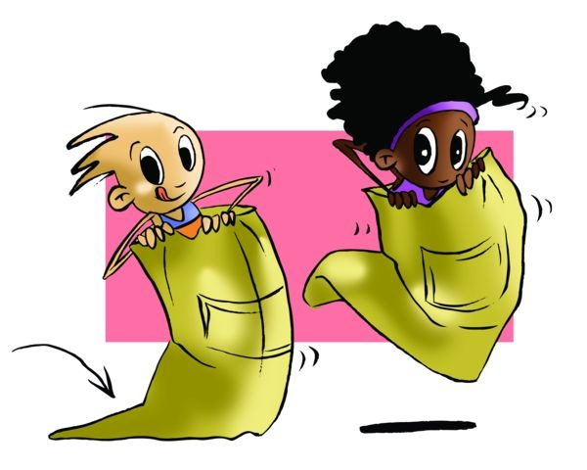
Sack Racing
It is widely played at parties to compete for a prize. They use empty potato sacks where you put your legs and hold it with your hands then race over a predetermined track there and back. You could compete in teams making it into a relay race.

Slide 7
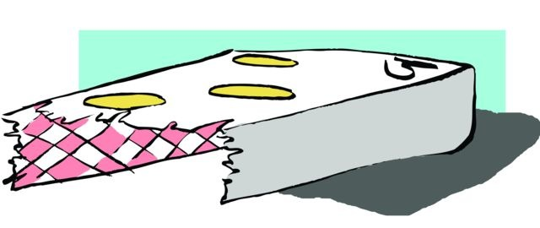
Las carpetas (Flipping cards)
It originated mainly in rural areas and consisted in developing a carpeta (one’s collection of old playing cards cut in half gifted to children by the owner of the bar). They were used as if they were trading cards or stickers. The game consisted in throwing a card against the wall and the winner was the one whose card landed closest to the wall. Another version was one in which you dropped the carpeta down from a ledge having previously chosen how it would land (suit or the back), betting on how many would land facing the back or suit, and the winner would be the one who was closest in number to the one predicted.

Slide 8
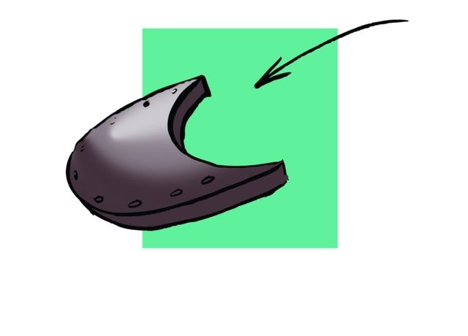
El taco
It is also called tacón; it was a game that was played with the old, discarded rubber heels of used shoes. They were very difficult to find because no shoes were ever thrown out. It was a betting game that earned you stickers. Every player, (there was no limit to the number of players) took turns throwing the taco on the ground until one of the players saw the opportunity to throw it towards another taco, leaving a distance such as the width of the palm, then you won the cards wagered. If the taco fell on top of the other then double the amount bet was paid.

Slide 9
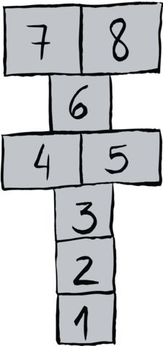
El Tejo (Hopscotch)
This game consists of the following:
A group of up to six players with chalk to draw the pattern to follow as shown (there are many variants of this drawing). The player throws a marker (smooth, flat stone that can easily slide) to box Nº. 1 and hops to the other boxes on one leg, except where there are two boxes (players may straddle them) in which case they can put one foot in each unless they contain the marker (tejo). To make the trip back the player has to hop on one leg and when reaching the square with the stone he/she has to kick it out.

Slide 10
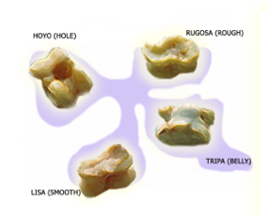
Las Tabas (Knucklebones)
Each piece has four sides: one is called tripa (belly), another called hoyo (hole), another called lisa (smooth), and another taba called rugosa (rough). The game consists of throwing each of the seven tabas into the air until all of them have landed with a certain side facing up. The game begins when the player chooses of the sides, picks one of the thrown tabas (knucklebone), and rolls it until it lands with the chosen side up. Once he/she has managed to do this with all the seven tabas, the player goes on to choose another side, and the game continues until he/she has played all the four sides.

Slide 11
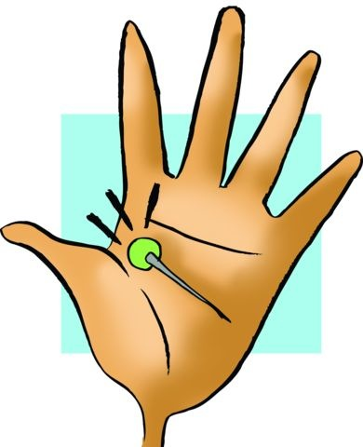
Agujas de colores (Coloured pins)
This game is not very popular. It is played by boys and girls although the latter played it more. The coloured needles are coloured head pins; the colours having been selected on the basis of preference. One of the games played had children placing the pins on the floor with the heads together. Using light finger taps, the player tries to project them up from the ground, i.e., have them jump up and fall lying across each other. If you manage to do it you win the pins. Another game consisted in holding a pin in the hand; the others can guess you guess its position by the other player placing his/her hand over the hand holding the pin. If the player correctly guessed how the pin lay, then he/she wins the needle.

Slide 12
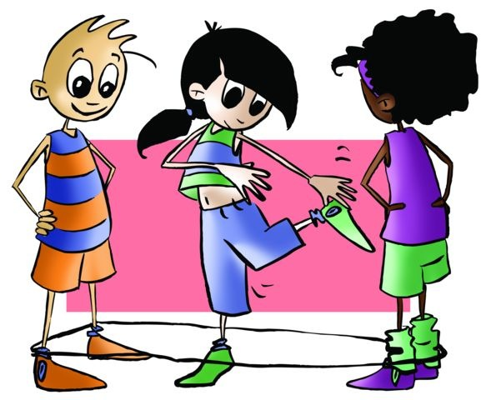
La goma
Today you still see some girls playing it. The game is easy even though there are difficult moves to be made. The game calls for a rubber or elastic band to be placed between two girls or boys around the ankles. The game could be made more challenging by slowly raising it the elastic band. The player jumps and does jump combinations with the rubber band entwined around his/her feet. If a mistake is made, then the band is raised.

Slide 13
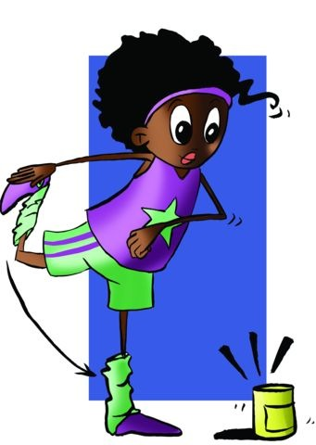
El bote (Hide and seek)
This game is played more often in rural areas, in urban areas it has become known as alto la maya.
Out in the country a tin (bote) is placed on the ground, and everyone hides except one. That player stands next to the bote and covers his/her eyes next to a bote. The seeker waits until everyone has found a hiding place. He/she tries to find them, and if the seeker discovers someone in his/her hiding place, he/she has to run back to the bote, hit it against a stone and shout the name of the person found and where this person is hiding. This player will then automatically be eliminated, and the game continues until the seeker has found everyone. When this happens, the first person found then becomes the seeker. However, if the seeker gets too far away from the bote he/she risks one of other players in hiding running to the bote, kicking it and “saving” everyone, signalling the start of a new game.

Slide 14
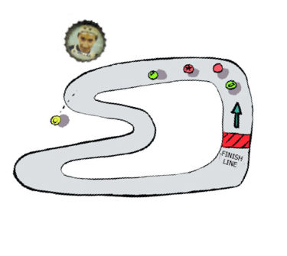
El pirulo
The pirulo (also referred to in other regions as spinning top, spin or galdrufa) requires skill. It consists of throwing the top (made of wood with a metal tip on which it spins) with a string on the ground. Being skilful means being able to make the top keep spinning for a long time.
Las chapas
Using the bottle caps that are least deformed possible, races are held on circuits painted with chalk, marked with a stick on the ground or on the street. The bottle cap is hit with the index or middle finger by flicking it. The blow should be precise so as not to leave the circuit. If this happened the player has to return to the start line. The winner is the first one to cross the finish line.
The caps may be adorned and worked on. First they can be polished by scraping them against rocks so they slide better and then adorned by placing photos of football players or cyclists sticking them inside with wax, thus the cap had more body and elegance.

Slide 15
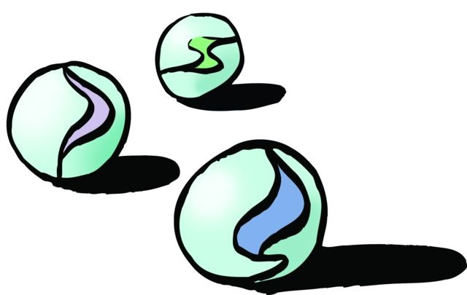
Las chivas (Marbles)
This game is very popular, it is also known as marbles or pitones. It is usually played on the dirt floor of playgrounds.
Marbles are small balls of very different composition; they are made from clear and multi-coloured glass, but they used to very expensive even though some were very nice. There were others made from stone or mud and because they were cheap, they became widely used. Iron marbles were forbidden among players since they would break those made of glass, stone, or clay, and finally opaque glass multicolour called "American" almost nobody had them because they were expensive.
The marble is flicked with fingers, placing it between the tip of the index finger and the last interphalangeal joint of the thumb, which is the finger that really propels it.
The simplest game, called a seguirla (“boss out”), is trying to hit the marble of the opponent; if that happens, you win one (“play for keeps”).

Slide 16
QUESTIONNAIRE AND ACTIVITIES
What is the game called that has coloured needles?
Why is the hide and seek game presented here called bote?
How do you play hopscotch?
What jump rope games do you know?

