Slide 1
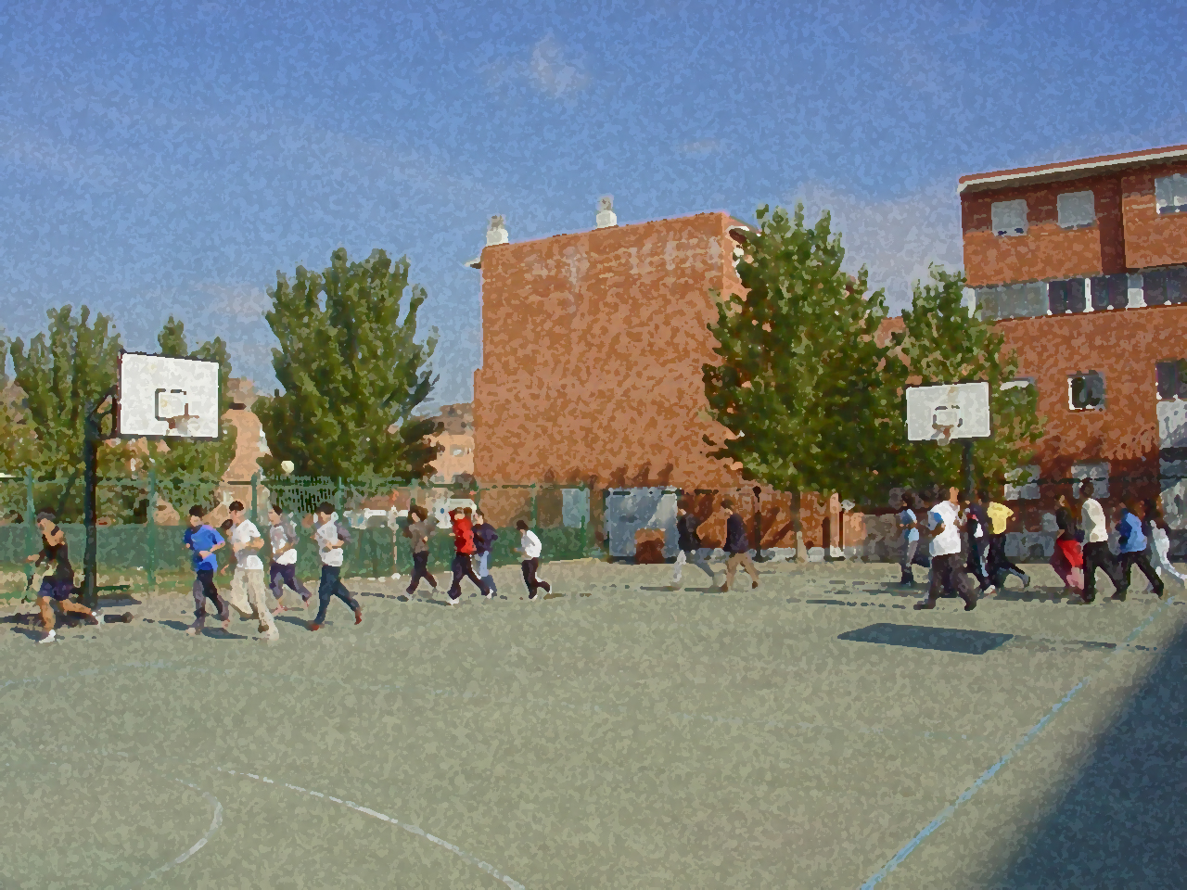
Fundamentals for Secondary School and Baccalaureate. Comprehensive and experiential learning
Physical Abilities & Motor Skills

Slide 2
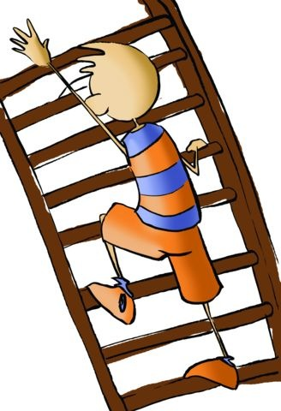
Contents
Objectives
Concept and Classes
Physical Abilities
Strength
Endurance
Speed
Flexibility
Motor Skills: Balance and Co-ordination
Conditioning Factors: Extrinsic and Intrinsic
Development of Physical Abilities and Motor Skills
In Relation to Age and Fitness: Evolution

Slide 3
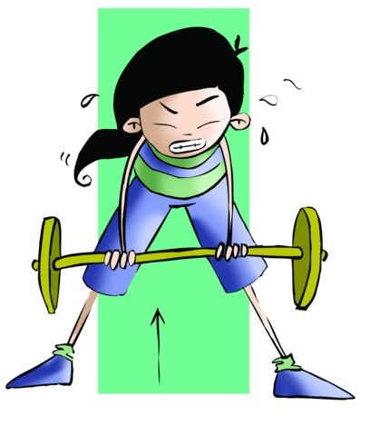
OBJECTIVES
- To learn the different physical abilities and motor skills, distinguishing the peculiarities of each of them when it comes to implementing them.
- To understand the benefits of healthy exercise conducted in an organised fashion to improve our physical condition.

Slide 4
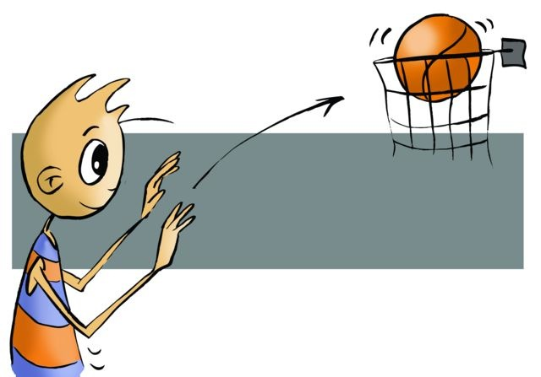
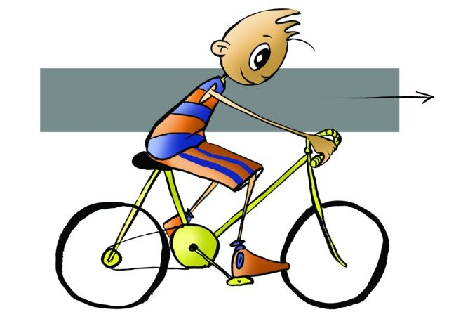
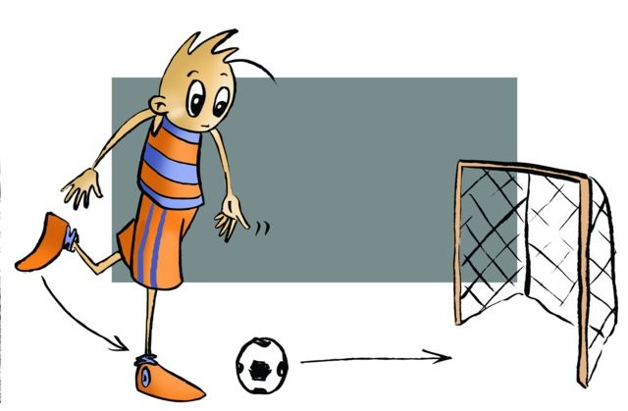
FITNESS.
Motor skills and physical abilities also known by others as co-ordinating capacities and conditional capacities. They are those physical characteristics reached by training, its highest level of development, reliant on the possibility of implementing any physical and sporting activities. Moreover, together they determine the physical condition of an individual, which is also called fitness.

Slide 5
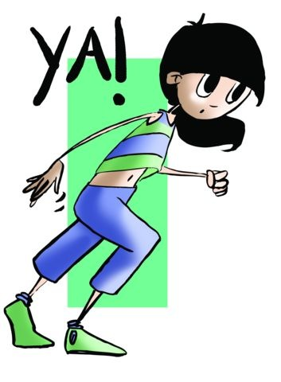
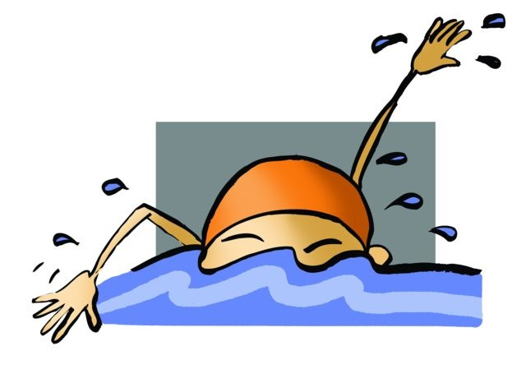
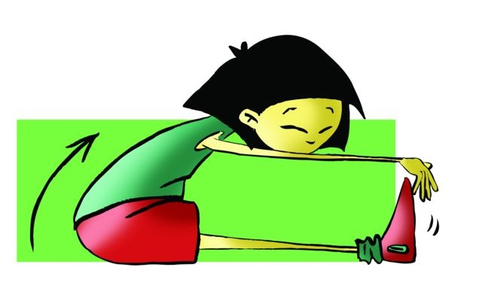
PHYSICAL ABILITIES
Strength
Flexibility
Endurance (Stamina)
Speed
The ability through which movement reaches its maximum degree of extension. For example, sitting on the floor, legs extended and together, hands reach maximum distance.
The ability to overcome, move or maintain external resistance through muscular contraction.
The ability to develop a motor response in the shortest possible time.
Capacity that entails making a determined effort as long as possible and quickly recovering from it.

Slide 6
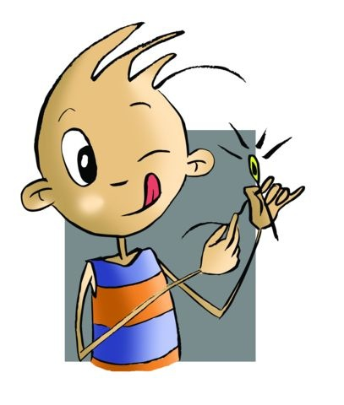
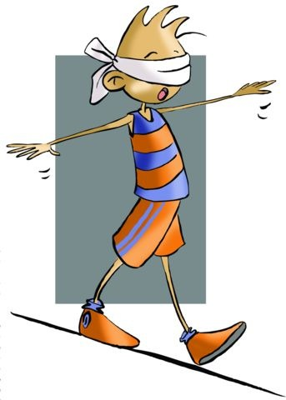
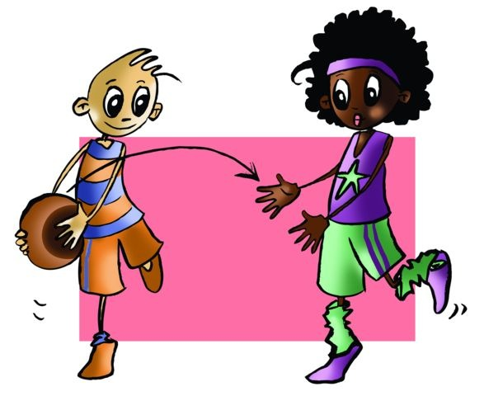
MOTOR SKILLS
Balance
Co-ordination
The ability to withstand, i.e., retain without variation a certain posture, the force of gravity.
There is optimal neuromuscular control of motor action.

Slide 7
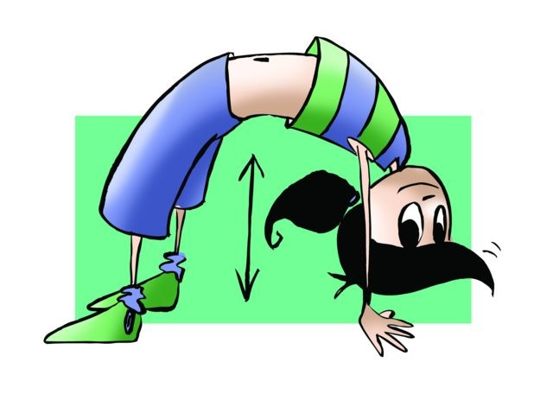
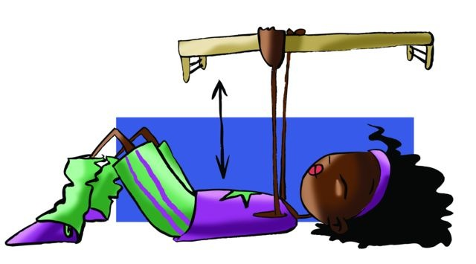
CONDITIONING FACTORS
INTRINSIC | Factors that come from within and may have a positive or negative effect on our physical fitness | Respiratory system
 |  | Nervous system
 |  | Cardiovascular system
 |  | Muscular system
 |  | Skeletal system
EXTRINSIC | Factors that come to us from the outside and can also alter our physical condition | Socio-cultural environment
 |  | Food
 |  | The weather...
 |  | Type of job. etc.

Slide 8
Look at this questions carefully and take a few moments to think before you start to answer.
1. Could you define motor skills and physical abilities? 2. What do you understand by reaction rate? 3. What, in your opinion, is flexibility? 4. Check your pulse during mild and intense workout. 5. Are there any differences in the developmental process of physical fitness?
6.Write down in your notebook unknown vocabulary from this unit.
Look at this picture, this exercise is from...
Look at this picture, this exercise is from...
Look at this picture, this exercise is from...

