Slide 1
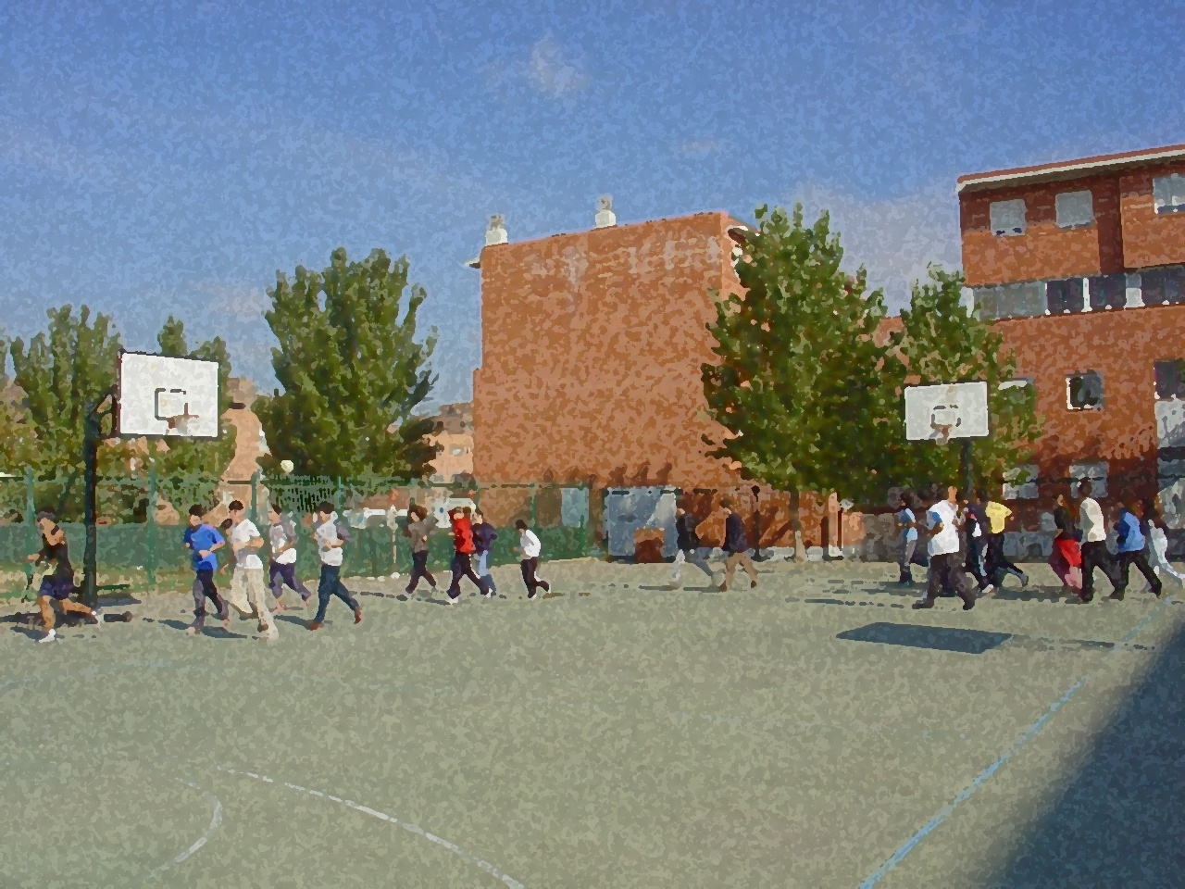

Fundamentals for Secondary School and Baccalaureate. Comprehensive and experiential learning
Frisbee

Slide 2
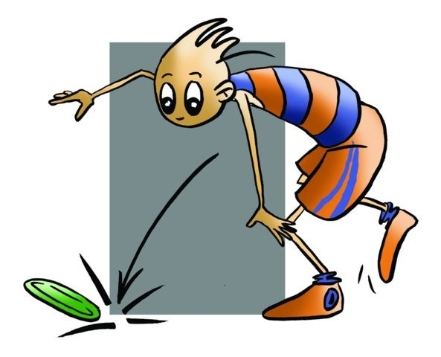
Frisbee
Objectives
Basic Regulation: Types of Games
Equipment and Facilities
Basic Technical-Tactical Resources
Questionnaire and Activities

Slide 3
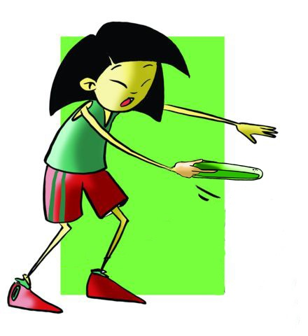

OBJECTIVES
To learn a different game involving a fundamental commitment and effort.
To accept conflicts and resolve them by finding consensus.

Slide 4
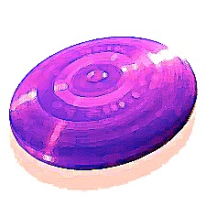
BASIC REGULATION: TYPES OF GAMES
The rules are based on the disc flying as far as possible without touching the ground, passing a particular point or falling within a given area.

Slide 5
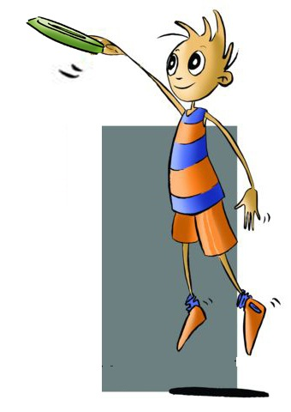
Types of games
Hula Hoop Frisbee | it consists in throwing the disc through a hoop held one metre from floor/ground.
Disc Freestyle | it involves the player using all the skills the thrower is capable of exhibiting with the disc.
Disc Golf | it is played much like golf, baskets are used instead of holes.
Ultimate Frisbee | the game is played in over 40 countries consisting in passing the disc between seven players and trying to get it in a specific area called the goal.

Slide 6
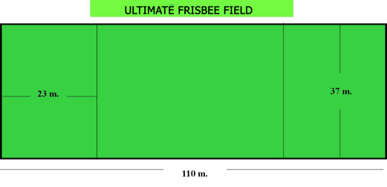
BASIC REGULATION
Games are played to 19 points (always a difference of two) changing ends whenever a goal is scored.
It is played 7 vs. 7 or 5 vs. 5 on the beach.
The player cannot run or walk with the disc in hand, only pivot.
Each player has 10" possession that his marker counts out loud, and who cannot grab it or make physical contact although he is not in possession of the disc.
Two players of the opposing team may not mark one.
Possession of the disc changes when the disc is intercepted in a pass, when the 10” of possession runs out, when a pass is received outside of the area or when the disc hits the ground.
Whenever there is a foul, whatever it is, it can be accepted by the opponents and the match is restarted from the place where it was committed or it may not be accepted in which case the disc returns to the place from where it came. Until the disc is back in play, game players cannot move. The changes are unlimited but they will be made when the game has stopped.
And most importantly, there is no referee or judge.

Slide 7
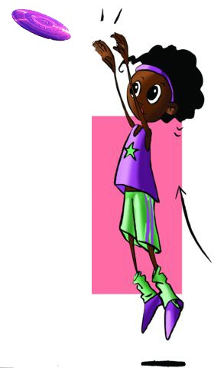
EQUIPMENT AND FACILITIES
The disc for playing outdoors weighs 175g, and indoors 165g with a diameter of 20cm. In some specialities it can weigh up to 200g and in others 90g.
The facilities will depend on the type of game. For Ultimate Frisbee a handball field can be adapted so that the end zones can be the goal areas.

Slide 8
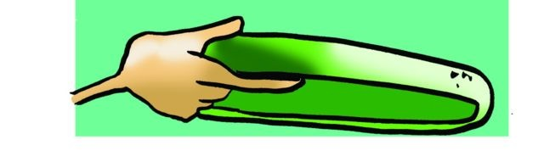
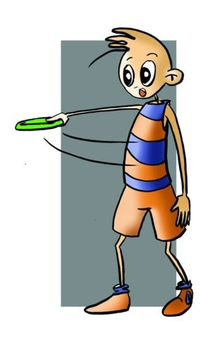
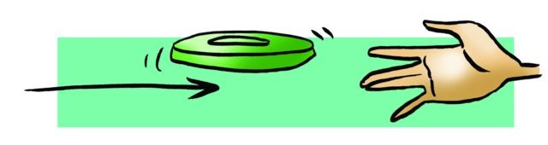

BASIC TECHNICAL-TACTICAL RESOURCES
Grip
Throwing:
Backhand
  Blade
Air Bounce
Catching:
Low Catch
High Catch

Slide 9
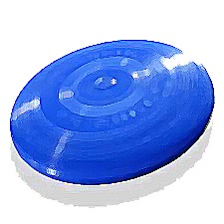
QUESTIONNAIRE AND ACTIVITIES
Name two ways to play with a frisbee.
How many ways can you catch a disc?
Take a disc and try to pass it to a classmate in the following ways: classical, between the legs and back.
Invent a game of marksmanship or accuracy with a frisbee.
Do you know the origin of the game?
Write down in your notebook unknown vocabulary from this unit.
Check the Federation website or any sports association in your region and checks for changes or modifications, if any, in its regulations.

