Slide 1
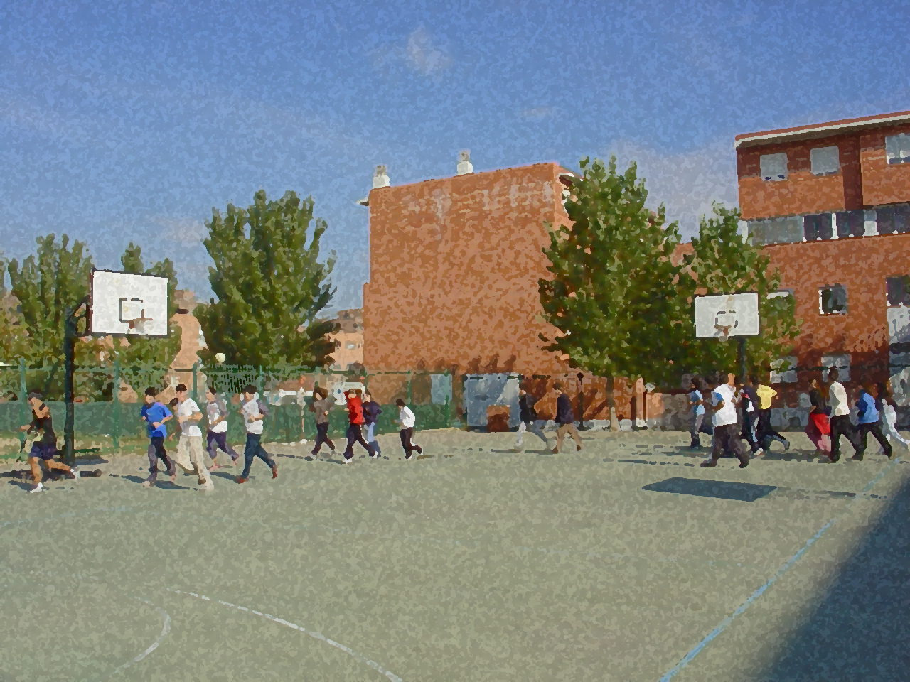

Fundamentals for Secondary School and Baccalaureate. Comprehensive and experiential learning
FLEXIBILITY

Slide 2
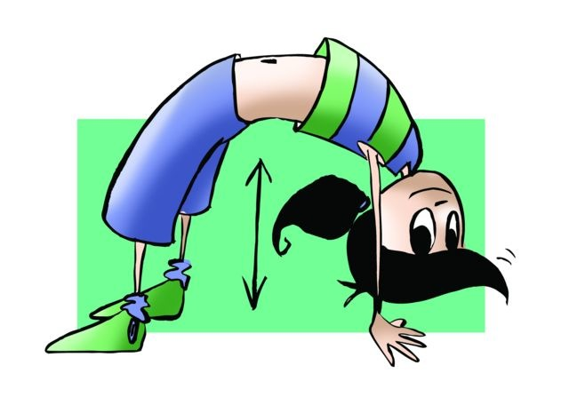
FLEXIBILITY
1. Objectives
2. Concept of Flexibility
3. Essential Factors in Flexibility:
Joint Mobility
Muscle Elasticity Extensibility
4. Determining Factors in Flexibility
5. Measurement of Flexibility
6. Development of Flexibility: Methods
Static-Active
Ballistic
Static-Passive
Isometric
PNF
7. Questionnaire and Activities

Slide 3
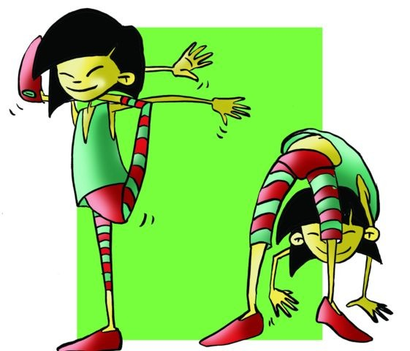
OBJECTIVES
- To understand the need to acquire some flexibility to maintain healthy joint mobility and elasticity in our muscular system.
- To use the most adequate system to practise a variety of exercises that are balanced thus helping to improve physical capacity of flexibility.

Slide 4
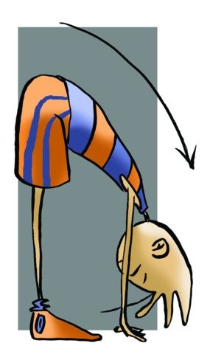
The degree of this ability is reflected in how movements may reach their maximum range of motion.

Slide 5
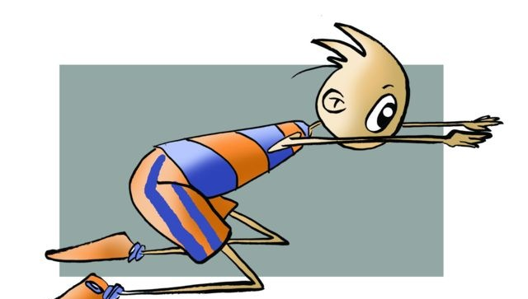
ESSENTIAL FACTORS IN FLEXIBILITY (Intrinsic)
1. Joint Mobility
The mobility of the joint is determined by the anatomical constitution. In this sense there are three types of joints:
Sinarthrodial: Joints that have no movement and no separation, i.e., there is no joint cavity. An example of this is the joints of the skull bones.
Amphiarthrosis: Joints that have reduced movements and have an intra-articular cartilage disc through which movements are facilitated. A clear example is the intervertebral joint.
Diarthrosis: Joints that enjoy the possibility of performing large movements and have joint space, i.e., a joint capsule, etc. For example, the shoulder joint.
2. Muscle Elasticity and Extensibility
Muscle elasticity: Is the ability to recover its original shape after being deformed by the application of a force .
Extensibility: The variation in the muscle becomes the application of a force.

Slide 6
DETERMINING FACTORS IN FLEXIBILITY (Extrinsic):
Hereditary
Age
Gender
Muscle Temperature
Type of Regular Work
Muscle Volume and Adipose Tissue
Ambient Temperature

Slide 7
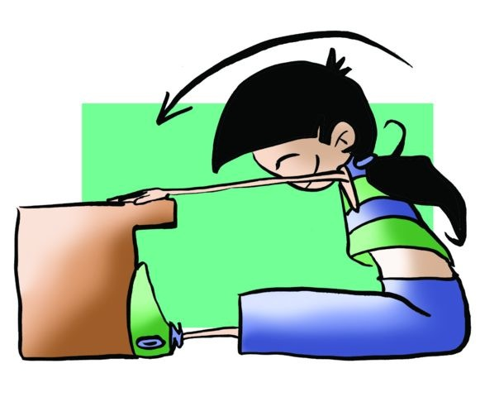
MEASUREMENT OF FLEXIBILITY
Flexibility is measured with apparatuses specially designed on some occasions and less sophisticated in others, to determine the degree of movement in a particular joint and apply relevant exercises to it.
Deep Body Flexion

Slide 8
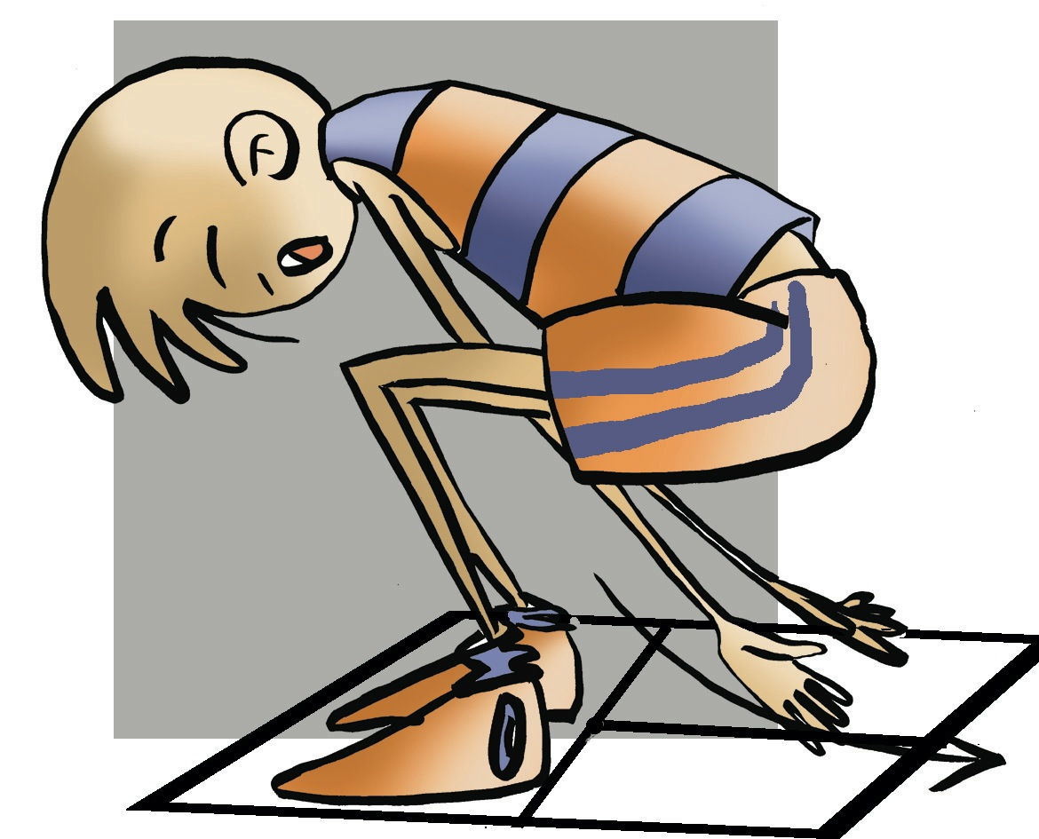
2. Anterior Trunk Flexion

Slide 9
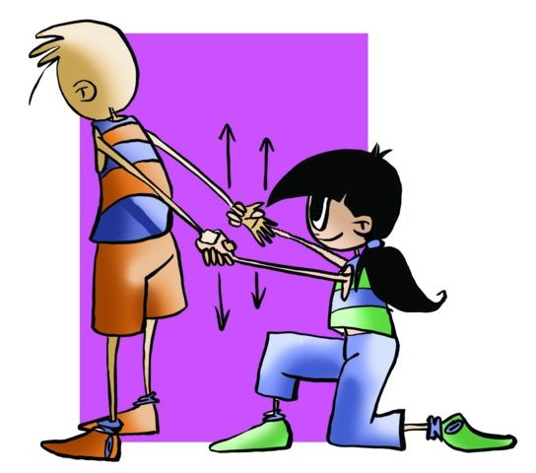
Methods to develop flexibility
Static-Active
Isometric
Ballistic
PNF
Static-Passive

Slide 10
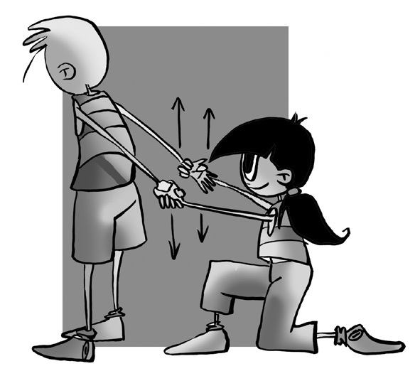
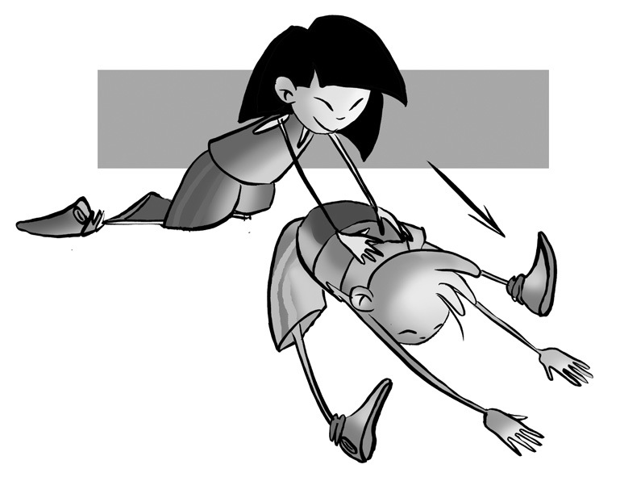
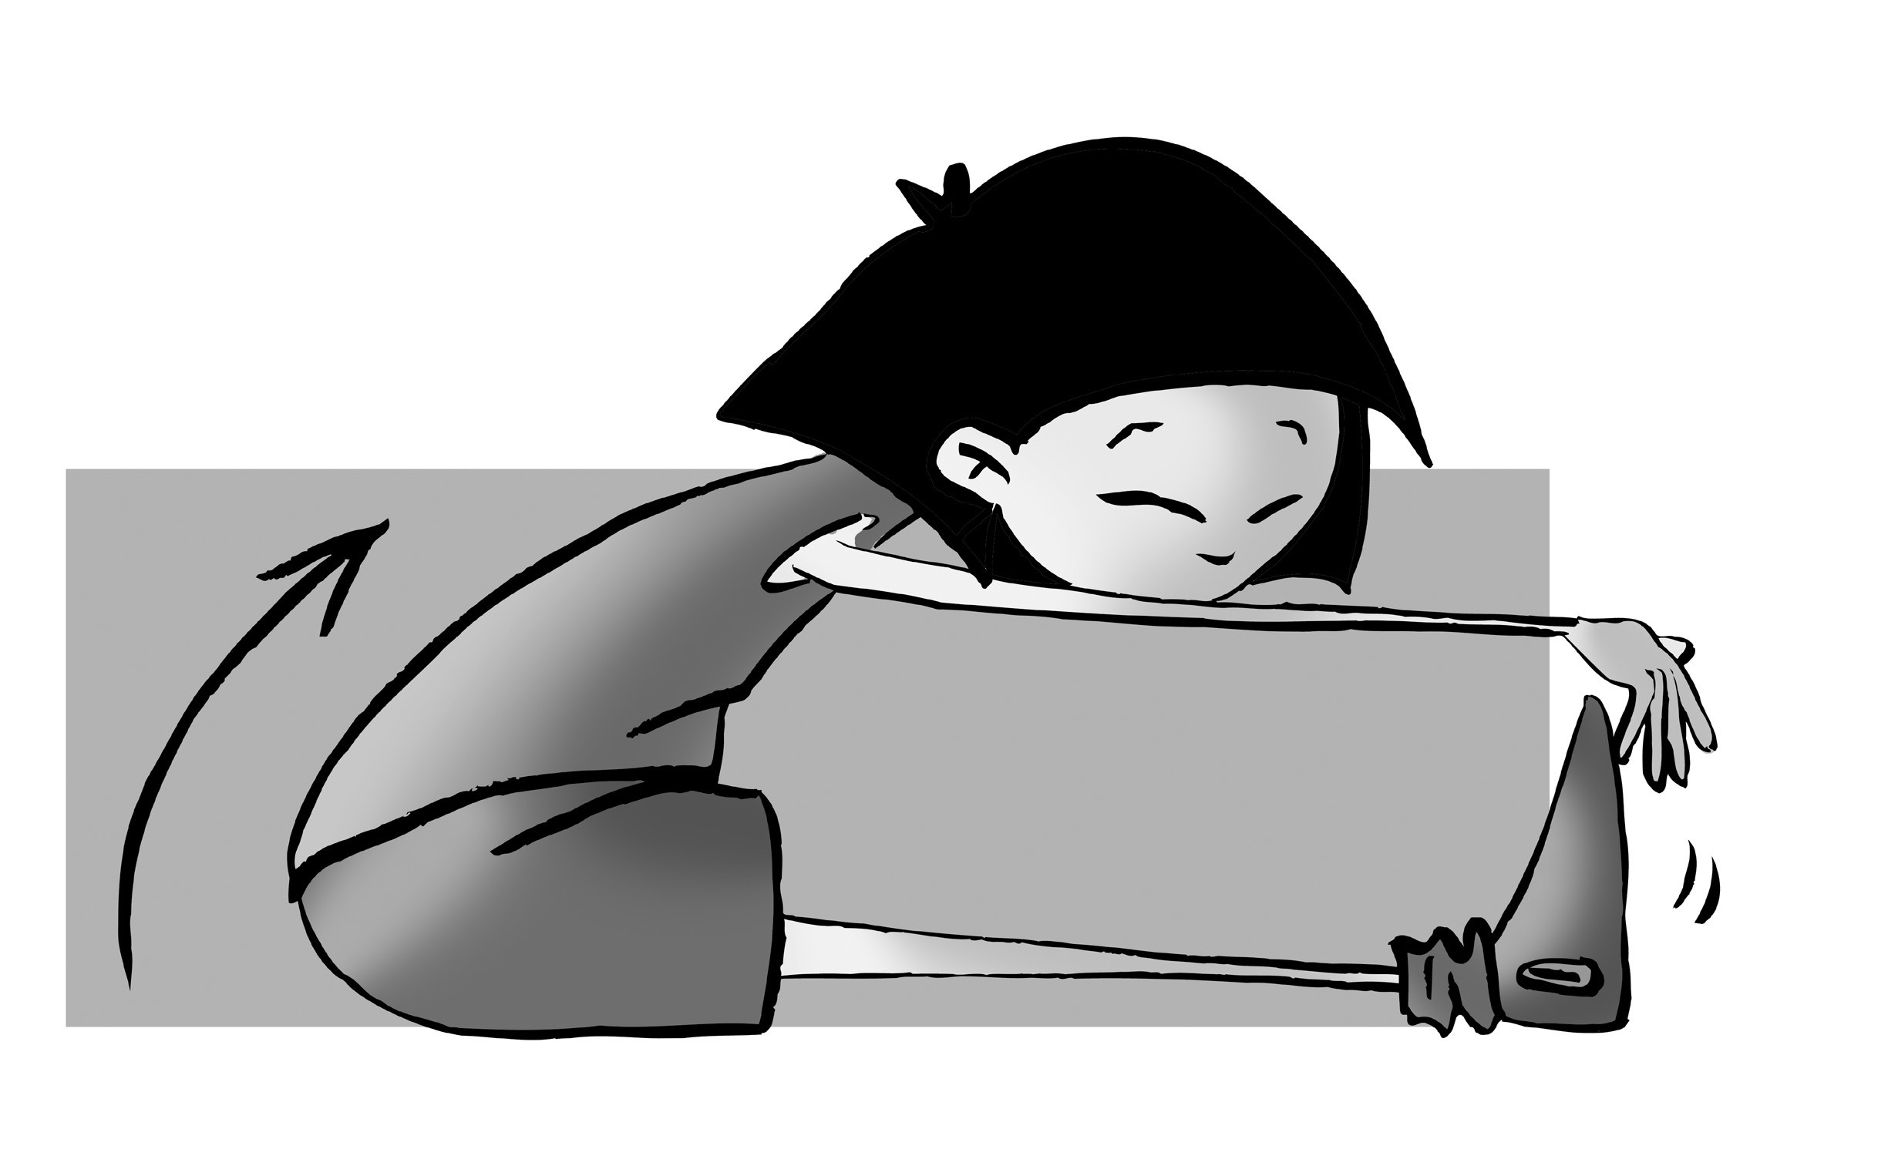
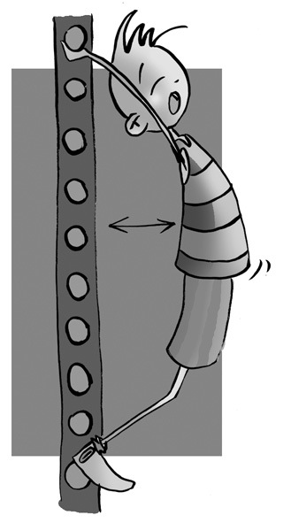
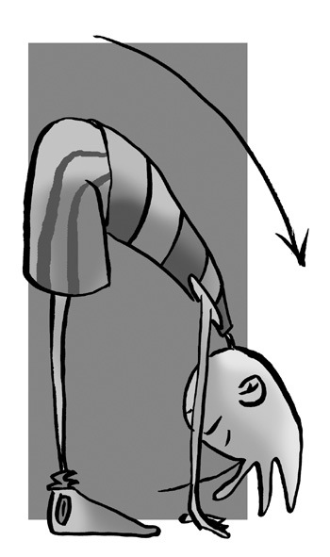
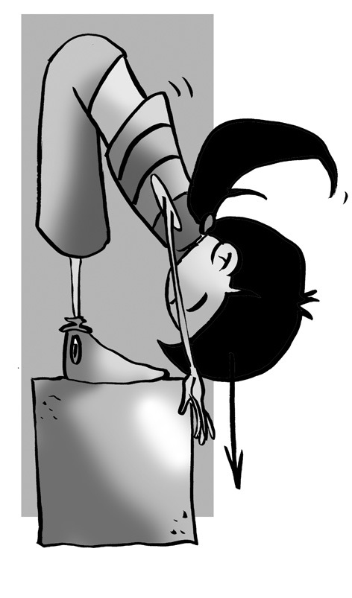
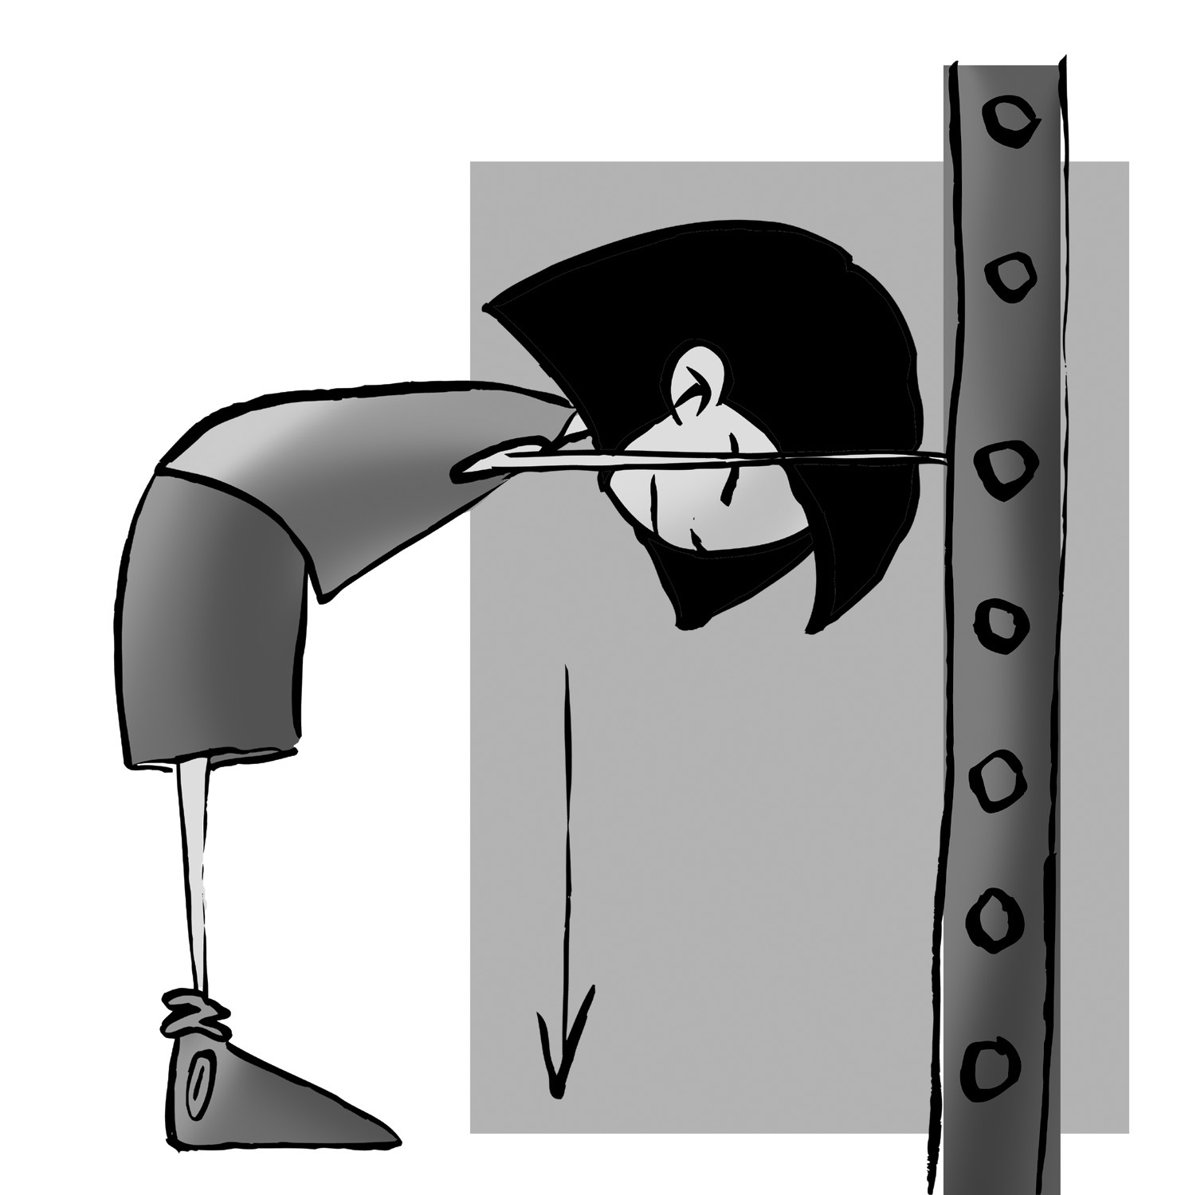
Algunos ejercicios que puedes hacer en clase con las indicaciones de tu profesora o profesor. ¿Podrías identificar a qué grupo muscular y articulación afecta cada un de estos ejercicios?
Algunos estiramientos específicos para deportes de equipo, volei, baloncesto, balonmano, etc.

Slide 11
QUESTIONNAIRE AND ACTIVITIES
1. What do you mean by flexibility?
2. What factors can somehow influence this capacity?
3. What sports specialities is more flexibility needed?
4. Measure yourself with your classmate and explain the differences.
5. Explain to your partner some tips for developing flexibility.
7. Calculate the degree of flexibility among the members of your family.
6. What are the main characteristics of the PNF method?

