Slide 1
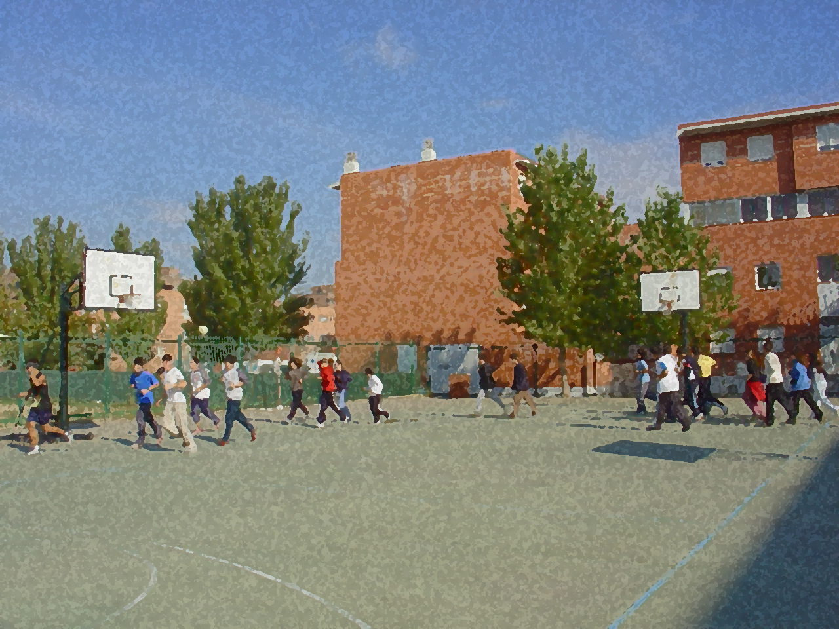

Fundamental for Secondary School and Baccalaureates
Comprehensive and Experiential Learning
Competent Students

Slide 2
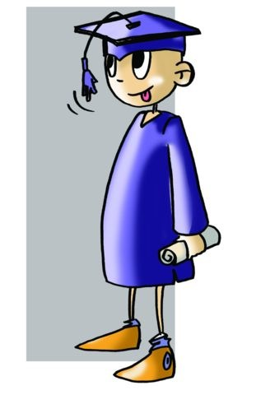
The Organic Law of Education (Ley Orgánica de Educación or LOE in Spanish)
The Organic Law of Education was modified by the Organic Law for the Improvement of the Quality in Education (LOMCE) 8/2013, December 9. This law indicates in Chapter III, Section 6 some leading aspects which should be learned, acquired and passed throughout the four years of secondary education.

Slide 3
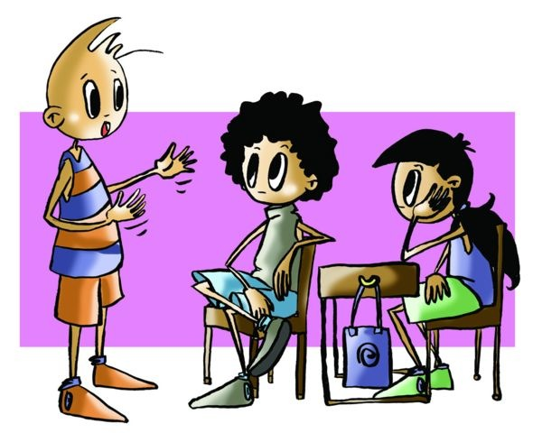
They are called, in an attempt to comply with the European project, Key Competencies (formerly known as Basic). There are seven such competencies, and they will be subsequently discussed.
During the four years of ESO, you will have to learn, among other things, how to solve problems, learn to use the skills being acquired resourcefully, and carry out tasks in such a way as to reflect your growing autonomy.

Slide 4

“What do you think makes an engineer, lawyer, teacher or blacksmith competent?”
You would surely know how to answer the question. Without a doubt you would be able to respond with:
“What they do is satisfactory,”
“They are meticulous in what they do,”
“They are able to reach agreements which are fair,”
“They solve problems of varying degrees of difficulties as they arise,”
“They keep abreast of the latest technologies and/or advances,”
“They know full well how to use their resources.”
However, have you ever wondered what constitutes a competent student?

Slide 5
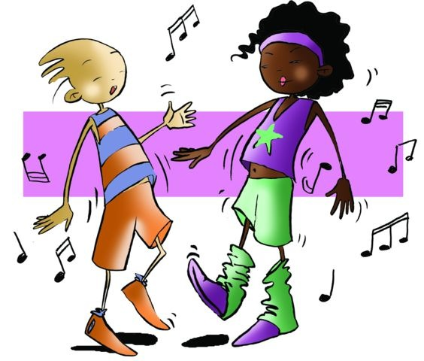
During this period, you are about to commence, you should extend your knowledge, abilities and attitudes which by your fourth year will have reached a certain level of competency:
- You should be able to approach problems with varying degrees of difficulty and resolve them using such abilities learned as socio-affective processes.
- You should find ways to acquire and combine strategies, resources, responses, knowledge (of language, new technologies, ideas, etc.)
- You should have strength and emotional discipline so that, in the task entrusted, you are able to provide an appropriate answer and solution with a critical spirit, smoothly identifying mistakes to take measures to correct them.
Everything can be learned. Some key competencies identify the knowledge, skills and attitudes necessary to ensure that you may continue learning.

Slide 6
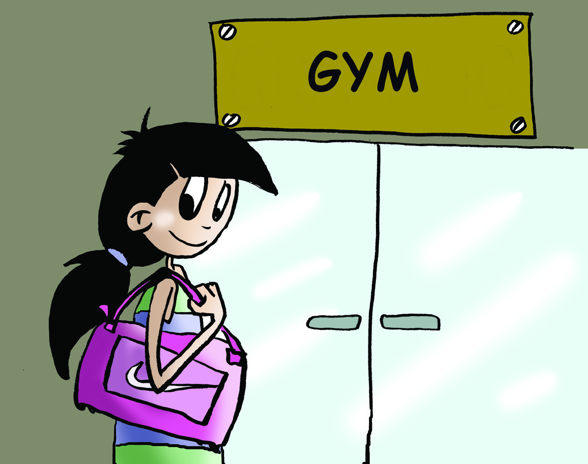
When you are in class and you are faced with a task, a learning situation or any challenge, you should:
Organise and lay out your solution from an independent and universal point of view, which implies using a variety of approaches which will allow you to see the connections within the project with the use of your knowledge so that you will know how to link them, to comprehend them clearly and to use your resources, your tools, your most effective means in order to find a solution.
Be effective and efficient, doing things well, fast and, if it is group work, organising the task responsibly and by general agreement whenever it is necessary, varied (using different techniques) and continuously (at least at those moments when you want to learn).
Use what has been learned in new and different situations should enable us to say what we know and what we do not know, what we can and cannot do to express and present it.

Slide 7
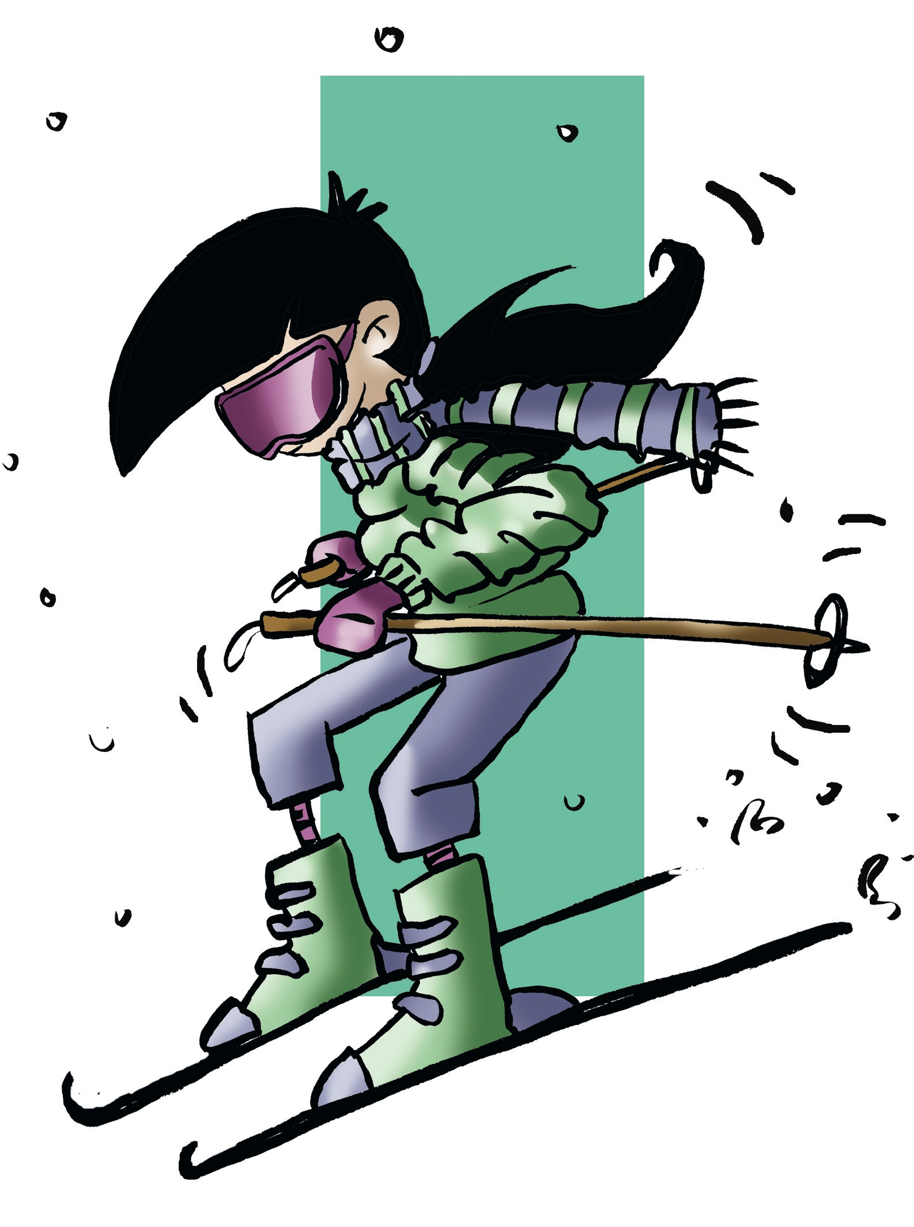
Key Competencies
INITIATIVE AND ENTREPENEURSHIP
SOCIAL AND CIVIC DUTIES
CONSCIENCE AND CULTURAL EXPRESSION
LEARN TO LEARN
LINGUISTIC COMMUNICATION
DIGITAL COMPETENCE
MATHEMATICAL COMPETENCE AND BASIC COMPETENCIES IN SCIENCE AND TECHNOLOGY

Slide 8
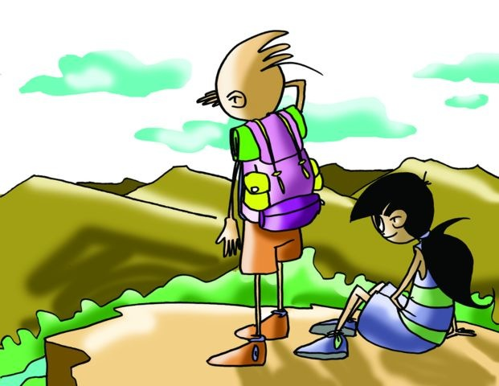
1. INITIATIVE AND ENTREPRENEURSHIP
This competency will permit you to take decisions, take risks, use your initiative and face difficulties and handle conflicts independently and collectively.

Slide 9
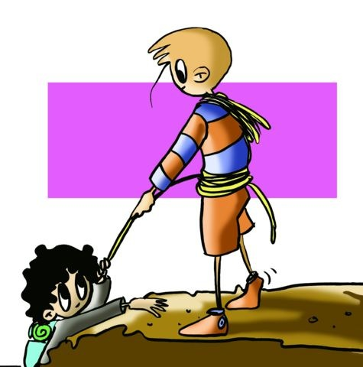
2. SOCIAL AND CIVIC DUTIES
You may already be aware that you are completely immersed in social structures which include family, friends, school, a dance class, and while each one has its own distinct norms, each is configured around respect, equality and co-operation, democratic values which sustain us. Not all individual behaviour is ethical and respectable; it is only when it responds to universal principles which are encompassed in the Declaration of Human Rights or in our Constitution approved by all its citizens.

Slide 10
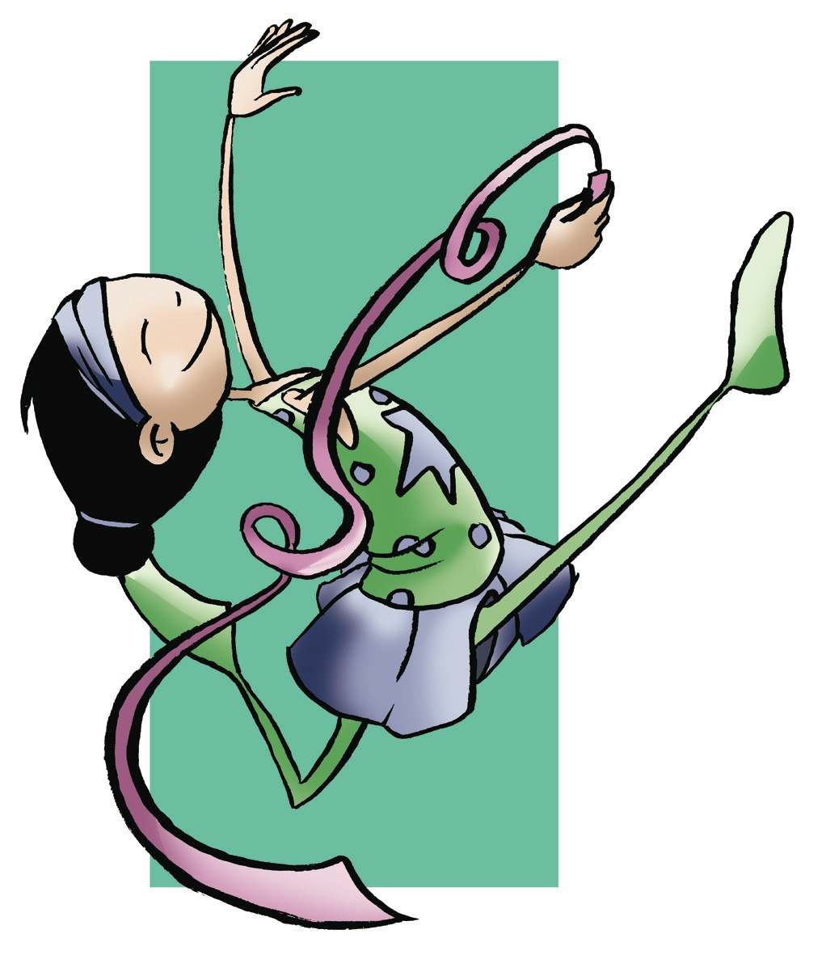
3. CONSCIENCE AND CULTURAL EXPRESSION
You will need to appreciate and value artistic expressions, ideas, music, and flexibility of body movement whether it is in relation to a sport, expression, emotion or a dance. You will practise everything, in addition to the dances and games typical of your culture, in class, and you may enjoy doing it well. By doing the dances of other countries or games played by other cultures which co-exist with yours, you may better understand people and learn to love them.

Slide 11
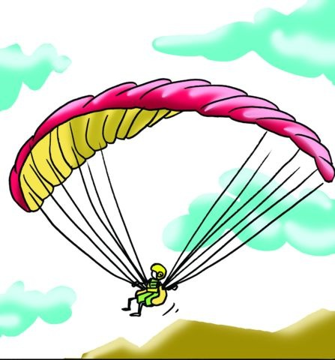
4. LEARN TO LEARN ￼
We should never stop learning. What you learn at school should serve to motivate you to continue your learning after school hours. Being aware of the extent of our knowledge is necessary and just as essential as how it can motivate us to move to explore the unknown in order to learn about it. Movement in sports or specific physical exercises are learned in class so that they may allow you to continue practising them and making progress. You will learn to determine your level of physical fitness, and acquire the skills which will help you to improve it.

Slide 12
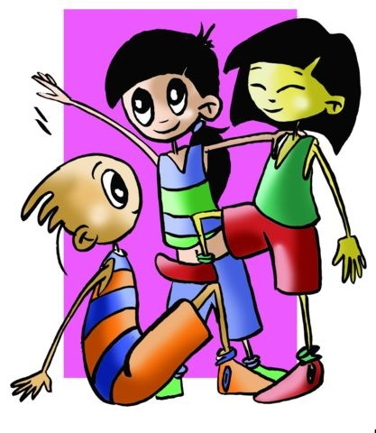
5. LINGUISTIC COMMUNICATION
At times you will find new words which you should incorporate into your own lexicon. PE has its own terminology which is very specific, and you will have to record it and learn it. Furthermore, we contribute to this competency with the inclusion of projects, debates, presentation and individual and group work which you will undoubtedly do throughout this stage, observing your progress in such essential aspects as composition writing, structure, vocabulary, communication and presentation.

Slide 13
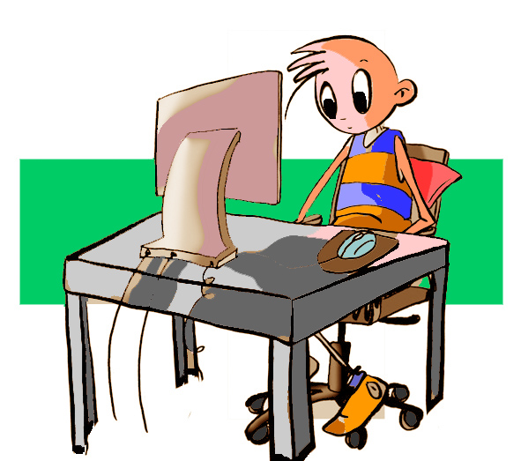
6. DIGITAL COMPETENCE ￼
In PE, you will work on assignments for which you will turn to information media such as the internet, social networks, books, newspaper, magazines or journals, etc. Consequently, you should learn to search and gather information properly, and shy away from “copying and pasting,” which is so often used, and may reflect a lack of interest in learning, and the subject matter. Use these resources confidently, respectfully and carefully, exchanging accurate information. Gather all the information which will help you with the assignment, organise it, include personal opinion, be critical, quote text, do not forget to write your sources in the bibliography.

Slide 14
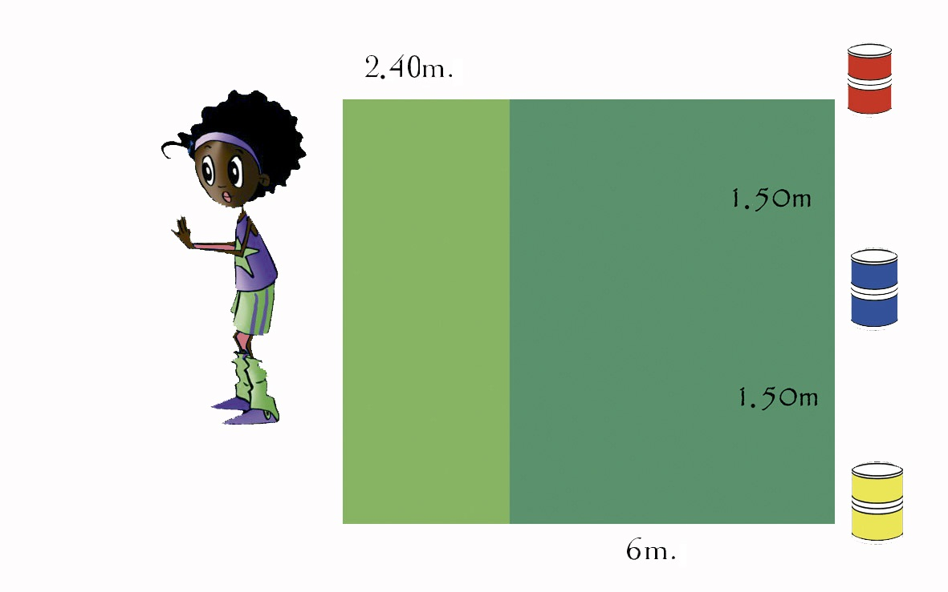
7. MATHEMATICAL COMPETENCE AND BASIC COMPETENCIES IN SCIENCE AND TECHNOLOGY
It is possible that you believe this subject has little to offer; however, it will definitely involve you measuring distances and jumps your classmates make, checking heart rate and applying formulas for some physical trial, calculating the distance on a map using the scale to value positions, and doing simple operations to calculate the average of marks in your records, etc. You will assess your own results or that of a classmate’s, and you should be able to evaluate your physical condition in order to design exercises to improve the outcome, and thus extrapolate this experience to daily life.

Slide 15
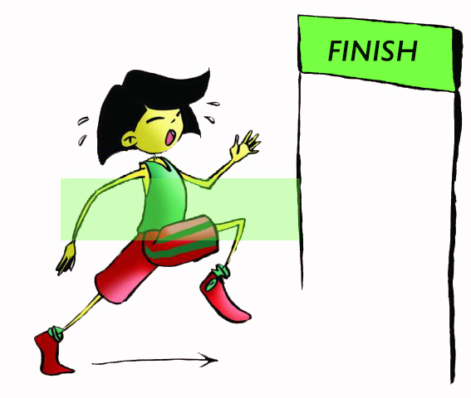
We are going to see if it has become clear to you how we work the competencies in our area or subject and, therefore, within the Centre’s project.
Depending on what you have had to achieve for your competency assessment to be positive, analyse the following challenges obtained from the next page from two points of view.

Slide 16
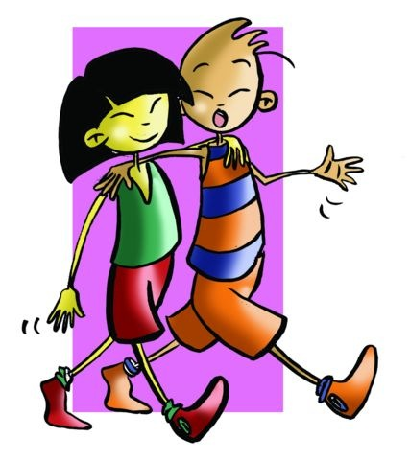
Which competency have you been working to develop?
Which tasks have you done in this academic year or in previous ones to achieve the following?
• Express yourself better in public.
• Seek to know more about someone from a culture other than your own.
• Reason mathematically before the measurement of a test.
• Realise the risks certain human activities have on the environment.
• Get more and better information.
• Find out how you learn best.
• Apply what you have learned outside of your school or centre.
• Respect others more.
• Know your strengths and weaknesses in this area.
• Appreciate and enjoy works of art.
• Carry out teamwork rigorously.
• Write and talk basically in a language other than your own.
• Present exams and assignments correctly.
• Know the systems to improve your physical condition.
• Be responsible about food - taking into account your health.
• Have fun with friends.
• Elicit desire and curiosity to know more things.

