Slide 1
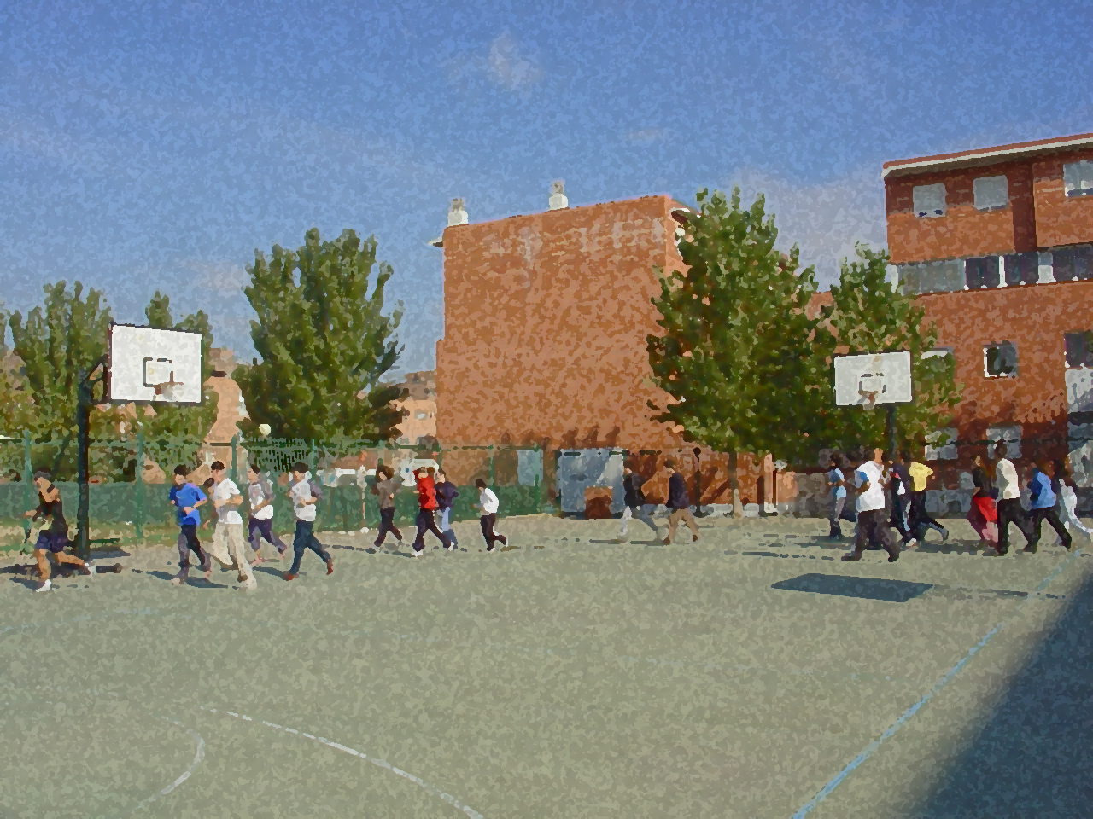

Fundamentals for Secondary School and Baccalaureate. Comprehensive and experiential learning
Korfball

Slide 2
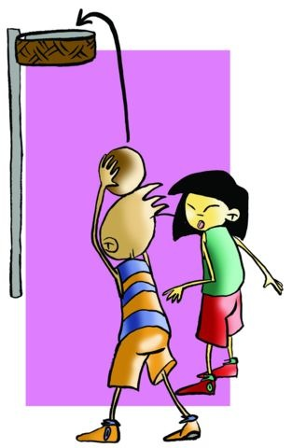
Contents
Objectives
Regulations, Facilities and Equipment
Basic Technical-Tactical Resources
Practical Exercises
Questionnaire and Activities

Slide 3
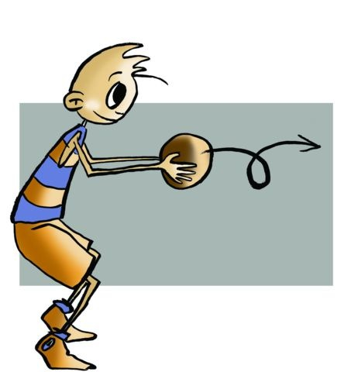
Objectives
- To learn the technical and tactical elements and basic regulations of korfball.
To understand the application in real-game situations in korfball and co-operate with fellow teammates in the setting up and execution of the activities.

Slide 4
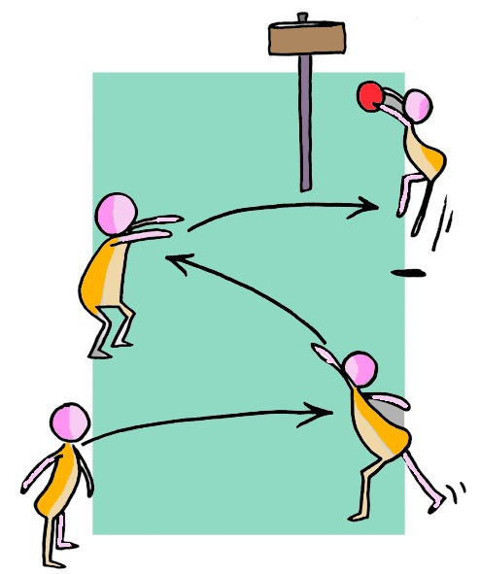
History
Korfball was born in the Netherlands at the beginning of the twentieth century. The Dutch teacher Nico Broekhuysen, in 1902, compiled a number of rules for a sport whose main objective was to offer a game- oriented activity in which both boys and girls could play at the same time. Its name comes from Dutch in which “Korf” means “basket”.

Slide 5
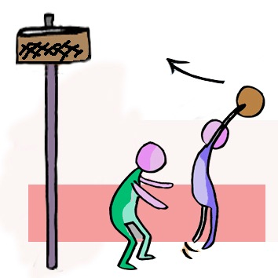
BASIC REGULATIONS
The composition of the teams is mixed, formed by four female and four male players. This rule allows a very important consideration to be taken seriously in education. We are referring to co-education, in which the two genders act collaboratively and participate on equal terms under the same rules pursuing shared goals.
The court is divided in two halves called zones so two boys and two girls (a division) will take position in each half.
Each boy in a team will defend/mark a boy from the other team, the same for the girls.
The players cannot go beyond the limits of their zone.
The aim of the game is to pass the ball through the basket, from top to bottom. Every time the ball is shot through the basket, a point is scored.

Slide 6
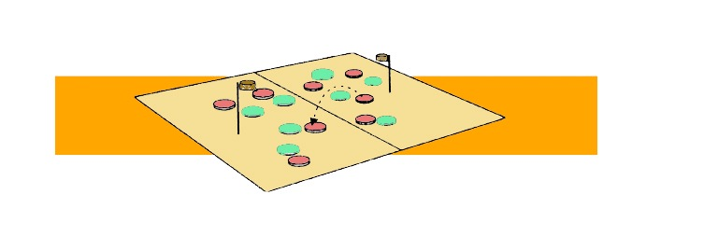
The player that has the ball cannot move; he can bounce, pivot, shoot or make a pass to a teammate, though he/she can take a step to jump and shoot
Every time a point is scored, there will be a throw-off (serve from the centre).
When shooting, the player has to jump and throw with both hands.
The match will have two periods of 30’ and a half-time break of 10’.

Slide 7
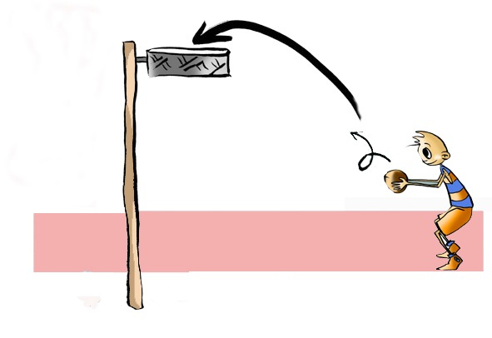
The following are considered offences:
Having contact with a player from the other team.
Acting violently.
Shooting if you are a defensive player.
Hitting/touching the ball with the fists or feet.
Marking a player of the opposite sex or a player who is already marked, and
Handing the ball to a teammate – the ball must be passed.
These offences will be penalised with a free shot taken by a player from the negatively affected team from the spot where the foul happened. Nobody can get closer than 2.5 metres.
It will be a penalty when the infringement is made to a player in a clear ac- tion of shooting and scoring. A shot will be taken from the penalty spot, jumping and 2.5 metres away from the basket and from other players.

Slide 8
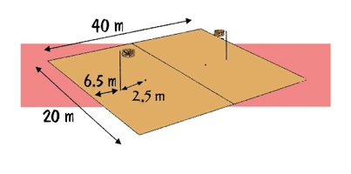
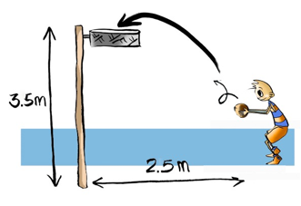
Facilities and Equipment
Pole: situated 6.5 meters away from the out-line and 3.5 meters high.
The korf’s inner diameter should be between 39 and 41cm.
Ball: a football can be used.

Slide 9
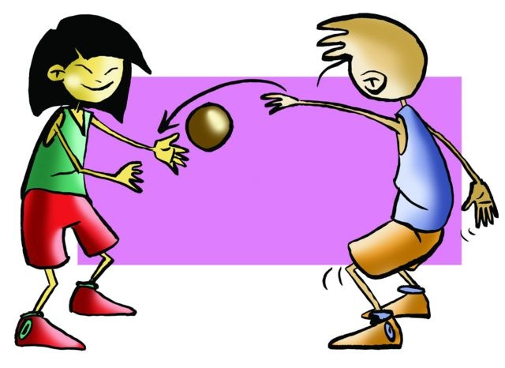
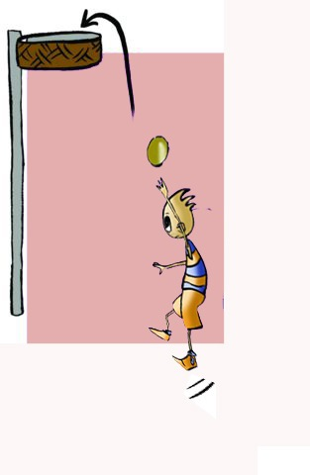
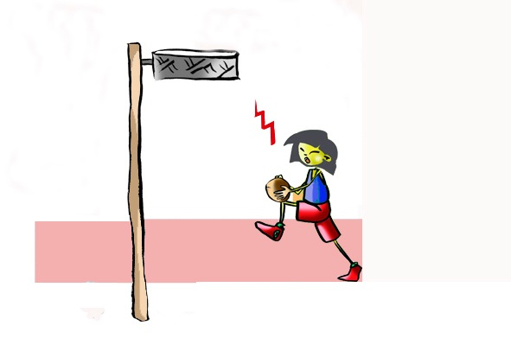
BASIC TECHNICAL- TACTICAL RESOURCES
The basic tactical resources in korfball in reference to passes, catches and lay-up shots are similar to those in basketball.
- Pass, in korfball, is usually executed with one hand.
- Long shot: almost forming the figure of a “6” when throwing.

Slide 10
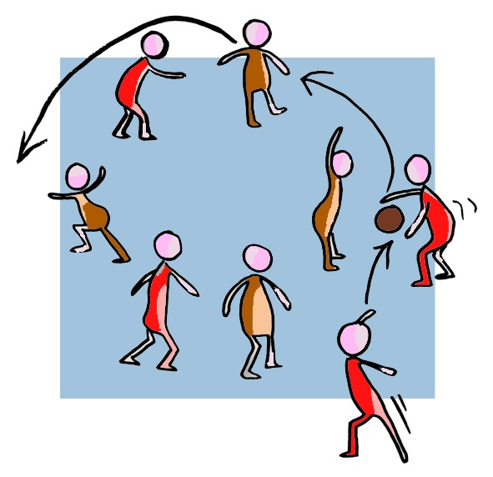
Joint Tactical Organisation
Professor Gerardo Ruiz in his book “Juegos y Deportes Alternativos”, proposes a gradual approach, which starts with basic exercises dealing with tactical resources, e.g., passing, catching, shooting. These drills may be executed in one–on-one defence, threes or groups of 4–5 players. The players establish variations in their approach to handling these skills and applying them in game-like situations of two-to-two defence, three-to-three, two-to-one, adapting strategies so that ultimately a real match may be played following korfball regulations.

Slide 11
QUESTIONNAIRE AND ACTIVITIES
Briefly describe korfball.
Describe the following technical-tactical resource: a long shot.
Describe an exercise to improve shooting.
Why is it called korfball?
Observe a match and act as a coach-player.
Write down in your notebook unknown vocabulary from this unit.
Check the Federation website or any sports association in your region and check for changes or modifications, if any, in its regulations.

