Slide 1
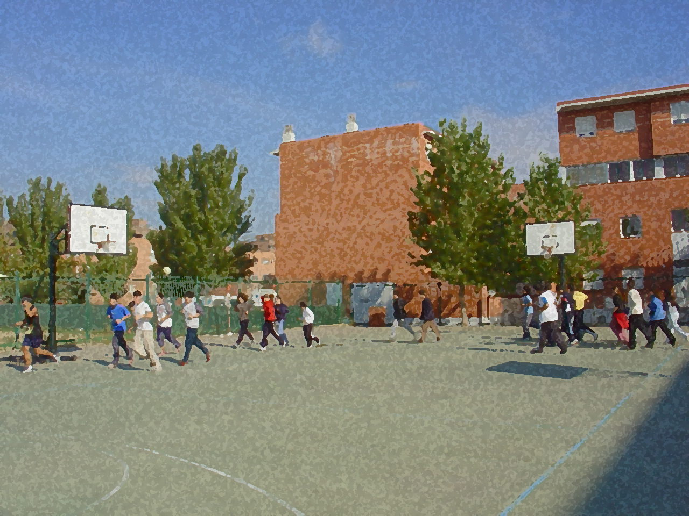

Fundamentals for Secondary School and Baccalaureate. Comprehensive and experiential learning
Physical Education and Sport

Slide 2
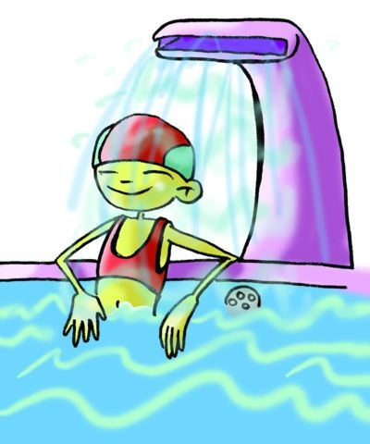
Objectives
Point to Consider: Trends in Social, Cultural and Economic Policy in a Debate
Organisation, Implementation and Evaluation of Activities
Activities in Natural Environment
Activities in an Artificial Environment
Traditional and Autochthonous Activities
Further Education in the Field of Physical Activity
Contents

Slide 3
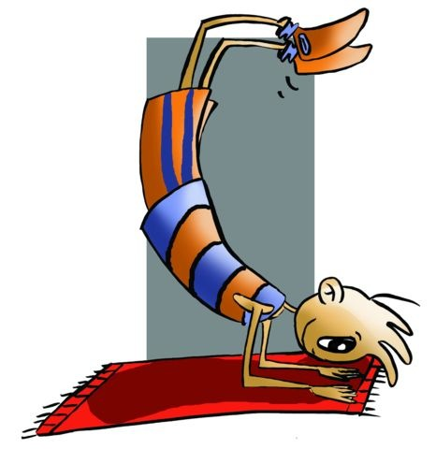

OBJECTIVES
To examine career opportunities this field of study may provide students.
To practise using diverse means of communication and debate issues.
To be able to organise activities in different settings and identify procedural requirements for such activities.
To encourage and inform about possible outcomes of doing physical activity.

Slide 4
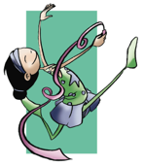
TRENDS IN SOCIAL, CULTURAL AND ECONOMIC POLICY IN A DEBATE
Physical Education (PE), for a while now, has taken more logical paths. We all want to see mainstream culture embrace the benefits derived from the understanding of the principles of anatomy and mastery of those skills in movement now that physical appearance and the cult of the body are at its highest point. Taking advantage of these trends, PE, which seeks the integral development of the person doing exercise, i.e., in motion, envisages a greater scope for its theory and practice. This entails defining some terms so that students may be able to apply them knowledgeably. In other words, the terminology of theory and practice is dependent on its definition as it indicates its function.
Gymnastics. May be conceived from two points of view. One is that it is a sport such as men and women's artistic gymnastics and women’s rhythmic gymnastics, i.e., two very spectacular specialties that are in the PE programme. The other is gymnastics as a varied and systematic series of exercises.

Slide 5
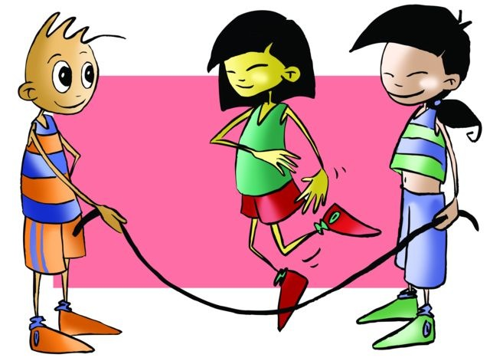
Games, whose objective is enjoyment and recreation, are also part of PE. It is the activity that adheres to expressive play, drama, etc., a competition without strict rules and where entertainment and exercise are some of its principles.

Slide 6
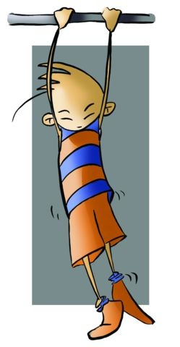
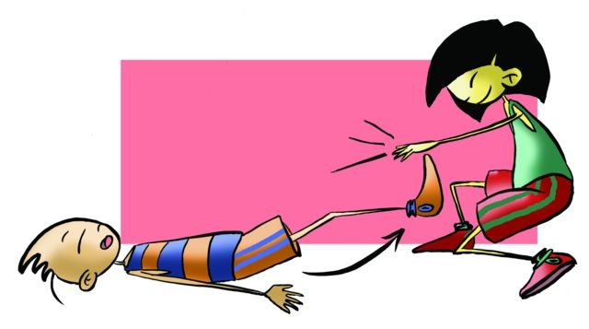
Systematic exercise, is, in our opinion, the most closely related to the concept that you may have of PE today. It aims to improve motor skills and physical abilities in order to improve our health.

Slide 7
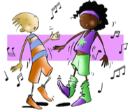
Corporal expression and dance, seek to activate, in students, the corporal echanisms. They are mechanisms through which feelings are expressed, emotions presented, tensions released and knowledge of one’s body is used in storytelling and freedom of movement is facilitated through rhythm and music.

Slide 8
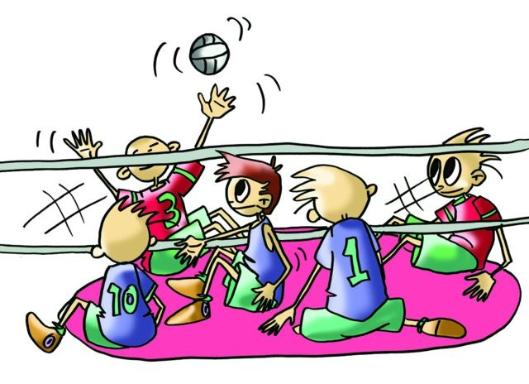
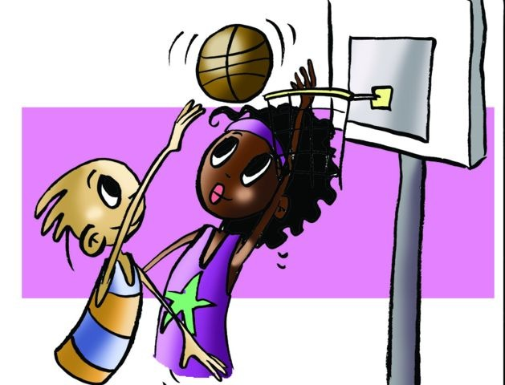
Lastly, Sports, the aim of which is as much enjoyment as the game itself, has undergone change in its regulation, competition and including aims. Today, this evolution is a social phenomenon. Sports has acquired a dimension that goes beyond the exercise itself and its cathartic and educational function, acquiring now a clear social impact.

Slide 9
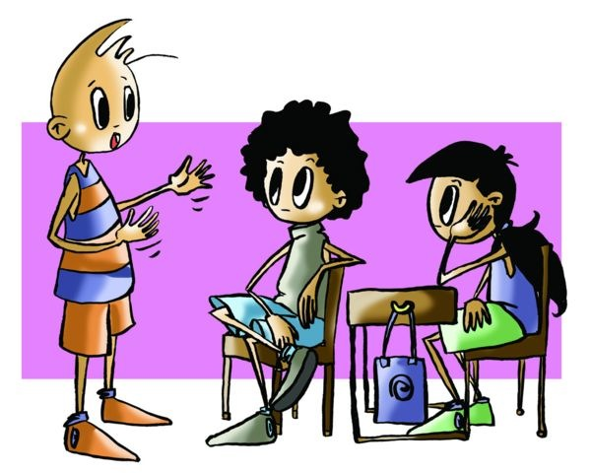
POINT TO CONSIDER:
PE, as a broader concept, incorporates diverse contents to develop properly. In secondary education (ESO), PE takes from the conceptual point of view or knowledge (applied theory) and procedural (theory applied to practise), concepts that complement it such as sports, gymnastics, games, and the systematic development of physical abilities and motor skills exercise.
Expanding on the purpose of this unit, issues will be addressed that need to be studied, learned or discussed. Whether they are or not social events these concerns can be discussed in a rigorous debate that include a motion (topic), argumentation and evidence.

Slide 10
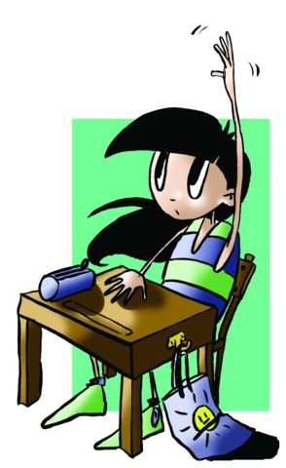
n conducting a debate it is important that the parties have learned some features of the issues well to obtain an objective evaluation. Aspects to consider
The selection of one of the topics
The motion should be prepared
The factors that shape the motion and how they are interrelated. Use rhetorical skills, reasoning and acceptance of plurality of opinions because disagreement can arise.
In terms of methodology, i.e. how to structure it, it is as follows: introduction, development and conclusion are the three pillars of a debate.

Slide 11
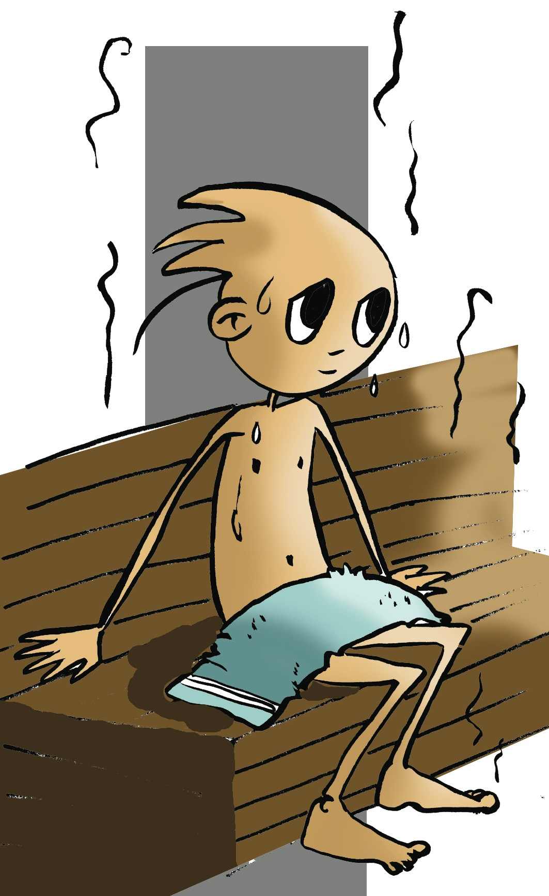
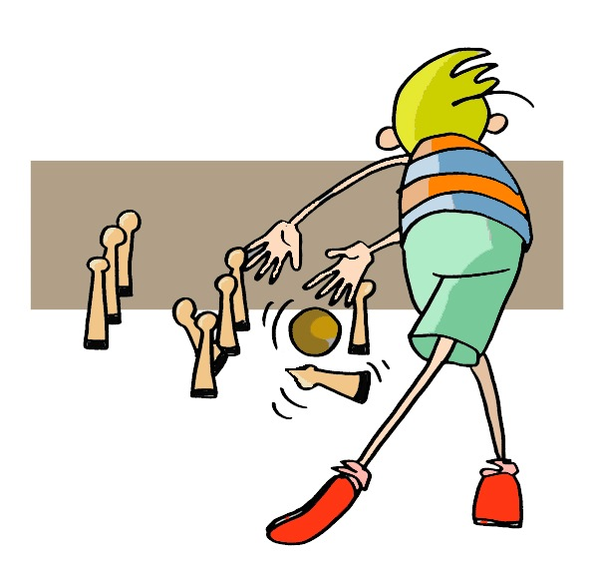
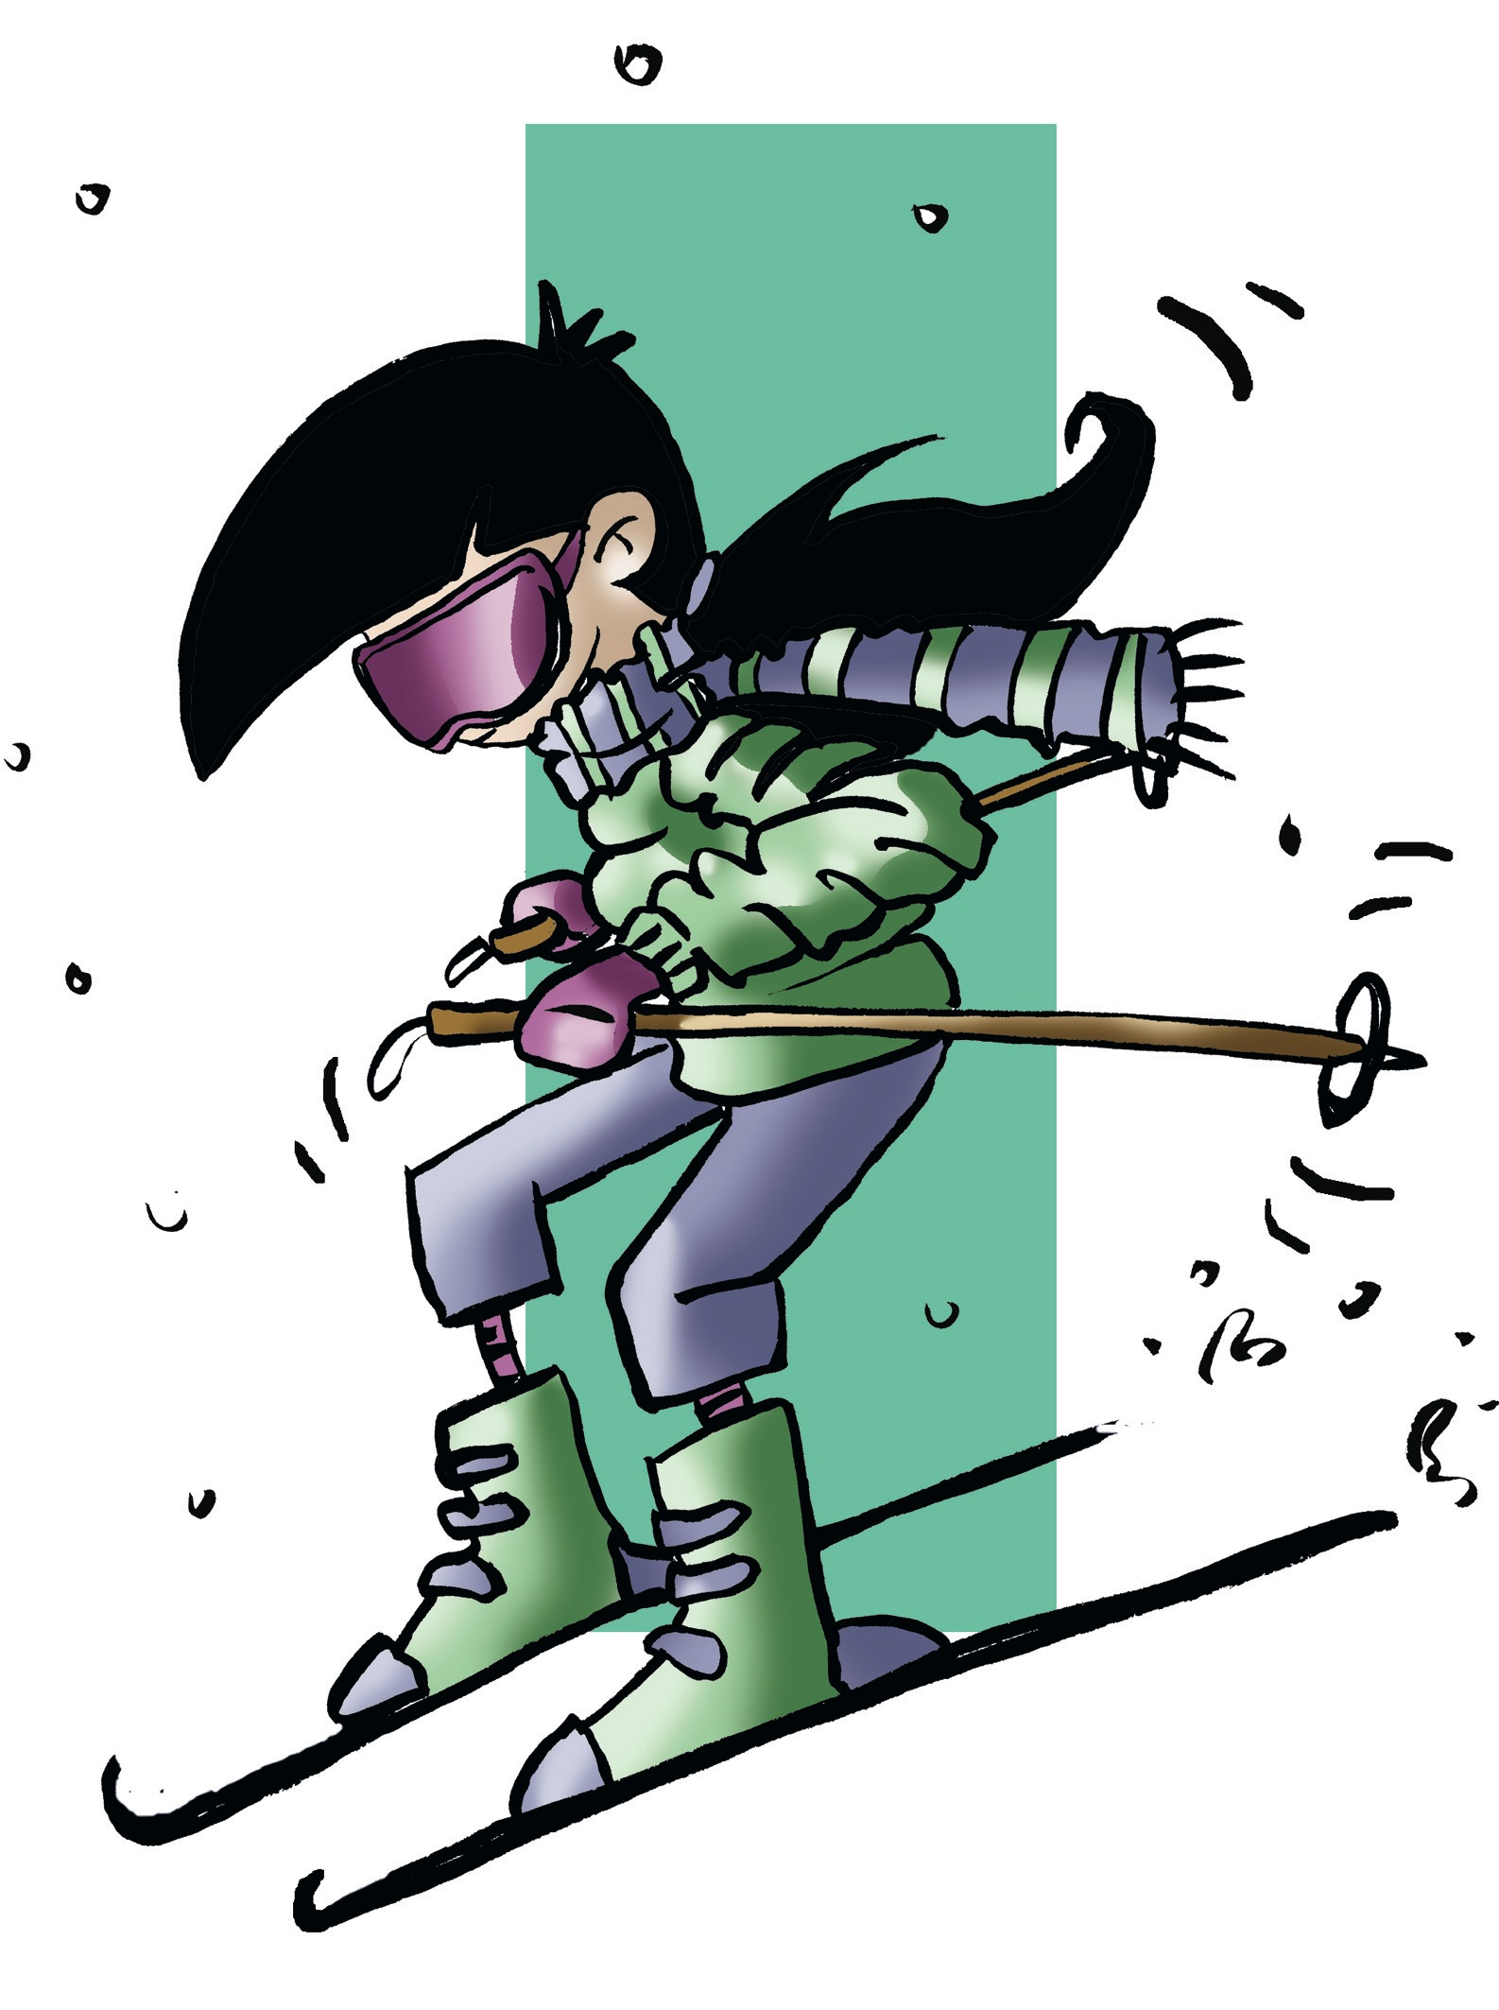
ORGANISATION, IMPLEMENTATION AND EVALUATION OF ACTIVITIES
Herewith is presented three sessions classified into three blocks that will complete your training curriculum. It will also allow you to have a broader vision of what physical activity is.
Activities in Natural Surroundings
Activities in an Artificial Environment
Traditional and Autochthonous Activities

Slide 12
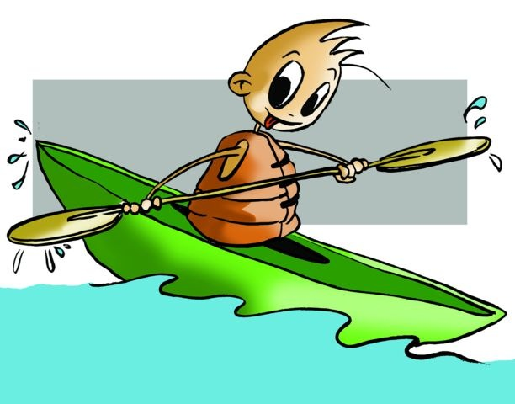

Activities in Natural Surroundings
we will introduce guide notes that will help you to organise a physical activity in the natural environment near to your school, and that will provide you with the knowledge of the environment, such as how to cope in it, and draw up a selection criteria for future activities.
Opportunities to use the natural environment for sports and recreational activities with minimal environmental impact
1. Selection of possible activities to do (see theme activities in the natural environment).
2. Overall description of the environment under study where it is located. General characteristics, conditions, etc.
3. Area apt for use. Name, map of the area, extension, accessibility, features (Are services provided, e.g. camp grounds, campsites, sports facilities, etc.), permits, condition, etc.
4. Programme of activities. Why the activity is being organised, how it will be done, duration, what activities, type of equipment/material needed,…
5. Assessment and analysis of the activity, once done.
6. Opportunities for other future uses. Family recreation with friends, sports, camps, courses, etc.

Slide 13
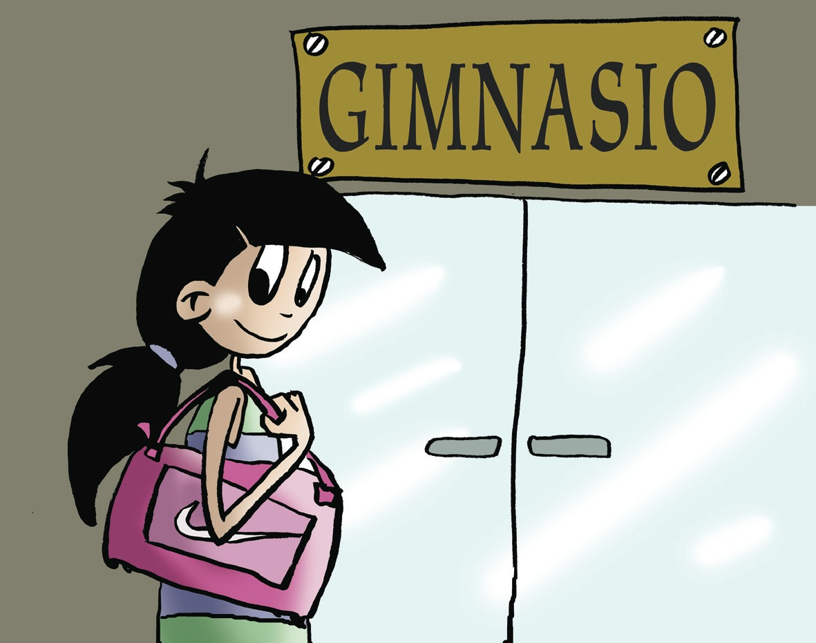
Activities in an Artificial Environment
Indoor facilities of today, apart from a few exceptional cases, are constructions that monitor temperature, humidity, etc.; some even reproduce natural environments with extraordinary precision. The range of activities offered in these facilities is very extensive but the time allotted for each use is not always adequate, and finally the price can be excessive in many cases.
Consequently, when looking for the facilities that best fit your needs, learn who will take part, make certain they are able to do it (medical examination), visit the facilities beforehand, determine if the venue meets health and sports requirements, and ask about terms of payment.

Slide 14
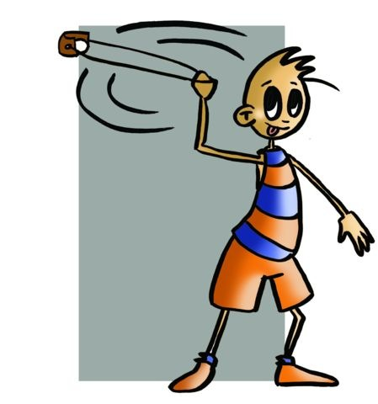
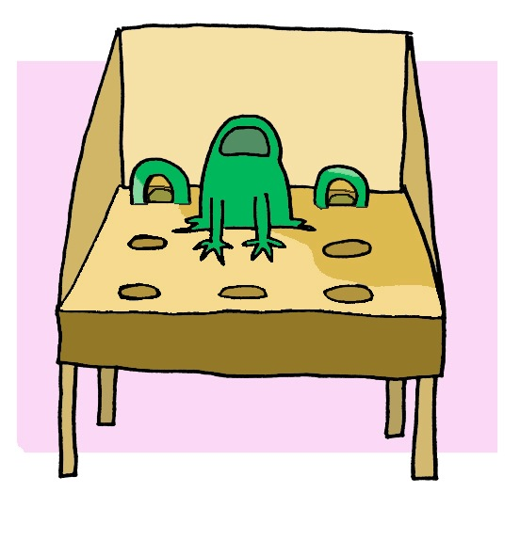
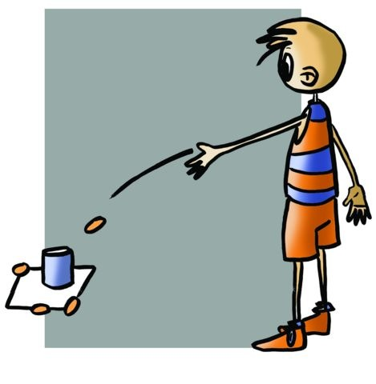
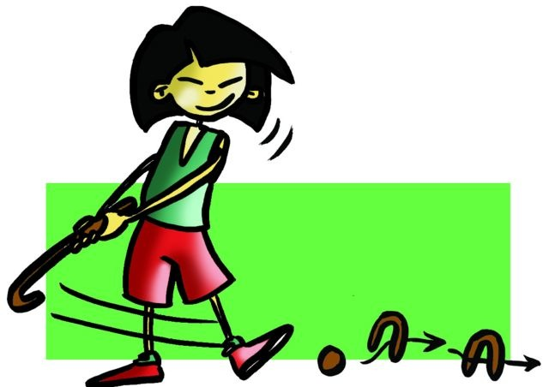
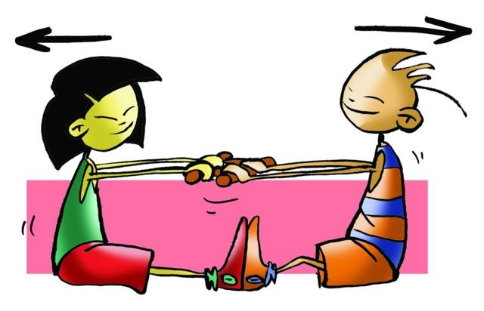
Traditional and Autochthonous Activities
Through bibliographic research, talks with parents and/or grandparents, senior citizens living in rural areas, tours, etc. we want to recover and put into practice ancient traditional games and native sports, heavily regulated today. You may conduct a piece of research in accordance with the following script:
1. Search for sources of information. Bibliography, senior citizens, visits to centres and libraries, etc.
2. Study of the different classifications of games and their location. Target (ball), precision, combat, strength, etc.
3. Description — game development. Place of origin, rules, equipment and facilities, evolution, possible variants, etc.
4. Assessment of the study
5. Possibilities for a practical application. Development of a class session.

Slide 15
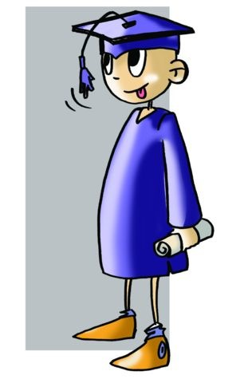
FURTHER EDUCATION IN THE FIELD OF PHYSICAL ACTIVITY
A. Sports Instruction: Athletics, football, handball, mountain sports climbing ...
Qualification: Sports technician and high level sports technician. Between 700 and 1,000 hours approximately.
Requirements: General Certificate of Secondary Education (GCSE) or equivalent for academic purposes and test of maturity for sports technician. For post of high level sports technician the qualifications will be to have a degree: General Certificate of Education or equivalent qualifications, be 19 years old and test of maturity.
Career: Coach and/or instructor of teams or specialty sports groups.

Slide 16
FURTHER EDUCATION IN THE FIELD OF PHYSICAL ACTIVITY
B. Vocational Education and Training (VET) in "Sport and physical activities in the natural environment" (1400 hours).
Qualification: Certificate of Higher Education (HNC) in "Conducting sport and physical activities in the natural environment.”
Requirements: General Certificate of Secondary Education (i.e. secondary school diploma). By test if 17 years old.
Career: Instructor or mountain guide for groups of people.

Slide 17
FURTHER EDUCATION IN THE FIELD OF PHYSICAL ACTIVITY
C. Certificate of Higher Education (GCE) in "Physical Activities and Sports" 2000 hours in two years.
Requirements:
General Certificate of Education. Specialist technician and 18 years old.
Entrance examination for those who do not have GCE (be at least 19 years old).
Qualification: Higher Technician of physical activities and sports animation.
Career: - Recreation co-ordination of physical and sports activities.
- Co-ordinator of multi-sport activities.
- Initiator of individual and team sports.
- Gym instructor, town/city councils or private clubs.
Access to following studies:
University Degree in Primary School Education
University Degree in Physiotherapy
University Degree in Social Education
University Degree in Social Work
Companies in tourism industry
University Degree in Sports and Exercise Science

Slide 18
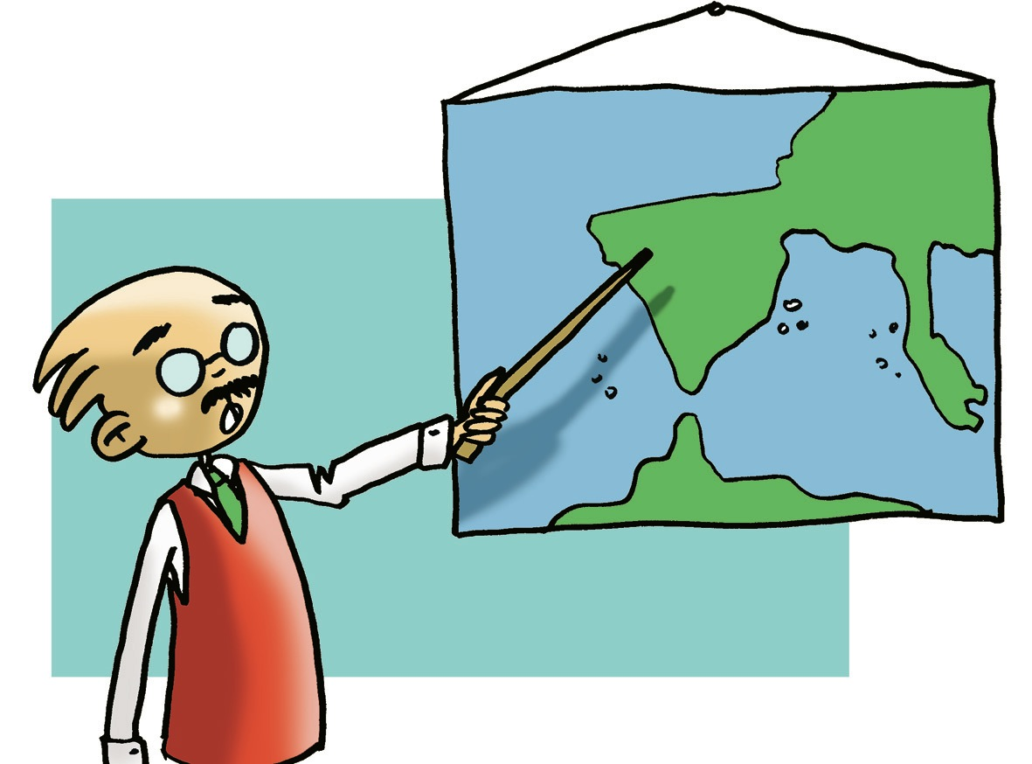
FURTHER EDUCATION IN THE FIELD OF PHYSICAL ACTIVITY
You must keep in mind the changes brought about in the revision of the new legislation Ley Orgánica para la Mejora de la Calidad Educativa (LOMCE) that affect undergraduate and graduate degrees. The following options are available:
D. University Education
1. University Degree Joint Honours in Primary School Education and Physical Education University Entrance Examination
Career in teaching at pre-school and primary level
2. University Degree in Sports and Exercise Science
University Entrance Examination and specific fitness test (depending on the university) which include the following:
vertical jump; throw medicine ball; move in water; move in zigzag; run an obstacle course; trunk flexion and hip; race 50m; steeplechase; 2000/1000m race.
The duration of undergraduate studies is 4 years.
Career opportunities include the following:
Teaching in secondary schools.
Administration and management of fitness sports centres and sport facilities training.
There are opportunities to continue tertiary studies to a Doctorate degree

Slide 19
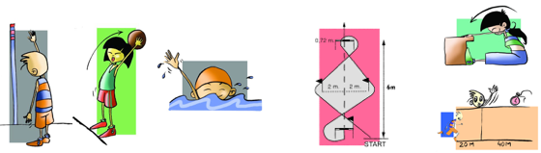
University Entrance Examination and specific fitness test (depending on the university) which include the following:

