Slide 1
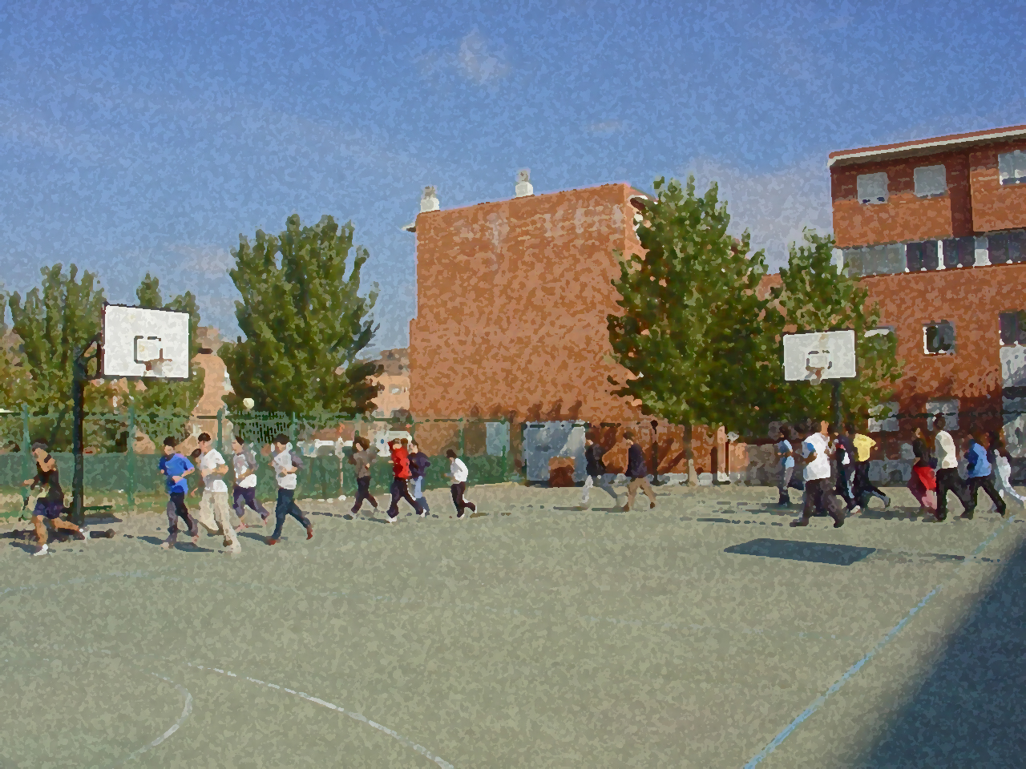
Fundamentals for Secondary School and Baccalaureate. Comprehensive and experiential learning
FIRST AID

Slide 2
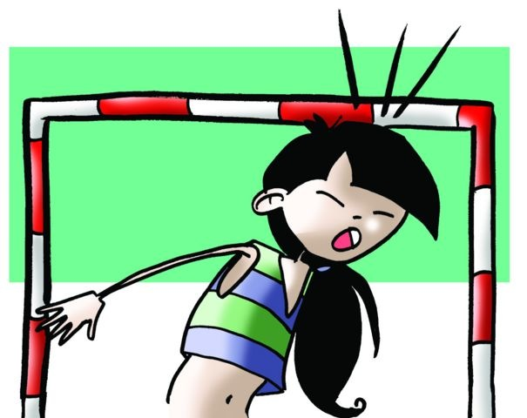
FIRST AID
Objectives
First Aid
Questionnaire and Activities

Slide 3
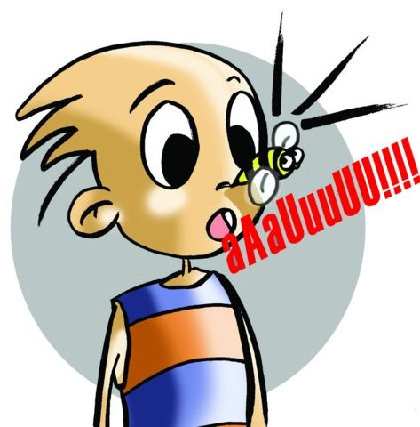
OBJECTIVES
- To learn some basic techniques to mitigate the effects of an injury.
- To practise of emergency intervention as required in a specific situation.
- To become aware of the importance of mastering the most appropriate techniques that circumstances require while doing a physical exercise.

Slide 4
FIRST AID. General Rules
Before jumping to act in an accident, you should take into account some recommendations. The suitability of initial response may result in either poor or good recovery from an injury. At that point we must not forget the following standards:
Do not move the injured person except to prevent further danger, until extent of the injury is known. Whatever happens, act appropriately.
It is preferable not to do anything rather than take ill-judged steps because of our ignorance.
Quickly notify a doctor or medical services if the situation seems critical.
Keep the injured person still and lying down if there is vomiting place the person’s head facing one side. Place the person in recovery position or lateral recumbent position.
The injured person’s clothing should be loosened if only if the victim finds it difficult to breathe. The clothing adhered to burns should not be removed.
By staying calm, we convey confidence to the victim.
If the person has had convulsions, care should be taken that he/she does not hit him/herself and more serious injury take place.
If symptoms of choking or apparent death should arise, appropriate measures must be taken.
.

Slide 5
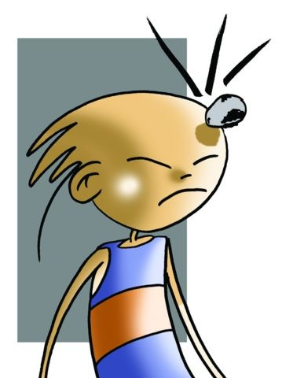
Common injuries which most frequently happen in different situations in our everyday lives:
Trauma is defined as an injury to organs or tissues by external mechanical action.
In this section we will consider the following points:
Wounds. Are defined as injuries where there is a break in the skin. They can be classified into three types:
Puncture | when an object pierces the skin without cutting it, leaving roughly circular holes. It may be produced by a needle, an awl, etc.
Incision | when there is a clean cut to the skin. It may be linear and more or less deep.
Laceration | when there is scraping of the skin, tissue damage around the area appearing, as in the case caused by stones, sticks, etc.

Slide 6
Wounds can have two types of complications:
Bleeding is defined as blood loss: arterial haemorrhage in which the blood escapes in spurts or jets; venous haemorrhage in which blood loss is more slowly and smoothly; and capillary haemorrhage in which blood comes out in droplets.
Treatment: Treatment: If they are small amounts of blood, simply clean it well with gauze, soap and water or abundant antiseptic liquid starting from the centre to the outside and place a bandage. First you have to wash your hands thoroughly.
In cases of more severe bleeding the use of manual compression of the artery, or very tightly bound bandages applied to the affected area with (non-absorbing) material.

Slide 7
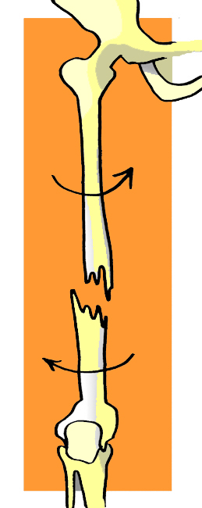
Fractures. are broken bones, and may include the following:
Closed. when the skin is intact.
Open. when fractured bone can be seen on the outside, protruding through the skin.
Complete. when the bone is separated.
Incomplete. when part of the bone is affected.
They can be diagnosed because they produce outward signs such as pain, inability to move or abnormal mobility, the strange position of the affected limb, swelling or crack that occurs when touching the fractured bone fragments.

Slide 8
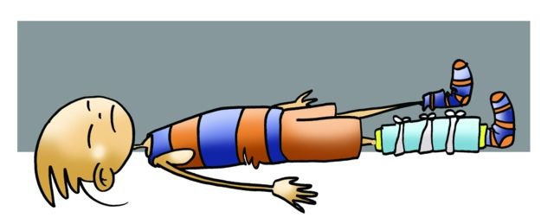
Treatment: What we must do when faced with a fracture is to immobilise the affected limb and then transfer the injured person to the nearest hospital.
Immobilising a fractured limb should entail immobilisation of joints located above and below the fracture, using, if there are no adequate instruments, improvised means such as canes, walking sticks, tree branches, boards, scarves, shirts, etc. Immobilisation will be done depending on the location of the fracture.
A fracture is considered significant when the spine has been affected. It does not always result in paralysis, as some claim, but mishandling by a fearless rescuer may cause fatal results. An absolute rule in these cases is not to bend the injured, or move the head; he/she should be moved as little as possible, and evacuated on a hard surface. If there is vomiting, the head must not be turned, but the surface on which the injured lies can be tilted.

Slide 9
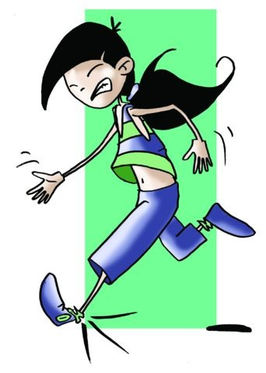
Dislocations. Occur when bones come out of their joints. A dislocation produces intense pain, an abnormal position of the affected limb and inability to perform any movements..
Sprain. To a joint has varying degrees of intensity as affecting the ligament, muscle and even bone. It is milder than a dislocation. There is almost always great pain and swelling.

Slide 10
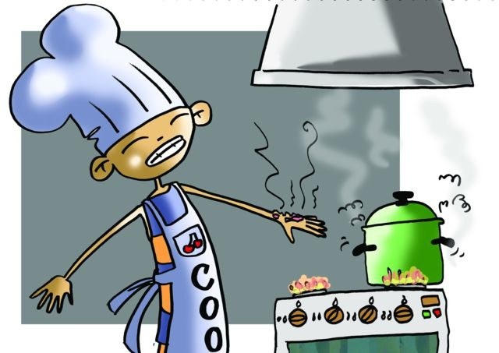
Other Injuries
Burns are injuries caused by the action of heat, and are classified into degrees:
First degree involves redness of the skin;
Second degree causes blisters; and
Third degree is the destruction of tissues.
Treatment: Minor burns or those of some importance may be mitigated by applying an appropriate ointment to the burn or dressing or the use of gauze impregnated with petrolatum, oil, or specific ointments. The largest and most complicated burns require a more complicated treatment in a specialised centre, evacuation of the victim should be fast and in the most aseptic conditions possible.

Slide 11
Accidents Caused by Electricity
Electric shocks can result in loss of consciousness, side effects to the brain such as irritation, and localised injuries, which are similar to burns.
Treatment: In any case before assisting someone injured by electricity, it will be necessary to eliminate danger to yourself by seeking to cut power or separating cables using non-conductive materials. Treatment will depend on the type of injury sustained.
Sunstroke or Heatstroke is the effects of sun on the head. Signs that motivate their diagnosis are headache, eye redness, fever, spasms, etc. Beware of heatstroke especially among the elderly and children
Treatment: The victim of sunstroke should strip down, cold compresses should be applied to the head, he/she given fluids to replenish the loss caused, as well as take a cold shower.

Slide 12
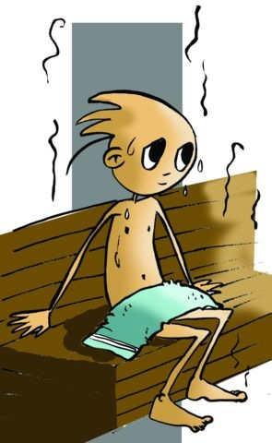
Dehydration
is caused by the lack of fluids in the body caused by the practice of continuous exercise and no replacement thereof, by vomiting or diarrhoea or continued sun exposure. Severe dehydration can result if not treated quickly in death. Its most important symptoms are dry mouth and nose, dry skin, under-eye circles, etc.
Treatment: It is usually treated as long as it is mild, with the replacement of fluids and salts (oral rehydration solutions) as water with lemon juice or with bicarbonate soda. Should it be necessary, accompany the patient to the hospital after this palliative treatment.

Slide 13
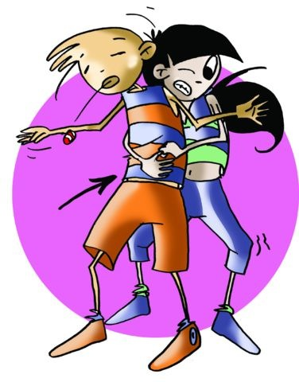
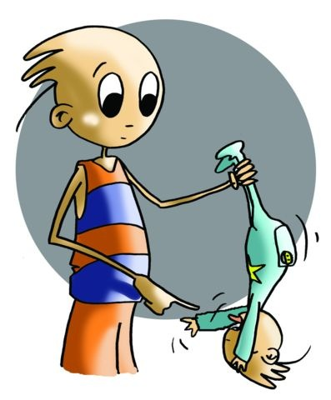
Foreign Bodies
Sometimes objects are inadvertently introduced into the airways causing very dangerous situations. For example:
Nose: This is common among children, who are playing when an object is inserted.
Pharynx: Ingestion of a foreign body (e.g. almost always fishbone) that lodges itself with relative ease in the pharyngeal mucous membrane, and may result in choking.
Trachea: It occurs infrequently, but it can be very dangerous. It may completely impede air flow, causing choking.
Ear: It is very common in children, and may produce, decreased hearing, dizziness, ringing of the ears, or coughing.
Eye: They are most common and easily seen.
Skin: It is the result of a foreign body becoming lodged in the skin.

Slide 14
Poison
We can establish two groups:
Bites and Stings. The measures taken will aim to remove the poison from the wound and prevent its absorption by the body. This may be done by placing ligatures above the bite or sting, and if medical help (call 112) takes a long time another ligature may be held above the area, approaching the beginning of the limb, i.e., part which is closest to the trunk. The first binding is not to be removed until the second is in place. If necessary, action will have to be repeated every 15 minutes.
Poison. If poisoning is caused by the inhalation of toxic gases, the victim will be moved outdoors to recover by either supplying oxygen or employing cardiopulmonary resuscitation (CPR) unless the gas inhaled impedes this treatment. In any of the above cases prompt medical attention is recommended.

Slide 15
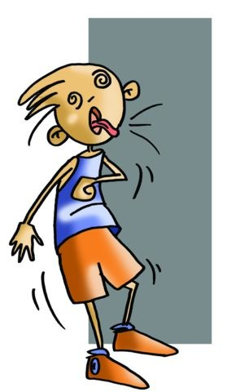
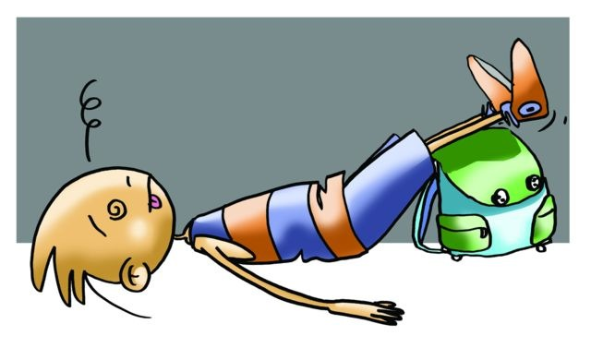
Urgent cases
Light-Headedness
is characterised by paleness, weakness, cold sweat and loss of balance. It may be produced by alterations in blood flow in the brain vessels.
Suffocation.
occurs when there is a cessation of respiratory activity. In lung disease or in cases where an obstacle prevents the entry of air, try extracting the foreign body, and if it is not possible, qualified medical personnel should intervene. If asphyxia is not produced by any blockage, until medical personnel arrive, we will practice artificial respiration during the time that is necessary.

Slide 16
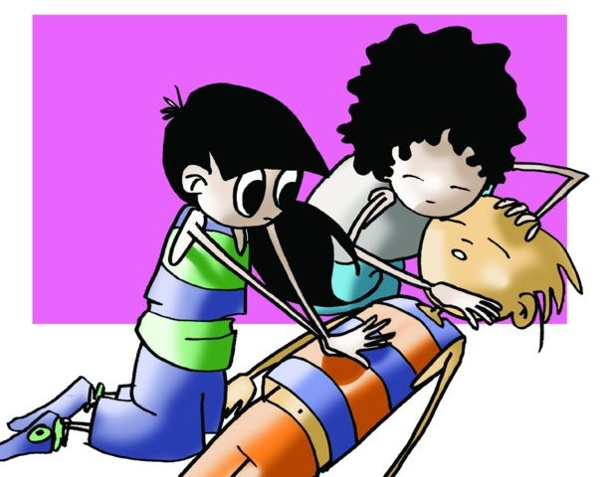
Urgent cases
Cardiopulmonary Resuscitation (CPR)
1/2 First aider | 30 chest compressions | 2 breaths

Slide 17
QUESTIONNAIRE AND ACTIVITIES
In the case of a fractured spine, how should the injured victim be moved?
What is the difference between dislocation and sprain?
What would you do in the case of a poisonous bite?
How do you immobilise a fractured forearm and elbow?
Write down in your notebook unknown vocabulary from this unit.

