Slide 1
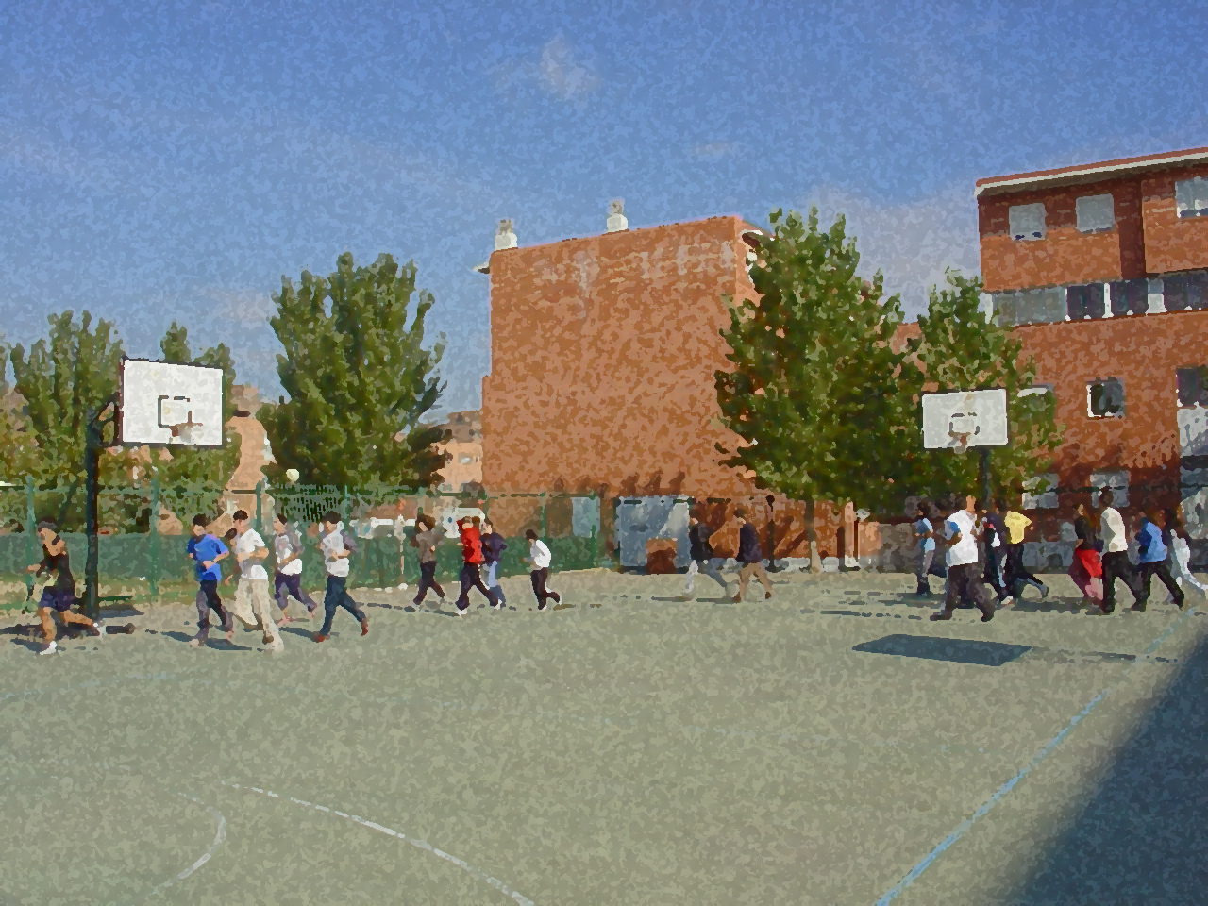

Fundamentals for Secondary School and Baccalaureate. Comprehensive and experiential learning
Evaluation in Physical Fitness

Slide 2
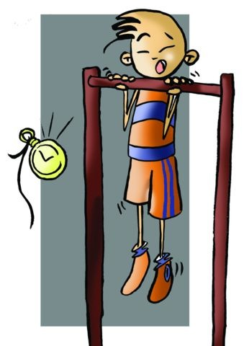
Evaluation in Physical Fitness
1. Objectives
2. Definition and Types of Evaluation
3. Objectives of Evaluation
- Work Plan
- Individual
4. Data and Requirements to Be Fulfilled by a Test of Motor
- Abilities
5. Advantages of Evaluation: Application Frequency
6. Examples of Tests
- Physical Fitness Test
- Sports-Performance Test
7. Questionnaire and Activities

Slide 3
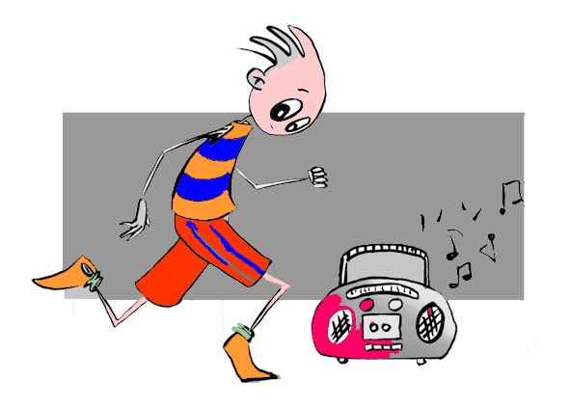
OBJECTIVES
- To learn to appraise and interpret the results of different tests carried out.
- To practise taking the different "tests" that measure our physical condition.
- To develop our own battery of exercises to evaluate our performance.

Slide 4
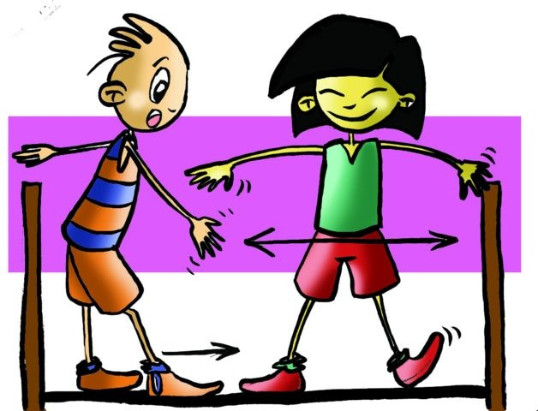
The best way to see if any activity we are doing is going well is to find the most scientific way possible to measure it. This we will call evaluation.
Any evaluation indicates the level we are at in that particular moment, identify the deficiencies we have, and which may direct us to correct, i.e., it has a diagnostic value.
As a starting point we know that as we want to establish some tests or others, so we have two groups:
Physical Fitness Tests
Sports-Performance Tests

Slide 5

OBJECTIVES OF EVALUATION
The main objective of evaluation is to measure. However, its use is not limited to measuring only the physical condition of an individual, but on average it can evaluate the work plan and the individual.

Slide 6
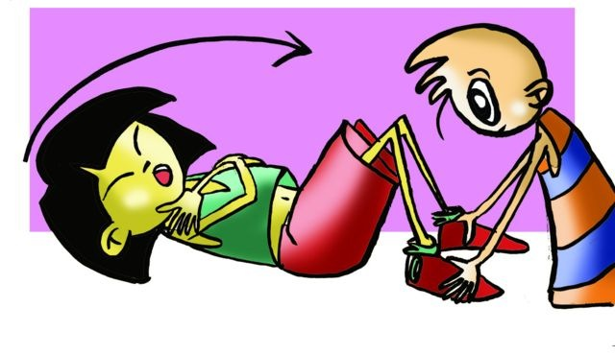
As to the individual:
It will allow us to know the following:
- if the resources and techniques used are appropriate,
- his/her physical condition and its possible relation to a particular group, - his/her physical condition and level of health,
- the possible changes that may be produced, and
- assess motor performance itself.
As to the work plan:
It will allow us to know the following:
- the extent to which the objectives are achieved, and
- its validity or on the contrary, the need to introduce any changes to any of its aspects.

Slide 7
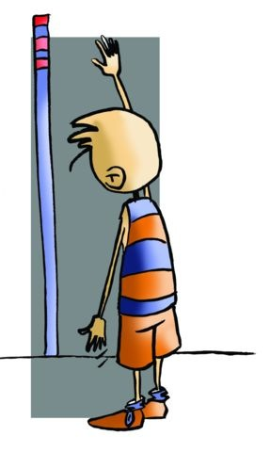
DATA AND REQUIREMENTS TO BE FULFILLED BY A TEST OF MOTOR ABILITIES
As for the data compiled in a test, the following information is required:
Physiological
Motor
Ability and Skill
As for the requirements to be met in these tests:
Validity, Objectivity, Practicality and Reliability

Slide 8
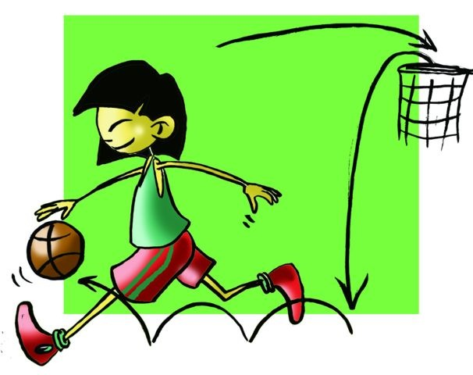
ADVANTAGES OF EVALUATION: APPLIED FREQUENCY
The most important advantages are:
to assess our fitness,
to know our strengths and weaknesses,
and helps us to compare our results with those of others of the same age.
With regards to the frequency of setting sports performance or fitness tests, we will carry out two annually to check whether its objectives are being met.

Slide 9
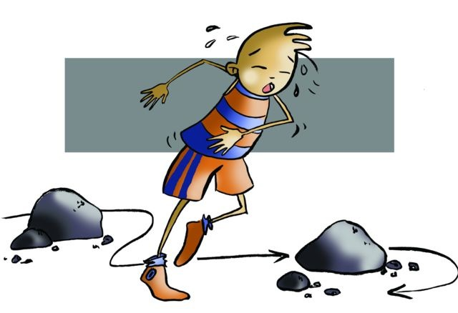
Physical Fitness Test
Endurance Test

Slide 10
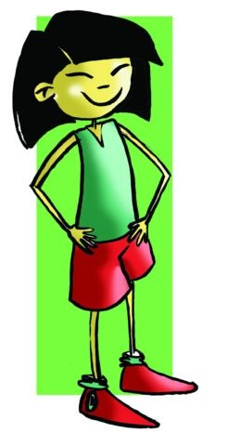
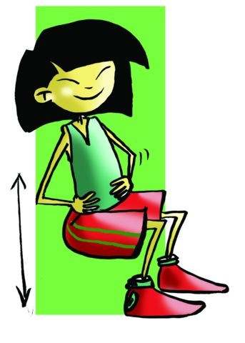
Ruffier Test
30 flex-leg extensions in a time of 45 "
To measure the adaptation of the cardiovascular system to exercise at middle and submaximal intensities i.e. Aerobic Endurance.
The participant should take his/her pulse at rest (P0), straight after exercise (P1) and finally after 1' 30 recovery (P2).
Ruffier Index
P0 + P1 + P2 – 200
I = ––––––––––––––––
10

Slide 11
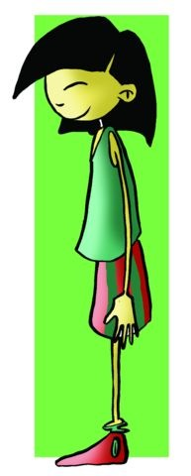
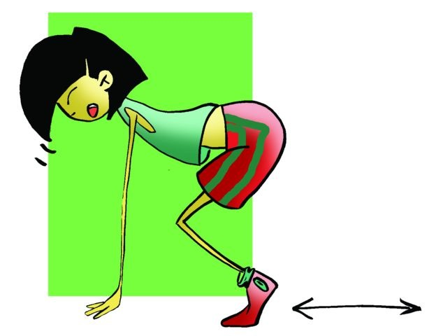
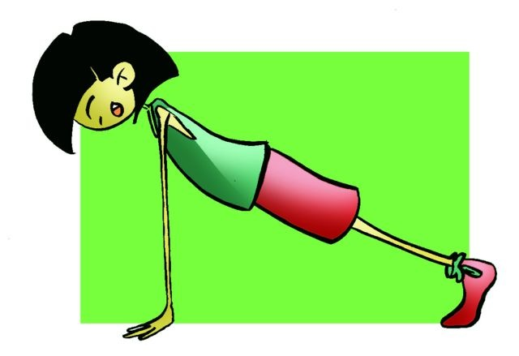
Burpee Test
2
3
The subject does the exercise described in the drawing as many times as possible in a minute.
1
4
5

Slide 12
1-Km Run Test
The athlete runs a distance of 1000 metres in the shortest time possible
Cooper Test
Participants will run during the specified time (12 'or 9') and when the time is up, the distance shall be recorded.
The Beep Test (Course-Navette Test)
Participants cover the distance of 20m without interruption, to the pace set by a recording with the registration of the corresponding protocol.

Slide 13
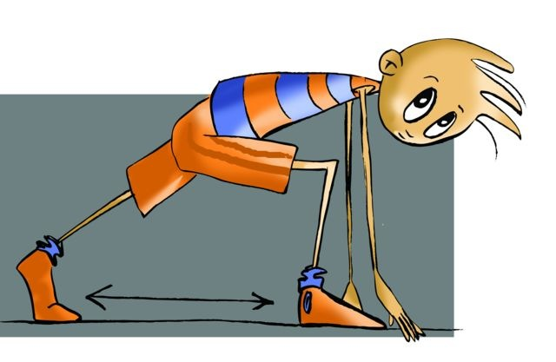
Physical Fitness Test
Speed Test

Slide 14
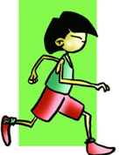
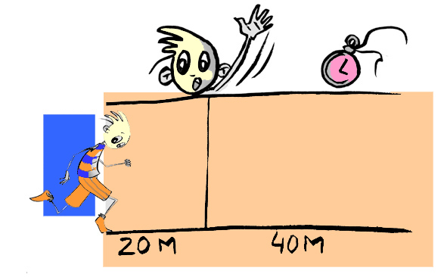
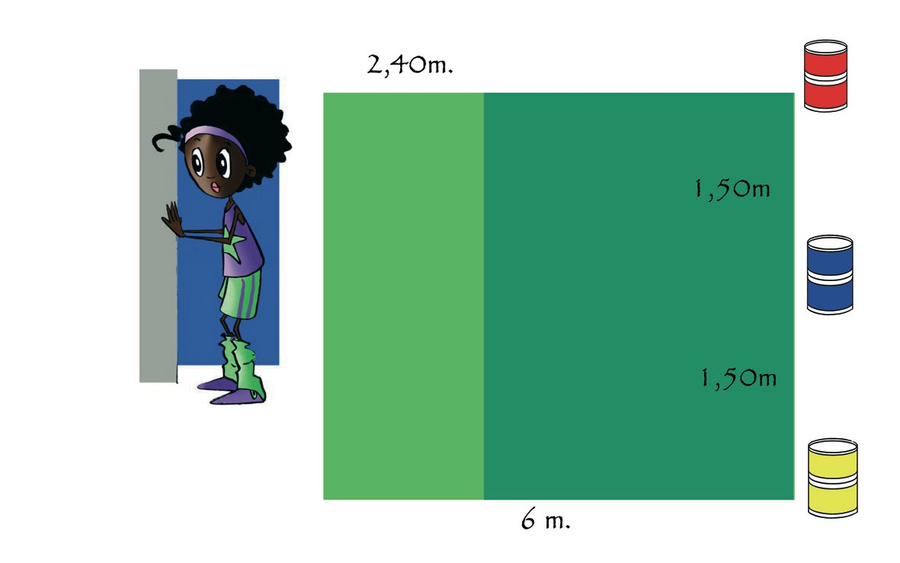
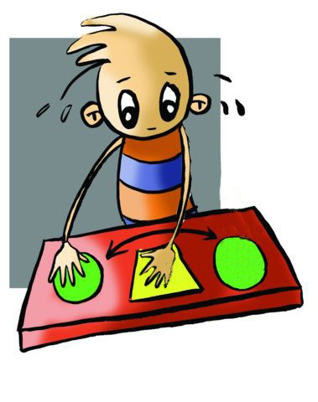
40-Metre Test
50- Metre Test
Letwin Test
Plate Tapping Test

Slide 15
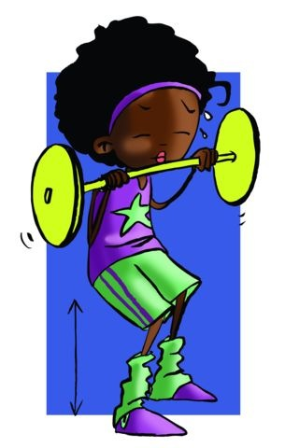
Physical Fitness Test
Strength Test

Slide 16
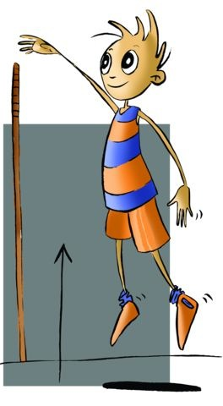
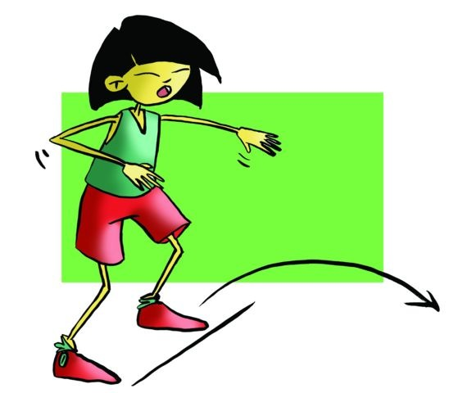
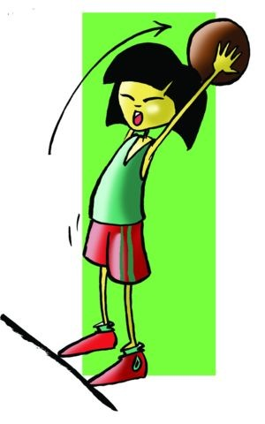
Sit-Up Test 30" and 1 minute
Flexed Arm-Hang Test
Vertical Jump Test
Overhead Medicine Ball Test
Stand Long Jump or Broad Jump Test

Slide 17
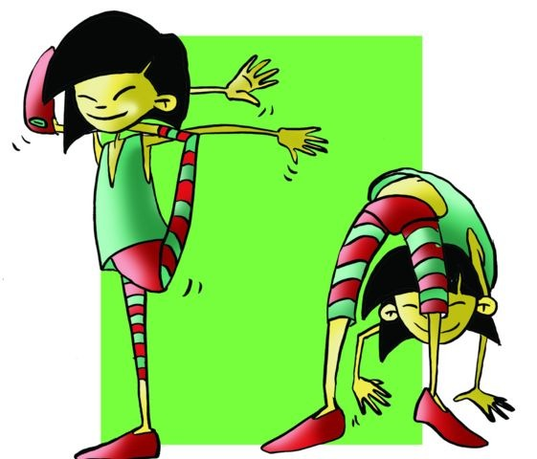
Physical Fitness Test
Flexibility Test

Slide 18
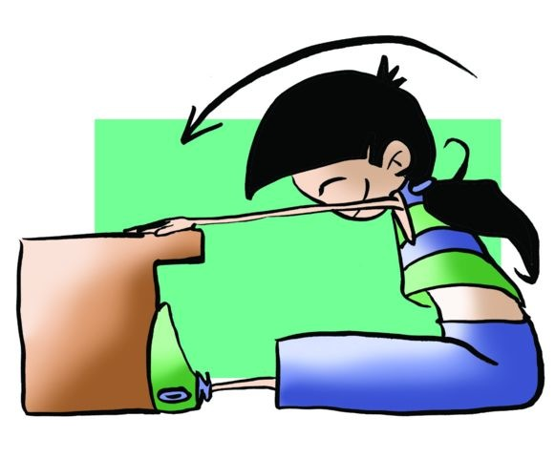
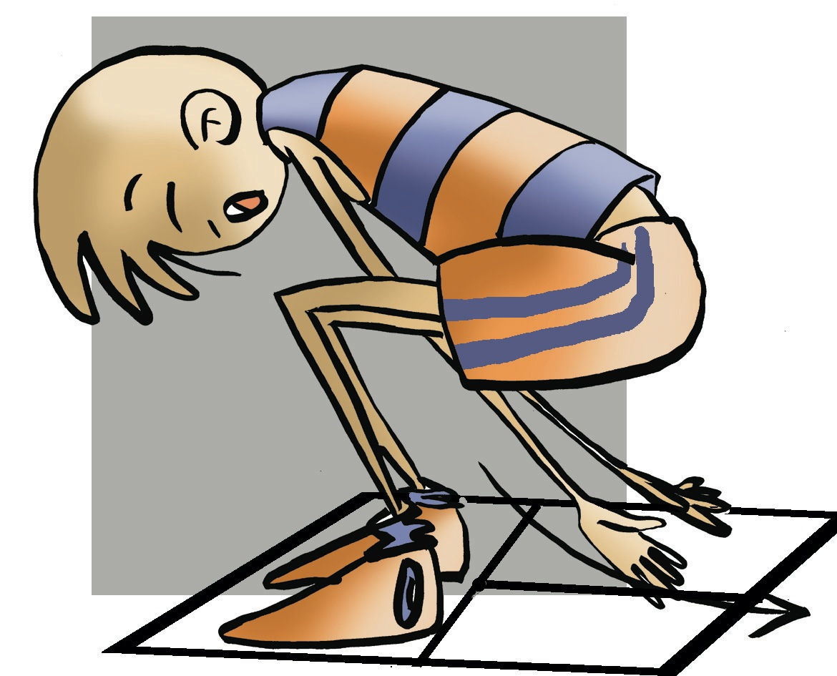
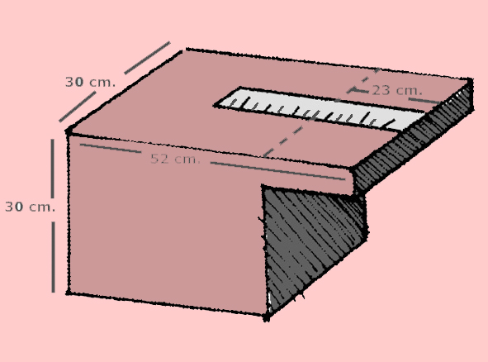
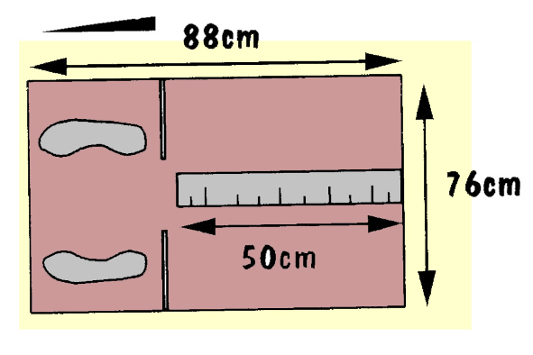
Sit and Reach Flexibility Test
Deep Trunk Bend Test
Equipment: Apparatus as illustrated.
Equipment: Specific apparatus

Slide 19
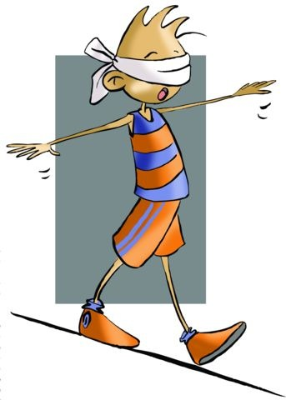
Physical Fitness Test
Balance Test

Slide 20
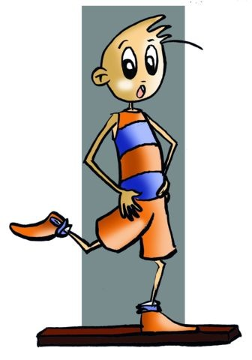
15cm
3.60m.
Balance Beam Test
Elmar Kornexl Test

Slide 21
Physical Fitness Test
DE Co-ordination Test

Slide 22
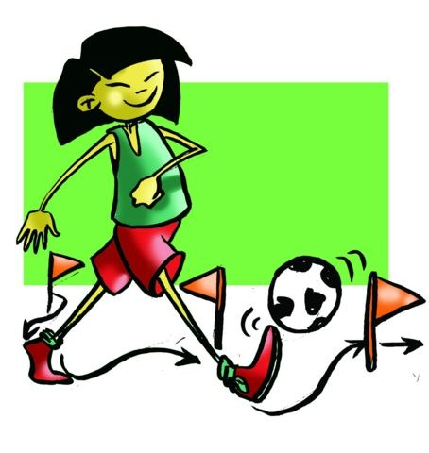
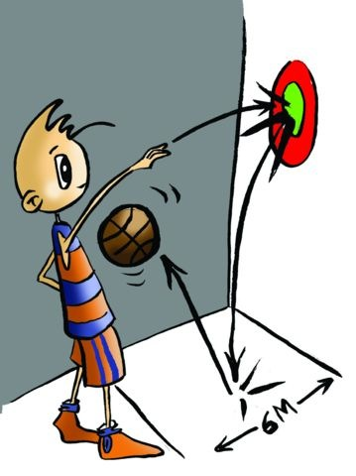
Objective: To measure the degree of co-ordination of the lower body (eye-foot co-ordination)
Objective: To measure the degree of hand-eye co-ordination.
Slalom with Ball Test
Wall Toss Test
4.50m.

Slide 23
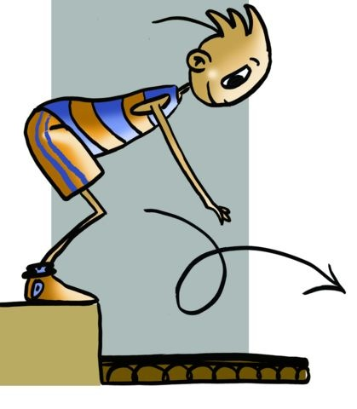
Physical Fitness Test
Agility Test

Slide 24
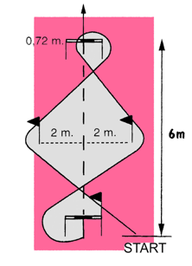
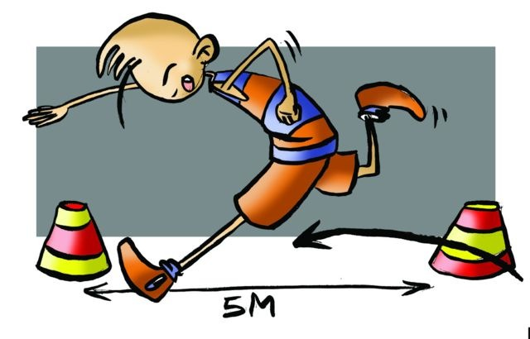
Obstacle Race Test
10 x 5 Shuttle Test

Slide 25
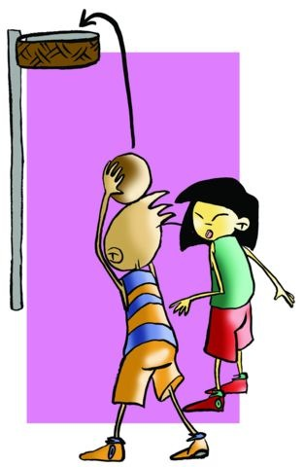
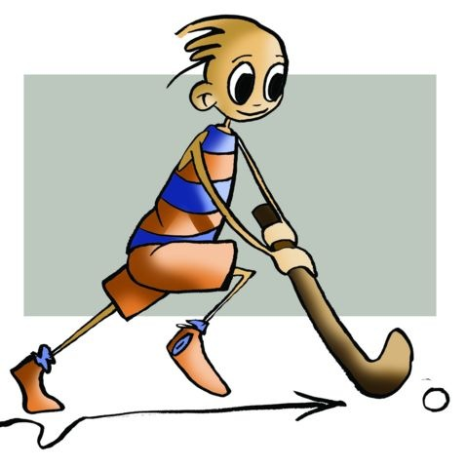
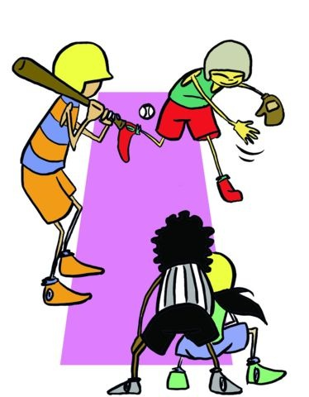
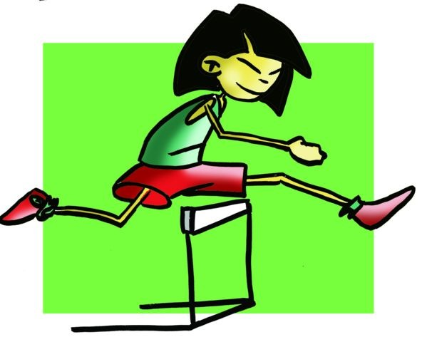
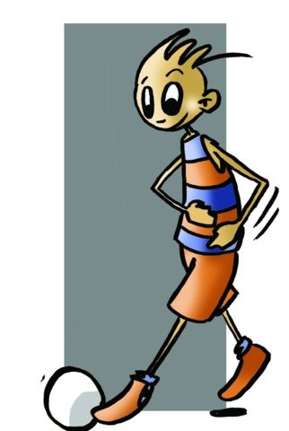
Sport Performance Test

Slide 26
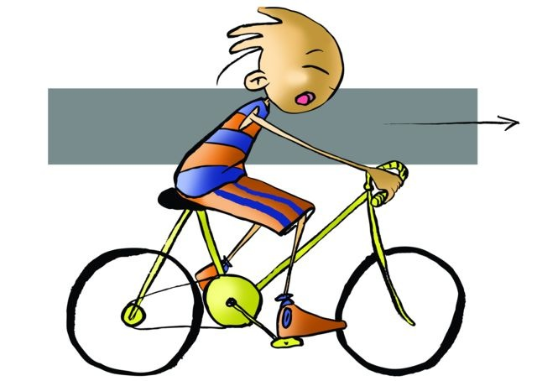
Sport Performance Test
We can develop specific evidence under speciality of each of the sports to evaluate ourselves. We can quantify motor skills and physical abilities involved in a particular sport, and we can also do exercises with independent or joint assessments but always in connection with the motor skills of the speciality.
If we evaluate athletic performance in basketball, for example:
we can test to measure the speed with the ball, or balance relative to the shot and specific bounce,
we can also develop a test that includes all the abilities and qualities to give us a more complete and interrelated information about our performance in the sport.

Slide 27
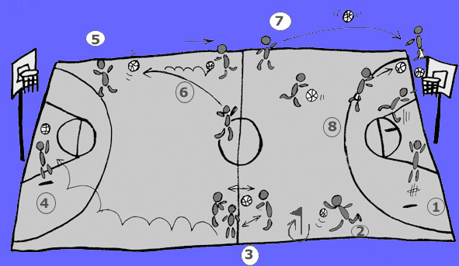
Sport Performance Test
conduct a shot at basket from under the hoop, pick up the ball, and
advance the ball down the court (i.e. speed dribble) taking a turn around the flag,
three chest passes to three teammates, and continue
to run forward and shoot at the basket. Abandon the ball,
catch, from the corner, a baseball pass from midcourt, receive and
dribble back to midcourt,
with the balls situated on the centre line, execute basketball passes to partner standing at the end line, and
with the last ball, speed dribble forward, bounce the ball, stop, pivot and make a jump shot near the hoop.

Slide 28
QUESTIONNAIRE AND ACTIVITIES
1. What is an evaluation of physical fitness for?
2. Which of these exercises could be used in an aptitude test and which could be used to evaluate performance?
                abdominal exercises,
                pull-ups on a bar,
                basketball shots,
                40-metre test,
                slalom with ball test, and
                deep trunk bend test.
3. How can an individual be evaluated?
4. Go ahead and compare your fitness with other classmates by taking a physical fitness test.
5. Look for new ways to evaluate.
6. Write down in your notebook unknown vocabulary from this unit.

