Slide 1
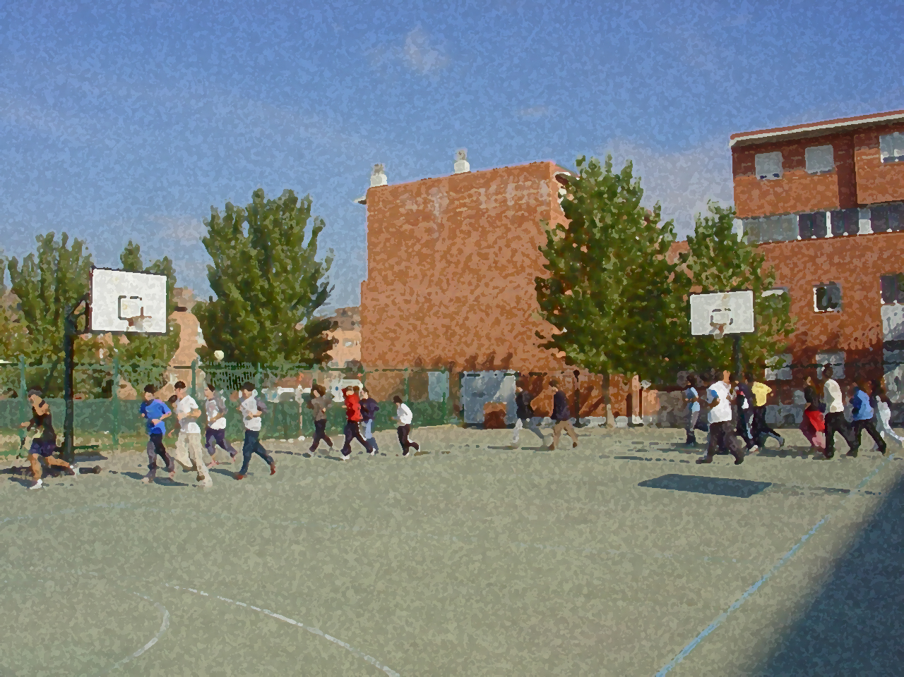
Fundamentals for Secondary School and Baccalaureate. Comprehensive and experiential learning
BALANCE

Slide 2
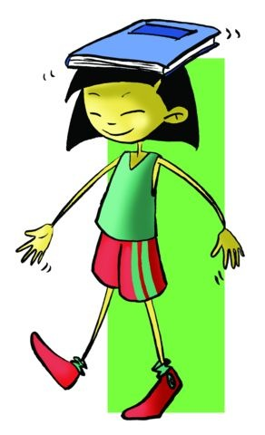
Balance
1. Objectives 2. Concepts and Types
Static Balance
Dynamic Balance 3. Factors Involved in Balance
The Senses 4. What Does Balance Depend On?
Physical Factors 5. Measurement of Balance 6. False Vertigo 7. Exercises to Develop Balance
8. Questionnaire and Activities
Not only is it important to have achieved balance before doing any movement, but also when you are executing it so that once on completion you can do the next one with the same effectiveness.
Controlling your body in any situation is a big ad- vantage that will help you to perform more complex exercises.

Slide 3
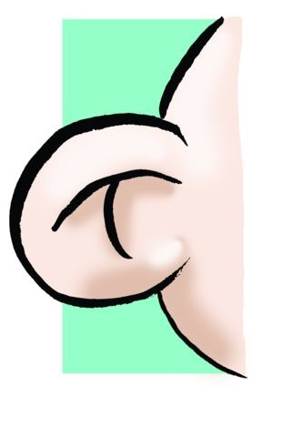
Objectives
˗ To perform physical activities that improve our static and dynamic postural control; becoming acquainted with the factors that affect, in one way or another, our imbalance.
˗ To develop activities that benefit and make our postural balance more powerful, and achieving proposed aims.

Slide 4
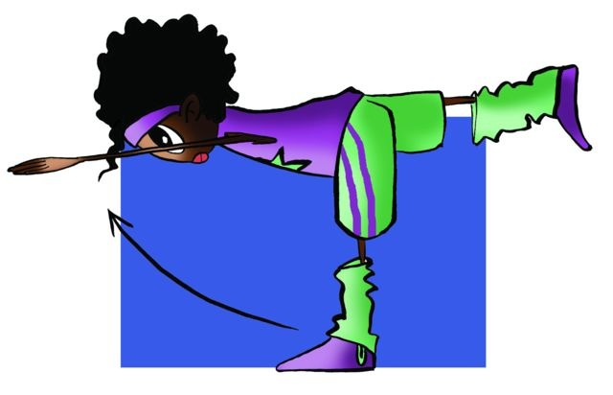
“...the capacity to assume and hold any body position against the law of gravity”.
Concepts

Slide 5
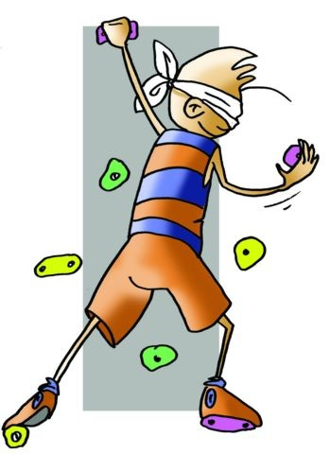
STATIC BALANCE
It is somewhat important in the sport world, especially in some artistic gymnastics exercises or climbing, it can be defined as the ability to keep the body straight or in any static position as it overcomes the force of gravity.

Slide 6
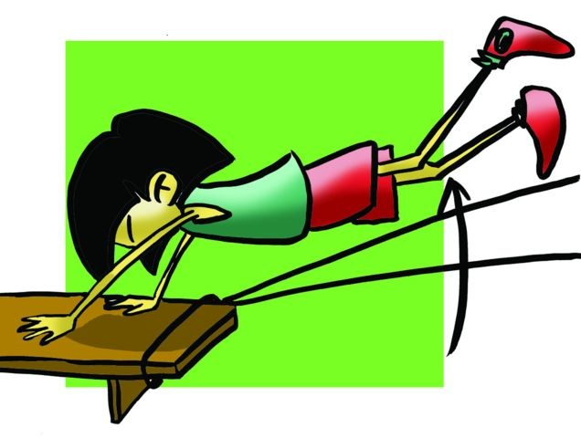
DYNAMIC BALANCE
Its importance in most sports cannot be denied. It can be defined as the ability to keep correct body position that is required by the physical activity (skiing, cycling and team sports). Sometimes it is performed without support in a specific space, i.e., in the air (volleyball, acrobatics, etc.) despite the force of gravity.

Slide 7
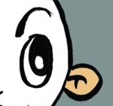
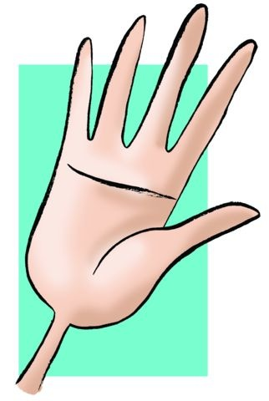
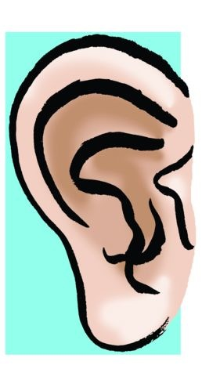
FACTORS INVOLVED IN BALANCE
Sensorial:
Sight: through the eye we can observe the distance of objects, and establish references and contrasts.
Touch: its function is to inform of the different postures that we experience through pressure, strain etc.
Hearing: through the semi-circular canals and the vestibular system located in the inner ear, this sense gives us constant information about our spatial orientation.
Proprioception: these receptor nerves are located in the muscles and the tendons, and give us constant information about which muscle should flex, extend ...in each movement.

Slide 8
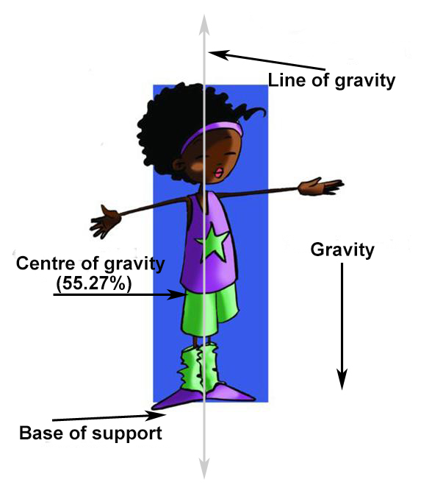
WHAT DOES BALANCE DEPEND ON?
Gravity | The strength that the Earth exerts on objects and that apply to all of us. Against this force, there is another one working with the same magnitude that keeps us balanced.
Centre of Gravity (COG) | The point through which the force of gravity passes and acts upon the body. It is located in a point that is the 55.27% of the height of the subject.
Base of Support (BOS) | The place where the individual supports himself during a movement. The larger, the greater and the better the balance.
Line of Gravity | An imaginary line that should always pass through BOS so that balance can be maintained. The line that joins the COG with Earth’s gravity.

Slide 9
MEASUREMENT OF BALANCE
Static Balance
Static Balance: this type of balance is easy to measure through the Letwin and Fernández’s test, which involves doing the balancing stick pose. Advancing the trunk forward and keeping it parallel to the floor, at the same time that a leg is lifted behind, looking always to the front. The aim is to maintain this position 10sec using the following scale:
˗ 4 points if the subject holds the position.
˗ 3 points if the subject holds the position slightly.
˗ 2 points if the subject loses his/her balance more than once.
˗ 1 point if the subject is unable to maintain the position not even once.

Slide 10
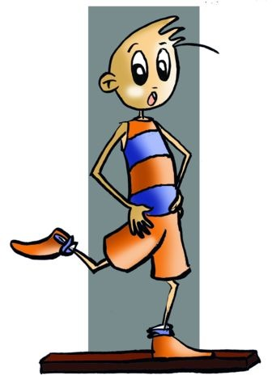
Also, we can measure this kind of balance with the Elmar Kornexl’s test, mentioned by the same author in his book “Measurements, Assessments and Statistics Applied to Physical Education and Sport.” These tests involve placing one foot on a block 2cm wide and stay in this position with your hands on your waist. The test will be done three times and the result will be the average of the three attempts divided by six. If any subject remains in this position for 60 sec, the result will be 10 out of 10.

Slide 11
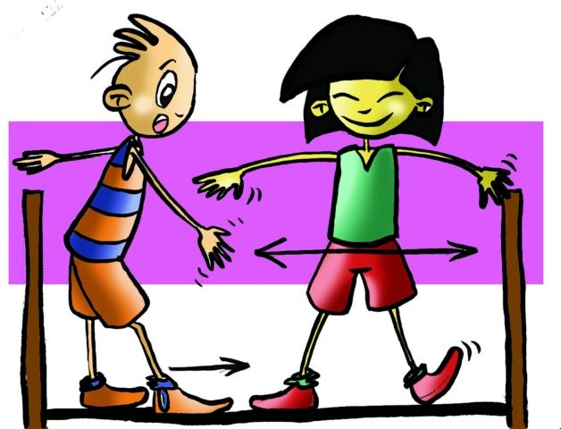
Measurement of Dynamic Balance
This type of balance will be measure through the Álvarez del Villar’s test, where the subject has to walk on a balance beam 3.60m long and 15 cm up from the floor. The subject has to go from one side to the other at least three times. The first time, the subject has to walk straight to the other side, the second and the third time he/she has to do it laterally and in both directions.
We will use the next scale:
4 points if the subject does it without a problem.
3 points if the subject tries to compensate any imbalance.
2 points if the subject tries to compensate any imbalance by touching the floor more than once.
- 1 point if the subject cannot complete the test.

Slide 12
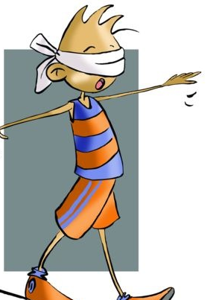
Exercises to develop balance should also be focused on the development of sensory factors, like tactile sensations, observation of reference points and distance, etc.
Some examples:
- Walking barefoot (sole of the feet sensations), - going up and down stairs (appreciation of distance), - walking with an object on your head, - doing the balancing stick pose, - walking with your eyes closed, - walking on a balance beam, - gymnastics exercises, - exercises using one foot on the floor and on smaller surfaces, and - walking on the inclined plane of the benches that are leaning on wall bars.

Slide 13
QUESTIONNAIRE AND ACTIVITIES
When you see a person in a circus walking on a tightrope, which type of exercise is that person doing?
Which senses are involved in balance?
Explain the relation between line of gravity and BOS for maintaining balance.
Check if your degree of balance is good by walking on a curb or a low balance beam.
Practise your balance with your eyes close on an overturned gymnastic bench.
Write down in your notebook unknown vocabulary from this unit.

