Slide 1
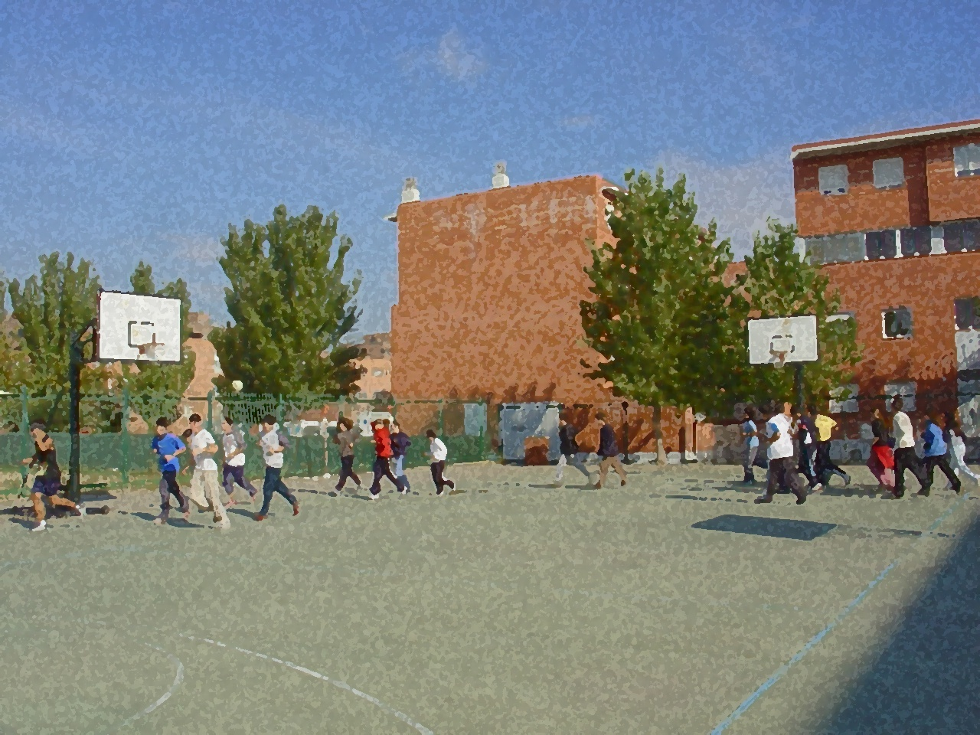

Fundamentals for Secondary School and Baccalaureate. Comprehensive and experiential learning
STRENGTH

Slide 2
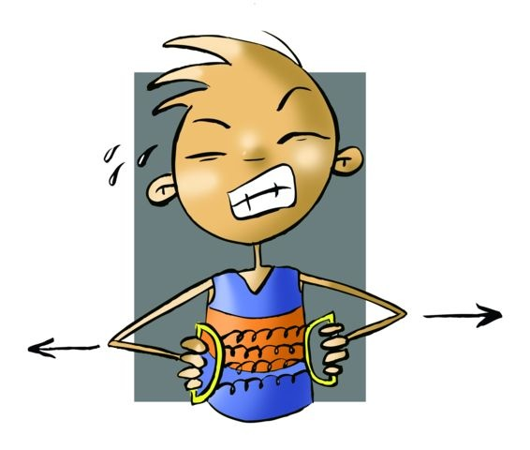
Contents
Objectives
Definition and Types of Strength 3. Muscle Contraction
Muscle Contraction
Measuring Strength
Factors Determining Strength
    Extrinsic: Mechanical and Other
    Intrinsic: Physiological
6. Ways to Develop Strength
Maximum Loads
Submaximal Loads
Endurance-Strength
Isometric
Plyometric I
Isokinetic
Electrostimulation
Multi-Jump Training
7. Strength Development In Relation To Age and Sex
8. Questionnaire and Activities

Slide 3
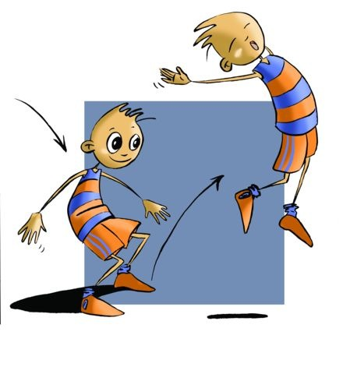
Objectives
To learn the characteristics of the physical capacities of strength, and the changes it exerts on the body.
To understand how it may be used taking into account our characteristics and level of physical fitness, elaborating and implementing sessions or exercises, depending on the course, in which we can improve or develop strength favouring a healthy approach.

Slide 4
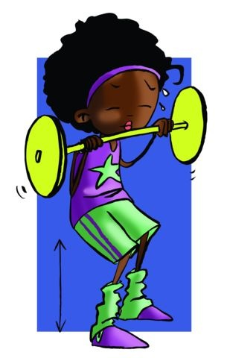
Definition
"Strength is the ability to overcome an external resistor or cope with muscle contraction."

Slide 5
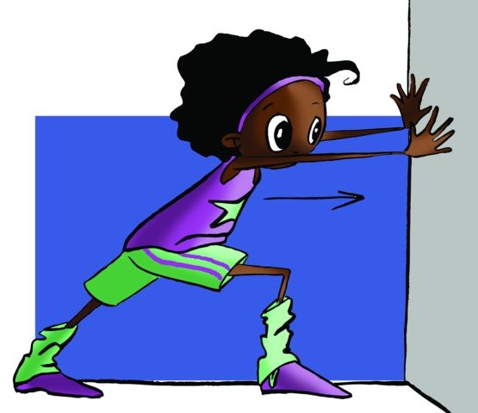

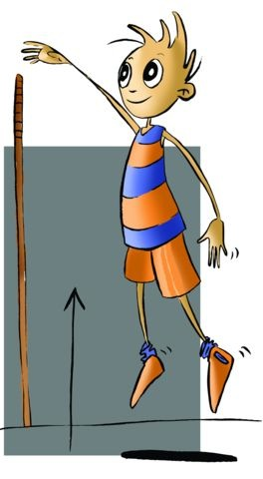
Types of Strength
Even with sustained resistance, e.g., an immovable object, there is no change in muscle length or movement.
Static
Maximum Strength
This is when moving or overcoming resistance, the muscle length changes.
Speed-Strength
Dynamic
Explosive Strength

Slide 6
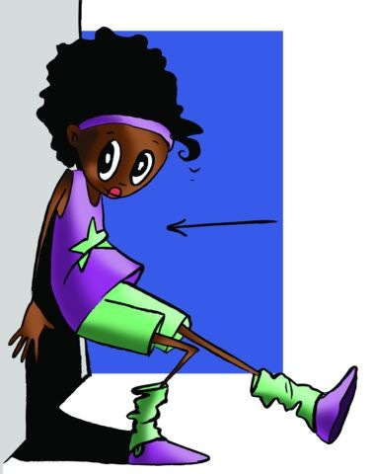
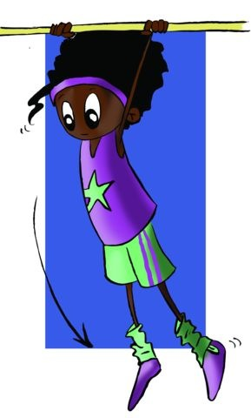
MUSCLE CONTRACTION
ISOMETRIC
Such contraction does not change the length of the muscle.
ISOTONIC
This contraction occurs when there is a change in muscle length, either by shortening or lengthening it.
AUXOTONIC
This type of contraction is a mixture of the two.

Slide 7
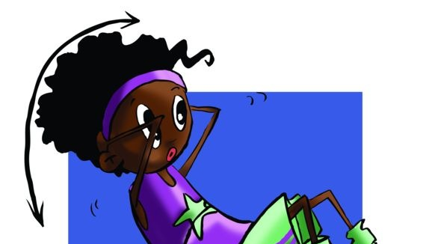
FACTORS DETERMINING STRENGTH
" The strength of a muscle is directly proportional to the magnitude of its cross section"
The muscle shape: the bipennate muscles develop more force than the longitudinal or fusiform.
Innervation: the more stimulated the fibres, the more connected they are with the central nervous system (CNS), the more strength there is.
The higher the proportion of white fibres, the greater the strength.
PHYSIOLOGICAL
The degree of rotation the joint attains in a particular movement.
The degree of rotation a joint could make when applying force determines the degree of intensity.
MECHANIC
OTHER FACTORS
Age, sex, Diet, Muscle temperature, Motivation

Slide 8
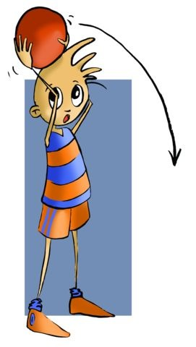
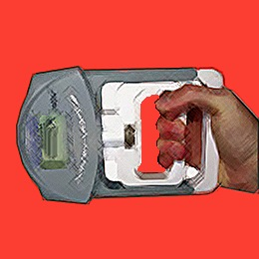
MEASURING STRENGTH
We find it impossible to measure only the strength of just one muscle since in any movement, however slight, we will use more than one. Nonetheless, there are devices for measuring the static strength of a muscle group. Force dynamometers are the most commonly used.
Dynamic force applied to sport is what interests us most and for this we have the bar-bell, dumbbell or medicine ball.

Slide 9
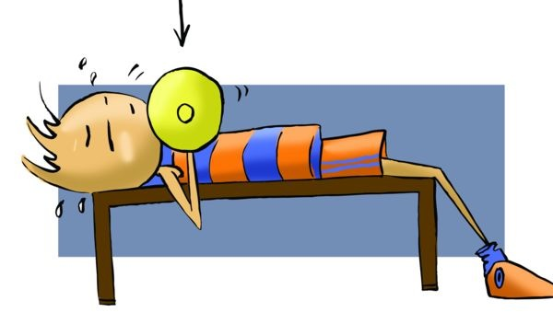
WAYS TO DEVELOP STRENGTH
MAXIMUM LOADS
This method works slow strength. It is the method used by athletes for weightlifting.
SUB-MAXIMAL LOADS
This method is called body building
The work is in a circuit with loads below 50% of maximum weight
ENDURANCE-STRENGTH
The feature of this kind of training is that the exercises are performed at maximal effort in a very short time, against great resistance and motionless in three angles.
ISOMETRICS
PLYOMETRICS
It is based on jumps from a height of between 0.75 and 1.10m.
It is training based on performing exercises on weight machines.
ISOKINETICS
It is, above all, a therapeutic method even though today it is also marketed in developing certain mus- cle groups "while reading a book."
ELECTRO-ESTIMULATION
Its objective is to enhance the muscles of the lower part of the body. The exercises are a series of jumps, or linked impulses, continuous along a path.
MULTI-JUMP

Slide 10
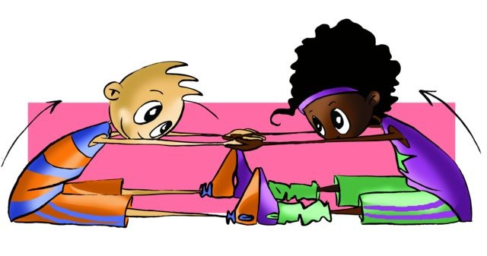
METHOD | OBJECTIVE | EXERCISES | REPS | SETS | LOADS | RECOVERY
MAXIMUM LOADS | Develop slow strength and maximum force | lifting own weight. From 3 to 7. | 1 to 3 | From 2 to 4 | 90/100% | Active 3 to 5' between sets
SUB- MAXIMAL LOADS | Develop strength, speed and muscle stamina | From 8-12 | 6 to 10 | 2 to 5 | 70/85% | Active 3 to 4’ between sets
ENDURANCE- STRENGTH | Muscular endurance-strength | From 9-14 in a circuit | 45 sec each exercise | 3. Minimum 140/160 bpm | > 50% | 1min maximum between series
ISOMETRIC | Improving strength in weak areas | 4 to 8 and in 3 angulations | 4 to 6 sec each | 1 to 5 | No | 5 sec between ejercise. 30 to 180sec between sets.
PLYOMETRIC | Improving explosive force | Jumping from heights | 20 to 40 jumps | 10 in each height | No | Relaxation, jogging
ISOKINETIC | Strength development | Those resembling sporting activity | From 6 to 15 fast | 3 to 5 | Continuous and varying | No rest
ELECTRO- STIMULATION | Improved strength in injured muscles | Electrical impulses | 10 taking 10 sec | One | 50 Hz | 50 sec between stimulus.1 month between sets
MULTI-JUMP | Improve muscular power | Continuous jumps | 1 to 10 short distances | From 1-4 300 jumps as max | Max 5% of body weight | Active 3 min to 5 min

Slide 11
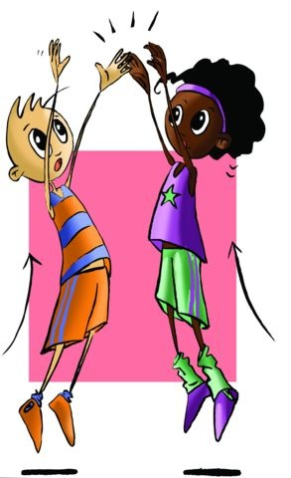
STRENGTH DEVELOPMENT IN RELATION TO AGE AND SEX
Strength is doubled between the ages of 11 and 16,
Maximum strength is achieved at around 30,
Children under 12 require special care when strength training,
Men can develop twice the strength of women mainly due to genetics,
Boys, aged 13-14, reach or can reach the maximum strength of an adult female, and
Strength decreases similarly after 30 in men and women.

Slide 12
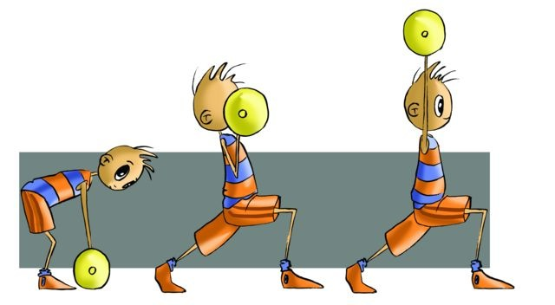
QUESTIONNAIRE AND ACTIVITIES
1. Could you say what strength is?
2. How many types of strength are there?
3. When you push a car and move it, what kind of force are you exerting?
4. As an activity, get to a gym, list the different apparatuses that you find and say what kind of strength you can develop with each. Make an outline of how they are distributed inside the gym.
5. Explain the relationship between age and strength.
6. Write down in your notebook unknown vocabulary from this unit.

