Slide 1
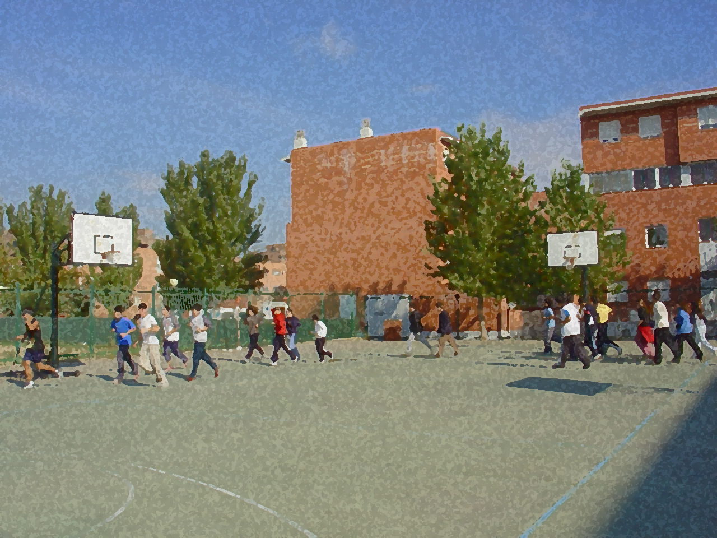

Fundamentals for Secondary School and Baccalaureate. Comprehensive and experiential learning
Floorball

Slide 2
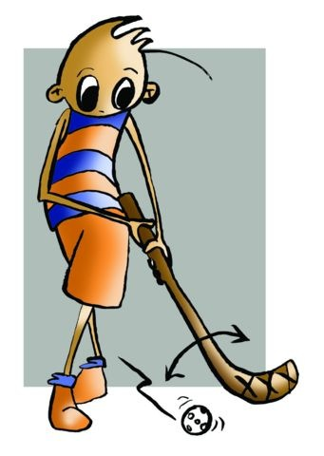
Contens
Objectives
Regulations, Facilities and Equipment
Basic Technical-Tactical Resource
Questionnaire and Activities

Slide 3
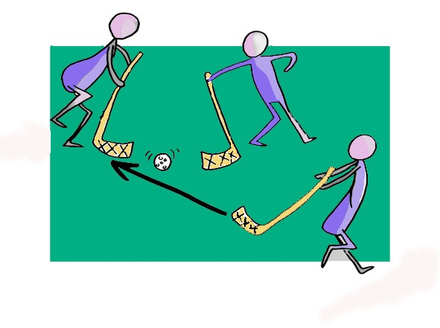
Objectives
To learn the basic technical and tactical and regulations of floorball.
To understand their application in these real game situations and collaborate with classmates in the development and implementation of activities.

Slide 4
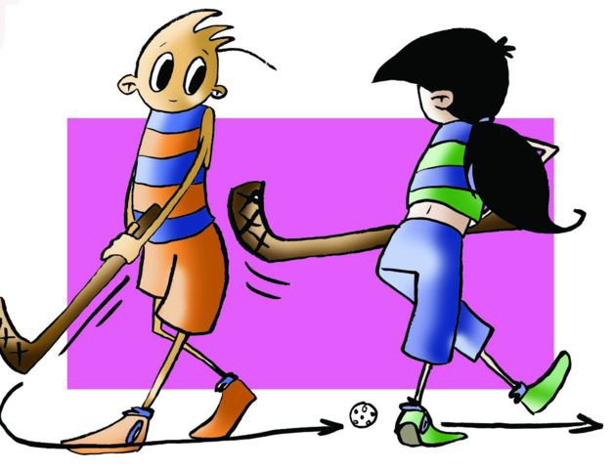
History
This sport is of Swedish origin. It can be considered an adaptation of Hockey and Bandy (ice hockey played in Sweden), since both the equipment and the regulations are very similar. Those who have played hockey tend to learn bandy (a variation of hockey) right away and will generally like it.

Slide 5
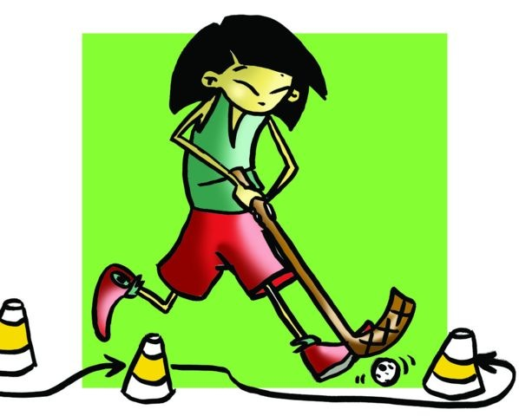
Basic Regulations
Two teams of 6 players (there exists an alternative 4x4, with a modification of the rules);
Trying to get the ball into the other team’s goal as many times;
During the three periods of 20 minutes allowed. However, a match can be modified to a minimum of 2 periods lasting 15 minutes;
Players have 10' rest or intermission between each period;
Each player will have a stick to use during the match;
Except for the goalkeeper whose hands are free and who is considered an extra player upon leaving the goal area then the goalkeeper may use any part of his/her body to stop or throw the ball;
The goalkeeper must put the ball into play within 3" so it touches the ground or a player before moving on to the opponents’ side of the field;
The match begins with a face-off in the middle of the field, with one player from each team in position to take over the ball; the other players need to be 3 metres away;
The same goes for the kick-off of the second half and every time a team scores a goal;
Players can use their feet and chest to direct the ball into the stick, and use both sides of the stick to strike;
Using the border around the pitch as a resource of the game is allowed. An amicable shoulder-to-shoulder contact with a player from the other team may also be permitted or taking the ball.

Slide 6
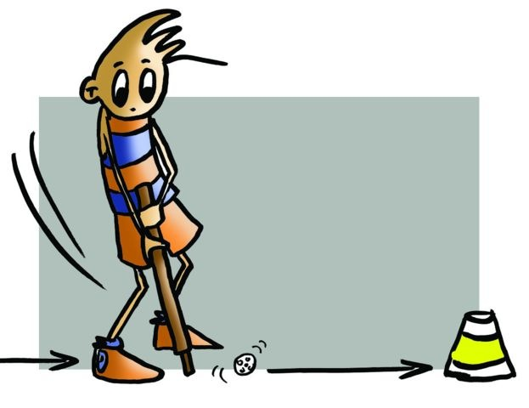
Basic Regulations
Regulations do not permit...
Entering the goal area, but putting the stick in is allowed,
Tripping an opponent, or playing while lying on the floor and raising the stick above the knee or releasing it,
When a team violates any rule, i.e., a foul has been called, there will be a face-off or a free-hit from the place where it occurred. The other players will have to stand 3 metres away and the ball cannot be thrown directly into the goal, and
If an offence is punishable by a penalty (a player denied a clear goal, and the goal is moved, or defender gets into the area of goalkeeper, for example), the kick-off will be made from the centre line moving forward and controlling the ball directly to goal, other players will be located outside the space where the action takes place.

Slide 7
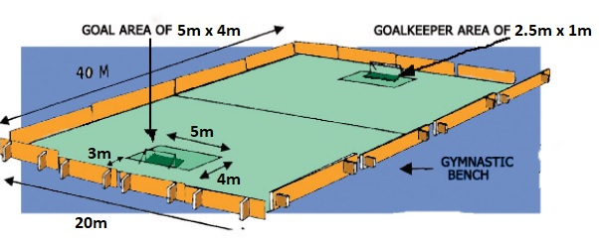
Facilities
Rink/field: 40m x 20m with curved corners and a band of 0.5 m in height surrounding the field. A goal area of 5m x 4m located 2.85 m from the line and goalkeeper area of 2.5m x 1m.

Slide 8
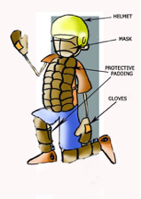
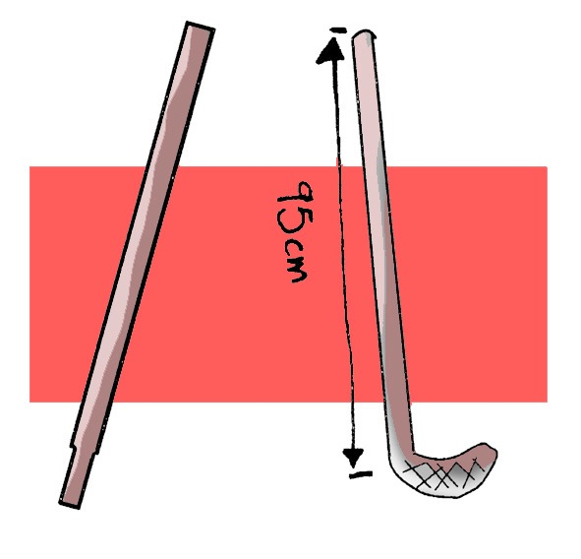
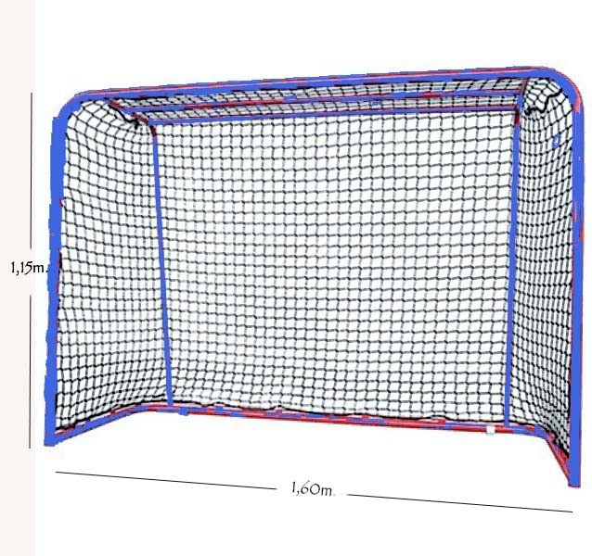
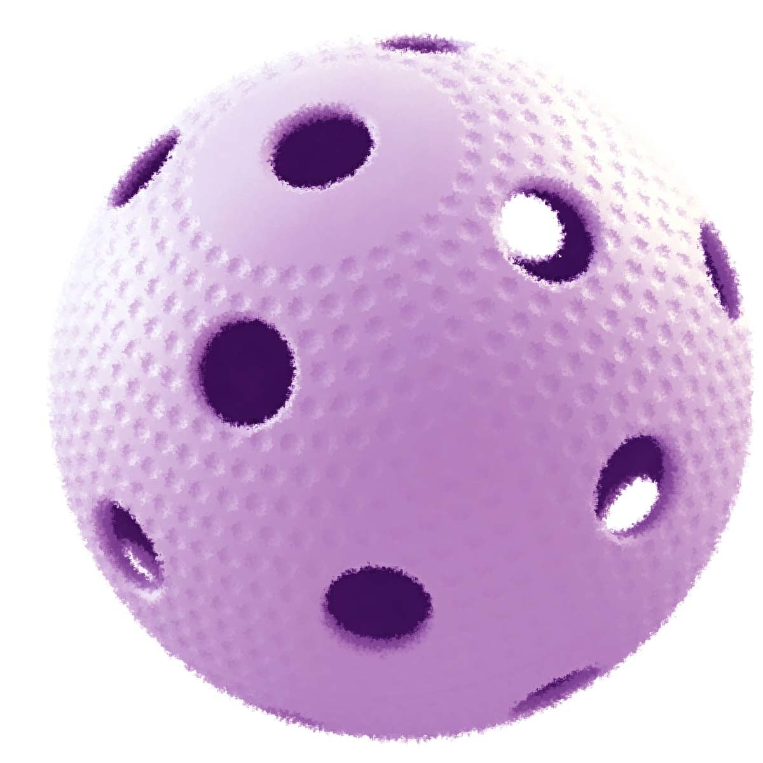
Equipment
Goal: size is 1.60m long x 1.15m high.
Goalkeeper: helmet, mask, gloves and protective padding for legs and chest.
Ball: made of plastic with holes.

Slide 9
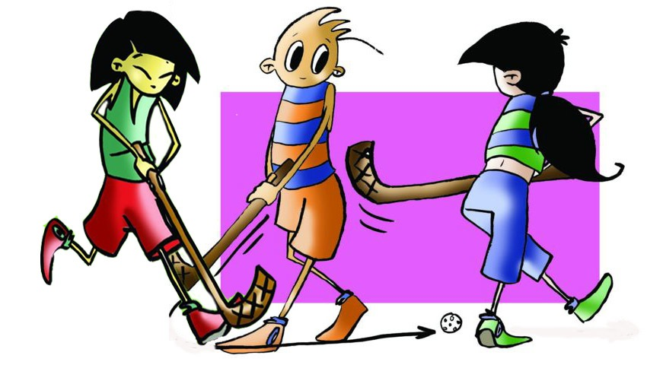
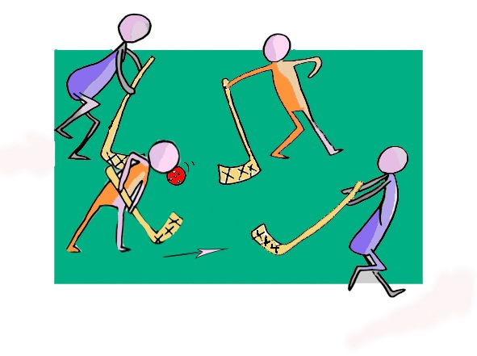
BASIC TECHNICAL-TACTICAL RESOURCES
Basic technical and tactical actions are:
Dribbling:
when moving with the stick and the ball we must do it with the greatest control and using both sides of the stick.
Passing and receiving:
it is important to keep the ball from bouncing when receiving it, for it places the stick at an angle of 90 degrees or less from the ground. To execute the pass the ball should be pushed, not hit.

Slide 10
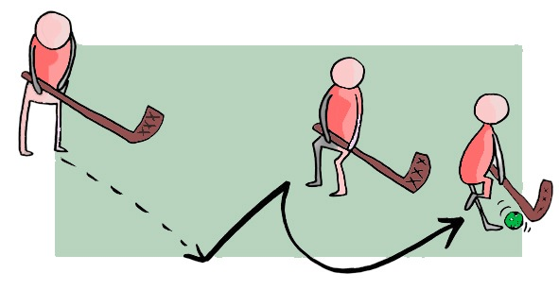
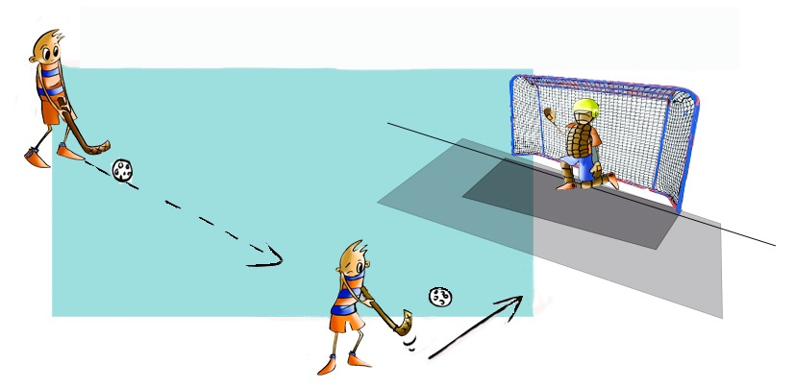
Feinting or dodging:
it occurs when in possession of the ball; the player has to overtake the opponent. The action taken by the opponent is called marking.
To feint well the player must put emphasis on the action of fooling the opponent, this may be done with the body and the stick, a change of direction and pace may be executed, and the player will need to have good control of the ball.
Shooting
it is done like a pass, but logically with more momentum, we must bring the ball more to the back foot and have a strong action with the forearm.

Slide 11
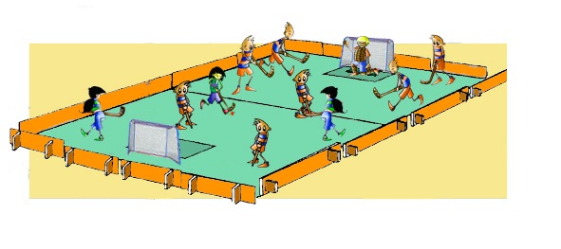
Joint Tactical Organization
We understand tactical actions as being those the players of the team carry out together as a unit, in a rational and organised way.
Endeavour to take responsibility for all game actions that occur at our home field, help our closest teammates when the situation requires it.

Slide 12
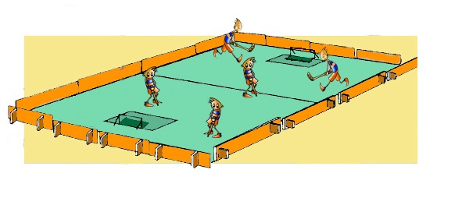
QUESTIONNAIRE AND ACTIVITIES
Write a short summary on how to play floorball.
Set out the basic technical and tactical resources of floorball.
Describe the act of feinting
Act the part of player-coach and give reasons for what you ask of them.
Have you seen a floorball match? Discuss it with a partner.
Look regulatory measures 4x4 mode.
Write down in your notebook unknown vocabulary from this unit.
Check the Federation website or any sports association in your region and check for changes or modifications, if any, in its regulations.

