Slide 1
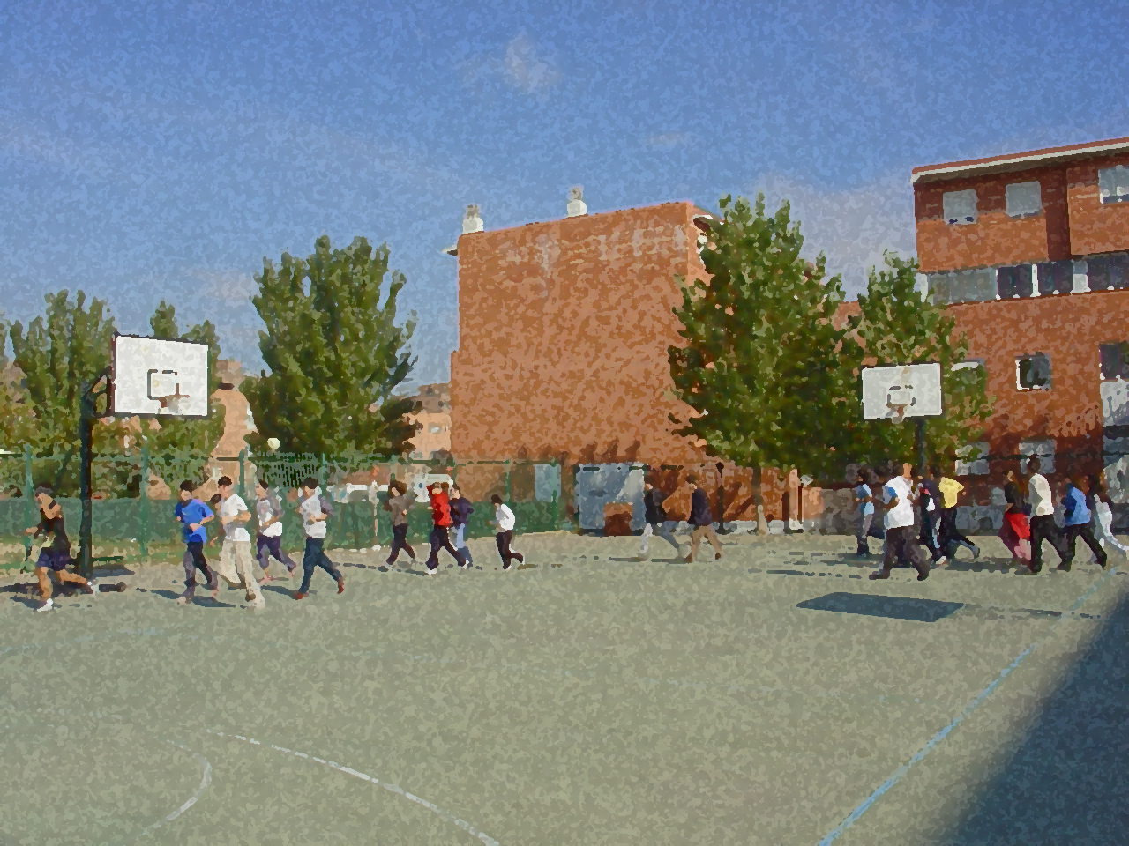

Fundamentals for Secondary School and Baccalaureate. Comprehensive and experiential learning
Breathing and Relaxation

Slide 2
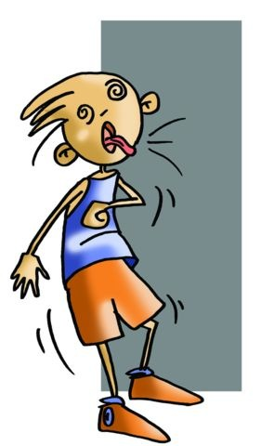
Breathing and Relaxation
Objectives
Types of Respiration
Basic Exercises
Questionnaire and Activities
Breathing is vital not only for life but because with knowledge and control we can draw upon it in a variety of situations. To know how to breathe and to know our own breathing rate well as well as its simple mechanism is very important.

Slide 3
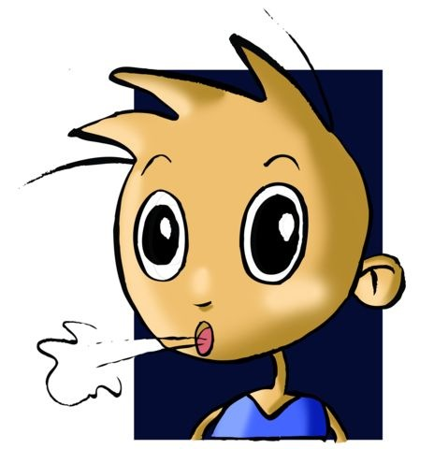

OBJECTIVES
To understand the different relaxation techniques in order to apply the most appropriate one.
To perform inspiratory and expiratory exercises to improve gas exchange.
To simulate situations of maximum and minimum effort in order to practise recovery after exercise and re- laxation.

Slide 4
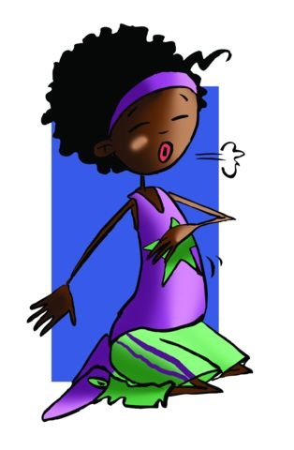
TYPES OF RESPIRATION
Diaphragmatic or Abdominal Breathing happens with movements of the diaphragm. On the inhalation the abdominal muscles swell and relax on the exhalation. | Thoracic Breathing (chest breathing) is produced by the intercostal muscles. With this type of breathing there is a widening of the ribcage.
Clavicular Breathing (shallow breathing) is a kind of breathing, at times, called high breathing, i.e. it raises the upper part of the chest. | Complete Breathing (deep breathing) is when thoracic and abdominal movements are executed simultaneously. On the inhalation the diaphragm is worked and then the thoracic cage expands and on the exhalation the upper part of the chest is relaxed and it finishes in the abdomen.

Slide 5
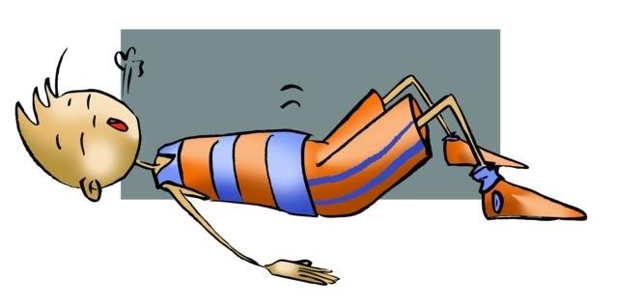
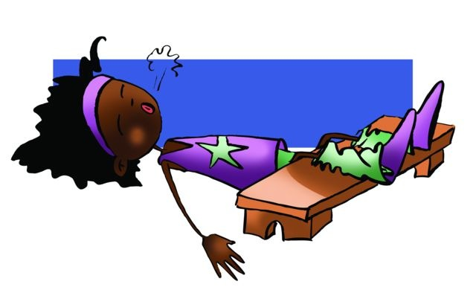
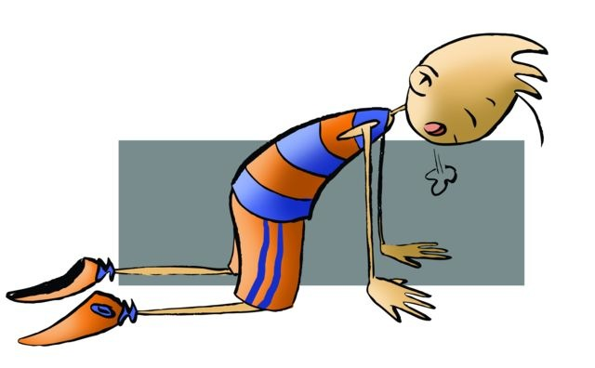
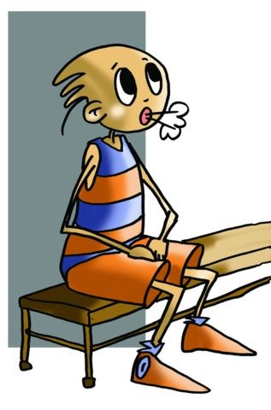
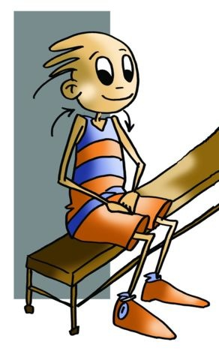
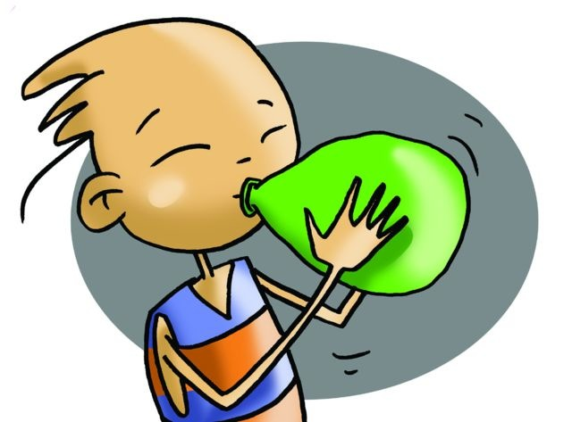
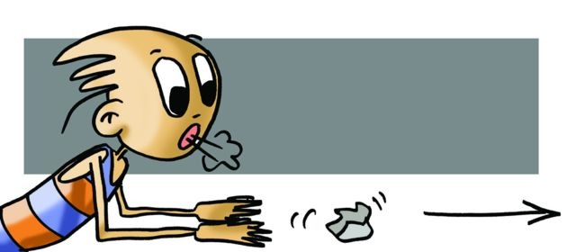
BASIC EXERCISES
1.- Lie down, face upwards with your legs bent and slightly separated and your arms by your sides, breathe in and note how your abdomen rises.
 | 2.- Same as above but with your legs positioned on a bench.
3.- Get on your hands and knees, and practise abdominal breathing.
 | 4.- Kneel, and sit on your heels, place one hand on your chest and practise thoracic breathing, observing the rising of the thoracic cage.
5.- Sit on a bench with your hands placed on your thighs, use the full breathing technique. Note first the expansion of your abdomen and later your chest.
 | 6.- Sit down with your hands on your thighs, rotate your shoulders whilst completing clavicular breathing.
7.- Take a balloon and inflate it with the least number of breaths possible.
 | 8.- Try to move a ball of paper from one place to another with your breath.

Slide 6
QUESTIONNAIRE AND ACTIVITIES
How many types of breathing are there?
What is respiration made up of?
When we exhale we expel...
Inflate a balloon quickly. What happens?
Count the number of times you breathe in and out in one minute.
Write down in your notebook unknown vocabulary from this unit.

