Slide 1
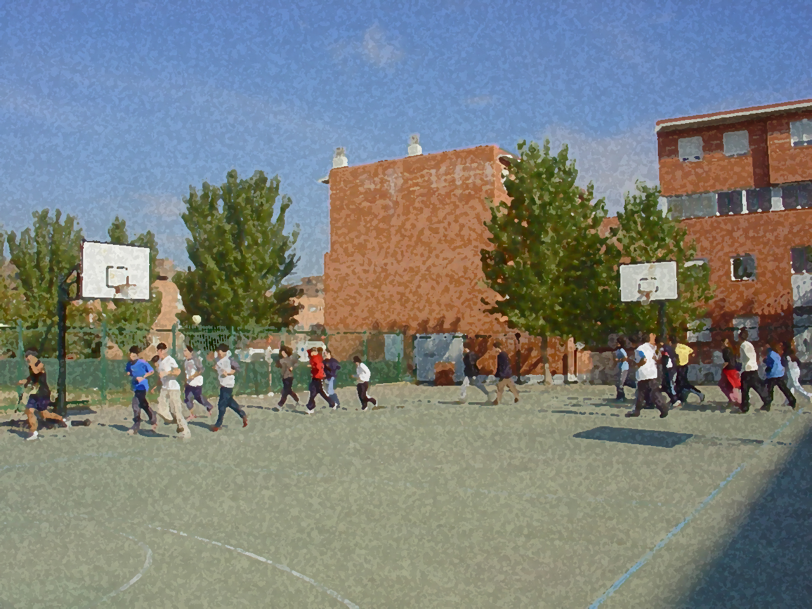
Fundamentals for Secondary School and Baccalaureate. Comprehensive and experiential learning
Physical Activity-Sports and Disability

Slide 2
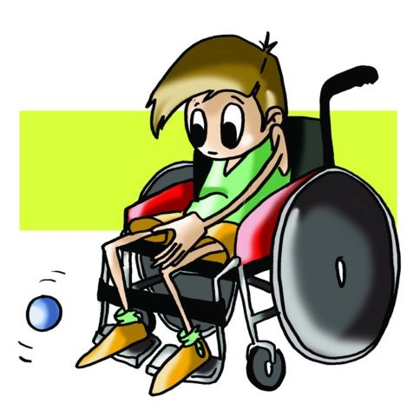
Contents
Objectives
Goalball
Boccia
Sitting Volleyball
Questionnaire and Activities

Slide 3
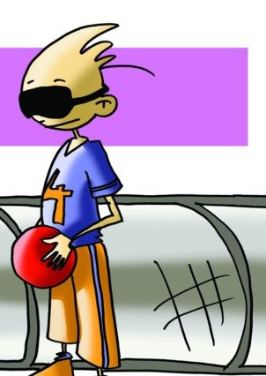
Objectives
The simulation of these conditions can help you see a different perspective of the situation by experiencing scenarios that your potential classmates who have disabilities experience and in some cases no one is exempt from suffering. Therefore, through the study and application of the contents of this unit, we want you to work on the following objectives:
To learn some specific sports for people with disabilities.
To understand and apply the elements that constitute them while showing also a respectful and co-operative attitude in their implementation and in providing new proposals to adapt the existing reality of your school.

Slide 4
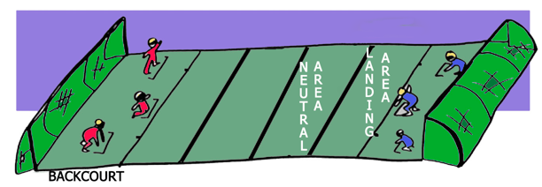
GOALBALL
Goalball is a Paralympic sport for people with visual impairment. It was invented by H. Lorenzen and S. Reindle Austrian and German respectively to facilitate the incorporation of sport into the lives of veterans left blind during World War II.

Slide 5
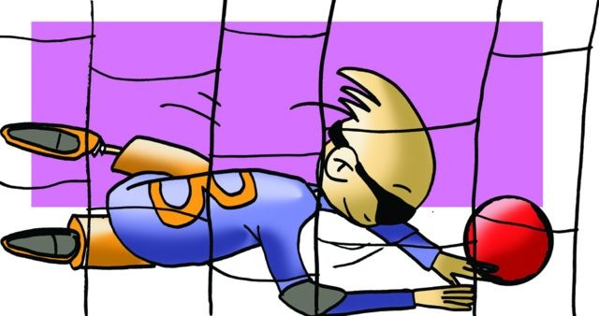
GOALBALL
Two teams of three players each try to get the ball into the opposite goal while keeping the ball from being sent into their goal.
This game needs an 18m x 9m pitch (the same size as a volleyball court) and two goals located at both ends of the pitch occupying the entire 9 metres. The goals measure nine metres long and 1.3 metre high. Each area of the pitch measures 9x3 metres. The type of ball used will be a sound ball, and it is similar in size to that of a basketball but with bells inside.
Field players must defend and shoot the ball from the backcourt. So players may identify their location on the pitch, some "rough" lines are marked (a short rope inserted below the tape) to serve as reference and guidance for the players.
The game consists of two halves of 10 minutes each with a half-time interval of three minutes.
- The ball will be thrown by hand and must touch the floor within the landing area.
- The same player cannot make more than two consecutive throws.
- The eyeshades/black-out masks cannot be touched during the match, unless the referee expressly allows the player.
The time available to each team for its throw is 10 seconds.

Slide 6
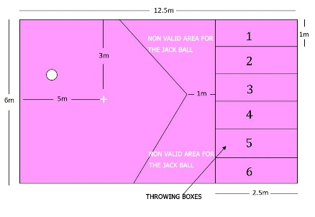
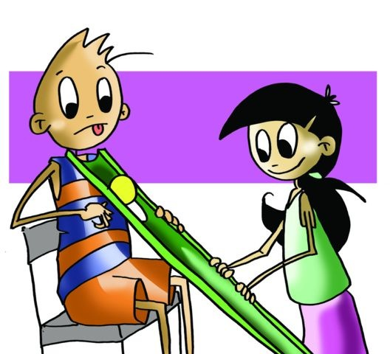
Boccia
The game takes place on a smooth, flat surface, the dimensions of the court of 12.5x6 metres with an area called throwing boxes where players place themselves to throw, roll or kick the balls.
The odd numbered boxes are for the players of the home team, and the even numbered boxes are for the visiting team.

Slide 7
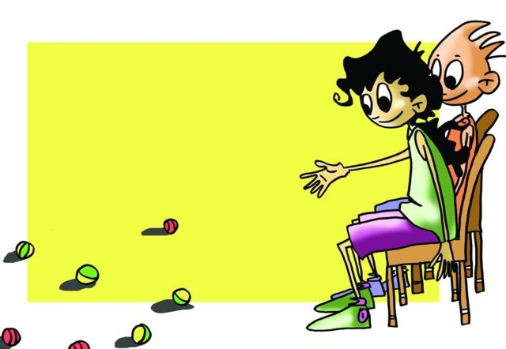
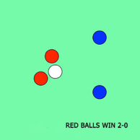
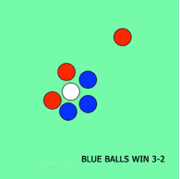
BOCCIA
The equipment needed to participate in this game material consists of 6 red balls, 6 blue balls and a jack/target ball.
The player who starts the game will throw their ball first, the white or target ball called jack, as it leaves the court will be placed on the + as reference. After this initial throw a player from the opposing team will throw, from this moment (white ball, one blue and one red in the field) the player whose ball is farthest from the jack or target ball will throw even if they have to throw all their balls..
At the end of each part (all players have thrown their balls), the closest ball to the white (jack/target) ball will score one point.
For example:

Slide 8
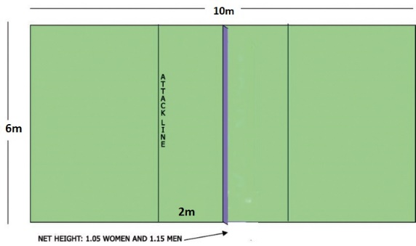
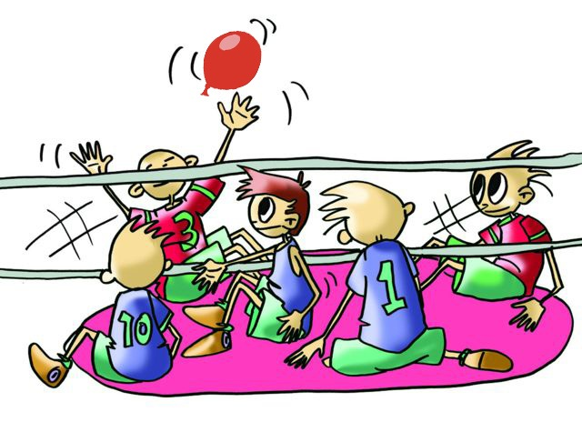
Sitting Volleyball
As you may well expect, the basic rule in sitting volleyball is that all players must be seated on the floor and they cannot take their pelvis off the ground, so all components of the class can participate regardless of range of leg mobility that you may have.
The structure of the game is similar to volleyball, so each team can use a maximum of three hits to the ball, starting the game with a serve and hitting it using sets or bumps, spikes or blocks in trying to get the point or trying to prevent it. In this sense, tactics and regulatory actions are similar in both games.

Slide 9
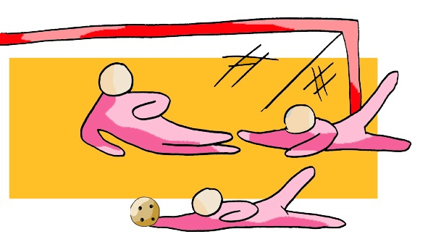
QUESTIONNAIRE AND ACTIVITIES
Why do you think it important to develop classroom activities?
In goalball, has it been easy for you to put yourself onto the pitch? How did you feel?
Did you participate with enthusiasm in sitting volleyball?
Do you know the game that resembles boccia?
Why not paint two sitting volley ball courts in the school.
Write down in your notebook unknown vocabulary from this unit.
Check the Federation website or any sports association in your region and check for changes or modifications, if any, in its regulations.

